Slide 1
Cosc 2030
Data structures in action.

Slide 2
File Systems
They use a number of data structures.
How to track and store information about the free space
bitvector (bitmap) or linked list.
how to write store the files and directories
linux ext and ext2 and windows fat file systems stored files and directories as linked lists
linux ext3 and ext4 use Htree (a tree that uses hashing) for directories
linux ReiserFS, NSS, XFS, JFS, ReFS, and BFS file system uses B+ trees.
windows NTFS uses B+ trees for directories

Slide 3
Free-Space Management
File system maintains free-space list to track available blocks/clusters
(Using term “block” for simplicity)
Bit vector or bit map (n blocks)
Bit map requires extra space. Example:
block size = 212 bytes
disk size = 230 bytes (1 gigabyte)
n = 230/212 = 218 bits (or 32K bytes)
0
1
2
n-1
…
1 ⇒ block[i] free
0 ⇒ block[i] occupied
bit[i] =


Slide 4
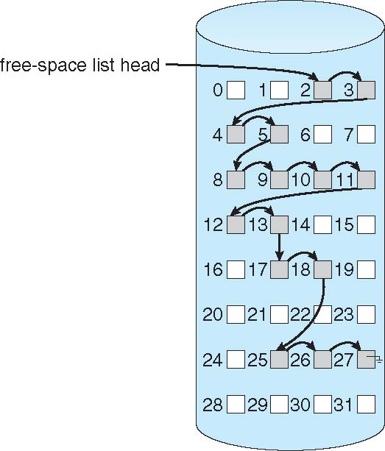
Free-Space Management
Linked list (free list)
Header pointer is stored in the superblock
(Linux) or File Allocation Table (windows)
Then each open block contains a pointer to
the next open block on the list.
advantages:
No waste of space

Slide 5
Files as linked lists

Slide 6
m-ary tree
A tree that where each node has no more then m children
also known as n-ary, k-ary or k-way trees.
A binary tree is a special case, where m=2
Some times talked in "high fan out"
meaning lots of children per node, 100+ normally.

Slide 7
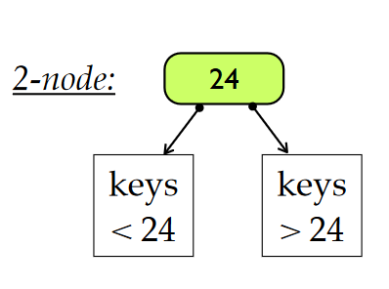
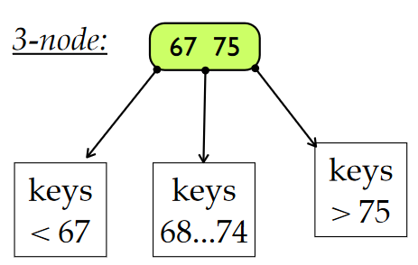
B-tree
We can get a global balance of the trees and it was will always have the height of log n where n is the number of nodes.
All leaves are at the same level
Each internal node has either 2 or 3 children
Which is why B-tree are also called 2-3 trees.
If the node has
2 children then it has one data (called a key)
3 children then it has two data items (or keys)

Slide 8
B-tree Find

Slide 9
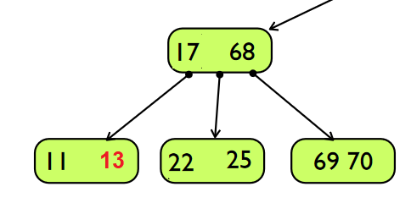
B-tree Inserts
Get complex fast.
Using previous tree
inserting 105 is easy, since there is an open spot in the far node of 98
inserting 13 is complex, because it would cause an overflow in the 11 17 node, which causes a rotation of 22 down to the 25 node.

Slide 10
b+ tree
like a B-tree, it's balanced, height adjust tree.
B+ tree only key is stored in the internal nodes for searching
This allows the trees to take far less memory, no matter what the data is.
IE is it a file or is just a data.
They have large number of children (high fanout), typically on the order of 100 or more.
An additional level, leaves, are added at the bottom. These are all at the same level and they point to the data.
All the leaves are also linked by next and prev pointers.
This allows for range queries

Slide 11
b+ tree

Slide 12
b+ trees
An file system example
so if I have files aa, ab, ac, and d the leave would look like something like this
So if we are looking for all files that start with a, it's a simple uses the links to find the rest of the files. The tree only contains the name of the file, not the actual contents of the file.

Slide 13
HTree
From http://ext2.sourceforge.net/2005-ols/paper-html/node3.html
Ext2's scheme, which we dubbed "HTree", uses 32-bit hashes for keys, where each hash key references a range of entries stored in a leaf block.
Since internal nodes are only 8 bytes, HTrees have a very high fanout factor (over 500 blocks can be referenced using a 4K index block), two levels of index nodes are sufficient to support over 16 million 52-character filenames.
To further simplify the implementation, HTrees are constant depth (either one or two levels).
The combination of the high fanout factor and the use of a hash of the filename, plus a filesystem-specific secret to serve as the search key for the HTree, avoids the need for the implementation to do balancing operations.
The HTree algorithm is distinguished from standard B-tree methods by its treatment of hash collisions, which may overflow across multiple leaf and index blocks.

Slide 14
Databases
Most databases store the tables in B+ trees
Relational database management systems such as IBM DB2, Informix,Microsoft SQL Server, Oracle 8, Sybase ASE, and SQLite use this type of tree for table indices.
database management systems such as CouchDB and Tokyo Cabinet use this type of tree for data access.
For fast searching processing, many Databases use hash tables
also for map reduce functions.

Slide 15
Compilers
syntax trees are n-ary trees.
The right shows a very simple syntax tree for the following program
void main() {
int a, b =5;
a = b + 6;
}

Slide 16
Spare Matrices.
A spare matrices is a large matrix, where a majority of the positions are going to be zero.
Example, you have a 2D array[100][100], but maybe only 10 positions are going to have values.
Standard int is 4 bytes, so you need 40,000 Bytes or about 40 MB of space, while only needing about 40B
This calculation get far worse, when you think about strings or larger data types.
So then what implementation/data structure can we use to save memory?

Slide 17
Spare Matrices (2)
implementation
Only the store the locations with a value
Arrays (row, column, value)
linked lists (node: row, column, value)
If the value is either 0 or 1, then don't store value.
In this case, we are trading speed for space.

Slide 18
Q
A
&

