Slide 1
Cosc 2030
Run time analyst and Big O

Slide 2
Introduction
Once an algorithm is given for a problem (and decided to be correct), it is important to determine how much in the way of resources, such as time or space, that the algorithm will require.
  We focus mainly on time in this course.
  Such an analysis will often allow us to improve our algorithms.

Slide 3
Running Time Analysis
N Data Items
1000101010100011111000110001110101010101010101
0010001010101000100000000000011110101000111010
0010101010101010101010101111111100000011001011
Returns in time T1(N)
Algorithm 1
N Data Items
1000101010100011111000110001110101010101010101
0010001010101000100000000000011110101000111010
0010101010101010101010101111111100000011001011
Returns in time T2(N)
Algorithm 2

Slide 4
Analysis of Running Time
(which program is better?)
Program 1
Running Time
Program 2
Number of Input Items

Slide 5
Example
int foo1 (int a, int N)
{
int i, temp;
temp = 1;
for (i = 1; i <= N; i++) {
temp = a*temp;
}
return(temp);
}
int foo2 (int a, int N)
{
if (N == 1) return(a);
else return(foo2(a, N/2) * foo2(a, N/2));
}
What do these two programs do? Do they compute the same thing?
If so, which program is more efficient? Or are they equally efficient?

Slide 6
Big-Oh Notation:
Definition:
This says that function T(N) grows at a rate no faster than f(N); thus f(N) is an upper bound on T(N).

Slide 7
Big-Oh Upper Bound
f(N)
Running Time T(N)
T(N)
Number of Input Items N

Slide 8
Big-Omega Notation
Definition:
This says that function T(N) grows at a rate no slower than f(N); thus f(N) is a lower bound on T(N).

Slide 9
Big-Omega Lower Bound
T(N)
Running Time T(N)
f(N)
Number of Input Items N

Slide 10
Big O functions.
Big O Notation | Name | Example(s)
O(1) | Constant | Odd or Even number, Look-up table (on average)
O(log n) | Logarithmic | Finding element on sorted array with binary search
O(n) | Linear | Find max element in unsorted array, Duplicate elements in array with Hash Map
O(n log n) | Linearithmic | Sorting elements in array with merge sort
O(n²) | Quadratic | Duplicate elements in array **(naïve)**, Sorting array with bubble sort
O(n³) | Cubic | 3 variables equation solver
O(2^{n}) | Exponential | Find all subsets
O(n!) | Factorial | Find all permutations of a given set/string

Slide 11
A Hierarchy of Growth Rates

Slide 12
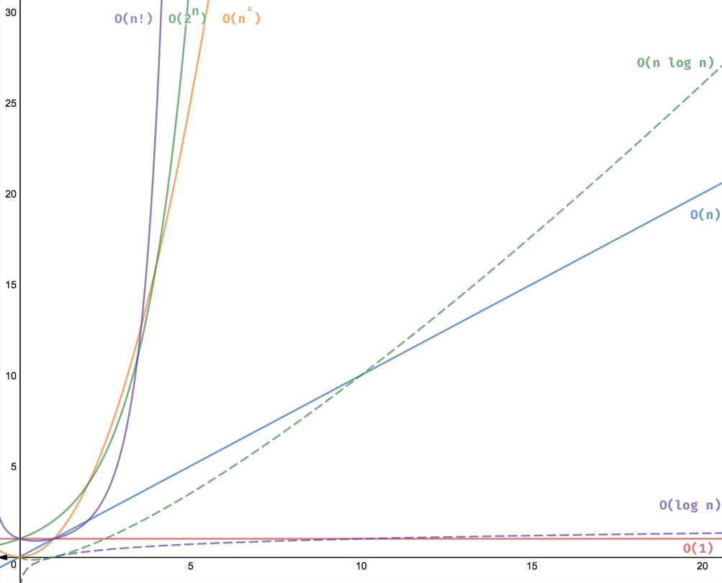
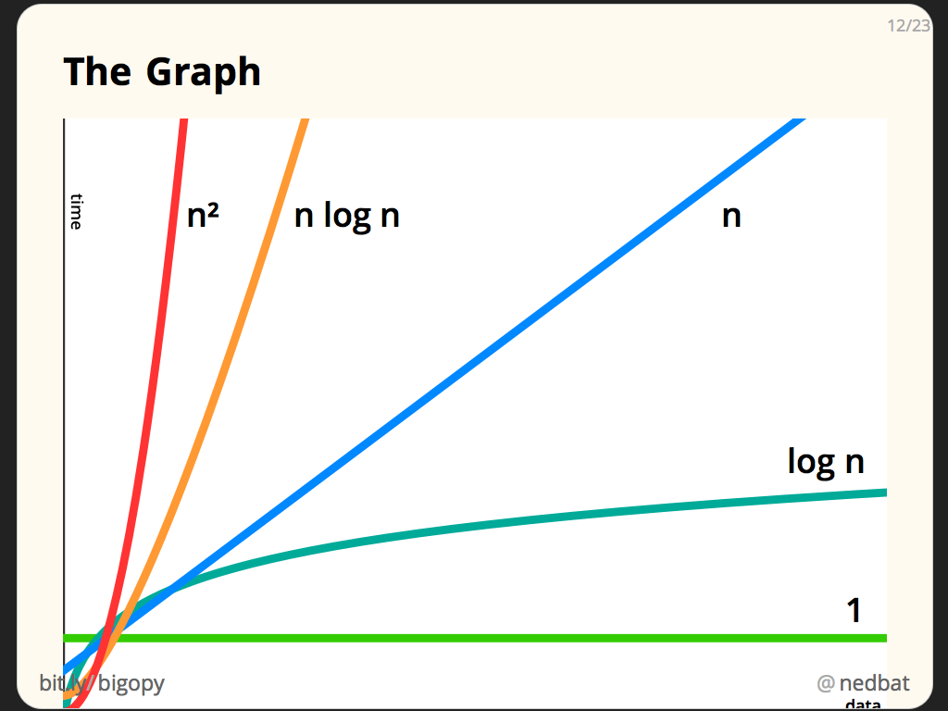
Grow rates graphed

Slide 13
General Rules: For Loops
The running time of a for loop is at most the running time of the statements inside the for loop (including tests) times the number of iterations.
The above example is O(N).
for (int i = 1; i <= N; i++) {
sum = sum+i;
}

Slide 14
General Rules: Nested Loops
Analyze these inside out. The total running time of a statement inside a group of nested loops is the running time of the statement multiplied by the product of the sizes of all the loops.
The above example is O(MN).
for (int i = 1; i <= N; i++) {
for (int j = 1; j <= M; j++) {
sum = sum+i+j;
}
}

Slide 15
General Rules: Consecutive Statements
Consecutive statements: These just add (which means that the maximum is the one that counts).
The above example is O(N²+N) = O(N²).
for (int i = 1; i <= N; i++) {
sum = sum+i;
}
for (int i = 1; i <= N; i++) {
for (int j = 1; j <= N; j++) {
sum = sum+i+j;
}
}

Slide 16
General Rules: Conditionals
If (test) s1 else s2: The running time is never more than the running time of the test plus the larger of the running times of s1 and s2.
The above example is O(N²).
if (test == 1) {
for (int i = 1; i <= N; i++) {
sum = sum+i;
}}
else for (int i = 1; i <= N; i++) {
for (int j = 1; j <= N; j++) {
sum = sum+i+j;
}}

Slide 17
Algorithms

Slide 18
Symbol Balancing
A useful tool for checking your code is to see if the (), {}, and [] symbols balance properly.
  For example the sequence …[…(…)…]… is legal but the sequence …[…(…]…)… is not.
  The presence of one misplaced symbol can result in hundreds of worthless compiler diagnostic errors!

Slide 19
Symbol Balancing Algorithm
The algorithm is simple and efficient O(N):
  Make an empty stack.
  Read characters until end of file (EOF).
  If the character is an opening symbol ([{, push it onto the stack.
  If it is a closing symbol )]}, then if the stack is empty report an error. Otherwise pop the stack.
  If the symbol popped is not the corresponding opening symbol, report an error.
  At EOF, if the stack is not empty report an error.

Slide 20
Linked lists.
We already know there are slow.
But how do they rank in O(?)
  We insert into the front of the list
  The operation is three steps
    get new node object with data
    change next pointer to where head points
    change head to point to the node

Slide 21
Linked lists (2)
how about find?
It looked something like this in code:
for (temp = head; temp != nullptr; temp = temp->next)
if (temp->data == item)
return true or pointer to item
    depends on what is needed.
return false or nullptr
O( ? )

Slide 22
Linked lists (3)
delete? O( ? )
insert last no tail pointer?
insert last with a tail pointer?
delete last?

Slide 23
Linked lists (3)
How about double linked lists?
Does it change the Big O ?
So how about efficiently questions?
  is Double linked lists faster or slower then single linked lists?

Slide 24
Stacks and Queues
For the STLs these are the required times.
stacks
insert O(1)
delete O(1)
search O(n)
Queues
insert O(1)
delete O(1)
search O(n)

Slide 25
Binary Search Algorithm
int a[N]; // Sorted array
int x; // Value to be found
int find (int left, int right) {
if (left > right) return –1;
int mid = (left+right) / 2;
if (x < a[mid])
bin_search(left, mid-1);
else if (x > a[mid])
bin_search(mid+1,right);
else return mid;
}
Time Units to Compute
-------------------------------
1 for comparison.
1 for computation of mid.
1 for comparison.
T(N/2)
1 for comparison.
T(N/2)
Thus T(N) = T(N/2) + 4.

Slide 26
Solution
Some math, a series for those interested…

Slide 27
General Observation
If an algorithm takes constant O(1) time to cut the problem size by a fraction (usually ½), then the algorithm is O(log₂N).
For binary search we halve the search space each time we call the function. Thus binary search is O(log₂N).
Generally speaking, most Divide and Conquer algorithms are O(log₂N)
  or O(Nlog₂N)
    because they loop around it.

Slide 28
Binary Search Trees
So with Binary search trees
We have a O( ? )
And our dictionary algorithm
  We have N number of words
O( ? )
BinaryNode *find (T x, BinaryNode<T> *t)
{
if ( t == nullptr )
return nullptr;
else if ( x < t → data )
return find ( x, t → left );
else if ( t → data < x )
return find ( x, t → right );
else
return t; // Match
}

Slide 29
Binary Search Trees (2)
So the insert would O(log₂N) as well.
void insert (T x, BinaryNode<T> *&t) {
if (t == nullptr)
t = new BinaryNode<T> (x);
else if (x < t → data)
insert(x, t → left);
else if( t → data < x)
insert(x, t → right);
else
; // Duplicate entry; do nothing
}

Slide 30
Binary Search Trees
So how about print in postfix order
O( ? )
postorderTravsal(BinaryNode<dtype> * t) {
if (t == nullptr)
return;
else {
postorderTravsal(t->left);
postorderTravsal(t->right);
cout << t->data << " ";
}
}

Slide 31
AVL and RedBlack tree.
1
2
This tree is
not a tree, it's a linked
list. Which is the
worst case of a tree
O(n)
We don't want O(n), instead they ensure we get a O(log₂N)
3
4
5
6
7

Slide 32
AVL and Redblack (2)
4
2
6
1
3
5
7
Now we know it will that search is O(log₂N)

Slide 33
Binary Heaps
Insert has two steps
add new value to add of the array.
"percolation up"
  We repair the heap property by comparing the added element with it parent and swapping positions as needed.
    min heap, comparison is parent smaller, swap positions.
    max heap, comparison is parent larger, swap positions.
  repeat from new position until the parent comparison is correct or at root level.
We'll skip over the math. the insert is worse case O(log₂N), but average case is actually O(1).

Slide 34
Binary Heaps (2)
How about the delete?
  Delete always removes head value.
    If the tree is not empty, find a replacement.
  Replacement is the last position
    "percolation down"
      We repair the heap property by comparing the element with both children and swapping positions as needed. if position has no children, stop.
        min heap, comparison is (smallest of) child smaller, swap positions.
        max heap, comparison is (largest of) child larger, swap positions.
      repeat from new position until it's the leaf node or heap property has been repaired.
Again, the math is outside of this course, but I would hope you can see it the worse case is O(log₂N)

Slide 35
sorting
Bubble sort
best, average and worst case
O(N²)
int arr[8] = {6,5,3,1,8,7,2,4}
for(int i=1, i<=8, i++)
for(int j=0, i<8-1; j++)
if (arr[i] > arr[i+1])
swap(arr[i],arr[i+1]);

Slide 36
Insertion Sort
It's good for "small lists" is the statement made before.
Why?
it's average and worse case are O(n²)
But the best case is O(n)
It takes one unsorted element at a time and sorts it into place.
  it swaps the element until it is sort into place.
There is a partially sort list on the "left" side and then unsorted elements are "right" side are sorted into place one at a time.
  Until the "left" side is full sorted list.

Slide 37
Merge Sort
this the same O(n log₂n) for all cases.
it's log₂n for the divide in sub lists
the merge is the n.
void mergeSort (array, left, right, size) {
if (left < right) {
int mid = left +((right-left)/2);
mergeSort(array, left, mid, size);
mergeSort(array, mid+1, right, size);
//merge is part 2!
merge(array, left, mid, right, size);
}
}

Slide 38
Heap Sort
Well, we already know part 2
  heapify is a delete operation
  and delete is log₂n
And repeating for first to last?
  O(n log₂n) for the entire algorithm.
  This is for all cases.
2 step algorithm
  build a heap out of the array. (think priority queue here)
  repeat, from last to first position.
    swap the root element with the current last element, and then update heap.

Slide 39
Quick Sort
As this is a divide and conquer algorithm, you could guess
best case and average case is
O(n log₂n)
Worse case is terrible!
O(n²)
But that is a sorted list with a bad pivot value.
  Always choose a good pivot value and the worse case never happens!
alogorthm:
pick an element as the pivot in the array (in black)
partitioning, reorder all the elements so values less then pivot on the left and greater on the right
  we may need to swap the pivot with an element in the array.
make two recursively with each sub array (pivot as the middle)
  stop at size 1 or zero array.

Slide 40
Hashing
Hashing is hard to explain, but there is some variants
  it's the collisions. separate chaining (linked list) or open addressing (linear probing, quadric probing, etc).
  The goal of hashing is have to be O(1) for all cases.
  But with bad coding and/or bad hash function. It could be in the worse case O(n).
    everything collides to one spot and that is then a linked list. so O(n)
  Done correctly and load factor of no greater then ½ , it's pretty close to O(1).

Slide 41
Brute Force Search Algorithm
We test all possible placements of Pattern relative to Text.
Algorithm:
for i = 0 to (n-m) {
j = 0;
while ((j < m) and (T[i+j] == P[j])) {
j++;
}
if (j == m) {
return(i); // The index where P is found.
}
}
return(“Pattern not found”);
Count character comparisons
Worst case complexity is O(nm).

Slide 42
Boyer-Moore Search Algorithm
i = m-1; j = m-1;
while (i < n) {
if (P[j] == T[i]) {
if (j == 0) return(i);
else {
i--; j--;
}
}
else {
i = i + m – min(j, 1+last(T[i]));
j = m-1;
}
}
return(“Pattern not found”);
Count character comparisons
Worst case run time is O(n-2m+2)m or O( nm )

Slide 43
Q
A
&

