Slide 1
Cosc 2030
binary Heap.

Slide 2
Binary Heap
Binary heap is with the following properties
it's a complete tree
reminder: all levels are completely filled except for maybe the last one.
Either it’s a
min heap: value of the each node is greater than or equal to the value of its parent with a smallest value at the root
max heap: value of each node is less then or equal to the value of its parent with the max value at the root
Note, some heaps may require the values inserted to be unique.

Slide 3
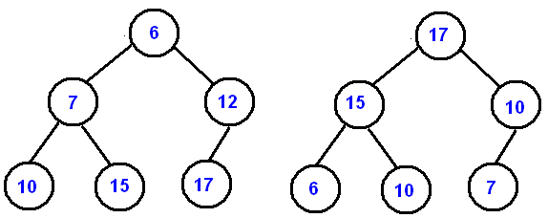
Binary Heap (2)
The highest or lowest is always at the root, hence the name "heap"
This is a sorted structure, but can be only thought as a partially ordered
Very useful as a priority queue.

Slide 4
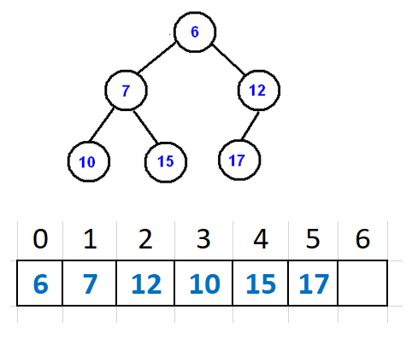
Binary Heap (3)
Since this is a complete binary tree, it can be easily represented in an array.
We store it by level, with the root in the first position
Note some implementations will skip position zero in the array
It makes the equations slightly simpler.
Why is storing in a array a good thing?

Slide 5
Binary Heap (4)
The root is in position zero
arr[0]
For an i^{th} node, we have the following equations.
parent node is located at (i-1)/2
left child is (2*i) +1
right child is (2*i)+2
with i=0
left child is 1, right child is 2
with i=2
left is child is 5, and right is 6.
Note, will need to the number of nodes.

Slide 6
Binary Heap (5)
A binary heap needs three functions
find
which is the same as other trees
With these two we have to account for min heap or max heap, but the operations.
insert
delete

Slide 7
insert (with arrays)
Insert has two steps
add new value to add of the array.
"percolation up"
We repair the heap property by comparing the added element with it parent and swapping positions as needed.
min heap, comparison is parent smaller, swap positions.
max heap, comparison is parent larger, swap positions.
repeat from new position until the parent comparison is correct or at root level.

Slide 8
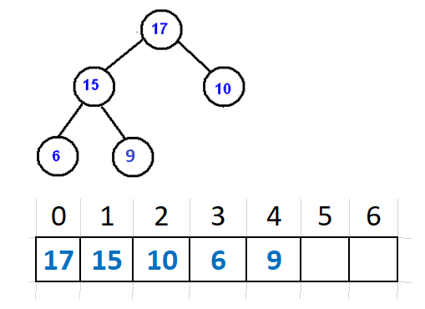
Example (max-heap)
Start with max-heap
Add 7
add to the array at position 5

Slide 9
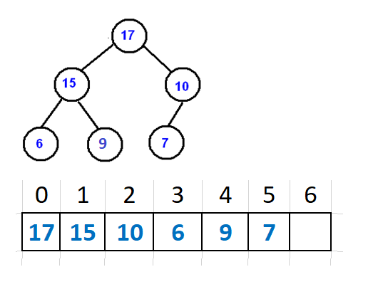
example (add 7)
Check parent of node 5
so (5-1)/2 is position 2
10 is less then 7.
no swap needed and done.

Slide 10
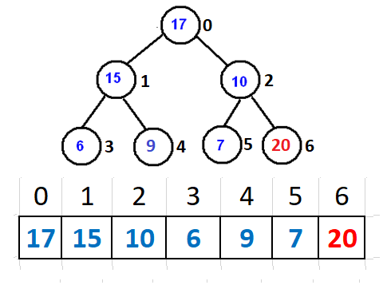
Example, add 20
add to the end, array position 6
Check parent of node 6
so (6-1)/2 is position 2
remember, floor/round down.
20 is greater then 10.
swap 2 and 6 positions.

Slide 11
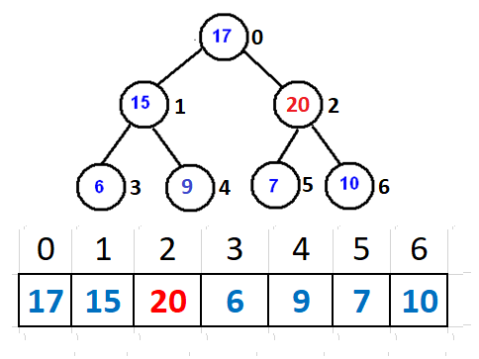
Example, add 20 (2)
repeat process at new position of 2
Check parent of node 2
so (2-1)/2 is position 0
again, floor/round down.
20 is greater then 17.
swap 17 and 20 positions.

Slide 12
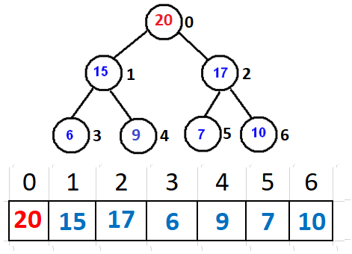
Example, add 20 (3)
repeat process at new position of 0
position zero is the root
done, max-heap property has been restored.

Slide 13
Code for "percolation up"/heapify
void maxHeap::heapify(int pos) {
if (pos ==0) return; //top, we are done
int par = parent(pos); //find the parent position
if (par < 0) return; //don't go outside the array bounds.
if (heap[pos] > heap[par]) {//child is bigger then parent, so swap
swap(pos, par);
heapify(par); //call heapify again with new position.
}
}

Slide 14
delete/remove
Delete always removes head value.
If the tree is not empty, find a replacement.
Replacement is the last position
"percolation down"
We repair the heap property by comparing the element with both children and swapping positions as needed. if position has no children, stop.
min heap, comparison is (smallest of) child smaller, swap positions.
max heap, comparison is (largest of) child larger, swap positions.
repeat from new position until it's the leaf node or heap property has been repaired.

Slide 15
Example deleteMax
Starting with our current tree
So remove 20 and use the heap size to find the last position, which is 6.
since it's not empty, move value at position 6 to position 0
and check is the heap property needs repaired.

Slide 16
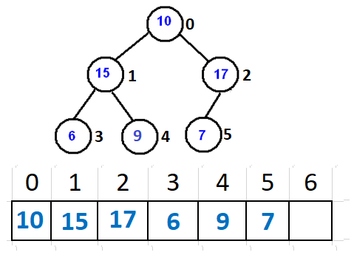
Example deleteMax (2)
position 0 has less then a (both) child, so max heap property needs repaired.
left child is (2*i) +1 is 1
right child is (2*i)+2 is 2
right child 2, has is larger, so swap position 2 and 0

Slide 17
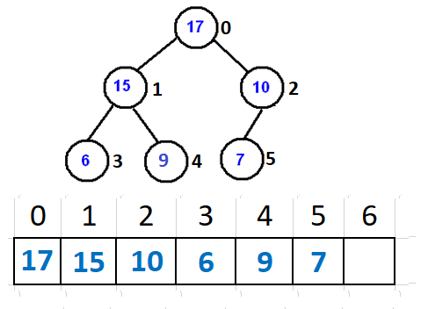
Example deleteMax (3)
position 2 has one child
left child is (2*i) +1 is 5
child 5 is less then it's parent, position 2.
max heap property has been repaired, so stop.

Slide 18
Example deleteMax again
Starting with our current tree
So remove 17 and use the heap size to find the last position, which is 5.
since it's not empty, move value at position 5 to position 0
and check is the heap property needs repaired.

Slide 19
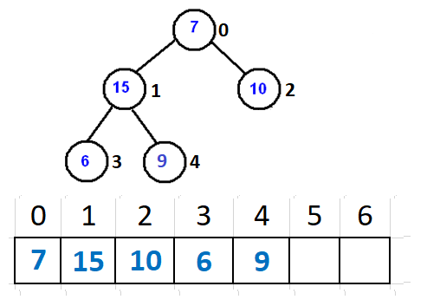
Example deleteMax again (2)
position 0 has less then a (both) child, so max heap property needs repaired.
left child is (2*i) +1 is 1
right child is (2*i)+2 is 2
left child 1, has is larger, so swap position 1 and 0

Slide 20
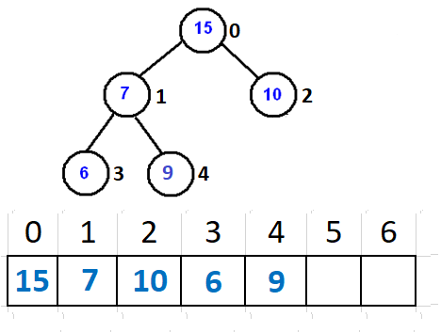
Example deleteMax again (2)
position 1 has less then the right child, so max heap property needs repaired.
left child is (2*i) +1 is 3
right child is (2*i)+2 is 4
right child 4, has is larger, so swap position 4 and 1

Slide 21
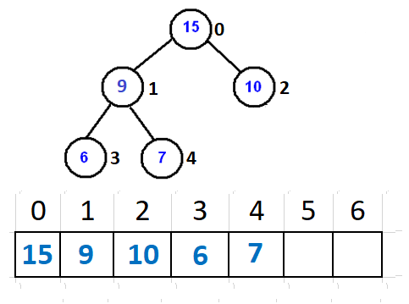
Example deleteMax again (3)
position 4 has no children
left child is (2*i) +1 is greater then size
right child is (2*i)+2 is greater then size
max heap property has been repaired.

Slide 22
code for "percolation down"
void maxHeap::maxHeapify(int par) {
int l = leftc(par); //find left child
int r = rightc(par); //find right child
int larger = par;
//check the left child first
if (l <size && heap[l] > heap[larger])
larger = l; //left is larger then parent
if (r <size && heap[r] > heap[larger])
larger = r; //right child is larger then left and/or parent.
if (larger != par) { //if not parent
swap(par, larger);
maxHeapify(larger); // move it down.
}
}

Slide 23
Priority queue
Most priority queues are implemented a binary heap
reminder
binary heap insert and delete are about log₂n
using a standard list for a priority queue
reminder
insert or search/delete is linear in timing.
Why choose a binary heap over a list/queue?

Slide 24
Priority queue note
If the items in the priority queue are unchangeable, then this works great.
If the items can be changed then the changed we need run heap repair on the new node to repair the heap.
Say we enter 'a' with a priority of 2 and then change the priority of 'a' to 4.

Slide 25
is a binary tree a heap?
properties of a heap
must be complete.
min/max heap property.
min heap: value of the each node is greater than or equal to the value of its parent with a smallest value at the root
max heap: value of each node is less then or equal to the value of its parent with the max value at the root
We can check
With a binary tree, starting a root
If has children and is heap property satisfied? (example max: is greater then both children)
If yes, recursively go down both child.
if no, return "false"
if no children, return true.
This needs be an extra check is this leaf is lower then the left most leaf for complete.

Slide 26
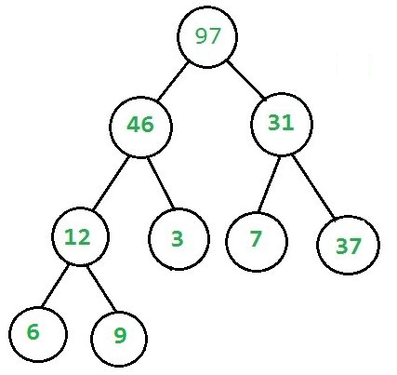
example max heap
a
b

Slide 27
is a binary tree a heap? (2)
If the tree is an array then is a heap?
The complete check has likely already been done, unless you can leave blanks in the array.
We can loop using this
for (i=0; i<=(n-2)/2) ;i++)
use i to position and check left/right children
return false if property fails
return true if we finish the loop.
If the tree is not stored in an array, much harder
Find out if it is a complete (or nearly complete tree)
Then check the max/min property.

Slide 28
is a binary tree a heap? (3)
recursive function using an array (array bounds check is missing and should be used).
bool isHeap(int arr[], int i, int n) {
If a leaf node
if (i > (n - 2)/2) return true;
If an internal node and is greater than its children, and same is recursively true for the children
if (arr[i] >= arr[left(i)] && arr[i] >= arr[right(i)] &&
isHeap(arr, left(i), n) && isHeap(arr,right(i), n))
return true;
return false;
}

Slide 29
Last note
There is a sort, called heap sort based on a binary heap.
we will come back to the heap sort and look at how it works.

Slide 30
Q
A
&

