Slide 1
Cosc 2030
Linux, g++, debugger, and Pis

Slide 2
Platforms and Compilers
Do I have to use linux?
  very likely.
Do I have to use the linux c++ compiler (g++) ?
  very likely
Can I use windows and Visual studio?
  Yes.
  Do You have to? No
  You can write and test your code on any windows machine and even on macs.
  But the program assignments will be run and graded on linux machines

Slide 3
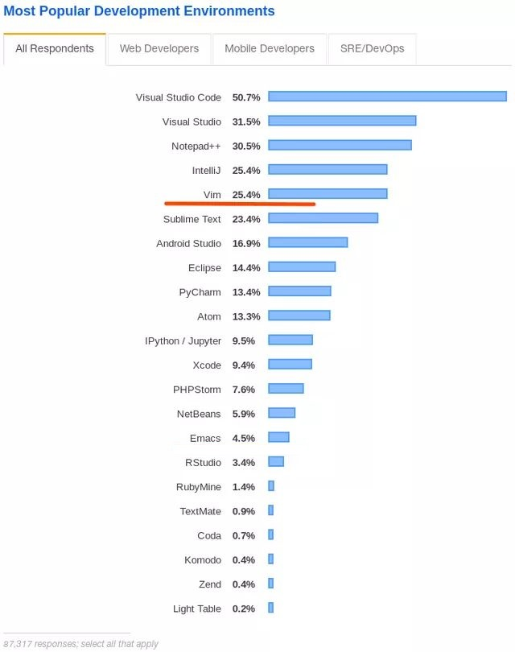
What IDE?
Whatever makes you happy.

Slide 4
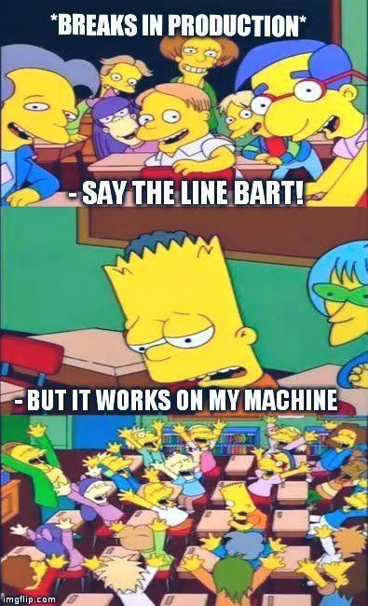
Not a valid excuse.

Slide 5
Platforms and Compilers (2)
But when it is graded, it will be compiled via the g++ compiler and run on a cosc department linux machine and/or Pi.
If you code doesn't compile for any reason, from syntax error to platform error (including problems generated by Macs).
  You will lose half the points off the top and then the grading begins.
  At this point in your college career, you can figure out how to comment out bad code or actually fix it.

Slide 6
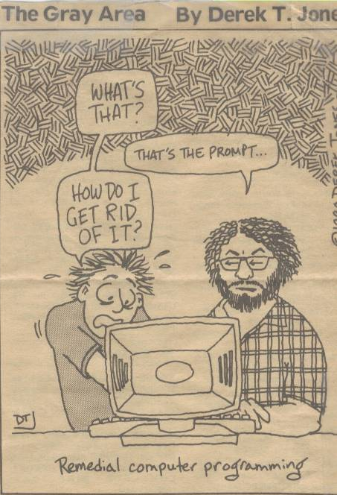
Don’t be afraid of the prompt, in linux it can be your best friend.
In some cases, the only way to do certain things.

Slide 7
Login
Any open lab on campus, you can use putty to ssh into cosc department linux machines.
  Wait, what's my password?
There are 4 linux machines in engineering 4072 that you can login as well, which provide a full GUI interface.
You can also install Rocky 8 on into a VirtualBox on your own machine.
  You can download the appliance from my website and use it.
  Debian maybe work but verify your code on CS machines.
wsl2 Ubuntu that you installed and used in lab1.
You could also use a Raspberry Pi with Raspbian/OS or Rocky (redhat linux or centos) 8 installed.

Slide 8
Editors
Note, most of these don't do any syntax or text highlighting for you.
GUI
  Emacs, Nedit, gvim, etc
non-gui
  vi, nano, etc
IDEs (requires a gui interface)
  kate, code (Vscode, Visual Studio interface), atom, etc

Slide 9
Command line
list the contents of the directory
  ls
    simple list of files.
  ls –la
    shows all the files in the directory, plus size, etc.
remove a file
  rm filename
create a directory
  mkdir dirname
delete a directory (note it must be empty)
  rmdir dirname
change directory
  cd dirname
  cd ..
    go up one directory
What directory are in?
  pwd (print working directory)
copy a file
  cp srcfile dstfile
move a file (also renames)
  mv srcfile dstfile
Note anytime I say file, you can always specify a path as well.
print out the first 10 lines of the file
  head filename
print out the last 10 lines of the file
  tail filename
print out the file
  cat filename

Slide 10
Quick note on path and files
Linux is very specific about files and paths and many times you need to specific about what file you want to run
  so instead typing a.out and pressing enter
  ./a.out You are telling the command, run the file in my current directory.
  Why?
    because your current working directory is rarely in the path.
  ../a.out means run the file a.out in the parent directory.

Slide 11
compiling

Slide 12
Compiling
The gnu compiler is basically the defacto standard.
  But Microsoft (Visual Studio) does try hard to pretend it is.
We are writing c++, so the compiler is called g++ (GNU c++ compiler
  c is gcc (GNU c compiler).
  There is also a front-end Objective-C, Fortran, Ada, Go, and D
Also, Please note, GNU is NOT actually part of any linux disto, nor the kernel.

Slide 13
command line g++
Basic simple compiling
  g++ file.cpp
    assuming no errors, it will create a file called, a.out that is your executable file
    If there are errors, it will print them out. If no errors, it will return the command prompt
What you will likely use
  g++ file.cpp -o outfilename
    creates a file call outfilename.
    For the debugger add we add "-ggdb"
    You will list all the .cpp files that you need to compile that program.
    DO NOT LIST .h files, because they are already included via #include statements
  Note, that -std=c++11 is now a standard switch, on Rocky/CentOS/Redhat 8 and Raspbian.

Slide 14
command line g++
Syntax and other errors.
  Always scroll up to the top of the list of errors. Fix the first (couple) error and then compile again.
    many of the later errors are because of the first ones.
  It will stop after 100 errors have been listed.
    This is equivalent to VS studio turning everything red.

Slide 15
GUI IDEs
Both code (vs code) and atom will do basic syntax highlighting for you.
  They may have some of methods as well, but no guarantees.
But they are IDEs (integrated Development Environments).
  NOT compilers. They may not compile for you.
You may still have to drop to the command to compile the program.

Slide 16

Debugging

Slide 17
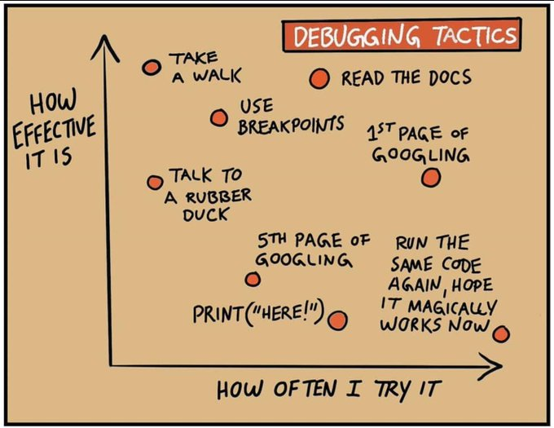
Debugging Tactics

Slide 18
Debugger

Slide 19
gdb (linux debugger)
The linux debugger is command line only. It's not pretty, but will get the job done
  But as note, print statements in your code maybe even more helpful in debugging task.
To use the debugger, first you need to have the compiler add in the pieces for it
  g++ file.cpp -o file -ggdb

Slide 20
gdb (2)
Then to use the debugger
  gdb file
    assuming the program doesn't die at start, you will get
    (gdb) prompt. This says it ready. Note, you can type "help" for help
  To just run the program
  type r press enter. (or run and press enter)
  It will create break points on function names (so main)
    break main (causing a break point at the start of main)
    again r and press enter
example with a file called test
first start up the file in gdb
gdb test
now set a break point.
(gdb) break main
Breakpoint 1 at 0x400c4d: file test.cpp, line 10.
start the program
(gdb) r
Starting program: test -d
Breakpoint 1, main () at test.cpp:10
10 cout <<"y is true\n";

Slide 21
gdb (3)
At a break point
  You can next, previous, and continue You can also print out variables.
    print variablename
    you can print out a class object, structs, arrays, etc.
  command
  n or next to run the next line
    s or step to "step into functions"
  step back one line (likely not supported)
    command is rni
  continue or c to start it running again

Slide 22
gdb (4)
list
  will list the next 10 lines of code.
until
  will run until the loop is finished. Very handy command.
q or quit
  exits gdb
There is a quick reference listed on the lecture.

Slide 23
gdb break points.
break functionname
  easy way to set a break point.
break linenumber
  break 63 stop at line 63 (list will be handy here)
clear functionname or linenumber
  removes the break point
delete
  removes all break points.

Slide 24
gdb and core files.
Core files are produces when you program dies from a segmentation fault
  You have a pointer error. Seg faults are 99% of the time errors with pointers.
gdb file corefile
  it will load everything
  you can print variables at that point
  bt (backtrace) gives you the stack of function calls.

Slide 25
A Note on debugging.
You all are mostly used to running a program and it finishes in less then a second.
the programs you will write and run for homework, may take upwards of 3 to 5 HOURS to complete.
  So you won't be to just make a minor change and run it again for testing.

Slide 26
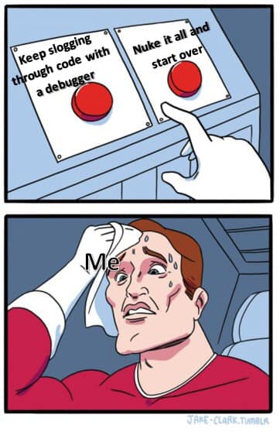
Lastly
They may come a point, where it is better to burn your the code and start over.
  The whole program?
  Just that function?

Slide 27
Raspberry Pis

Slide 28
Raspberry Pi 3 B
We will be using raspberry Pi 3 Bs
  NOT 3 B+ or Pi 4s.
  We have 15 of them, currently
they will used in lab and for programming assignments.
  Again, you can write your code on anything and transfer it to one of them.
For the programming assignments, they will be for the timing and speed tests.
  Is you code the fastest in class, can your code beat my code, or beat a specific time limit.
    These will be optional, but you could get extra credit points.

Slide 29
How to check out one.
DO NOT JUST LOGIN A PI,
  go to the web site and claim one first
  Use the web page connected to 2030 to first "claim" a pi
  Log into the pi claimed (within 5 minutes or you lose your claim)
    username: padawan
    Password: wyoming
Homework and labs
  During lab times (M 3-7pm), you should only use them during YOUR lab time.
  outside of either labs, claim one and use it as needed to complete homework.

Slide 30
Have a Pi? Want to get a Pi?
We are intentionally using Raspberry 3 B Pis.
  $35 for the pi
  power adapter $3-5 (2A at 5v usb micro)
  Micro Sdcard under $10
  I would suggest a case, but not required. under $10
    https://www.raspberrypi.org/documentation/setup/
  usb keyboard and mouse.
  https://projects.raspberrypi.org/en/projects/raspberry-pi-setting-up
  Use this one put the image on the sdcard. The above shows the "hard" way.
    https://www.raspberrypi.org/documentation/installation/installing-images/README.md

Slide 31
Q
A
&

