Slide 1
Cosc 2030
Linked lists

Slide 2
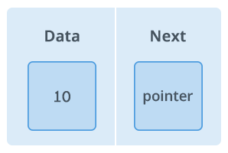
List data structures
This is the first of three list data structures
  linked lists, stacks, and queues.
There is a "node" object which is either a class or struct.
  we will use it as a class, but you will see many use a struct instead. Note, the class has only public members, nothing is private.
Basic node looks like this:
  template<class T>
  class node {
  public:
  T data;
  node<T> * next;
  …
  }
Notes:
pictures from https://www.hackerearth.com/practice/data-structures/linked-list/singly-linked-list/tutorial/

Slide 3
Node Class OR Node Struct
#ifndef NODE_
#define NODE_
template<class T>
class node {
public:
T data;
node<T> * next;
node() { next = nullptr;}
node(T item) {
data = item;
next = nullptr;
}
};
#endif
#ifndef NODE_
#define NODE_
template <class T>
struct node {
T data;
node<T> * next;
node() { next = nullptr;}
node(T item) {
data = item;
next = nullptr;
}
};
#endif
Note, you only need ONE of these, not both. This would be in a node.h file

Slide 4
Reminder of the class, from ADT lecture.
#ifndef MYLIST_
#define MYLIST_
#include "node.h" //previous slide
template <class T>
class myList {
private:
node<T> * head;
int size;
public:
myList()
{ head = nullptr; size=0;}
~myList();
void insert (T item);
void remove();
T front();
void print();
bool find(T item);
bool isEmpty() {
return size ==0;
}
int getSize() { return size;}
};
#endif

Slide 5
linked list
a linked list is similar to an array
  the data is stored in a node object
    The node are connected linearly.
four basic methods are required (in addition to constructor and destructor)
  insert front
    A new data item is added to the front of the list
  remove front
    the first data item (ie node) is remove from the list
  find
    does a piece of data exist in the list
  getSize (and isEmpty )
    how many items (ie nodes) are in the list.

Slide 6




linked list (2)
All list data structures will have a head pointer.
  node<T> * head;
  The head pointer points to the first node in the list or nullptr if the list is empty;
The linked list will then visually look this
Visually we just use a slash to represent the nullptr

Slide 7
linked list (3)
linked lists maybe similar to arrays, with the following exceptions
  Arrays are fixed in length, linked lists are not. Dynamic size
  Easily insert and delete new data
  No Random access to the data. We must always access the nodes sequentially starting from the first node
  uses more memory then arrays
    extra spot for the pointer is required for each element
  Not hardware cache friendly, since the data is not stored in contiguous locations.

Slide 8
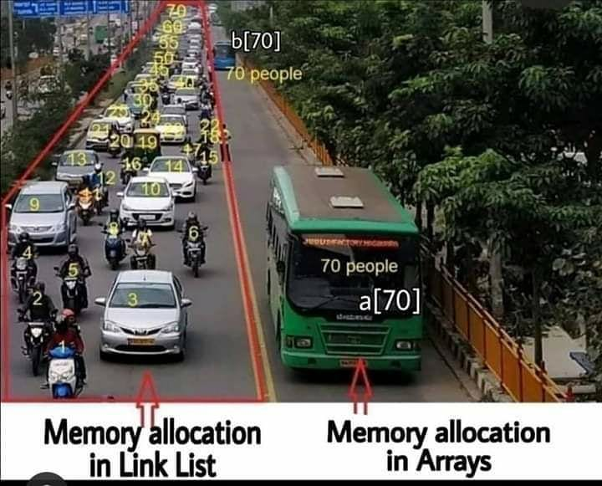
Visually.

Slide 9
Question
It's not random access to the data.
  So then what type of access is it?
  And what does that mean when you are trying to search?

Slide 10
Insert front operation
We insert into the front of the list
The operation is three steps
  get new node object with data
  change next pointer to where head points
  change head to point to the node
It also doesn't matter if the list is empty or non empty.

Slide 11
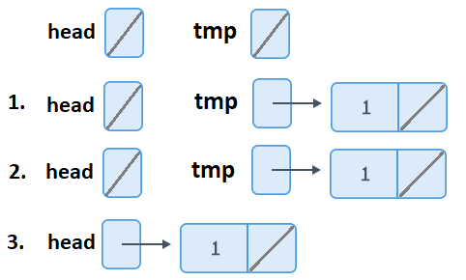
Insert operation graphically
empty list
no empty list

Slide 12
Example insert front
template <class T>
void myList<T>:: insert (T item) {
//first create a new node object with the item
node<T> * tmp = new node<T>(item);
//So what is the code that goes here?
size++;
}

Slide 13
delete front operation
deleting first, is very similar to insert
  if list is not empty
    set temp to first entry (ie to where the head pointer is pointing)
    change head to point to the node's next
    delete temp

Slide 14
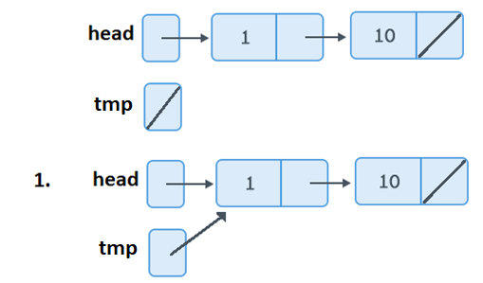
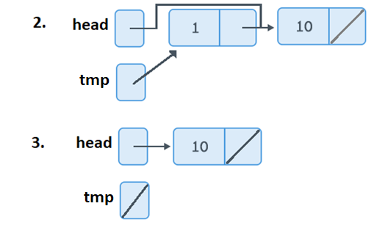
delete operation visually.

Slide 15
Question
Why is step three important? (3. delete temp)

Slide 16
remove front example.
template <class T>
void myList<T>:: remove() {
node <T> * tmp;
if (head != nullptr) {
//something in the list, so we can remove it.
// so what is the code that goes here?
//decrement size
size--;
}
}

Slide 17
destructor
once we have the remove method, then the destructor is easy
just loop while !isEmpty() and call remove
template <class T>
myList<T>:: ~myList() {
while(!isEmpty())
remove();
}

Slide 18
front operation.
front is a pretty simple operation. Return the first data item in the list.
template <class T>
T myList<T>:: front () {
if (head != nullptr) {
return head->data;
} else {
return T(0); //return the zero case here.
}
}

Slide 19
print
So looking at the print code.
We need to walk the entire list.

Slide 20
print example code
template <class T>
void myList<T>:: print() {
for( node<T> * tmp = head;
tmp != nullptr;
tmp = tmp->next ) {
cout<<tmp->data;
if (tmp->next != nullptr)
cout <<" -> ";
else
cout <<" /\n";
}
}
Walking the entire list
output example:
10 -> 20 -> 4 /

Slide 21
find operation
template <class T>
bool myList<T>:: find (T item) {
// so search through the list and see if it exists
//if yes, return true
//if we search the entire list and don't find it.
return false.
}

Slide 22
find operation
to search the list for a data node, we must always start at the beginning of the list (sequential access).
  We start at header pointer and work through the list, using the next pointer for each node, until either we find the data or end of the list.
it would look something like this
for (tmp = head; tmp != nullptr; tmp = tmp->next)
if (tmp->data == item)
return true or pointer to item
    depends on what is needed.
return false or nullptr

Slide 23
find operation (2)
insert and delete operations are pretty fast.
How about find?
  Is the time to find a data item constant like insert?
  What about failing to find?
what options could we use to make it faster?

Slide 24
other possible operations
insert last
insert "before data" or "here"
delete last
delete "data"
clone or override =

Slide 25
Insert last operation
With only the header pointer
  get new node object with data and set next to null pointer
    this done by the node constructor
  if list is not empty
    find end of list.
    change next pointer of last item to where new node.
  else
    change head to point to the node

Slide 26
Insert last operation (2)
like find, is this a fast operation or are the problems?
Can we make it faster or even a constant time to insert last?
  What would need to be added?
  Changes to other operations?

Slide 27
delete last operation
similar to insert last, but we have 3 cases to deal with
if list has 1 node
  delete head pointer
  set head pointer to null pointer
if list is has 2+ nodes
  find second to last node
  set temp to second last node->next
  set second last node->next to null pointer
  delete temp
if list is empty
  do nothing.

Slide 28
delete last operation (2)
if we have a last pointer does that help?
what could help?
what changes do we need to make and what problems arise?

Slide 29
insert variants
Insert data in the X position
  example insert into the 3rd position
    move the x-1 position
      set new node next to next value
      set next to new node
    zero case use header pointer
  What do we do if the user wants 3rd position, but only 1 node in the list?

Slide 30
insert variants (2)
insert before some data.
find the data
  while holding on to the position before it. then insert
  special case. before the first node?
    use head pointer.
if data doesn't exist?
  likely return failure.
  or could be a insert last.

Slide 31
general fixes for head pointer issues and next to last nodes.
use recursive method and call by reference parameter
it would look like this
node<T> * insertLast (node<T> * head, T item) {
if (head == nullptr) //found end of list or empty list
return new node<T>(item); //add new node to the list.
else
head->next= insertLast(head->next, item);
return head; //leave list unchanged at this point
}

Slide 32
recursive insert before data
what changes are needed to recursive insertLast?
  if data is not found? could insert last or fail.
    fail won't notify, unless a new parameter is added.

Slide 33
cloning the list.
it's pretty simple recursively. Make a new linked list and return it.
  be careful the list is in the same order though.
  node * clonelist(node<T> * head) {
  if (head == nullptr)
  return nullptr;
  else
  node * tmp = new node<T>(head->data); //copy the data
  tmp->next= clonelist(head->next); //copy the rest of the list
  return tmp; //return the current node that has the rest of the list too.

Slide 34

Other lists
double linked lists
  Change the node to have two pointers. A next and previous pointer.
  The first node will now have null pointer for the previous.
  we can search both directions.
  operations are pretty similar.
    The need for recursive function is removed as everything can now be done in loops
      head pointer special cases still exist for empty lists.
    insert and delete given a node is easy, since the node "knows" it place in the list.

Slide 35
double linked lists
How would you write a insert after method?
  the parameter is the data and the node to insert after.
how about delete given a data item (not a node)?

Slide 36

Other lists (2)
circular linked lists
  all the nodes are connected to for a circle. there is no nullptr
    the head pointer points to the first node
    the last node also points to the first node.
  It can be double linked list as well
we can traverse the list from any starting point, not just head
useful in applications where the work through the list and then start over. data can be inserted/deleted at any point.
  Some CPU schedulers use this for process lists and determine which process to schedule next.

Slide 37
Q
A
&

