Slide 1
cosc 2030
Queues

Slide 2
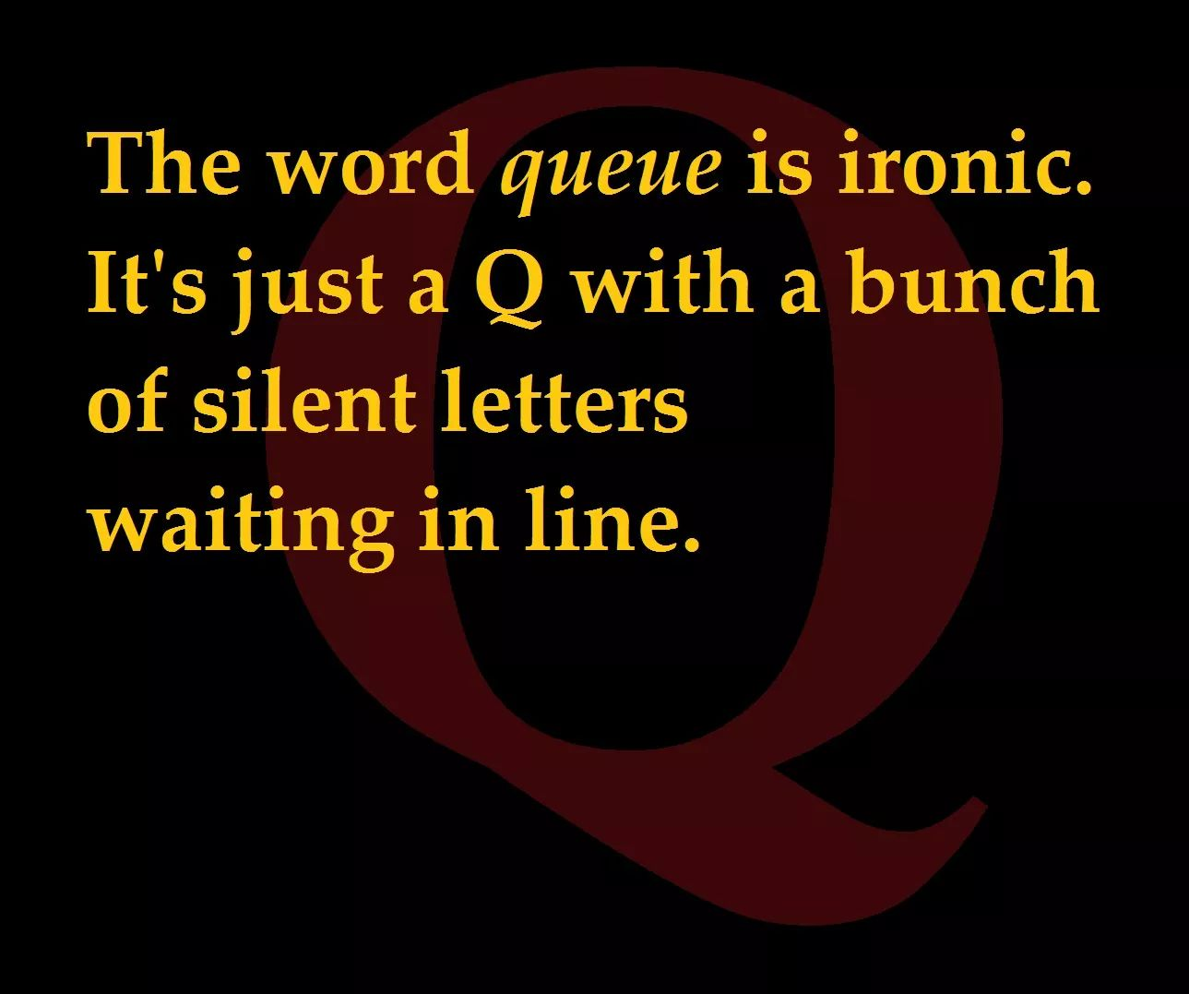

Slide 3

Queues
Queues are a simple data structure that uses FIFO (First In First Out) operations
  a new element is added to the end of the list.
  an element can only be removed from the top/front of the list.
  like stacks, we don't have random access to the list.

Slide 4
Queues
Operations
  enqueue
    add new item to end of the list
  dequeue
    remove front item in the list
  front
    return value of front of the list
      "zero" value if empty.
  Empty/isEmpty
    T/F if queue is empty.
  size
    return the size of the queue
examples
  scheduling algorithms
  networking
  inter-process communication
  graph and path-finding algorithms
  anything that needs a FIFO data sequence.
    real world: lines
      British word is queue

Slide 5
Writing a queue
We need to implement
  enqueue(), dequeue(), front() [sometimes called top() or peek()], isEmpty() and size()
Same as stacks, we already have a linked list. So instead of starting from scratch
  use inheritance.

Slide 6
inheritance for queue operations
void enqueue( data )
  calls what method already written?
void dequeue()
  calls what method already written?
data front()
  May need to be written. Remember peek just returns the value of the top of the stack
bool isEmpty()
  call what method already written?
  or no override if we just use the empty method from linked lists.
int size()
  calls what method already written?
  or no override needed, just use the size method in linked lists.

Slide 7
using inheritance!
template<typename T>
class myQueue: public myList<T> {
public:
void enqueue(T item) {
myList<T>::insertLast(item);
}
bool dequeue() {
if ( myList<T>::head != nullptr) {
myList<T>::remove();
return true;
} else
return false;
}

Slide 8
using inheritance! (2)
T front() {
if (myList<T>::head != nullptr)
return myList<T>::head->data;
else
return nullptr;
}

Slide 9
efficiency of queue operations
How fast are these operations?
Do they run in constant time or does the run time change depending on the length of the list?
  enqueue?
  dequeue?
  front?
  empty and size?

Slide 10
Priority Queue
Priority queues extend queues with the following changes:
  every data item has a priority associated with it
  higher priority data items are removed before lower priority
  if two elements have the same priority, it based on the order of the queue
uses
  most CPU scheduling algorithms use a priority queue. Some processes have a higher priority (ie need to run more often)
  graph algorithms like Dijkstra's shortest path and Prim's Minimum spanning tree can be implemented with priority queues data structures
  Any type of algorithm that needs a weight, cost, or distance applied to an item, vertex, and/or node.

Slide 11
Priority Queue (2)
Lets insert the following.
  Data is a letter, priority is a number (higher number, higher priority)
  enqueue order: A 2, B 4, C 1, D 4, E 2
  front() returns?
    now dequeue()
  front() returns?
    and dequeue()
  front() returns?

Slide 12
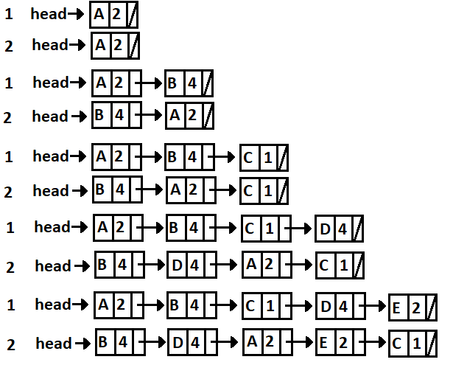
How is the queue "stored" and implemented.
Do we
  stored it just queue does and then search in front/dequeue?
  reorganize the queue during enqueue?
insert: A 2
insert: B 4
insert: C 1
insert: D 4
insert: E 2

Slide 13
implementation
The node has to hold a new piece of information
  integer priority variable to hold the priority.
  int priority;
Notes:
https://www.geeksforgeeks.org/binary-heap/

Slide 14
implementation (2)
Priority Queue changes
  front and dequeue to a search?
    What usage and/or data would this be the faster solution?
      Think about what happens more often. How much of the data is in the queue at any time.
  enqueue keeps a sorted list by priority?
    With what usage and/or data would be this be faster solution?

Slide 15
implementation (3)
A Priority Queue can also be implemented as Binary Heap (which is a version of Binary Tree)
  That is for a later lecture.

Slide 16
Q
A
&

