Slide 1
cosc 2030
trees:
Red-Black trees

Slide 2
Red-Black Tree
They are a self-balancing Binary Search Tree.
It's based on 2-3-4 trees (or sometimes 2-4 tree) from Rudolf Bayer in 1972.
Uses the following rules:
Every node has a color attribute: red or black
Root is always black
if the node is red, then it's parent must be black.
Also means the a red node can not have a red child.
Every path from root to any leaf node has the same number of black nodes.
Leaf nodes will always be black
Also a leaf node contains no data. Sometime called sentinel nodes.

Slide 3
visual red-black tree.
basic red-black tree.
with leaf nodes.

Slide 4
Which ones are valid red-black trees?
not valid
violates 4
valid
not valid
violates 3
not valid
violates 4
valid

Slide 5
inserting a node.
When inserting new data is always replaces a leaf node. So first find the leaf node to replace.
exception is the root node.
Create new node and color it red with black leaves.
case:
if root node, color it black and the tree is valid.
New node's parent is black and the tree is valid.
Parent is red and the uncle node is red
Parent is red and Uncle node is black.

Slide 6
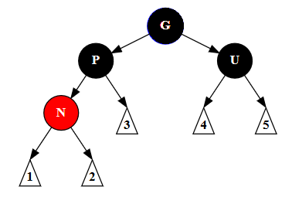
inserting a node, case 3
Parent is red and the uncle node is red
Then recolor Parent and Uncle node to black.
Grandparent node is recolored to red.
If this is the root node, which would then violate rule 2. Recolor it black.
Notes:
By Abloomfi - Own work, CC BY-SA 3.0, https://commons.wikimedia.org/w/index.php?curid=31167377

Slide 7
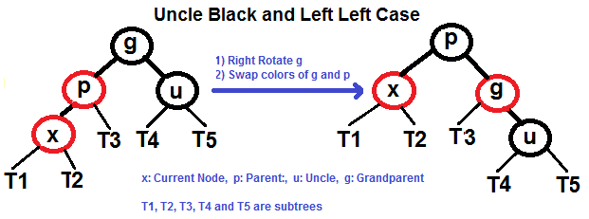
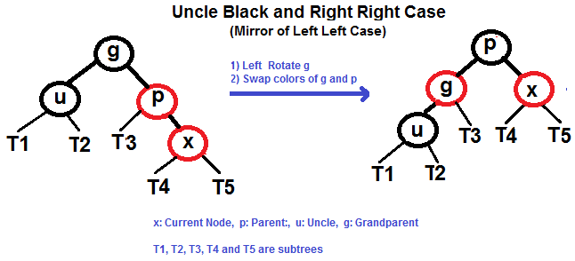
inserting a node, case 4
Parent is red and Uncle node is black.
We will rotate the parent into the grand parent spot and recolor.
There are four possible sub cases (2 are mirror of the tree)
Notes:
https://www.geeksforgeeks.org/red-black-tree-set-2-insert/

Slide 8
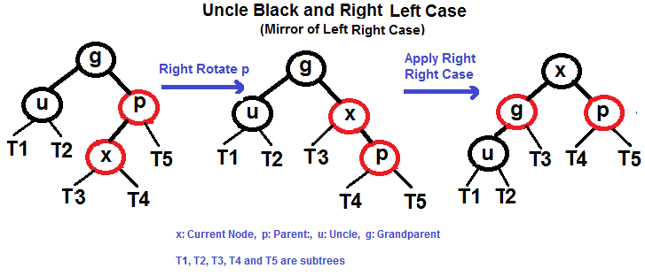
inserting a node, case 4 (2)

Slide 9
Deleting a node
There are similar issues. with 6 possible cases.
I'll leave this for you to look up and other classes to cover.

Slide 10
Red-black trees and efficiency.
Like AVL trees Red-Black trees ensure that the worse case can't happen.
and unbalanced tree. The height of a Red-Black tree will always be Log2N
So a search will take no more then height of the tree
Vs AVL tree
Red-Black trees are more efficient then AVL trees at insertion and delete.
Search time should be the same, but red-black trees can be more slightly more unbalanced then AVL trees.
if the tree is very stable (few insert and deletes) and lots of searches
use which?
If there are more inserts and deletes then searches
use which?

Slide 11
Final Note
We have AVL and red-black trees to avoid the worse case trees,
where they are basically just linked lists or a depth of about n
worse cases for tree happen when the data is sorted or almost sorted.
So, if the input data is randomly ordered, what is the average depth of the tree?
The analysis is beyond the scope of this course, but it can be shown that the average depth is around log₂ N, which is a very nice result.

Slide 12
Q
A
&

