Slide 1
cosc 2030
Mini lecture:
How big is that variable?

Slide 2
Background
We are going to be working with some bigger data sets
but more importantly, we are doing to be counting in code and some of the numbers can get big.
  Such as 4 billion. 4,000,000,000
  So what variable can hold that value without overflowing?
    Is it true for windows, linux, mac, IOS/Android, pi?
    language c++, python, java, etc.

Slide 3
Overflow?
Let's start with a very small and simple one.
int c++ there is a short int. It can represent -32,768 to 32,767 (16 bits)
  short int myvariable;
  myvariable = 32,766; //if printed it shows: 32,766
  myvariable++; // if printed it shows: 32,767
  myvariable++; // overflow, now shows: -32,768
  //do that 32,767 more times
  myvariable++; // overflow, now shows: 0

Slide 4
c++ standards.
c++ standard is pretty vague actually.
  it says that the "larger" data type, must be at least as big as a smaller one.
  so a long int must be at least as big as an int. But the size of the int is not set.
  It allows for differences in OS, plus 32 vs 64 bit (or older 16 bit!)
    as of the 2011 standard it has a little more info.
      int must be at least 16 bits (32,767)
      long int must be at least 32 bits (2,147,483,647)
  real numbers are worse actually.
    float - single precision floating point type. Usually IEEE-754 32 bit floating point type
    double - double precision floating point type. Usually IEEE-754 64 bit floating point type
    long double - extended precision floating point type.
      Does not necessarily map to types mandated by IEEE-754.
      Usually 80-bit x87 floating point type on x86 and x86-64 architectures.

Slide 5
c++ standards
Type | Size in bits | Range
Short int | 16 [ 2 bytes] | −32,768 to 32,767
Int | 32 [ 4 bytes] | −2,147,483,648 to 2,147,483,647
Long int | 32 [4 bytes] | −2,147,483,648 to 2,147,483,647
Long long int | 64 [ 8 bytes] | −9,223,372,036,854,775,808 to 9,223,372,036,854,775,807
Float | 32 [4 bytes] | +/− 3.4028 * 10^{+/-38}
Double | 64 [8 bytes] | +/− 1.7977 * 10^{+/-308}
Long double | ~96 [~12 bytes] | +/−1.1897 * 10^{+/-4932}
https://en.cppreference.com/w/cpp/language/types

Slide 6
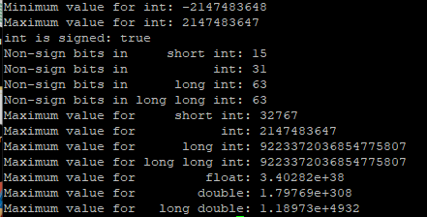
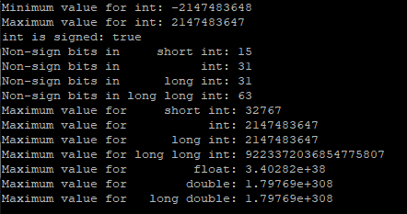
but standards …
Redhat linux
Pi linux

Slide 7
Why do I care?
I'm trying to store a 3 billion value in a long int.
sound code, different machines:
  Worked great on my linux machine.
  Overflowed on the Pi!
    Also my double value overflowed as well.

Slide 8
Last side note
What is the alphabetical order for an apostrophe (')
  vs the ASCII standard for an apostrophe?
  Some ignore it, some say after. it's vs its alphabetical ordering?
  in ASCII, the apostrophe comes before the numbers.
    making it smaller then 0 when comparing strings!
    ' is 44, 0 is 48, A is 65, and finally a is 97
    As long as your are consistent, it shouldn't matter. But sorting could be an issue.
http://www.asciitable.com/

Slide 9
Q
A
&

