Slide 1
cosc 2150
Subroutines in ARC
Notes:
1

Slide 2
Assembly code
There are two instructions used for subroutine calls
call label
  This will change the PC to where the label’s address and put the current address into %r15
jmpl %rX+4, %rY
  will jump to the address %rX and put the current address in %rY
  Normally %rX is %r15, the +4 is because you would return the call instruction, instead of the next instruction.
Notes:
2

Slide 3
example
…. (instructions)
call sub_r ! call subroutine sub_r
sub %r2, 2,%r1
…. (more instructions)
halt
sub_r: addcc %r1, 2, %r2
jmpl %r15+4, %r0 !go back to sub instruction
Notes:
3

Slide 4
Code style
Subroutines are written so that you execute a piece of code and then return back.
  You can not branch out of a subroutine back to the "main" code.
  Your subroutines are not be "inside" the main code either.
    IE, you can not branch over a subroutine.
  Call places the return address in %r15. We MUST store this value into the stack so we have the value later.
    Because if the code makes another call, the register will be over written.
Notes:
4

Slide 5
The stack
The stack is not fully implemented in the simulator, so we need to do a few things
  The stack pointer's value when the simulator starts up is zero.
    We will need to change it
    At the top of the code, give the stack pointer a reasonable value
      Add %r0, 4092, %r14
    So the stack will start at memory location 4092
  When we place a value on the stack, we must decrement it by 4 as well.

Slide 6
Example 1
int a =2;
main () {
a = a +3;
sub_r();
}
void sub_r() {
a = a +1;
}
.begin
.org 2048
main: add %r0, 4092, %r14
ld [a],%r1
add %r1,3, %r1
st %r1, [a]
call sub_r !call sub sub_r
halt
! subroutine sub_r
sub_r: st %r15, %r14+0 !st return addr
sub %r14, 4, %r14 !dec sp pointer
ld [a],%r1
add %r1,1,%r1
st %r1, [a]
add %r14, 4, %r14 !incr sp pointer
ld %r14+0, %r15 !ld the return addr
jmpl %r15+4,%r0
a:2
.end
Notes:
6

Slide 7
Example 2
int a=2;
main () {
sub1();
sub2();
sub1();
}
sub1 () {
a = a +1;
sub2();
}
sub2 () {
a = a +2;
}
.begin
.org 2048
main: add %r0, 4092, %r14
ld [a], %r1 !load A into %r1
call sub1 !call sub sub1
call sub2 !call sub sub2
call sub1 !call sub sub1
halt
sub1: st %r15, %r14+0 !st rtrn addr
subcc %r14, 4, %r14 !dec sp ptr
add %r1, 1, %r1
st %r1, [a]
call sub2
add %r14, 4, %r14 !incr sp ptr
ld %r14+0, %r15 !ld rtrn addr
jmpl %r15+4, %r0
sub2: st %r15, %r14+0 !st rtrn addr
sub %r14, 4, %r14 !dec sp ptr
add %r1, 2, %r1
st %r1, [a]
add %r14, 4, %r14 !incr sp prt
ld %r14+0, %r15 !ld rtrn addr
jmpl %r15+4, %r0
a: 2
.end
Notes:
7

Slide 8
Example 3
int a=1, b =2;
main () {
a = a + b;
sub1();
b = b + a;
}
sub1 () {
a = b –1;
b = a + 2;
}
.begin
.org 2048
main: add %r0, 4092, %r14 !sp value
ld [a], %r1
ld [b], %r2
add %r1,%r2, %r1
st %r1, [a]
call sub1 !call subroutine sub1
add %r1, %r2, %r2
st %r2, [b]
halt
! subroutine sub1
sub1: st %r15, %r14+0 !st rtrn addr
sub %r14, 4, %r14 !dec sp ptr
sub %r2,1,%r1
st %r1, [a]
add %r1, 2, %r2
st %r2, [b]
add %r14, 4, %r14 !incr sp ptr
ld %r14+0, %r15 !ld rtrn addr
jmpl %r15+4,%r0
a: 1
b: 2
.end
Notes:
8

Slide 9
Example 4
.begin
.org 2048
main: add %r0, 4092, %r14
ld [i], %r1
top: subcc %r1, 3, %r0 ! i<3
bpos done
!if (i>0)
subcc %r1, 1, %r0
bneg else
call sub1
ba incr
else: sll %r1, 2, %r2 !a[i] = i -1;
addcc %r1, 1, %r3
st %r3, %r2+a
incr: add %r1, 1, %r1 !i++
st %r1, [i]
ba top
done: halt
sub1: st %r15, %r14+0
sub %r14, 4, %r14
sll %r1, 2, %r2 !a[i] = i +1;
subcc %r1, 1, %r3
st %r3, %r2+a
add %r14, 4, %r14
ld %r14+0, %r15
jmpl %r15+4, %r0
i:0
a:0
0
0
.end
int a[3], i=0;
main() {
for (i; i<3; i++) {
if (i >0) {
sub1();
} else {
a[i] = i + 1;
}
}
sub1 () {
a[i] = i - 1;
}
Notes:
9

Slide 10
Recursion
Is recursion possible in ARC code?
  Yes
  We store return address on the stack, then move the stack pointer, so the next time we call that code, it works.
  We have not spent any time on return values or parameters, so first we'll look at how the stack works
Notes:
10

Slide 11
How the Stack works

Slide 12
The Stack
The stack holds the all the data for the program
  Code and data kept separate so that the we can easily reuse the code
  When the program is called or a subroutine is called, a new stack frame is created to hold the data.
    Local variables, parameters to, and the return pointer.

Slide 13
The Heap
The heap, which is not to be confused with the stack, is memory to dynamically allocate memory
  A new operation allocates memory from the heap

Slide 14
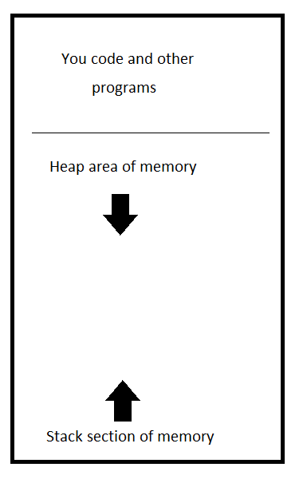
Representation of memory
Classic representation
  Program code at the top of memory
  Heap section of memory after the programs
    Goes down as more memory is needed for new operations
  Stack section of memory
    Grows up from the bottom of memory
Most modern OSs, reverse the stack and heap, so that heap grows up and the stack grows down.

Slide 15
Representation of memory
A note
  The lecture is covering the stack similar to the c/c++ model
  Take cosc 4785 compiler construction or Cosc 4740 Operating Systems
    To learn how to do this 100% correctly

Slide 16
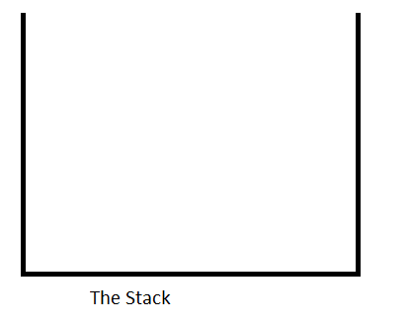
Example
main() {
int a = 1;
int b = 2;
sub(a);
sub(b);
}
void sub( int p) {
int q;
q = p +2;
}
Stack pointer

Slide 17
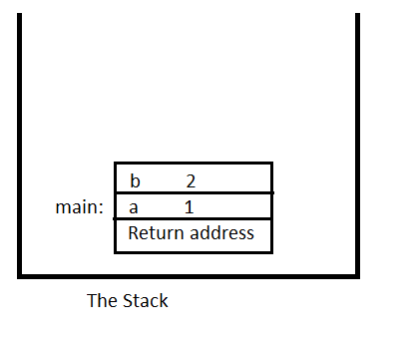
Example
main() {
int a = 1;
int b = 2;
sub(a);
sub(b);
}
void sub( int p) {
int q;
q = p +2;
}
Stack pointer

Slide 18
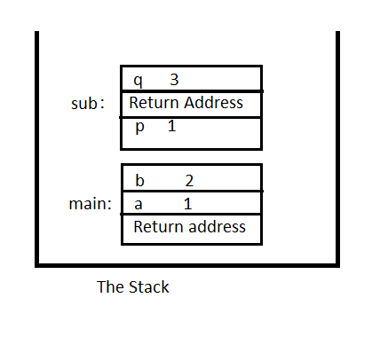
Example
main() {
int a = 1;
int b = 2;
sub(a);
sub(b);
}
void sub( int p) {
int q;
q = p +2;
}
Stack pointer

Slide 19
Example
main() {
int a = 1;
int b = 2;
sub(a);
sub(b);
}
void sub( int p) {
int q;
q = p +2;
}
Stack pointer

Slide 20
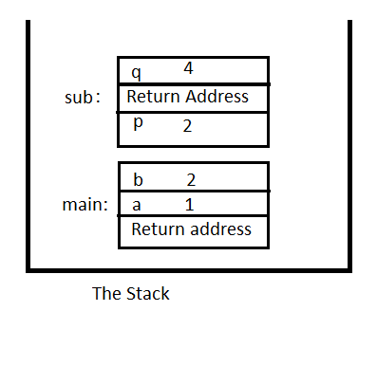
Example
main() {
int a = 1;
int b = 2;
sub(a);
sub(b);
}
void sub( int p) {
int q;
q = p +2;
}
Stack pointer

Slide 21
Example
main() {
int a = 1;
int b = 2;
sub(a);
sub(b);
}
void sub( int p) {
int q;
q = p +2;
}
Stack pointer

Slide 22
Example
main() {
int a = 1;
int b = 2;
sub(a);
sub(b);
}
void sub( int p) {
int q;
q = p +2;
}
Stack pointer

Slide 23
Example Code in ARC
.begin
.org 2048
main: add %r0, 4092, %r14 ! stack pointer
! create stack for main
! %r14+8 return address
! %r14+4 is variable a
! %r14+0 is variable b
sub %r14, 8, %r14 ! move stack pointer
add %r0, 1, %r1 ! a variable
add %r0, 2, %r2 ! b variable
st %r0, %r14+8 !bogus return address
st %r1, %r14+4 !put a on the stack
st %r2, %r14+0 !put b on the stack
! prep to call sub1, put a on stack
! move stack pointer for the parameter
sub %r14, 4, %r14
st %r1, %r14+0
call sub1
! return from sub y and restore stack pointer
! back to correct spot
add %r14, 4, %r14
! prep to call y, put b on stack
! move stack pointer for the parameter
sub %r14, 4, %r14
st %r2, %r14+0
call sub1
! return from sub y and restore stack pointer
add %r14, 4, %r14
! restore stack pointer and ready to return from main…
! except we won't
halt

Slide 24
Example Code in ARC (2)
! subroutine sub1
! move stack pointer, store return address and create q variable
sub1: sub %r14, 8, %r14 !remember stacked moved by main for parameter already
! %r14+8 is p parameter
! %r14+4 is return address
! %r14+0 is variable q
st %r15, %r14 + 4 !store return address
add %r0, 0, %r4 ! variable q
st %r4, %r14+0 ! store q on the stack
! q = p +2
ld %r14+8, %r5 !load p into register 5
add %r5, 2, %r4 ! q = p +2
st %r4, %r14+0 !store q
!now return and change stack pointer
ld %r14+4, %r15 !reload %r15 to correct pointer
add %r14, 8, %r14
jmpl %r15 +4, %r0
.end

Slide 25
Call by Reference, Call by Value
The previous example, all the parameters were call by value.
With call by reference, the address of the variable is placed on the stack, instead of the value.

Slide 26
Example Call by Reference
main() {
int a = 1;
int b = 2;
sub(&a);
}
void sub( int *p) {
*p = *p +2;
}
Stack pointer

Slide 27
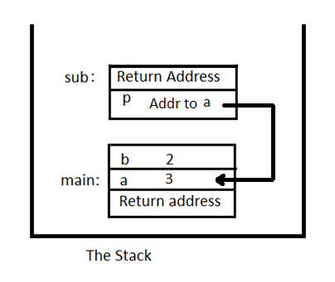
Example Call by Reference
main() {
int a = 1;
int b = 2;
sub(&a);
}
void sub( int *p) {
*p = *p +2;
}
Stack pointer

Slide 28
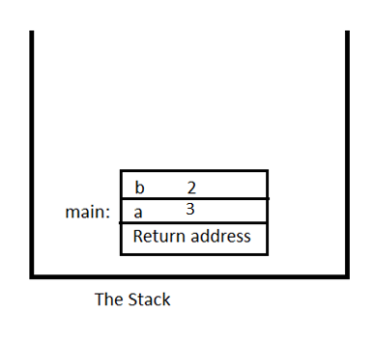
Example Call by Reference
main() {
int a = 1;
int b = 2;
sub(&a);
}
void sub( int *p) {
*p = *p +2;
}
Stack pointer

Slide 29
ARC Example, call by reference
.begin
.org 2048
main: add %r0, 4092, %r14 ! stack pointer
! create stack for main
! %r14+8 return address
! %r14+4 is variable a
! %r14+0 is variable b
sub %r14, 8, %r14 ! move stack pointer
add %r0, 1, %r1 ! a variable
add %r0, 2, %r2 ! b variable
st %r0, %r14+8 !bogus return address
st %r1, %r14+4 !put a on the stack
st %r2, %r14+0 !put b on the stack
! prep to call y, put pointer to a on stack
! move stack pointer for the parameter
add %r14, 4, %r10 ! pointer for a
sub %r14, 4, %r14
st %r10, %r14+0
call sub1
! return from sub y and restore stack pointer
! back to correct spot
add %r14, 4, %r14
halt
! subroutine sub1
! move stack pointer, store return address and create q variable
! %r14+4 is p parameter pointer
! %r14+0 is return address
sub1: sub %r14, 4, %r14 !remember stack moved by main for parameter already
st %r15, %r14 + 0 !store return address
! *p = *p +2
ld %r14 +4, %r20 !load pointer to p
ld %r20+0, %r5 !load p into register 5
add %r5, 2, %r5 ! q = p +2
st %r5, %r20+0 !store p
!now return and change stack pointer
ld %r14+0, %r15 !reload %r15 to correct pointer
add %r14, 4, %r14
jmpl %r15 +4, %r0
.end

Slide 30
Return values
Return values work like parameters. The "code" calling subroutine allocates the space needed on the stack
  The subroutine then places the value or pointer into the return value location so it can be used by the subroutine that this subroutine was called by.
  This can get complex when doing operations like
    x = sub(a) / (sub(a-1) *2) !because maybe need to use "temp" variables to deal with math precedence operators

Slide 31
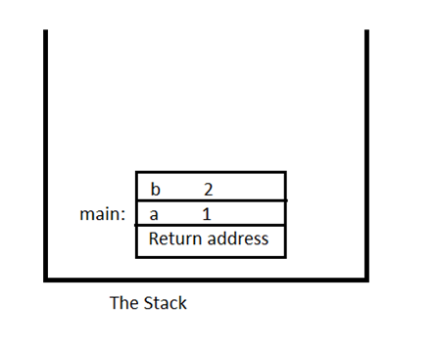
Example Return values
main() {
int a = 1;
int b = 2;
b = sub(a);
b = sub(b);
}
int sub( int p) {
return p +2;
}
Stack pointer

Slide 32
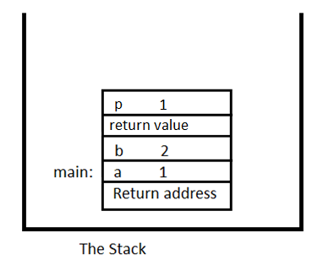
Example Return values
main() {
int a = 1;
int b = 2;
b = sub(a);
b = sub(b);
}
int sub( int p) {
return p +2;
}
Stack pointer

Slide 33
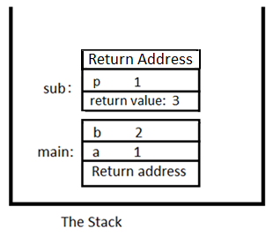
Example Return values
main() {
int a = 1;
int b = 2;
b = sub(a);
b = sub(b);
}
int sub( int p) {
return p +2;
}
Stack pointer

Slide 34
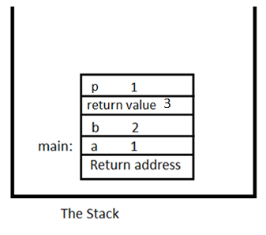
Example Return values
main() {
int a = 1;
int b = 2;
b = sub(a);
b = sub(b);
}
int sub( int p) {
return p +2;
}
Stack pointer

Slide 35
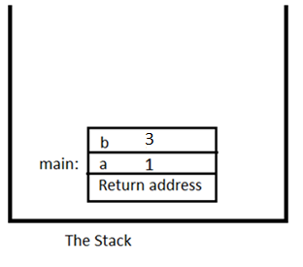
Example Return values
main() {
int a = 1;
int b = 2;
b = sub(a);
b = sub(b);
}
int sub( int p) {
return p +2;
}
Stack pointer

Slide 36
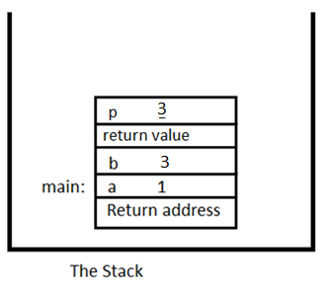
Example Return values
main() {
int a = 1;
int b = 2;
b = sub(a);
b = sub(b);
}
int sub( int p) {
return p +2;
}
Stack pointer

Slide 37
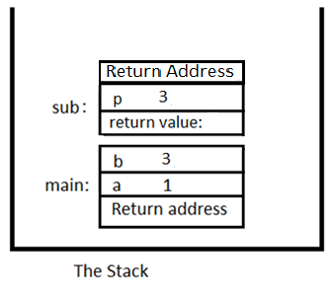
Example Return values
main() {
int a = 1;
int b = 2;
b = sub(a);
b = sub(b);
}
int sub( int p) {
return p +2;
}
Stack pointer

Slide 38
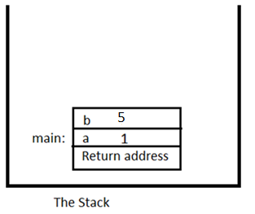
Example Return values
main() {
int a = 1;
int b = 2;
b = sub(a);
b = sub(b);
}
int sub( int p) {
return p +2;
}
Stack pointer

Slide 39
ARC Example Return Values
.begin
.org 2048
main: add %r0, 4092, %r14 ! stack pointer
! create stack for main
! %r14+8 return address
! %r14+4 is variable a
! %r14+0 is variable b
sub %r14, 8, %r14 ! move stack pointer
add %r0, 1, %r1 ! a variable
add %r0, 2, %r2 ! b variable
st %r0, %r14+8 !bogus return address
st %r1, %r14+4 !put a on the stack
st %r2, %r14+0 !put b on the stack
! prep to call sub1, put a on stack
! move stack pointer for the parameter and return value
sub %r14, 8, %r14
st %r1, %r14+0 !put p on stack
call sub1
! return from sub sub1 put return value in b
ld %r14+4, %r2
!and restore stack pointer back to correct spot
add %r14, 8, %r14
! store b back on the stack
st %r2, %r14+0
! prep to call sub1, put b on stack
! move stack pointer for the parameter and return value
sub %r14, 8, %r14
st %r2, %r14+0
call sub1
! return from sub sub1 put return value in b
ld %r14+4, %r2
!and restore stack pointer back to correct spot
add %r14, 8, %r14
! st b back on the stack
st %r2, %r14+0
halt

Slide 40
ARC Example Return Values (2)
! subroutine sub1
! move stack pointer, store return address and create q variable
! %r14+8 is return value
! %r14+4 is the p parameter
! %r14+0 is return address
sub1: sub %r14, 4, %r14 !remeber moved by main already
st %r15, %r14 + 0 !store return address
! return = p +2
ld %r14+4, %r5 !load p into register 5
add %r5, 2, %r5 ! p +2
st %r5, %r14+8 !store in return value spot
!now return and change stack pointer
ld %r14+0, %r15 !reload %r15 to correct pointer
add %r14, 4, %r14
jmpl %r15 +4, %r0
.end

Slide 41
Finally The Fibonacci example
main() {
int x=0;
x = fib(5);
}
int fib(int f) {
if (f ==1) {
return 1;
} else if (f ==2) {
return 1;
} else {
return fib(f-1) + fib(f-2);
}
.begin
.org 2048
main: add %r0, 4092, %r14 ! stack pointer
! create stack for main
! %r14+4 return address
! %r14+0 is variable x
sub %r14, 8, %r14 ! move stack pointer for variable x and return address
st %r0, %r14+4 !bogus return address
st %r0, %r14+0 !put x on the stack
! prep to call fib, put a on stack
! move stack pointer for the parameter and return value
sub %r14, 8, %r14
add %r0,5, %r1 !parameter 5
st %r1, %r14+0 !put parameter on stack
call fib
! return from fib(5) put return value in x
ld %r14+4, %r1
!and restore stack pointer back to correct spot
add %r14, 8, %r14
! st x back on the stack
st %r1, %r14+0
add %r14,8,%r14 !put the stack back to where we found it.
halt

Slide 42
Finally The Fibonacci example (2)
! subroutine fib
! move stack pointer, store return address and create temp variable
! %r14+12 is return value
! %r14+8 is the f parameter
! %r14+4 is return address
! %r14+0 is a temp value needed return f() + f()
fib: sub %r14, 8, %r14 !remember moved by main already
st %r15, %r14 + 4 !store return address
!load f into a register 5 for use
ld %r14+8, %r5
! if (f ==1) {
subcc %r5, 1, %r0
bne elseif
! f==1, just return 1
add %r0, 1, %r6
st %r6, %r14+12
ba endsub
elseif: subcc %r5, 2, %r0
bne else
! f==2, just return 1
add %r0, 1, %r6
st %r6, %r14+12
ba endsub
!call fib(f-1)
! move stack pointer for the parameter and return value
else: sub %r14, 8, %r14
sub %r5,1, %r1 !parameter f-1
st %r1, %r14+0 !put parameter on stack
call fib
! return from fib(f-1) put return value in temp
ld %r14+4, %r6
!restore stack pointer
add %r14, 8, %r14
!Now store that value in the stack in "temp" spot
st %r6, %r14+0
!reload f, into register 5
ld %r14+8, %r5
!call fib(f-2)
! move stack pointer for the parameter and return value
sub %r14, 8, %r14
sub %r5,2, %r1 !parameter f-2
st %r1, %r14+0 !put parameter on stack
call fib

Slide 43
Finally The Fibonacci example (3)
! return from fib(f-2)put return value in register for addition.
ld %r14+4, %r6
!restore stack pointer
add %r14, 8, %r14
!Now get the "temp" add them, and return the return value
ld %r14+0, %r7 !load temp
add %r7, %r6, %r7 !fib(f-1) + fib(f-2)
st %r7, %r14+12
endsub: !now return and change stack pointer
ld %r14+4, %r15 !reload %r15 to correct pointer
add %r14, 8, %r14
jmpl %r15 +4, %r0
.end

Slide 44

Visual explanation of Fibonacci
Starting up and execute the following code.
.begin
.org 2048
main: add %r0, 4092, %r14 ! stack pointer
! create stack for main
! %r14+4 return address
! %r14+0 is variable x
sub %r14, 8, %r14 ! move stack pointer for variable x and return address
st %r0, %r14+4 !bogus return address
st %r0, %r14+0 !put x on the stack

Slide 45
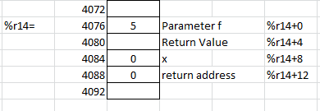
Visual explanation of Fibonacci
Setup to call Fib
! prep to call fib, put a on stack
! move stack pointer for the parameter and return value
sub %r14, 8, %r14
add %r0,5, %r1 !parameter 5
st %r1, %r14+0 !put parameter on stack
call fib

Slide 46
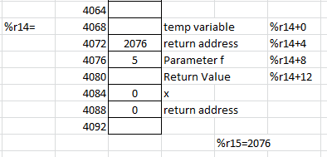
Setup at the start of the fib function.
! subroutine fib
! move stack pointer, store return address and create temp variable
! %r14+12 is return value
! %r14+8 is the f parameter
! %r14+4 is return address
! %r14+0 is a temp value needed return f() + f()
fib: sub %r14, 8, %r14 !remember moved by main already
st %r15, %r14 + 4 !store return address
!load f into a register 5 for use
ld %r14+8, %r5

Slide 47
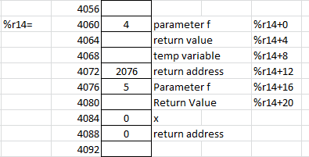
f not ==1 or 2, so call fib(f-1) again setup to call fib.
So moving down the code to
!call fib(f-1)
! move stack pointer for the parameter and return value
else: sub %r14, 8, %r14
sub %r5,1, %r1 !parameter f-1
st %r1, %r14+0 !put parameter on stack
call fib

Slide 48
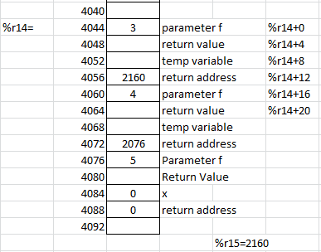
Setup when fib(4), f is still not 1 or 2, so call fib(f-1)
! subroutine fib
! move stack pointer, store return address and create temp variable
! %r14+12 is return value
! %r14+8 is the f parameter
! %r14+4 is return address
! %r14+0 is a temp value needed return f() + f()
fib: sub %r14, 8, %r14 !remember moved by main already
st %r15, %r14 + 4 !store return address
!load f into a register 5 for use
ld %r14+8, %r5
… ! Not f=1 or f=2
!call fib(f-1)
! move stack pointer for the parameter and return value
else: sub %r14, 8, %r14
sub %r5,1, %r1 !parameter f-1
st %r1, %r14+0 !put parameter on stack
call fib

Slide 49
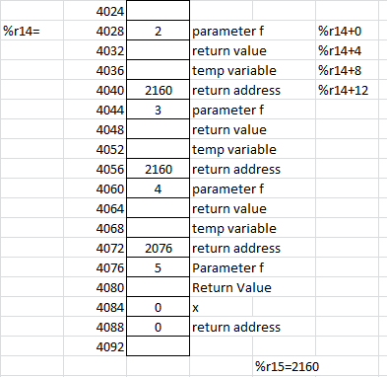
Setup when fib(3), f is still not 1 or 2, so call fib(f-1)
! subroutine fib
! move stack pointer, store return address and create temp variable
! %r14+12 is return value
! %r14+8 is the f parameter
! %r14+4 is return address
! %r14+0 is a temp value needed return f() + f()
fib: sub %r14, 8, %r14 !remember moved by main already
st %r15, %r14 + 4 !store return address
!load f into a register 5 for use
ld %r14+8, %r5
… ! Not f=1 or f=2
!call fib(f-1)
! move stack pointer for the parameter and return value
else: sub %r14, 8, %r14
sub %r5,1, %r1 !parameter f-1
st %r1, %r14+0 !put parameter on stack
call fib

Slide 50
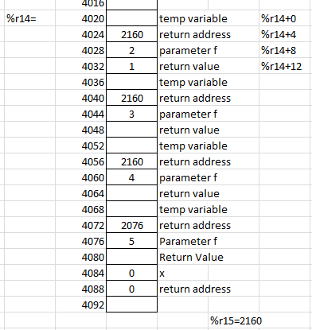
Setup when fib(2), f is 2, so store 1 in the return value.
! subroutine fib
! move stack pointer, store return address and create temp variable
! %r14+12 is return value
! %r14+8 is the f parameter
! %r14+4 is return address
! %r14+0 is a temp value needed return f() + f()
fib: sub %r14, 8, %r14 !remember moved by main already
st %r15, %r14 + 4 !store return address
!load f into a register 5 for use
ld %r14+8, %r5
bne elseif
! f==1, just return 1
add %r0, 1, %r6
st %r6, %r14+12
ba endsub
elseif: subcc %r5, 2, %r0
bne else
! f==2, just return 1
add %r0, 1, %r6
st %r6, %r14+12
ba endsub

Slide 51
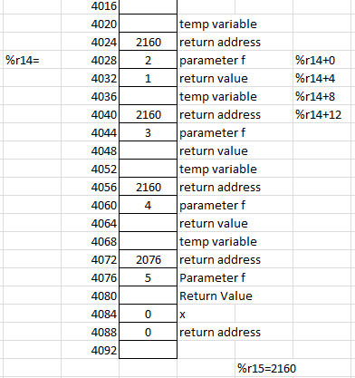
Finish the subroutine
endsub: !now return and change stack pointer
ld %r14+4, %r15 !reload %r15 to correct pointer
add %r14, 8, %r14
jmpl %r15 +4, %r0

Slide 52
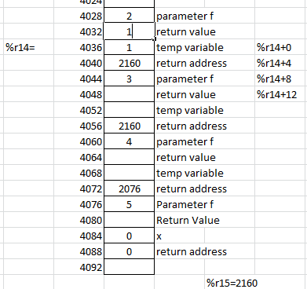
Back to F(3) with return value, store return value in temp.
! return from fib(f-1) put return value in temp
ld %r14+4, %r6
!restore stack pointer
add %r14, 8, %r14
!Now store that value in the stack in "temp" spot
st %r6, %r14+0
!Stop here for stack.
!reload f, into register 5
ld %r14+8, %r5
!call fib(f-2)
! move stack pointer for the parameter and return value
sub %r14, 8, %r14
sub %r5,2, %r1 !parameter f-2
st %r1, %r14+0 !put parameter on stack
call fib

Slide 53
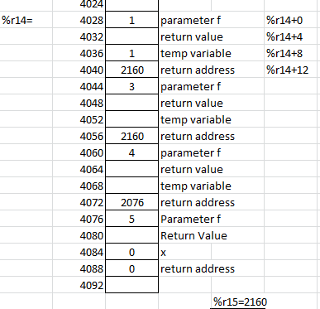
Now setup for the + fib(f-2)
! return from fib(f-1) put return value in temp
ld %r14+4, %r6
!restore stack pointer
add %r14, 8, %r14
!Now store that value in the stack in "temp" spot
st %r6, %r14+0
!reload f, into register 5
ld %r14+8, %r5
!call fib(f-2)
! move stack pointer for the parameter and return value
sub %r14, 8, %r14
sub %r5,2, %r1 !parameter f-2
st %r1, %r14+0 !put parameter on stack
call fib

Slide 54
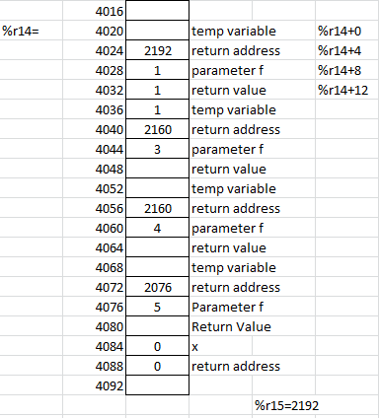
Setup when fib(1), f is 1, so store 1 in the return value.
! subroutine fib
! move stack pointer, store return address and create temp variable
! %r14+12 is return value
! %r14+8 is the f parameter
! %r14+4 is return address
! %r14+0 is a temp value needed return f() + f()
fib: sub %r14, 8, %r14 !remember moved by main already
st %r15, %r14 + 4 !store return address
!load f into a register 5 for use
ld %r14+8, %r5
bne elseif
! f==1, just return 1
add %r0, 1, %r6
st %r6, %r14+12
ba endsub
elseif: subcc %r5, 2, %r0
bne else
! f==2, just return 1
add %r0, 1, %r6
st %r6, %r14+12
ba endsub

Slide 55
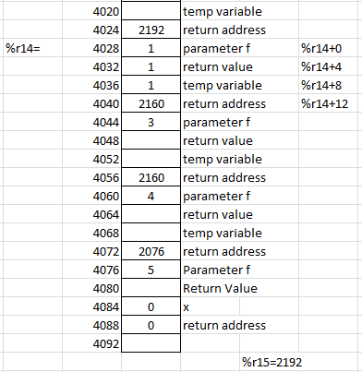
Finish the subroutine
endsub: !now return and change stack pointer
ld %r14+4, %r15 !reload %r15 to correct pointer
add %r14, 8, %r14
jmpl %r15 +4, %r0

Slide 56
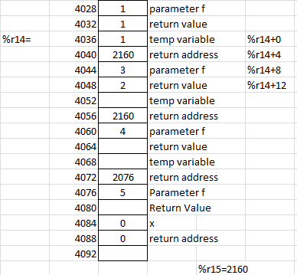
Back to fib(3) with return value of fib(F-1), store return value in temp.
! return from fib(f-2)put return value in register for addition.
ld %r14+4, %r6
!restore stack pointer
add %r14, 8, %r14
!Now get the "temp" add them, and return the return value
ld %r14+0, %r7 !load temp
add %r7, %r6, %r7 !fib(f-1) + fib(f-2)
st %r7, %r14+12
endsub: !now return and change stack pointer
ld %r14+4, %r15 !reload %r15 to correct pointer
add %r14, 8, %r14
jmpl %r15 +4, %r0

Slide 57
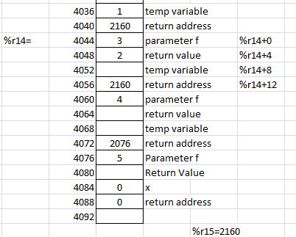
And finish fib(3) and return back to fib(4)
! return from fib(f-2)put return value in register for addition.
ld %r14+4, %r6
!restore stack pointer
add %r14, 8, %r14
!Now get the "temp" add them, and return the return value
ld %r14+0, %r7 !load temp
add %r7, %r6, %r7 !fib(f-1) + fib(f-2)
st %r7, %r14+12
endsub: !now return and change stack pointer
ld %r14+4, %r15 !reload %r15 to correct pointer
add %r14, 8, %r14
jmpl %r15 +4, %r0

Slide 58
And then in f(4), with start up +fib(f-2)
  Which is fib(2), which falls back and finishes fib(4)
And falls back to fib(5)
  When then call +fib(f-2) which is fib(3)
    That then calls fib(2) + fib(1)

Slide 59
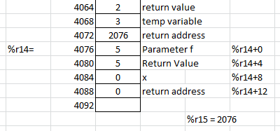
And return to main.
call fib
!at this point the stack looks like
! return from fib(5) put return value in x
ld %r14+4, %r1
!and restore stack pointer back to correct spot
add %r14, 8, %r14
! st x back on the stack
st %r1, %r14+0
halt

Slide 60
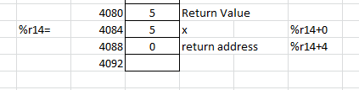
And at the finally store.
call fib
! return from fib(5) put return value in x
ld %r14+4, %r1
!and restore stack pointer back to correct spot
add %r14, 8, %r14
! st x back on the stack
st %r1, %r14+0
add %r14, 8, %r14
halt

Slide 61
Questions?
Make sure you understand the examples
You will be expected to do something similar in the homework.

Slide 62
Q
A
&

