Slide 1
Cosc 5/4735
AdMob for Android

Slide 2
Make money with apps
AdMob
  Google’s AdMob is cross platform
    Android, iOS, unity, Cocos2d-x game engines, and generic OpenGL based Android games too.
  Includes analytics to show how users are clicking and on how users are using your app as well.
  https://admob.google.com/home/
Firebase console has the AdMob as well, it will help you setup an account as well.

Slide 3
Ad format
Banner ads appear at the top or bottom of your app screen and can prompt users to install apps, visit websites, get directions, view products or call a phone number.
  Our in-app engagement ads expand to full screen when the banner is tapped. Our smart banners automatically resize to fit different screen sizes as the user rotates their device.
AdMob interstitials are full-page ads that appear in your app at natural breaks or transition points.
  A common use case is after a level is completed in a game. Our advertisers use interstitials to create engaging brand experiences, or direct action, such as driving app downloads.
AdMob’s video ads bring rich brand experiences to your app, and the flexible nature of the format allows users to skip the video after 5 seconds.
Source: https://www.google.com/admob/monetize.html?subid=ww-en-googdev-admob&utm_source=internal&utm_medium=et&utm_term=productssubpage&utm_content=monetize&utm_campaign=googledevproductsadmob

Slide 4
AdMob develop notes
It is against AdMob policy to click on your own live ads. During development and testing, use test ads. If you do need to render live ads before launch, avoid clicking on them.
If you click on live ads, your AdMob account may be suspended.
You can use Test Ads by telling AdMob you are using a test device.
  https://developer.android.com/reference/com/google/android/gms/ads/AdRequest.Builder.html#addTestDevice(java.lang.String)

Slide 5
Sign up for an account
Sign up for an account (need a gmail account) and select information.
  https://support.google.com/admob/answer/3052638
  You can choose a different ID for each activity.
  Example id will look like this:
    ca-app-pub-3940256099942544/6300978111
  Add that to the strings.xml as something like
    <string name="banner_ad_unit_id">ca-app-pub-3940256099942544/6300978111</string>

Slide 6
Adding to your app
In build.gradle
  Add this to the dependencies
  implementation 'com.google.android.gms:play-services-ads:20.4.0'
    or newer current version
In the AndroidManifest.xml, in the application section you need to add
  <manifest>
  <application>
  <!-- Sample AdMob App ID: ca-app-pub-3940256099942544~3347511713 -->
  <meta-data
  android:name="com.google.android.gms.ads.APPLICATION_ID"
  android:value="[ADMOB_APP_ID]"/>

Slide 7
Adding to your app (2)
Layout file
    Assuming a relative layout here
  <com.google.android.gms.ads.AdView
  android:id="@+id/adView"
  android:layout_width="wrap_content"
  android:layout_height="wrap_content"
  android:layout_centerHorizontal="true"
  android:layout_alignParentBottom="true"
  ads:adSize="BANNER"
  ads:adUnitId="@string/banner_ad_unit_id">
  </com.google.android.gms.ads.AdView>
  Add the following to top level:
  xmlns:ads="http://schemas.android.com/apk/res-auto"

Slide 8
Adding to your app (3)
Activity:
  First initialize admob, then setup your ad, based on which ones you want to use.
  In the onCreate:
    MobileAds.initialize(this, new OnInitializationCompleteListener() { //19.7.0+ version.
  @Override
  public void onInitializationComplete(InitializationStatus initializationStatus) {
  Log.wtf(TAG, "Initialization is completed.");
  }
  });
  AdView mAdView = (AdView) findViewById(R.id.adView);
  AdRequest adRequest = new AdRequest.Builder().build();
  mAdView.loadAd(adRequest);

Slide 9
Adding to your app (4)
Remember, don’t click on live ads! We need test ads for development
Run the app. Look in the logging for something like this lines:
  I/Ads: Starting ad request.
  I/Ads: Use AdRequest.Builder.addTestDevice("BA1CEB4E1E91135B32F3D0E23E8F6246") to get test ads on this device.
    Add that line to your code, to produce test ads for this device.
    Note, you need this for every device (ie phone/tablet/wear?).

Slide 10
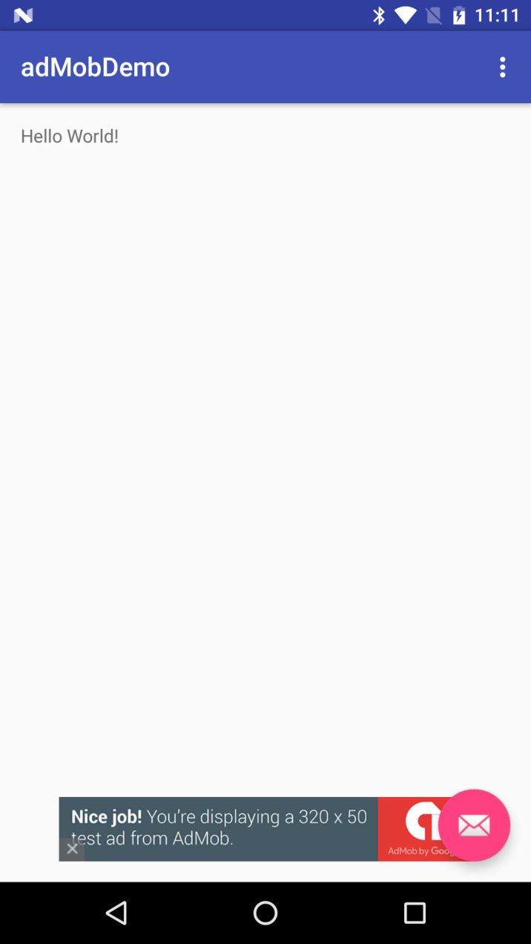
Adding to your app (5)
The result should look something like this

Slide 11
Demo code
You can get their demo code from
  https://developers.google.com/admob/android/quick-start#see_the_finished_example_on_github
  It has a lot more examples and you can run it without your own ids.
    This lecture is using one of their IDs.

Slide 12
References
https://developers.google.com/admob/
https://www.google.com/admob/platform.html
Developers guide:
  https://developers.google.com/admob/android/quick-start
  https://developers.google.com/android/reference/com/google/android/gms/ads/package-summary

Slide 13
Q
A
&

