Slide 1
Cosc 5/4730
Architecture components
Navigation

Slide 2
Navigation components
Jetpack's Architecture Components make it easy to implement in-app navigation by providing a set of Navigation components that handle most of the details for you.
With Navigation, you create a navigation graph, which is an XML resource that represents the individual destination nodes within your app along with the actions that connect the nodes.
  Reference: https://developer.android.com/topic/libraries/architecture/navigation/navigation-implementing
  This lecture is using the ArchNavigationDemo in the ui/Advanced repo

Slide 3
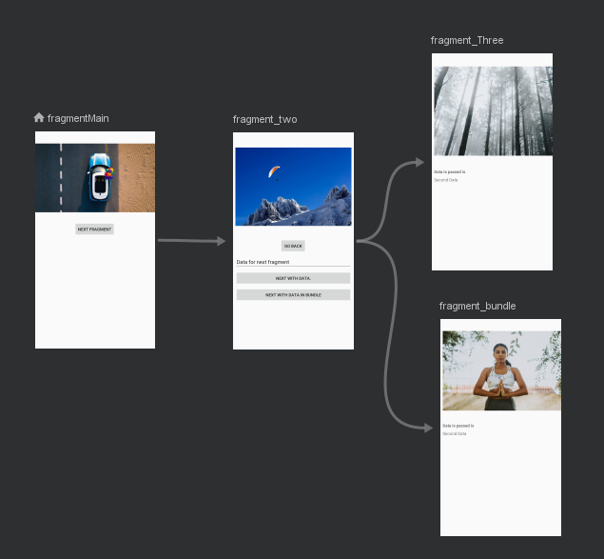
Navigation components (example)
Creating a series of fragments, you can connect them together (in an activity) and have the navigation do most of the work (mostly) for you.
You can even pass data.
Note, you can use multiple activities and fragments.
  This example just uses fragments and one activity.

Slide 4
Setup the project.
Build.gradle (module)
  dependencies {
  …
  implementation "androidx.navigation:navigation-fragment:2.5.0"
  implementation "androidx.navigation:navigation-ui:2.5.0"
  }
Build.gradle (project) for safe-args
  classpath "android.arch.navigation:navigation-safe-args-gradle-plugin:2.5.0"
  And
    apply plugin: "androidx.navigation.safeargs"
      wherever the other apply plugin is

Slide 5
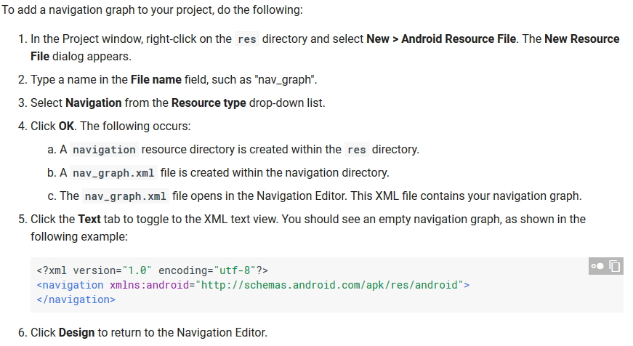
Create the navigation graph

Slide 6
Continue to make the graphs.
Let's use google's documentation here.
  https://developer.android.com/topic/libraries/architecture/navigation/navigation-implementing

Slide 7
Main Activity layout.
Once the navigation graph resource has been created, we now change the activity layout to a NavHostFragment.
  Drag one from the palette Containers.
  Have it fill the screen.
  Change the navGraph to match your nav graph name.

Slide 8
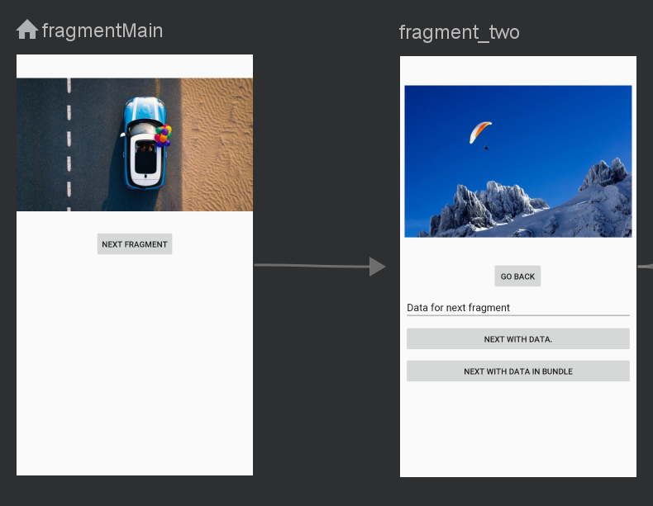
A simple transition.
When the user click the next fragment button in fragmentMain we want it to go the fragment_two.

Slide 9
A simple transition (2)
With navigation, in the fragmentMain, we setup this single line of code
btn.setOnClickListener(Navigation.createNavigateOnClickListener( R.id.action_fragmentMain_to_fragment_two, null));
  Where action… the name of the action (the arrow actually).
The "standard" way would use a listener in the fragment, that calls the activity, that then does the fragment transition.

Slide 10
A simple transition (3)
In fragment_two, two things are setup.
  The back button, will return to fragmentMain
  Navigation.findNavController(view).navigateUp();
    Assumes a button for the view. navigateUp() will also go back to fragmentMain.

Slide 11
With safetype parameters (google rec way)
Note, you should really be using a viewmodel to hold the data, so the only thing you are passing it a reference to the model. BUT…
Passing parameters. First in the nav_graph.xml file.
  You need to setup the parameters names, argType, and default values for each parameter to the receiving fragment and in the action to that fragment.
fragment_three has this: and action_fragment_two_to_fragment_Three has them listed too.
<fragment
android:id="@+id/fragment_Three android:name="edu.cs4730.archnavigationdemo.Fragment_Three"
android:label="fragment__three"
tools:layout="@layout/fragment__three">
<argument android:name="Message" android:defaultValue="Default value" app:argType="string" />
<argument android:name="Number" android:defaultValue="2" app:argType="integer" />
</fragment>
These names become very important and get used in the java code

Slide 12
On the sending side (Fragment_two)
The action, which have the name of the fragment appended with "Directions". And the setters are appended with the parameter names
The code will look like this:
Fragment_twoDirections.ActionFragmentTwoToFragmentThree action
= new Fragment_twoDirections.ActionFragmentTwoToFragmentThree();
action.setMessage(et.getText().toString());
action.setNumber(3012);
Navigation.findNavController(view).navigate(action);

Slide 13
Receiving side (Fragment_Three)
A little simpler looking
  This time Args is appended to the fragment name. And we use the get appended with the name.
  This is done in the OnCreateView.
Fragment_ThreeArgs.fromBundle(getArguments()).getMessage();
Fragment_ThreeArgs.fromBundle(getArguments()).getNumber();
Yes… it really is "Google Magic". And a minor syntax errors, causes dozens of compiler errors.

Slide 14
Simpler way, but not the "recommended way"
Use a bundle. (just we normally do when passing between activities)
  No changes are needed to the nav_graphic.xml!
in Fragment_two using the action to call Fragment_bundle
  Bundle bundle = new Bundle();
  bundle.putString("message", et.getText().toString());
  bundle.putInt("number", 3012);
  Navigation.findNavController(view).navigate(R.id.action_two_to_bundle, bundle);
And in receiving side to Fragment_bundle
  getArguments().getString("message", "no data");
  getArguments().getInt("number", 1);

Slide 15
References
https://developer.android.com/topic/libraries/architecture/navigation/navigation-pass-data#Safe-args
https://developer.android.com/topic/libraries/architecture/adding-components search for safe-args to find the right version number.
https://developer.android.com/guide/topics/resources/animation-resource for animation
https://developer.android.com/topic/libraries/architecture/navigation/navigation-implementing google current howto.
https://medium.com/deemaze-software/android-jetpack-navigation-architecture-component-b603c9a8100c a good, but slightly out of date howto.

Slide 16
Q
A
&

