Slide 1
Cosc 5/4730
Architecture:
Room Persistence library (sqlite replacement) with livedata and modelview
plus content providers, recyclerview

Slide 2
Adding to dependencies
In the Dependencies section of the build
ViewModel and LiveData
implementation "androidx.lifecycle:lifecycle-viewmodel:2.5.0"
implementation "androidx.lifecycle:lifecycle-livedata:2.5.0"
Room
implementation "androidx.room:room-runtime:2.4.2"
annotationProcessor "androidx.room:room-compiler:2.4.2"

Slide 3
Other dependencies
And since we are using recyclerview and cardview layouts plus design pieces you will need these too:
implementation 'com.google.android.material:material:1.6.1'
recyclerview and card view
implementation 'androidx.recyclerview:recyclerview:1.2.0'
implementation 'androidx.cardview:cardview:1.0.0'

Slide 4
ROOM

Slide 5
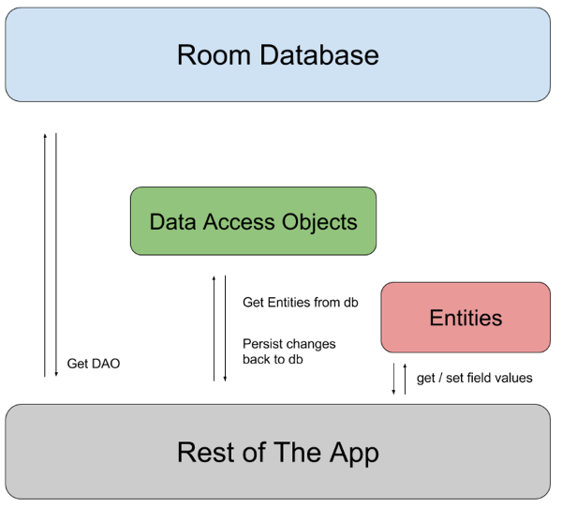
Room Persistence Library
The Room persistence library provides an abstraction layer over SQLite to allow fluent database access while harnessing the full power of SQLite.

Slide 6
Room
First there is a POJO that has entity markups
POJO is a Plain Old Java Object
We need to markup the class using the entity so it can be used by below.
Second is the Data Access interface
It has the methods and markups for say a data query
Third and finally the RoomData class itself.

Slide 7
First the POJO
public class Score {
public long id;
public String name;
public int score;
Get and setters
getID and setID
getName and setName
getScore and setScore
And a couple of constructors
// blank
public Score() {
}
constructor for the 2 data points.
public Score( String name, int score) {
this.name = name;
this.score = score;
}
}

Slide 8
Now add entity markup for the db.
example:
@Entity(tableName = Score.TABLE_NAME)
public class Score {
@PrimaryKey(autoGenerate = true)
@ColumnInfo(index = true, name = COLUMN_ID)
public long id;
@ColumnInfo(name = COLUMN_NAME)
public String name;
@ColumnInfo(name = COLUMN_SCORE)
public int score;
Added constants in the class
/** The name of the Score table. */
public static final String TABLE_NAME = "scores";
/** The name of the ID column. */
public static final String COLUMN_ID = BaseColumns._ID;
/** The name of the name column. */
public static final String COLUMN_NAME = "name";
/** The name of the score column. */
public static final String COLUMN_SCORE = "score";

Slide 9
Data Access Object
Create an interface class with the DAO and query, etc info.
Example:
@Dao
public interface ScoreDao {
//select everything from the table.
@Query("SELECT * FROM " + Score.TABLE_NAME)
List<Score> selectAll();
//select only those rows where the score matches.
@Query("select * from score where "Score. COLUMN_SCORE "= :scoreValue")
List<Score> loadScore(int scoreValue);
//insert a new row
@Insert
long insert(Score scoreData);
//insert many replaces, if conflicts, just replace them
@Insert(onConflict = OnConflictStrategy.REPLACE)
void insertAll(List<Score> scores);

Slide 10
RoomDatabase class
In the simplest version it would look like this:
@Database(entities = {Score.class,}, version = 1, exportSchema = false)
public abstract class AppDatabase extends RoomDatabase {
public abstract ScoreDao ScoreDao();
}
Normally it has code for static database creation piece or it can be done in the "activity"

Slide 11
RoomDatabase class (2)
This can be static method in the database class or done in the "activity"
To open( or create) the database.
db = Room.databaseBuilder(getApplicationContext(),
AppDatabase.class, "database-name").build();
Note, since we need context, the ViewModel, will need an AndroidModelView if it opens the room Database.
my examples the mainactivity opens the database and then passes to the viewModel. likely

Slide 12
Using the Room Database.
First, Room requires a thread for queries and inserts.
Can not be done on the main UI thread.
Once we have the database, we then use the Data Access Object to access the database.
Query example would look like this:
Find query for all scores that are 3012.
List<Score> scores = db.ScoreDao().loadScore(3012);
Interrate though the list, with say, for (Score score : scores) {
And score.getId() to find the id value.
An insert of multiple enters would be
First generate a List<Score> scores = generateScores());
db.ScoreDoa().insertAll(scores);

Slide 13
ViewModel and room

Slide 14
Room, updates, and lifecycle aware.
Adding to the "gmagic", Room is aware of updates and the lifecycle.
So we can actually run the "query" in a AndroidViewModel
We need context, so AndroidViewModel
The db is opened and usd inside the ViewModel
The mainactivity adds observers to where they are needed
Now when the database changes, the UI can update "on it's own"

Slide 15
Example Android ViewModel.
public class ScoreListViewModel extends AndroidViewModel {
private final MediatorLiveData<List<Score>> mObservableScores;
private final AppDatabase ad;
public ScoreListViewModel(@NonNull Application application) {
super(application);
ad = AppDatabase.getInstance(application);
mObservableScores = new MediatorLiveData<>();
mObservableScores.setValue(null); //default to null until there is data
LiveData<List<Score>> scores = ad.ScoreDao().selectAll(); //actual query.
mObservableScores.addSource(scores, new android.arch.lifecycle.Observer<List<Score>>() {
@Override
public void onChanged(@Nullable List<Score> scoreEntities) { mObservableScores.setValue(scoreEntities);}
} );
}
public LiveData<List<Score>> getScores() { return mObservableScores; }
}

Slide 16
MainActivity (or other places)
All we need is ViewModel. This is likely in main activity or could be a fragment.
Remember the ViewModel is now the database class, so we have add, remove, etc methods in the viewmodel.
ScoreListViewModel scoreListViewModel = new ViewModelProvider(this).get(ScoreListViewModel.class);
Add an observer for when the data changes
scoreListViewModel.getScores().observe(this, new Observer<List<Score>>() {
@Override
public void onChanged(@Nullable List<Score> scores) {
//Now up date the UI with the new/changed data.
}
});
this is very likely the activity

Slide 17
Recyclerview and adapter.
So for a recyclerView, we need to tell it there is a new/changed dataset to display.
We can do this from the outside, but simpler to do it in the adapter for the recyclerview.
The only change is to the constructor and we use the observer!
It takes a ModelView, rowlayout, and the activity (needed for the observer only). Instead of the data itself.
public myAdapter(ScoreListViewModel scoreListViewModel, int rowLayout, AppCompatActivity activity) {
mViewModel = scoreListViewModel;
this.rowLayout = rowLayout;
mViewModel.getScores().observe(activity, new Observer<List<Score>>() {
@Override
public void onChanged(@Nullable List<Score> scores) {
myList = scores; //this where the actually data to be displayed comes from.
notifyDataSetChanged();
}
});
}
The rest of the adapter is unchanged from the previous "versions".

Slide 18
Room and a Content Provider

Slide 19
Content provider
We can change it to use a content provider pretty easily.
Change need to change the DAO, so it returns a cursor.
So this
//select everything from the table.
@Query("SELECT * FROM " + Score.TABLE_NAME)
List<Score> selectAll();
Becomes this
@Query("SELECT * FROM " + Score.TABLE_NAME)
Cursor selectAll();
Change and create the remaining pieces needed for a content provider

Slide 20
Content provider (2)
Then create the content provider class like normal, even the loaders work, just like before.
Except use the room db, instead of sql.
Example query code
ScoreDao score = AppDatabase.getInstance(context).ScoreDao();
Cursor c;
switch (uriMatcher.match(uri)) {
case SCORE:
c = score.selectAll();
break;
case SCORE_ID:
c = score.selectById(ContentUris.parseId(uri));
break;
default:
throw new IllegalArgumentException("Unknown URI " + uri);
}
//this line is added for the loaders. if we changed the database, this allows a notification to be set.
c.setNotificationUri(getContext().getContentResolver(), uri);
return c;

Slide 21
Content provider (3)
As note, the previous example didn't take into account all the selectionARGs.
A method would need be added that could serialize the selection args into a query and added the query.
Second note.
This content provider is also unstable.
Room DB can't be accessed on the main thread. So depending on where the user accesses the content provider, it may throw an exception.
Main thread it fails.
All others it works.
The content provider should likely access/inserts on a separate thread.

Slide 22
Demo code
All the demos use the same highscore database.
roomDemo
an example of use the room objects to create and access a database.
LiveDataRoomDemo
shows how to use the liveData object with the database to have the display updated when new data is added.
LiveDataRoomRecyclerDemo
shows a room database with livedata/modelview that auto updates a recyclerview (using an observer in the adapter) as the data changes.
ContentProviderRoomDemo
shows how to create a contentprovider using a room database.

Slide 23
References
https://developer.android.com/topic/libraries/architecture/index.html
https://developer.android.com/topic/libraries/architecture/livedata.html
https://developer.android.com/topic/libraries/architecture/viewmodel.html
https://developer.android.com/topic/libraries/architecture/room.html
Useful 4 part tutorial
https://android.jlelse.eu/android-architecture-components-room-introduction-4774dd72a1ae

Slide 24
Q
A
&

