Slide 1
Cosc 5/4730
Android Architecture Components
LiveData, ViewModel

Slide 2
Architecture Components
Lifecycle
  LiveData and ViewModel with LifecycleObservers and LifecyclerOwner
  ViewModel is where data can now be stored outside of the activity.
    and It can be referenced in the layout as well.
    You don't necessary need callbacks, because all the fragment in an activity will have access to the same ViewModel data.
  Combining LiveData with a ViewModel, we introduce the first of many "G Magic" actions
    The screen can be set to "auto" update when data is changed at in ViewModel in another fragment or even an activity.

Slide 3
LiveData and ViewModel

Slide 4
Adding to dependencies
In the Dependencies section of the build
just ViewModel
  implementation "androidx.lifecycle:lifecycle-viewmodel:2.8.4"
just LiveData
  implementation "androidx.lifecycle:lifecycle-livedata:2.8.4"
Normally you want to include both.

Slide 5
ViewModel (version 2.4+)
as a POJO

Slide 6
ViewModel
At its core, it just a the POJO (Plain Old Java Object)
  Example: ViewModelDemo
Public class DataViewModel extends ViewModel {
int count=0;
myObject stuff; //a java object you created.
private string myString; //a string.
Provide get and set methods for the data just like always.
}

Slide 7
ViewModel (2)
Declare the viewModel in the activity, fragment, etc to use them
DataViewModel mViewModel;
mViewModel = new ViewModelProvider(this).get(DataViewModel.class);
  Where this is the activity. Fragments use requireActivity()
  kotlin: val mViewModel = ViewModelProvider(this).get(DataViewModel::class.java)
    Note, the model DOES NOT need to be in java. Even in kotlin, uses the same class.java.
This ViewModel now exists in the activity, but it is separate.
  It can be accessed by activity and all it fragments very easily.
  We now have a shared "memory" space of variables.
    Now, we have a set of shared data per screen.
    There are ways to share between activities, but it's much more complex and needs a viewModelFactory.

Slide 8
ViewModel (3)
Now you use the ViewModel, just like any data object.
  learns into the MVC
The main difference it that every fragment and the activity will see the same data
  and the variable is local to the fragments and activity.

Slide 9
ViewModel (4)
Constructors and a weird problem.
  While we can have constructors if you use just a ViewModel
  When combined with a LiveData object and observers. The constructors can not be called.
  You will need to create a viewModelFactory that could need call the constructor.

Slide 10
Do not pass context into ViewModel
Never pass context into ViewModel instances
Do not store Activity, Fragment, or View instances or their Context in the ViewModel
An Activity can be destroyed and created many times during the lifecycle of a ViewModel
If you need application context, inherit from AndroidViewModel
  It's a modelView that has a constructor that gets application context
    and can call getApplicationContext().
  you can change any ViewModel to and AndroidViewModel.

Slide 11
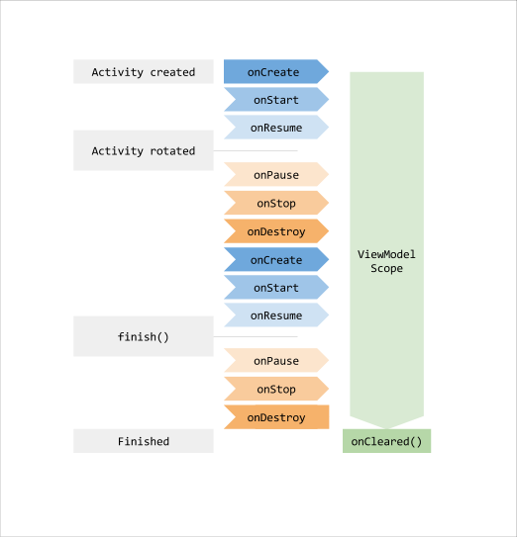
ViewModel does not survive app closure
ViewModel survives configuration changes, but not app shutdown
We will come back to saving data later on.
Notes:
In the practicals, you use ViewModel with Room. However, you can use ViewModel without Room; the goal of ViewModel is to provide data to the UI. If that data changes and the app quits, the changed data is lost if you don't save it somehow.

Slide 12
LiveData

Slide 13
LiveData
LiveData
  is lifecycle-aware, meaning it respects the lifecycle of other app components, such as activities, fragments, or services. This awareness ensures LiveData only updates app component observers that are in an active lifecycle state.
  easy to make sure the data is always update without worrying about lifecycle changes, including across activates, fragments, and services.
  Use with a ViewModel to setup java Object like you normally would.
  Uses a method, setValue
    Which will then trigger any observers to deal with new data.
Use the MutableLiveData<> object.

Slide 14
example
For a String
  MutableLiveData<String> myString
To change the data and trigger the observers
  myString.setValue("hi there");
To retrieve the value
  String temp = myString.getValue();
  It's required that you use the setValue and getValue. Otherwise the observers will not be triggered.

Slide 15
ViewModel and LiveData
Use liveData with the ViewModel to provide an easy way to add observers.
Public class DataViewModel extends ViewModel {
private MutableLiveData<dataObj> data; //POJO
private MutableLiveData<String> myString; //a string.
Provide get and set methods for the data
  they should use the getValue and setValue methods.
}

Slide 16
ViewModel and LiveData (2)
We also need to provide a method for the observers.
  it needs to return a LiveData<object> for each MutableLiveData.
example:
  public LiveData<String> getStr() { return myString; }
Since no constructors, this is a better solution:
public LiveData<dataObj> getData() {
if (data == null) {
data = new MutableLiveData<dataObj>();
data.setValue(new dataObj());
}
return data;
}

Slide 17
MainActivity/fragment and Observers
Delcare the viewModel in the activity, fragment, etc to use them
DataViewModel mViewModel;
mViewModel = new ViewModelProvider(this).get(DataViewModel.class);
  Where this could the activity, fragment in a fragment, change to requireActivity()
And declare the observer and action.
  mViewModel.getData().observe(this, new Observer<dataObj>() {
  @Override
  public void onChanged(@Nullable dataObj data) {
  tv_count.setText(data.getCount()); //where tv_count is a text view.
  }
  });
To change the data call the setter
  mViewModel.setCount(3); //for example, set count to 3.
  This will trigger the observer above to change the textView count as well.

Slide 18
ViewModel (3)
Since there is an instance of your ViewModel,
  Changing the example setcount to 3, could also update the activity and any fragments, plus services. If they are foreground, otherwise they will be notified when they become active again.
  This assumes they have declared observers in each as well.
  Any new fragments/services would also get the data as they start.
Example: liveDataDemo

Slide 19
Q
A
&

