Slide 1
Cosc 5/4730
Multimedia Part 1:
Audio media

Slide 2
Playing Audio
Android android.media

Slide 3
Playing audio
android.media can be very simple or really complex
Get a MediaPlayer
use the MediaPlayer class, with the create() method to get a "player".
  States: prepare() → start()
    You can pause(), then start() without calling prepare()
      Also seekTo() without needed prepare() again.
    with stop() and reset(), then you must prepare() again
    See next slide for states and where to go…
  supported media formats http://developer.android.com/intl/zh-CN/guide/appendix/media-formats.html

Slide 4
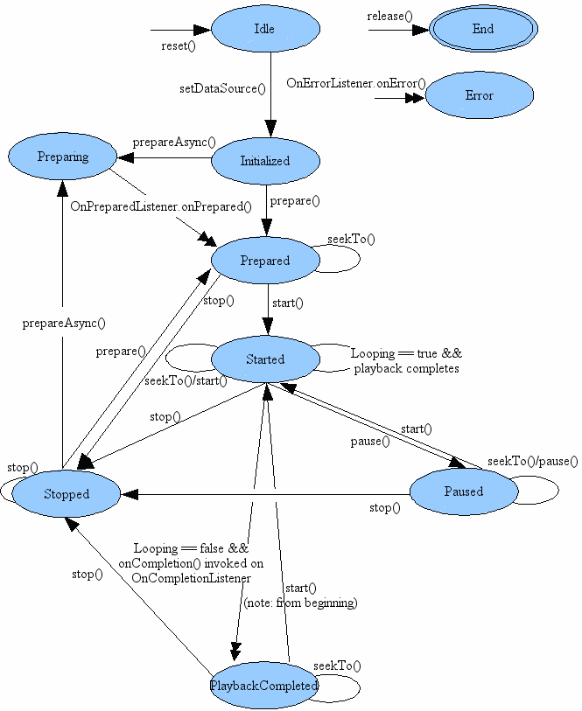
mediaplayer states

Slide 5
Example
When it is stored as a Resource (res/raw directory)
MediaPlayer mp = new MediaPlayer.create(getBaseContext(), R.raw.laser);
mp.start(); //create calls prepare
For media store somewhere else
MediaPlayer mp = new MediaPlayer();
mp.setDataSource("http://www.cs.uwyo.edu/~seker/courses/4730/example/MEEPMEEP.WAV");
OR on filesystem, “/sdcard/file.mp3”
mp.prepare();
mp.start();

Slide 6
As a note.
You can also play the audio from video files with the method as well.
  There just won’t be any picture, just the audio.

Slide 7
Audio Capture
May not be able test with the android simulators
  Android simulators may through errors, saying device doesn’t exist.
  You need to have a microphone attached before the simulator is launched.
You have to test all the code on the phone.
  All examples were tested and worked on the phones.

Slide 8
Capturing Audio
Android android.media

Slide 9
Recording Audio
Get a new instance of the MediaRecorder()
  Configure it for recording the mic, set the audio type
  And configure the output FILE. (there is no outputStream)
  Like playing, you prepare() and start().
    No thread needed.
  Stop() when done recording and then release().
  The audio is now located in the file.

Slide 10
Recording Audio (2)
You need to set the following permissions in the AndroidManifest.xml file
  android.permission.RECORD_AUDIO
    required for all APIs
  android.permission.WRITE_EXTERNAL_STORAGE
    required for API 23 to 28.
    as of API 29, it's depreciated.
      But you can write audio/video files to the sdcard without needed permissions through the mediastore ContentResolver, which is what the examples now use.

Slide 11
Example Code
private void startRecording() {
get MediaRecorder
mRecorder = new MediaRecorder();
configure it
mRecorder.setAudioSource(MediaRecorder.AudioSource.MIC);
mRecorder.setOutputFormat(MediaRecorder.OutputFormat.THREE_GPP);
mRecorder.setOutputFile(mFileName);
mRecorder.setAudioEncoder(MediaRecorder.AudioEncoder.AMR_NB);
Prepare to record
try { mRecorder.prepare();
} catch (IOException e) {}
start recording
mRecorder.start();
}
private void stopRecording() {
mRecorder.stop();
mRecorder.release();
mRecorder = null;
}

Slide 12
Audio settings
mRecorder.setAudioSource();
  MediaRecorder.AudioSource.MIC
  MediaRecorder.AudioSource.CAMCORDER
    Audio source with same orientation as camera, otherwise mic.
  MediaRecorder.AudioSource.VOICE_CALL
    Voice call uplink + downlink audio source
  http://developer.android.com/reference/android/media/MediaRecorder.AudioSource.html
mRecorder.setOutputFormat();
  MediaRecorder.OutputFormat.THREE_GPP
    Recommended setting by Andriod.
  Also, AMR_NB, AMR_WB, RAW_AMR
  MediaRecorder.OutputFormat.MPEG_4
    Using an MPEG-4 container format may confuse some desktop players.
    http://developer.android.com/reference/android/media/MediaRecorder.html#setOutputFormat%28int%29
mRecorder.setAudioEncoder();
  MediaRecorder.AudioEncoder.AAC
    AAC audio codec
  MediaRecorder.AudioEncoder.AMR_NB
    AMR (Narrowband) audio codec
  MediaRecorder.AudioEncoder.AMR_WB
    AMR (Wideband) audio codec

Slide 13
Recording incoming phone calls
As of the current time
  It doesn't appear to be possible via Android to record the audio "from the other end" of the conversation.
  Some phones allow you record the mic during a phone call "headset speaker“
    But Android has a setting for recording, so it may work

Slide 14
Permissions
Permissions for Audio, Pictures, and Video.
  For Audio and video, you need RECORD_AUDIO and CAMERA permission by default. Just to access the camera and mic.
Store and Reading get more complex and by APIs.
  For API 28 and below.
    to use the SD card and external, you WRITE_EXTERNAL_STORAGE and READ_EXTERNAL_STORAGE
  29 to 32
    READ OR use the newer ACCESS_MEDIA_LOCATION (for writes)
  33
    use ACCESS_MEDIA_LOCATION
    use READ_MEDIA_VIDEO, READ_MEDIA_IMAGES, or READ_MEDIA_AUDIO
  34 also add
    READ_MEDIA_VISUAL_USER_SELECTED, where the use can specify only a directory that app can read or everything.

Slide 15
Media Store and no write permissions.
You can use the MediaStore to read and write, going through the OS to most of the work
  then you also don't need write permissions.
build ContentValues of information about the file you want to write.
ContentValues values = new ContentValues(4);
values.put(MediaStore.Audio.Media.TITLE, fileName);// not needed?
values.put(MediaStore.Audio.Media.DISPLAY_NAME, fileName);
values.put(MediaStore.Audio.Media.DATE_ADDED, (int) (System.currentTimeMillis() / 1000));
values.put(MediaStore.Audio.Media.MIME_TYPE, "audio/mp3");
if (Build.VERSION.SDK_INT >= Build.VERSION_CODES.Q) { //For API 29+ (q), for 26 to 28, it just goes into the music directory.
values.put(MediaStore.Audio.Media.RELATIVE_PATH, "Music/Recordings/");
}
audiouri = getContentResolver().insert(MediaStore.Audio.Media.EXTERNAL_CONTENT_URI, values);
file = getContentResolver().openFileDescriptor(audiouri, "w");

Slide 16
now write.
if the file comes back as null, you failed
otherwise you can now write to the file and it wll be go to the external audio directory in this case.
  Change the mediaStore.Images or Video for pictures and video.
See the FileSystemMediaStoreREcAudioDemo Example in the saveData repo.

Slide 17
References
Android
  http://developer.android.com/intl/zh-CN/guide/topics/media/index.html
  http://developer.android.com/guide/topics/media/index.html

Slide 18
Q
A
&

