Slide 1
Cosc 5/4730
Android
Content Providers and
Intents

Slide 2
Data storage
There are several methods to store data
  Preferences
    is a lightweight mechanism to store and retrieve key-value pairs of primitive data types. It is typically used to store application preferences
  Files System
    Internal storage and external storage (SD card)
  Databases
  Cloud DataStores: supported by networked servers.
  Content Providers
    These use one of the above or something else (say networking)
    Only method to "share" information between applications.

Slide 3
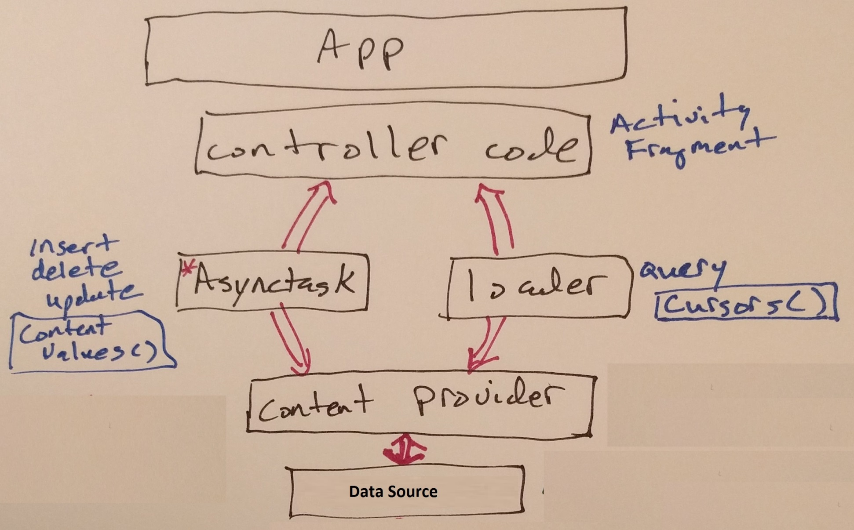
App Overview

Slide 4
Content Providers
Any Uri that begins with content:// is retrieved with a content provider.
  The data is encapsulated using a Uri instance
  You don't know where it is, nor care actually
  Could be a database, files, or retrieved from off the device
With a Uri, you perform basic CRUD operations using the content provider
  CRUD = create, read, update, delete

Slide 5
URI
Examples:
content://media/internal/images
  return the list of all internal images on the device.
content://contacts/people/
  return the list of all contact names on the device.
  Better to use the build in ContactsContract.Contacts.CONTENT_URI
content://contacts/people/45
  return the single result row, the contact with ID=45.
content://mms
  returns a list of the mms messages (content://mms/part/<partID> gets the message)
content://constants/5
  return the constant number 5
content://edu.cs4730.provider/square
  a custom content provider covered later in the lecture.

Slide 6
URI (2)
android.providers package provide some ready made URIs, example:
  ContactsContract.Contacts.CONTENT_URI
  MediaStore.Images.Media.INTERNAL_CONTENT_URI
Otherwise, use Uri.parse(String);
Uri CONTENT_URI = Uri.parse("content://"+ PROVIDER_NAME + "/square");

Slide 7
Android Content Providers
Android provides an example of how to use the built-in user dictionary.
  http://developer.android.com/guide/topics/providers/content-provider-basics.html
They is also a description of Contacts and Calendar Providers
  http://developer.android.com/guide/topics/providers/contacts-provider.html
  http://developer.android.com/guide/topics/providers/calendar-provider.html

Slide 8
Contacts Example
Simple code to read the contacts
Note, need at least these permissions
  <uses-permission android:name="android.permission.GET_ACCOUNTS" />
  <uses-permission android:name="android.permission.READ_CONTACTS" />
Uri CONTENT_URI = ContactsContract.Contacts.CONTENT_URI;
String[] projection = new String[] { ContactsContract.Contacts._ID, ContactsContract.Contacts.DISPLAY_NAME };
Cursor c = managedQuery(CONTENT_URI, projection, null, null, null);
if (c.moveToFirst()) {
do {
String str = "Id: " + c.getString(0);
str += "Name: " + c.getString(1);
} while (c.moveToNext());
}
The ContentProvider Demo has a better version of this showing the contacts in a listview.
  Note, if running on the emulator, you will to create some contacts to display!
Notes:
<uses-permission android:name="android.permission.GET_ACCOUNTS" />
<uses-permission android:name="android.permission.READ_CONTACTS" />
<uses-permission android:name="android.permission.WRITE_CONTACTS" />

Slide 9
Custom Content Providers
Content Providers share content with applications across application boundaries.
This allows us to make information/data available between applications (including ones we write)
  This provides a way to hide how we are storing the data and present to our activity in a standard way as well.

Slide 10
Custom Content Providers (2)
Extend the ContentProvider class and implement the required methods.
  getType(): Returns the MIME type of the data at the given URI.
  onCreate(): Called when the provider is being started.
  query(): Receives a request from a client. The result is returned as a Cursor object.
  insert(): Inserts a new record into the content provider.
  delete(): Deletes an existing record from the content provider.
  update(): Updates an existing record from the content provider.

Slide 11
Custom Content Providers (3)
With our content provider we can choose how to store the data:
  file system, xml, database, or on the internet
For this lecture example:
  A dummy content provider
  It ignore inserts, updates, deletes
  It will return the square of the number sent to it
    Zero for non numbers
    Square 1 to 10 for “all rows” query

Slide 12
Creating a Custom Content Provider
create a class that extends ContentProvider
  Using eclipse you can also have to create the necessary methods.
  In our case:
    public class dummyCP extends ContentProvider {
  Most of the methods are going to leave with the default return value (null or 0)

Slide 13
Constants we need
public static final String PROVIDER_NAME =
"edu.cs4730.provider";
public static final Uri CONTENT_URI =
Uri.parse("content://"+ PROVIDER_NAME + "/square");
These are the ContentProvider information to access it later.

Slide 14
UriMatcher
private static final int SQUARE = 1;
private static final int SQUARE_ID = 2;
private static final UriMatcher uriMatcher;
static{
uriMatcher = new UriMatcher(UriMatcher.NO_MATCH);
uriMatcher.addURI(PROVIDER_NAME, "square", SQUARE);
uriMatcher.addURI(PROVIDER_NAME, "square/#", SQUARE_ID);
}
Observe from the code above that you use a UriMatcher object to parse the content URI that is passed to the content provider through a Content Resolver. For example, the following content URI represents a request for all rows in the content provider:
content://edu.cs4730.provider/square
In contrast, the following represents a request for a particular row with _id=5:
content://edu.cs4730.provider/square/5

Slide 15
override getType()
You'll need to override the getType() method so it uniquely describes the data type for your content provider.
  Using the UriMatcher object, you will return "vnd.android.cursor.item/vnd.cs4730.square" for a single row, and "vnd.android.cursor.dir/vnd.cs4730.square" for multiple rows:
@Override
public String getType(Uri uri) {
switch (uriMatcher.match(uri)) {
// get all rows
case CSTEACH:
return "vnd.android.cursor.dir/vnd.cs4730.square";
// get a particular row
case CSTEACH_ID:
return "vnd.android.cursor.item/vnd.csc4730.square";
default:
throw new IllegalArgumentException("Unsupported URI: " + uri);
}
}
vnd.android.cursor is the set of vender android minetypes

Slide 16
Query method
@Override
public Cursor query(Uri uri, String[] projection, String selection, String[] selectionArgs, String sortOrder) {
String[] Column = new String[] { "number", "square"};
if (uriMatcher.match(uri) == SQUARE_ID) { //query with for “one”, use number to get the square
int val = Integer.parseInt(uri.getPathSegments().get(1));
//must return a Cursor, MatrixCursor is an editable cursor.
MatrixCursor myCursor = new MatrixCursor(Column);
myCursor.addRow(new Object[] { val, val*val});
return myCursor;
} else if (uriMatcher.match(uri) == SQUARE) { //query for “all”, so just return 1-10 squares
MatrixCursor myCursor = new MatrixCursor(Column);
for (int i=1; i<11; i++) {
myCursor.addRow(new Object[] { i, i*i});
}
return myCursor;
}
//something else, just return null
return null;
}

Slide 17
MatrixCursor
android.database.MatrixCursor
  This allows us to create an editable Cursor
    We can’t add to a standard Cursor.
  On instancesation of the Matrix Cursor, we provide it an array of strings that are the Column names.
  Then use myCursor.addRow(new Object[]);
    Where the Object[] array is the entries for the row.
    In the example I just has it cast integers to the generic Object type.

Slide 18
The Rest of the methods
@Override
public boolean onCreate() {
//nothing to create, so just return true
return true;
}
@Override
public Uri insert(Uri uri, ContentValues values) {
//ignore insert
return null;
}
@Override
public int update(Uri uri, ContentValues values, String selection, String[] selectionArgs) {
// ignore, return default
return 0;
}
@Override
public Uri insert(Uri uri, ContentValues values) {
// ignore, return default
return null;
}
@Override
public int delete(Uri uri, String selection, String[] selectionArgs) {
// ignore, return default
return 0;
}

Slide 19
Register the provider
In the AndroidManifest.xml file
  add the class the is the provider and register the content string
<application …>
<activity …
</activity>
<provider android:name=“dummyCP"
android:authorities="edu.cs4730.provider" />
</application>

Slide 20
Register the provider (2)
starting in API 28 (with more in 30)
<provider
android:name="dummyCP"
android:authorities="edu.cs4730.provider"
android:enabled="true"
android:exported="true"
android:grantUriPermissions="true" //any app can access.
android:multiprocess="true" />

Slide 21
Activity class
Now in the activity class we can use it.
example, select one of them, in this case 2
Uri onerow = Uri.parse("content://edu.cs4730.provider/square/2");
Cursor c = getContentResolver().query(onerow, null, null, null, null);
if (c != null) {
c.moveToFirst();
do {
logThis(c.getString(0) + " value is " + c.getString(1));
} while (c.moveToNext());
}
now select "all", which will return 1 to 10 squared.
Uri allrow = Uri.parse("content://edu.cs4730.provider/square");
c = getContentResolver().query(allrow, null, null, null, null);
...

Slide 22
Remote access to provider
starting in API 30, there is a "package visibility" requirement now
  Now all packages can be search, visible to each other.
So in the Manifest file, you will need to declare packages you want to access
it's own section, (outside of the package)
<queries>
<package android:name="edu.cs4730.contentprodemo" />
</queries>

Slide 23
Loaders
Loaders allow you to keep the data in the cursors update from Content Providers
  We’ll come back to them in the sqlite lecture.
native Loaders are deprecated in API 28.
  use LiveData/Modelview with observers.
  implementation 'androidx.loader:loader:1.1.0'
    which is actually a re-implementation of livedata/modelview.

Slide 24
References
http://developer.android.com/guide/topics/providers/content-providers.html
http://developer.android.com/reference/android/database/Cursor.html
http://developer.android.com/reference/android/database/MatrixCursor.html
http://www.vogella.com/articles/AndroidSQLite/article.html#contentprovider
Using and Implementing Content Providers in Android
  http://www.devx.com/wireless/Article/41133/1763/page/1
https://developer.android.com/training/basics/intents/package-visibility for API 30+

Slide 25
Q
A
&

