Slide 1
Cosc 5/4730
Dialogs
and dialogfragments

Slide 2
Dialogs and DialogFragment
Much of the dialog builder code must be used in a fragment, since it was depreciated in the Activity at API 13.
Instead change to the import androidx.appcompat.app.AlertDialog
And it works just fine.
There is also a dialogfragment
Which can be "shown" on it's own or place in a framelayout just like any other fragment.
note you can combine this with arch navigation too.

Slide 3
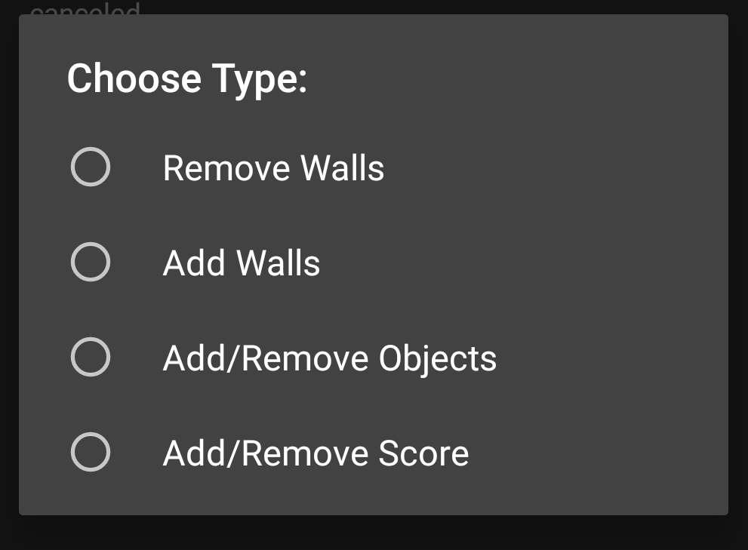
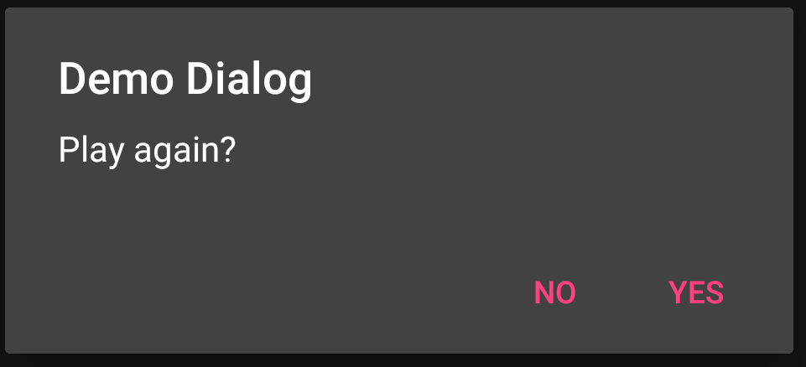
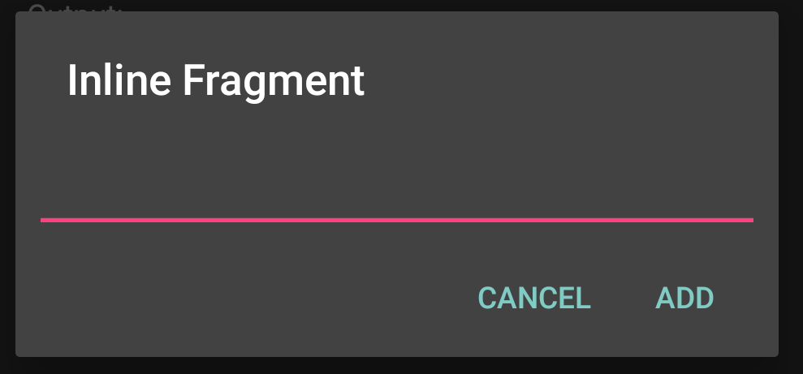
Dialog
There is a dialog builder for "standard" dialogs
Normally 3, 2, or 1 button and a message
Select an item from a list.
You can also easily build "custom" dialogs

Slide 4
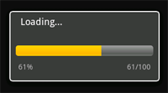
Creating a Dialog
There are several dialogs you can create
AlertDialog, which can have up to 3 buttons
ProgressDialog
DatePickerDialog and TimePickerDialog
Custom dialog, which you create the layout for an AlertDialog.

Slide 5
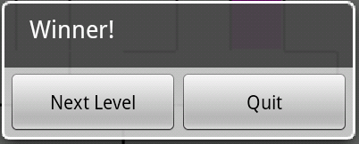
AlertDialog
Use the AlertDialog.Builder to create the dialog
You can have up to three buttons, “positive”, “negative” and cancel
To create the following Dialog
Set the positive and negative, and disable cancel.

Slide 6
AlertDialog (2)
Code: with two listeners, one for each button.
AlertDialog.Builder builder = new AlertDialog.Builder(MainActivity.this);
builder.setMessage("Winner!")
.setCancelable(false)
.setPositiveButton("Next Level", new DialogInterface.OnClickListener() {
public void onClick(DialogInterface dialog, int id) {
dialog.dismiss(); //clear the dialog
// now do what needs to be done.
}
})
.setNegativeButton("Quit", new DialogInterface.OnClickListener() {
public void onClick(DialogInterface dialog, int id) {
finish(); //leave the app here.
}
});
builder.show(); //the dialog will now show.

Slide 7
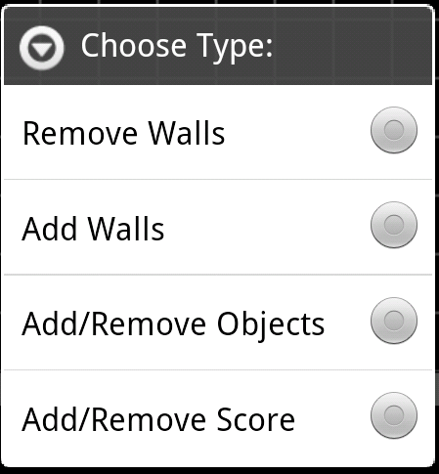
AlertDialog (3)
Instead of buttons, you can have it as radio buttons (and more then just three);
Use Builder.setSignleChoiceItems
Where we send a CharSequence[] of items.
final String[] items = {"Remove Walls", "Add Walls", "Add/Remove Objects", "Add/Remove Score"};

Slide 8
AlertDialog (4)
code:
final String[] items = {"Remove Walls", "Add Walls", "Add/Remove Objects", "Add/Remove Score"};
AlertDialog.Builder builder = new AlertDialog.Builder(this);
builder.setTitle("Choose Type:");
builder.setSingleChoiceItems(items, -1, new DialogInterface.OnClickListener() {
public void onClick(DialogInterface dialog, int item) {
dialog.dismiss();
if (item == 0) { //remove walls
} //etc..
}
});
Builder.show(); //show the dialog

Slide 9
Alert Dialogs view custom layouts
Using alertdialog and custom view.
Like fragments, recyclerview, you need inflate the yourlayout, set it up as normal.
Create the builder like normal, including positive, negative buttons.
Add the view
Builder.setView(myView);
Show dialog.

Slide 10
Examples
DialogDemo
Support dialog fragment has
Two button alert dialog
A list dialog
CustomFragment
showInputDialog setups an alertdialog with a custom view. Allowing input of text.

Slide 11
DialogFragment
Basically, a fragment and everything that we have already done.
Or you implement onCreateDialog(Bundle)
Instead of (or in addition to ) onCreateView
DialogFragments can be added to a framelayout just like fragments OR we can use the show method
All the demos are going to use show, instead putting in the framelayout, since you already saw how to do it.

Slide 12
DialogFragment (2)
To show the fragment, use the following as an example:
FragmentManager fm = getSupportFragmentManager();
EditNameDialogFrag editNameDialog = new EditNameDialogFrag();
editNameDialog.show(fm, "fragment_edit_name");
Show function, causes the dialogFragment to popup on the screen.

Slide 13
DialogFragment and AlertDialog
We can embed the alertDialogs into the FragmentDialog.
Use the Dialog OnCreateDialog(…)
Create the dialog via a builder.
Return the dialog.
Shown in code myDialogFragment

Slide 14
DialogFragment with AlertDialog
Two pieces for the Dialog Fragment
newInstance and using callbacks.
newInstance
Creates a new dialogFragment, instead doing this in the Activity/fragment.
onCreateDialog
Creates the AlertDialog via the builder just like before.
Then use callbacks in the positive/negative methods.

Slide 15
DialogFragment with AlertDialog (2)
In the fragment
new DialogInterface.OnClickListener() {
public void onClick(DialogInterface dialog, int whichButton) {
mlistener.doPositiveClick(); //using “normal” callbacks.
}}
In the Activity:
public void doPositiveClick() {
// Do stuff here.
}
Note, all these listeners and callback could be replaced with
modelview and livedata.

Slide 16
EditNameDialogFrag example
Create a callbacks as we have done before
In Dialog onCreateDialog( …)
Inflate the layout, create the dialog and return it.
LayoutInflater inflater = LayoutInflater.from(requireActivity());
View myView = inflater.inflate(R.layout.fragment_edit_name, null);
mEditText = (EditText) myView.findViewById(R.id.txt_your_name);
AlertDialog.Builder builder = new AlertDialog.Builder( …);
builder.setView(myView).setTitle("Hello");
…
return builder.create(); //remember show is called else where.

Slide 17
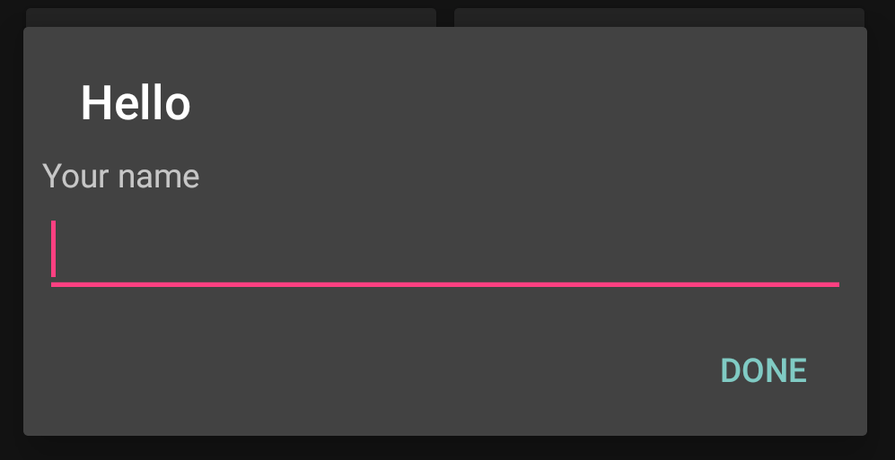
EditNameDialogFrag example (2)
So we have the dialog

Slide 18
EditNameDialogFrag and keyboard
The keyboard doesn't show automatically, even with a edittext (with focus).
So minor change to get the keyboard to display when the dialogbox shows.
Dialog dialog = builder.create();
dialog.getWindow().setSoftInputMode(WindowManager.LayoutParams.SOFT_INPUT_ADJUST_RESIZE); //show the keyboard.
return dialog;

Slide 19
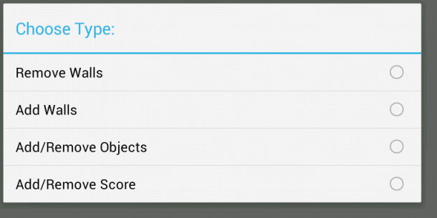
Example code
CustomFragment
myAlertDialogFragment
Cancel/Ok dialog
myDialogFragment
Implements the two dialog from the beginning of the lecture No/Yes, and a ListDialog
myEditNameDialogFrag has on EditText box
MultiInputDialogFragment has 2 EditText boxes
Plus you can set data in the input boxes as well.
There is a doPositivieClick(), doNegativeClick(), and doItem(String) for these dialog
Implemented via the callbacks.

Slide 20
Example code (2)
CustomFragment
There is a inline method, called via showInputDialog method.
The method name means nothing, just a way to hold all the code in a subroutine.
You may find this useful, if all the callbacks are confusing.
This example uses a custom layout as well.

Slide 21
Key take away.
If you need a dialog box it can be pretty simply (or very complex).
simple with a custom view.
create the xml for the view (without the yes/no buttons)
inflate the view.
add all of that to a alertDialog box.
set the positivebutton, negative button as needed.
build and show.

Slide 22
Key take away (2)
example code (not complete)
final View textenter = inflater.inflate(R.layout.layout_dialog, null);
final EditText et_name = (EditText) textenter.findViewById(R.id.et_name);
final AlertDialog.Builder builder = new AlertDialog.Builder(new ContextThemeWrapper(this, R.style.AppTheme_Dialog));
builder.setView(textenter).setTitle("My Title");
builder.setPositiveButton("Update", new DialogInterface.OnClickListener() {
@Override
public void onClick(DialogInterface dialog, int id) {
do something here.
}
})
.setNegativeButton("Cancel", new DialogInterface.OnClickListener() {
public void onClick(DialogInterface dialog, int id) {
dialog.cancel();
}
});
AlertDialog dialog = builder.create();
dialog.show();

Slide 23
Examples
In the ui repo, dialogs directory
CustomDialogDemo (java and kotlin) show a simple inline custom dialog example in the main activity
DialogDemo (java and kotlin) more complex examples from this lecture in fragments.
DialgoViewModelDemo (java and Kotlin) uses a viewmodel instead of callbacks to mainactivity.

Slide 24
DialogFragment References
https://developer.android.com/guide/topics/ui/dialogs.html
http://developer.android.com/reference/android/app/DialogFragment.html
http://android-developers.blogspot.com/2012/05/using-dialogfragments.html
http://stackoverflow.com/questions/12912181/simplest-yes-no-dialog-fragment
https://stackoverflow.com/questions/3455235/when-using-alertdialog-builder-with-edittext-the-soft-keyboard-doesnt-pop

Slide 25
Q
A
&

