Slide 1
Cosc 5/4730
Android drawing

Slide 2
Screen support
Android is the OS and is used a many different hardware created by different vendors.
Screen size
For simplicity, Android collapses all actual screen sizes into three generalized sizes: large, normal, and small
Resolution
The total number of physical pixels on a screen. Note that, although resolution is often expressed as width x height, resolution does not imply a specific aspect ratio. In Android, applications do not work directly with resolution.
Density
Based on the screen resolution, the spread of pixels across the physical width and height of the screen.
For simplicity, Android collapses all actual screen densities into three generalized densities: high, medium, and low.
Notes:
See http://developer.android.com/guide/practices/screens_support.html

Slide 3
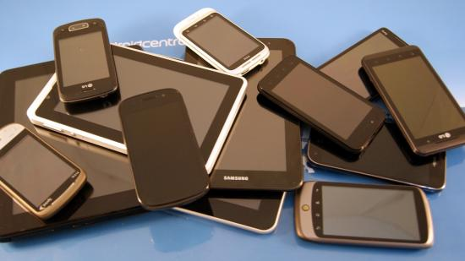
Screen Size example

Slide 4
Screen support (2)
Dots-per-inch (DPI)
There are HIGH, MEDIUM, and LOW DPI, even with the same screen size.
In res: drawable-hdpi, drawable-mdpi, and drawable-ldpi and the system can
Density-independent pixel (dip)
A virtual pixel unit that applications can use in defining their UI, to express layout dimensions or position in a density-independent way.
The density-independent pixel is equivalent to one physical pixel on a 160 dpi screen, the baseline density assumed by the platform (as described later in this document).
At run time, the platform transparently handles any scaling of the dip units needed, based on the actual density of the screen in use. The conversion of dip units to screen pixels is simple: pixels = dips * (density / 160).
For example, on 240 dpi screen, 1 dip would equal 1.5 physical pixels.
Using dip units to define your application's UI is highly recommended, as a way of ensuring proper display of your UI on different screens.

Slide 5
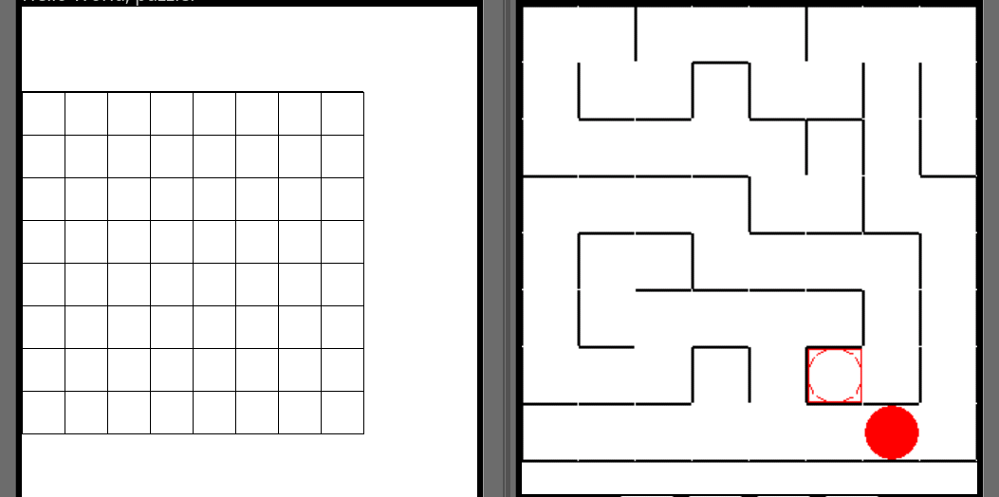
Why does it matter?
Same code to draw, 8x8 squares. Notice the difference even on the same emulator (screen: Hdpi WVGA854).

Slide 6
Screen size and emulators
Screen sizes and densities of emulator skins included in the Android SDK.
 | Low density (120), ldpi | Medium density (160), mdpi | High density (240), hdpi
Small screen | QVGA (240x320)
Normal screen | WQVGA400 (240x400) WQVGA432 (240x432) | HVGA (320x480) | WVGA800 (480x800) WVGA854 (480x854)
Large screen |  | WVGA800* (480x800) WVGA854* (480x854)
* To emulate this configuration, specify a custom density of 160 when creating an AVD that uses a WVGA800 or WVGA854 skin.

Slide 7
API versions.
Skipping the Min SDK version also effects the drawing.
Screen is much smaller resolution of 320x480 even with a larger screen size
While using Min SDK version 8, gives you the whole resolution of 480x854 (droid screen size)

Slide 8
And supporting the "notch"
https://android-developers.googleblog.com/2018/07/supporting-display-cutouts-on-edge-to.html
Android calls them cutouts and it limited to only one cutout per side and only the top and bottom. No cutouts on the left/right in portrait mode. (so a max of 2 per screen)
Basically it works without making any changes. But if you go full screen and/or use rawX/Y coordinates you will need to account the cutouts.
See the blog post above for more info.

Slide 9
Drawing
In Android, you draw “on something”, instead of on a screen.
This is not OpenGL, instead a native graphics package.
The canvas of an image in the gui lecture
Canvas is what you draw on. You get a canvas of the “widget” you are drawing on.
Generally: custom View, SurfaceView, or image.
You draw with a “brush”, that android calls a Paint object.
We cover the Canvas first, then how each of those work.

Slide 10
Canvas
Everything is drawn with the canvas object
assume canvas. in front of these methods.
drawColor(int color)
Fills the entire canvas with specified color.
To clear the canvas with white
drawColor(Color.WHITE)
drawPaint(Paint paint)
Fill the entire canvas with the specified paint.
like drawColor, but uses a Paint object.
drawPoint(float x, float y, Paint paint)
for drawing a single point.
Note the Float x and y
Paint can be thought of a brush, that has color and style

Slide 11
Paint object
a brush, that has color and style
Paint black = new Paint()
black.setColor(); //default is black
Black.setColor(Color.Black);
Color is another class, with predefined colors, but only contains:
BLACK, BLUE, CYAN, DKGRAY, GRAY, GREEN, LTGRAY, MAGENTA, RED, TRANSPARENT, WHITE, YELLOW
black.setStyle(Paint.Style.STROKE);
Paint.Style.STROKE for outlines (like lines)
Paint.Style.FILL for filled (such as filled rectangles)
example:
drawPoint(1.0, 1.0, black); //draw a black point at 1,1

Slide 12
Points and lines
drawPoints (float[] pts, Paint paint)
drawPoints(float[] pts, int offset, int count, Paint paint)
Draw a series of points.
pts
Array of points to draw [x0 y0 x1 y1 x2 y2 ...]
drawLine(float startX, float startY, float stopX, float stopY, Paint paint)
Draw a line segment with the specified start and stop x,y coordinates, using the specified paint.
drawLines(float[] pts, Paint paint)
drawLines(float[] pts, int offset, int count, Paint paint)
Draw a series of lines.
pts
Array of points to draw [x0 y0 x1 y1 x2 y2 ...]
drawPath(Path path, Paint paint)
Draw the specified path using the specified paint.

Slide 13
Rectangles
drawRect(RectF rect, Paint paint)
Draw the specified Rect using the specified paint.
drawRect(float left, float top, float right, float bottom, Paint paint)
Draw the specified Rect using the specified paint.
drawRect(Rect r, Paint paint)
Draw the specified Rect using the specified Paint.
drawRoundRect(RectF rect, float rx, float ry, Paint paint)
Draw the specified round-rect using the specified paint.

Slide 14
circles and ovals
drawCircle(float cx, float cy, float radius, Paint paint)
Draw the specified circle using the specified paint.
drawArc(RectF oval, float startAngle, float sweepAngle, boolean useCenter, Paint paint)
Draw the specified arc, which will be scaled to fit inside the specified oval.
drawOval(RectF oval, Paint paint)
Draw the specified oval using the specified paint.

Slide 15
Drawing images
drawBitmap(Bitmap bitmap, float left, float top, Paint paint)
Draw the specified bitmap, with its top/left corner at (x,y), using the specified paint, transformed by the current matrix.
drawBitmap(Bitmap bitmap, Rect src, RectF dst, Paint paint)
Draw the specified bitmap, scaling/translating automatically to fill the destination rectangle.
drawPicture(Picture picture, Rect dst)
Draw the picture, stretched to fit into the dst rectangle.

Slide 16
Loading images.
Assuming the images are in the drawable (or drawable-*) directory
Bitmap bg = BitmapFactory.decodeResource( getResources(), R.drawable.bg );
Where R.drawable.bg is the id of the image you want to load.

Slide 17
Drawing Text
drawText(String text, float x, float y, Paint paint)
Draw the text, with origin at (x,y), using the specified paint.
drawText(String text, int start, int end, float x, float y, Paint paint)
Draw the text, with origin at (x,y), using the specified paint.
drawTextOnPath(String text, Path path, float hOffset, float vOffset, Paint paint)
Draw the text, with origin at (x,y), using the specified paint, along the specified path.
The text will follow the path, including angles down.
drawPosText(String text, float[] pos, Paint paint)
Draw the text in the array, with each character's origin specified by the pos array.
pos is an Array of [x,y] positions, used to position each character

Slide 18
Text and Paint
How the font is drawn is controlled with the paint object
Paint black = new Paint()
black.setColor(Color.BLACK);
So to change the font size and make it twice the default size
black.setTextSize(black.getTextSize()*2);
See the Android.graphics Paint for more methods.

Slide 19
other interesting methods.
You can scale, skew, rotate, and translate
using the setMatrix(…), scale(…), rotate(…), translate(…) and skew(…) methods.
And many other methods I skipped over.

Slide 20
Paint and Color
The Color class has very few colors
BLACK, BLUE, CYAN, DKGRAY, GRAY, GREEN, LTGRAY, MAGENTA, RED, TRANSPARENT, WHITE, YELLOW
But you can “create” more colors.
Say we want purple, we can use Color.rgb()
Using http://cloford.com/resources/colours/500col.htm
Paint purple = new Paint()
purple.setColor(Color.rgb(128,0,128));
Now we can “draw” with a purple color.

Slide 21
Canvas
Not a complete list, see
http://developer.android.com/reference/android/graphics/Canvas.html

Slide 22
Images
You can get a blank Bitmap or Image and then draw on them.
Bitmap eBitmap= eBitmap = Bitmap.createBitmap(x, y, Bitmap.Config.ARGB_8888);
Where x and y are the size of the image to create.
Canvas eCanvas = new Canvas(eBitmap);
eCanvas.drawColor(Color.WHITE); //white screen
Paint black = new Paint(Color.BLACK); //black paintbrush
eCanvas.drawRect(0,0,x, y, black);
eCanvas.DrawText(“Hi there”, 10.0, 10.0, black);
And display the image in a ImageView or other image widget
Use invalidate() method for the imageView, so it is redrawn.

Slide 23
custom View
Using a custom View, you can use the whole screen or only part as you need.
create the myView constructor.
Override the onDraw method and you are ready to draw.
class myView extends View {
public myView(Context context) {
super(context);
}
@Override protected void onDraw(Canvas canvas) {
}
}
Remember you can override many other methods as well.

Slide 24
custom View (2)
Displaying a custom View.
If your view is the only widget on the screen, then you can skip the layout and use something like this in OnCreate(…) them
public void onCreate(Bundle savedInstanceState) {
super.onCreate(savedInstanceState);
mv = new myView(this);
setContentView(mv);
mv.requestFocus();
}

Slide 25
custom View (3)
If it is one of many widgets, then you need a layout. In the layout, it would look something like this:
<view class=“edu.cs4730.test.myView"
android:id="@+id/myView01" android:layout_width="wrap_content" android:layout_height="wrap_content"/>
If it’s a sub class of your activity: Note the $
<view class=“edu.cs4730.test.main$myView"
android:id="@+id/View01" android:layout_width="wrap_content" android:layout_height="wrap_content"/>
Also the myView class needs to be declared static.

Slide 26
SurfaceView and TExtView

Slide 27
SurfaceView
Similar in nature to a View
Intended more for games
We come back to surfaceView again with OpenGL.
extend the SurfaceView and implement SurfaceHolder.Callback
The reason we need the SurfaceHolder is to provide us with the canvas we can draw on.
The SurfaceHolder.Callback interface requires 3 additional methods we need to implement: surfaceCreated(), surfaceDestroyed(), surfaceChanged()
and the constructor for SurfaceView

Slide 28
SurfaceView (2)
It will look something like this:
class mySurfaceView extends SurfaceView implements SurfaceHolder.Callback {
public mySurfaceView(Context context) {
super(context);
getHolder().addCallback(this);
}
@Override public void surfaceChanged(SurfaceHolder holder, int format, int width, int height) {
// TODO Auto-generated method stub
}
@Override public void surfaceCreated(SurfaceHolder holder) {
// TODO Auto-generated method stub
}
@Override public void surfaceDestroyed(SurfaceHolder holder) {
// TODO Auto-generated method stub
}
}

Slide 29
SurfaceHolder.Callback
surfaceCreated
called when the surface is created. A good place to setup stuff
surfaceDestroyed
called when the surfaced is destroyed. need to close down anything. We can’t touch the surface/canvas once this has been called.
surfaceChanged
likely called when screen flipping or other change to the surface. I’ve left this method blank in the code.

Slide 30
a Thread
The next thing we need is a thread to control the drawing.
extend the thread class and create a constructor to pass the surfaceholder and surfaceview too.

Slide 31
Thread Example
class myThread extends Thread {
private SurfaceHolder _surfaceHolder;
private mySurfaceView _mySurfaceView;
private boolean _run = false;
public myThread(SurfaceHolder surfaceHolder, mySurfaceView SurfaceView) {
_surfaceHolder = surfaceHolder;
_mySurfaceView = SurfaceView;
}
public void setRunning(boolean run) {
_run = run;
}
@Override
public void run() {
while (_run) {
//now code for drawing…
}
}
}

Slide 32
locking the surfaceHolder
before we draw, we need to make sure we change a sync lock on the surfaceHolder
Canvas c;
while (_run) {
c = null;
try {
c = _surfaceHolder.lockCanvas(null);
synchronized (_surfaceHolder) {
_mySurfaceView.onDraw(c); //finally we can draw now.
}
} finally {
// do this in a finally so that if an exception is thrown
// during the above, we don't leave the Surface in an
// inconsistent state
if (c != null) {
_surfaceHolder.unlockCanvasAndPost(c);
}
}
}

Slide 33
Back to SurfaceView
We start the thread in surfaceCreated
public void surfaceCreated(SurfaceHolder holder) {
mythread.setRunning(true);
mythread.start();
}
end the thread in surfaceDestroyed
public void surfaceDestroyed(SurfaceHolder holder) {
boolean retry = true;
mythread.setRunning(false);
while (retry) {
try {
mythread.join();
retry = false;
} catch (InterruptedException e) {
// we will try it again and again...
}
}
}

Slide 34
lastly
override onDraw(Canvas c) in mySurfaceView class with any drawing needed.
To see the complete code check the example code for SurfaceViewDemo.
It draws an alien that moves across the screen. If you touch it, it moves to a new location.
We’ll come back to this for game design in the next lecture.

Slide 35
Surface
Handle into a raw buffer that is being managed by the screen compositor
as an output destination for the android.hardware.camera2, MediaCodec, MediaPlayer, and Allocation APIs (including OpenGL ES)
The surface is displayed via
android.view.SurfaceView (API 1+)
android.view.TextureView (API 14+)

Slide 36
SurfaceView and TextureView
A SurfaceView and TextureView can be used to display a content stream.
Such a content stream can for instance be a video, Camera, or an OpenGL scene. The content stream can come from the application's process as well as a remote process.
We can get a canvas for it and draw on the canvas as well.
TextureView can only be used in a hardware accelerated window. When rendered in software, TextureView will draw nothing.
Unlike SurfaceView, TextureView does not create a separate window but behaves as a regular View. This key difference allows a TextureView to be moved, transformed, animated, etc.

Slide 37
Declaring/using
For a Surfaceview we need a "implements SurfaceHolder.Callback"
sv = findViewById(R.id.surfaceview);
sv.getHolder().addCallback(this)
Where this is: (SufaceHolder.Callback)
//called when surface is created
public void surfaceCreated(SurfaceHolder holder) {
//start whatever will draw/user the surface
}
//called when the surfaceview has changed size.
@Override
public void surfaceChanged(SurfaceHolder holder, int format, int width, int height) {
}
//called when surfaceview is done.
public void surfaceDestroyed(SurfaceHolder holder) {
}
For a TextureView we need a "implements TextureView.SurfaceTextureListener"
tv = sv = findViewById(R.id.textureview);
tv.setSurfaceTextureListener(this)
Where this is: (SurfaceTextureListener)
//called when surface is ready to use
public void onSurfaceTextureAvailable(SurfaceTexture surface, int width, int height) {
//start whatever will draw/user the surface
}
//called when textureview has changed sized.
public void onSurfaceTextureSizeChanged( SurfaceTexture surface, int width, int height) {
}
//called when textview is done
public boolean onSurfaceTextureDestroyed( SurfaceTexture surface) {
}
//Invoked when the specified SurfaceTexture is updated through updateTexImage().
public void onSurfaceTextureUpdated( SurfaceTexture surface) {
}
Note, if you forget the method in RED, nothing will happen.

Slide 38
TextureView note
There is no onDraw() method to override.
So create your own as my demo does.
Otherwise the thread is same as with a SurfaceView.

Slide 39
Why care?
For this class, I’m generally use a surfaceview in my examples (with TextureViews for the newer examples)
Most of my examples are still compatible with API 10+, even though we are using 19+
Remember TextureView starts in API 14
Many new examples on the web/android use the textureView.
Since they are very similar in declaration, it with modifications they can be translated back and forth.

Slide 40
Example.
There is a textureview example
TextViewDemo
It creates a box with a bouncing green square.
One is full screen while another version is in a smaller layout.

Slide 41
Q
A
&

