Slide 1
Cosc 5/4730
EmojiCompat library.

Slide 2
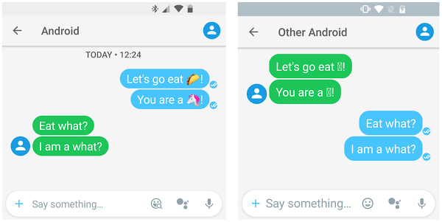
Emoji Compatibility
The EmojiCompat support library aims to keep Android devices up to date with the latest emoji. It prevents your app from showing missing emoji characters in the form of ☐, which indicates that your device does not have a font to display the text. By using the EmojiCompat support library, your app users do not need to wait for Android OS updates to get the latest emoji.
Supports API 19+

Slide 3
add androidx pieces
implementation "androidx.emoji:emoji-appcompat:1.1.0"
implementation "androidx.emoji:emoji-bundled:1.1.0"
implementation "androidx.emoji:emoji:1.1.0"

Slide 4
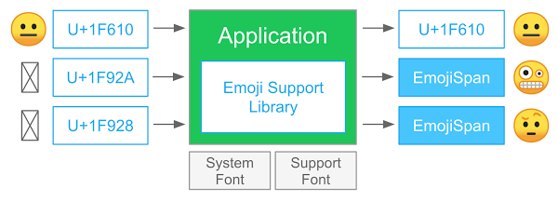
How it works.
It identifies emoji for a given CharSequence, replaces them with EmojiSpans, if required, and finally renders the emoji glyphs.
demonstration the process.

Slide 5
implementation
First the app need to initial the downloadable font configuration
IE get the more current font set that supports the newer emoji.
This can be as a download or via bundled font in the app.
NOTE, this must come before any setContentView call, otherwise, it will force close.
Use the bundled font for EmojiCompat
EmojiCompat.Config config;
config = new BundledEmojiCompatConfig(getApplicationContext());
EmojiCompat.init(config);

Slide 6
Implementation (2)
Use a downloadable font for EmojiCompat
EmojiCompat.Config config;
final FontRequest fontRequest = new FontRequest(
"com.google.android.gms.fonts", "com.google.android.gms",
"Noto Color Emoji Compat", R.array.com_google_android_gms_fonts_certs);
config = new FontRequestEmojiCompatConfig(getApplicationContext(), fontRequest)
.setReplaceAll(true)
.registerInitCallback(new EmojiCompat.InitCallback() {
@Override public void onInitialized() { … }
@Override public void onFailed(@Nullable Throwable throwable) { … }
}); }
EmojiCompat.init(config);

Slide 7
Use EmojiCompat widgets
Instead of a TextView use
<android.support.text.emoji.widget.EmojiTextView
android:layout_width="wrap_content"
android:layout_height="wrap_content"/>
Instead of EditText use
<android.support.text.emoji.widget.EmojiEditText
android:layout_width="wrap_content"
android:layout_height="wrap_content"/>
And instead of Button use
<android.support.text.emoji.widget.EmojiButton
android:layout_width="wrap_content"
android:layout_height="wrap_content"/>

Slide 8
For regular textviews and customview
You can process the text so it displays correct for the rest of the widgets and customViews as well.
Regular TextView without EmojiCompat support; you have to manually process the text
TextView regularTextView = findViewById(R.id.regular_text_view);
EmojiCompat.get().registerInitCallback(new InitCallback(regularTextView));
The call uses the compat system to process the text into emojispan
regularTextView.setText(
compat.process( text) );

Slide 9
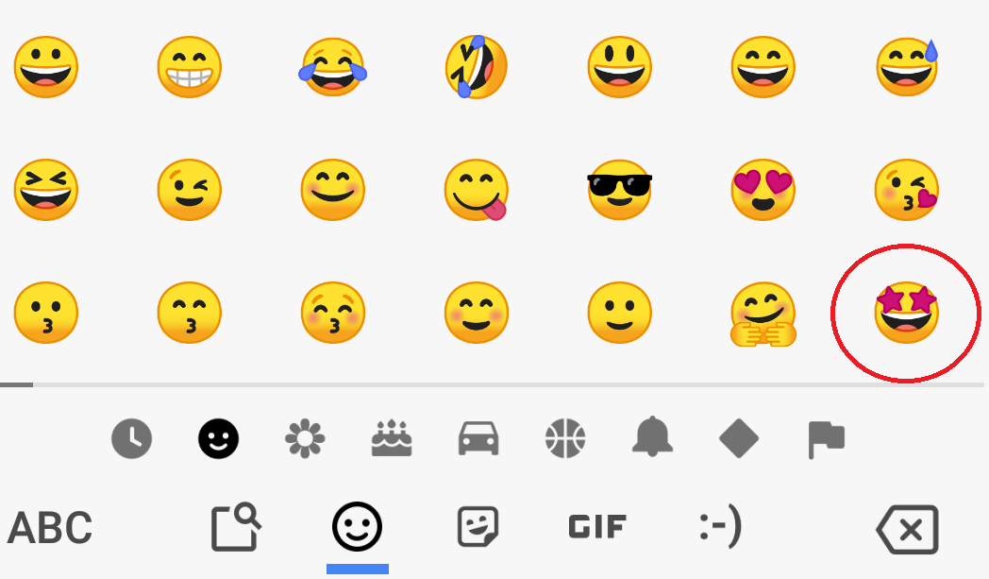
Keyboard IMEs
With the EmojiCompat and font with the app, the keyboard is updated to handle the new emojis as well.
So example android 9 added the star-struck emoji and it will show in the keyboard.

Slide 10
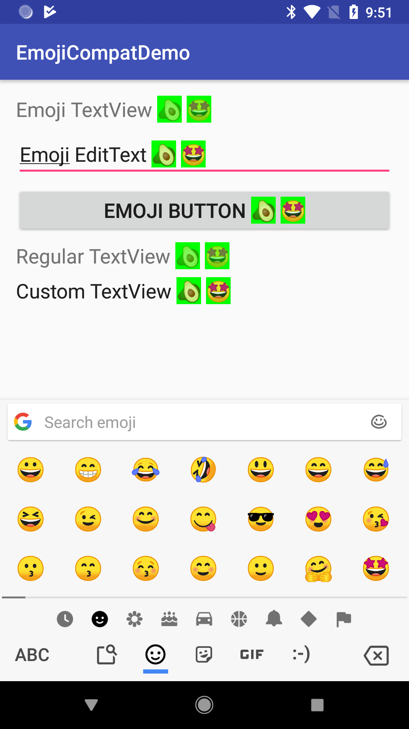
Example code
In UI advanced, the emoji Compat demo.

Slide 11
last note.
there is a emoji2
from their site:
Features in this initial release
Integrating emojicompat is recommended for all apps to support modern emoji from API19. All user generated content in your app contains 🎉.
EmojiCompat has moved from the androidx.emoji artifacts to the new androidx.emoji2. The new artifacts replace the previous version.
emoji2 is added as a dependency to AppCompat starting in AppCompat 1.4.0-alpha01 and is enabled by default for AppCompat views.
The emoji2 artifact introduces a new automatic configuration using the androidx.startup library. You no longer need to write any ‍💻 code to display 🐻‍❄️.
it appears powerpoint also needs a emoji-compat.

Slide 12
References
https://developer.android.com/guide/topics/ui/look-and-feel/emoji-compat
http://codinginfinite.com/android-emojicompat-library-example-tutorial/
https://medium.com/exploring-android/exploring-the-android-emoji-compatibility-library-1b9f3bb724aa
http://www.iemoji.com/view/emoji/2487/smileys-people/star-struck

Slide 13
Q
A
&

