Slide 1
Cosc 5/4730
Firebase ML and ML-kit

Slide 2
Firebase Components
Machine Learning
  "use machine learning to solve problems."
    https://firebase.google.com/docs/ml
  This would use the cloud-based systems instead of just the device CPU.
    Use your own TensorFlow Lite models for on-device inference. Just deploy your model to Firebase. It will dynamically serve the latest version of the model to your users, allowing you to regularly update them without having to push a new version of your app to users.
      Can use remote config and A/B testing as well.
    Firebase ML comes with a set of ready-to-use APIs for common mobile use cases: recognizing text, labeling images, and identifying landmarks.

Slide 3
ML Kit
ML Kit: Ready-to-use on-device models
  On June 3, 2020, we started offering ML Kit's on-device APIs through a new standalone SDK. It then depreciated all the models provided in ML kit (former Vision API) in the Cloud APIs.
    Google Cloud APIs, AutoML Vision Edge, and custom model deployment will continue to be available through Firebase Machine Learning.
  has APIs for many use cases: (replaces Cloud Vision APIs in firebase)
    Text recognition V2, Image labeling, Object detection and tracking, Face detection and contour tracing, Barcode scanning, Entity Extraction, Digital Ink recognition
    Language identification, Translation (language), Smart Reply
    Beta: pose detection, Face Mesh detection, Selfie Segmentation, Subject segmentation, Document Scanner

Slide 4
ML Kit
not Firebase.

Slide 5
bundled vs thin version
In the original Vision APIs, there were thin version that required the phone to download parts to the phone. the first time your app had to wait normally about 30 seconds.
  Most of these you can choose to bundle in your app (at most 16Mbs) or use the thin version.
  Text Recognition can't be bundled and Object Detection and tracking doesn't have thin version.
    example barcode scanning implementations
      thin: implementation 'com.google.android.gms:play-services-mlkit-barcode-scanning:17.0.3'
      bundle: implementation 'com.google.mlkit:barcode-scanning:18.1.0 ' // about 2.2 MB.

Slide 6
A note.
Most of these are pretty simple to explain
  but because of the camera parts are such a mess, they turn out to look very complex.
    camera, camera2, and/or camerax
      plus, which format, bitmap, bytebuffer/byteArray,
    or a just file URI.
Google's example code, doesn't help in the confusion, since they provide a huge over all example with inheritance classes, instead each piece, say the barcode scanner example.

Slide 7
BARcode scanner

Slide 8
Barcode Scanning
In the manifest.xml file include the following meta-data
<meta-data
android:name="com.google.mlkit.vision.DEPENDENCIES"
android:value="barcode" />
    Note, if you need barcode and face, then "barcode,face"

Slide 9
Configure the barcode Scanner
BarcodeScannerOptions options =
new BarcodeScannerOptions.Builder()
.setBarcodeFormats(
Barcode.FORMAT_QR_CODE,
Barcode.FORMAT_AZTEC)
.build();
the following are supported
Code 128 (FORMAT_CODE_128), Code 39 (FORMAT_CODE_39), Code 93 (FORMAT_CODE_93), Codabar (FORMAT_CODABAR), EAN-13 (FORMAT_EAN_13), EAN-8 (FORMAT_EAN_8), ITF (FORMAT_ITF), UPC-A (FORMAT_UPC_A), UPC-E (FORMAT_UPC_E), QR Code (FORMAT_QR_CODE), PDF417 (FORMAT_PDF417) only in bundled version, Aztec (FORMAT_AZTEC), Data Matrix (FORMAT_DATA_MATRIX)

Slide 10
We need an Image.
There is where things get complex
  via the camera (media.Image) so get an image from there and it's rotation
  via a file:
    InputImage image;
    try {
    image = InputImage.fromFilePath(context, uri);
    } catch (IOException e) { e.printStackTrace(); }
  via a ByteBuffer or ByteArray
  via a bitmap :
    InputImage image = InputImage.fromBitmap(bitmap, rotationDegree);

Slide 11
The scanner
get the scanner
BarcodeScanner scanner = BarcodeScanning.getClient(); //all possible formats
Or, to specify the formats to recognize: from 2 slides back.
BarcodeScanner scanner = BarcodeScanning.getClient(options);

Slide 12
process the image
We use the scanner to create a Task to get a "result", ie process that image
Task<List<Barcode>> result = scanner.process(image)
.addOnSuccessListener(new OnSuccessListener<List<Barcode>>() {
@Override
public void onSuccess(List<Barcode> barcodes) {
// Task completed successfully
// code for here is on the next slide
}
})
.addOnFailureListener(new OnFailureListener() {
@Override
public void onFailure(@NonNull Exception e) {
// Task failed with an exception image was not processed.
}
});

Slide 13
Reading the barcodes.
We get a list of barcodes found or an empty list
  for (Barcode barcode: barcodes) { //to loop through them all.
If we want to draw on the screen, gives cooridantes
  Rect bounds =barcode.getBoundBox()
If you want types and info
  int valueType = barcode.getValueType();
    barcode.TYPE_WFI
      barcode.getWifi().getSsid() and bardcode.getWifi().getPassword()
    barcode.Type_URL:
      bardcode.getUrl().getUrl() and barcode.getUrl().getTitle()
    the API lists the complete list,

Slide 14
Face Detection

Slide 15
Face Detection
In the manifest.xml file include the following meta-data
<meta-data
android:name="com.google.mlkit.vision.DEPENDENCIES"
android:value="face" />
    Note, if you need barcode and face, then "barcode,face"

Slide 16
Face Detection
similar to old vision.
first setup the options (the default nothing, so you to have options)
// High-accuracy landmark detection and face classification
FaceDetectorOptions highAccuracyOpts =
new FaceDetectorOptions.Builder()
.setPerformanceMode(FaceDetectorOptions.PERFORMANCE_MODE_ACCURATE) //MODE_FAST
.setLandmarkMode(FaceDetectorOptions.LANDMARK_MODE_ALL) //eyes, ears, nose, cheeks, mouth, etc.
.setClassificationMode(FaceDetectorOptions.CLASSIFICATION_MODE_ALL) //smiling and eyes open
.build();
Real-time contour detection (not can't do landmark with contour)
FaceDetectorOptions realTimeOpts =
new FaceDetectorOptions.Builder()
.setContourMode(FaceDetectorOptions.CONTOUR_MODE_ALL)
.build();

Slide 17
We need an Image.
There is where things get complex
  via the camera (media.Image) so get an image from there and it's rotation
  via a file:
    InputImage image;
    try {
    image = InputImage.fromFilePath(context, uri);
    } catch (IOException e) { e.printStackTrace(); }
  via a ByteBuffer or ByteArray
  via a bitmap :
    InputImage image = InputImage.fromBitmap(bitmap, rotationDegree);

Slide 18
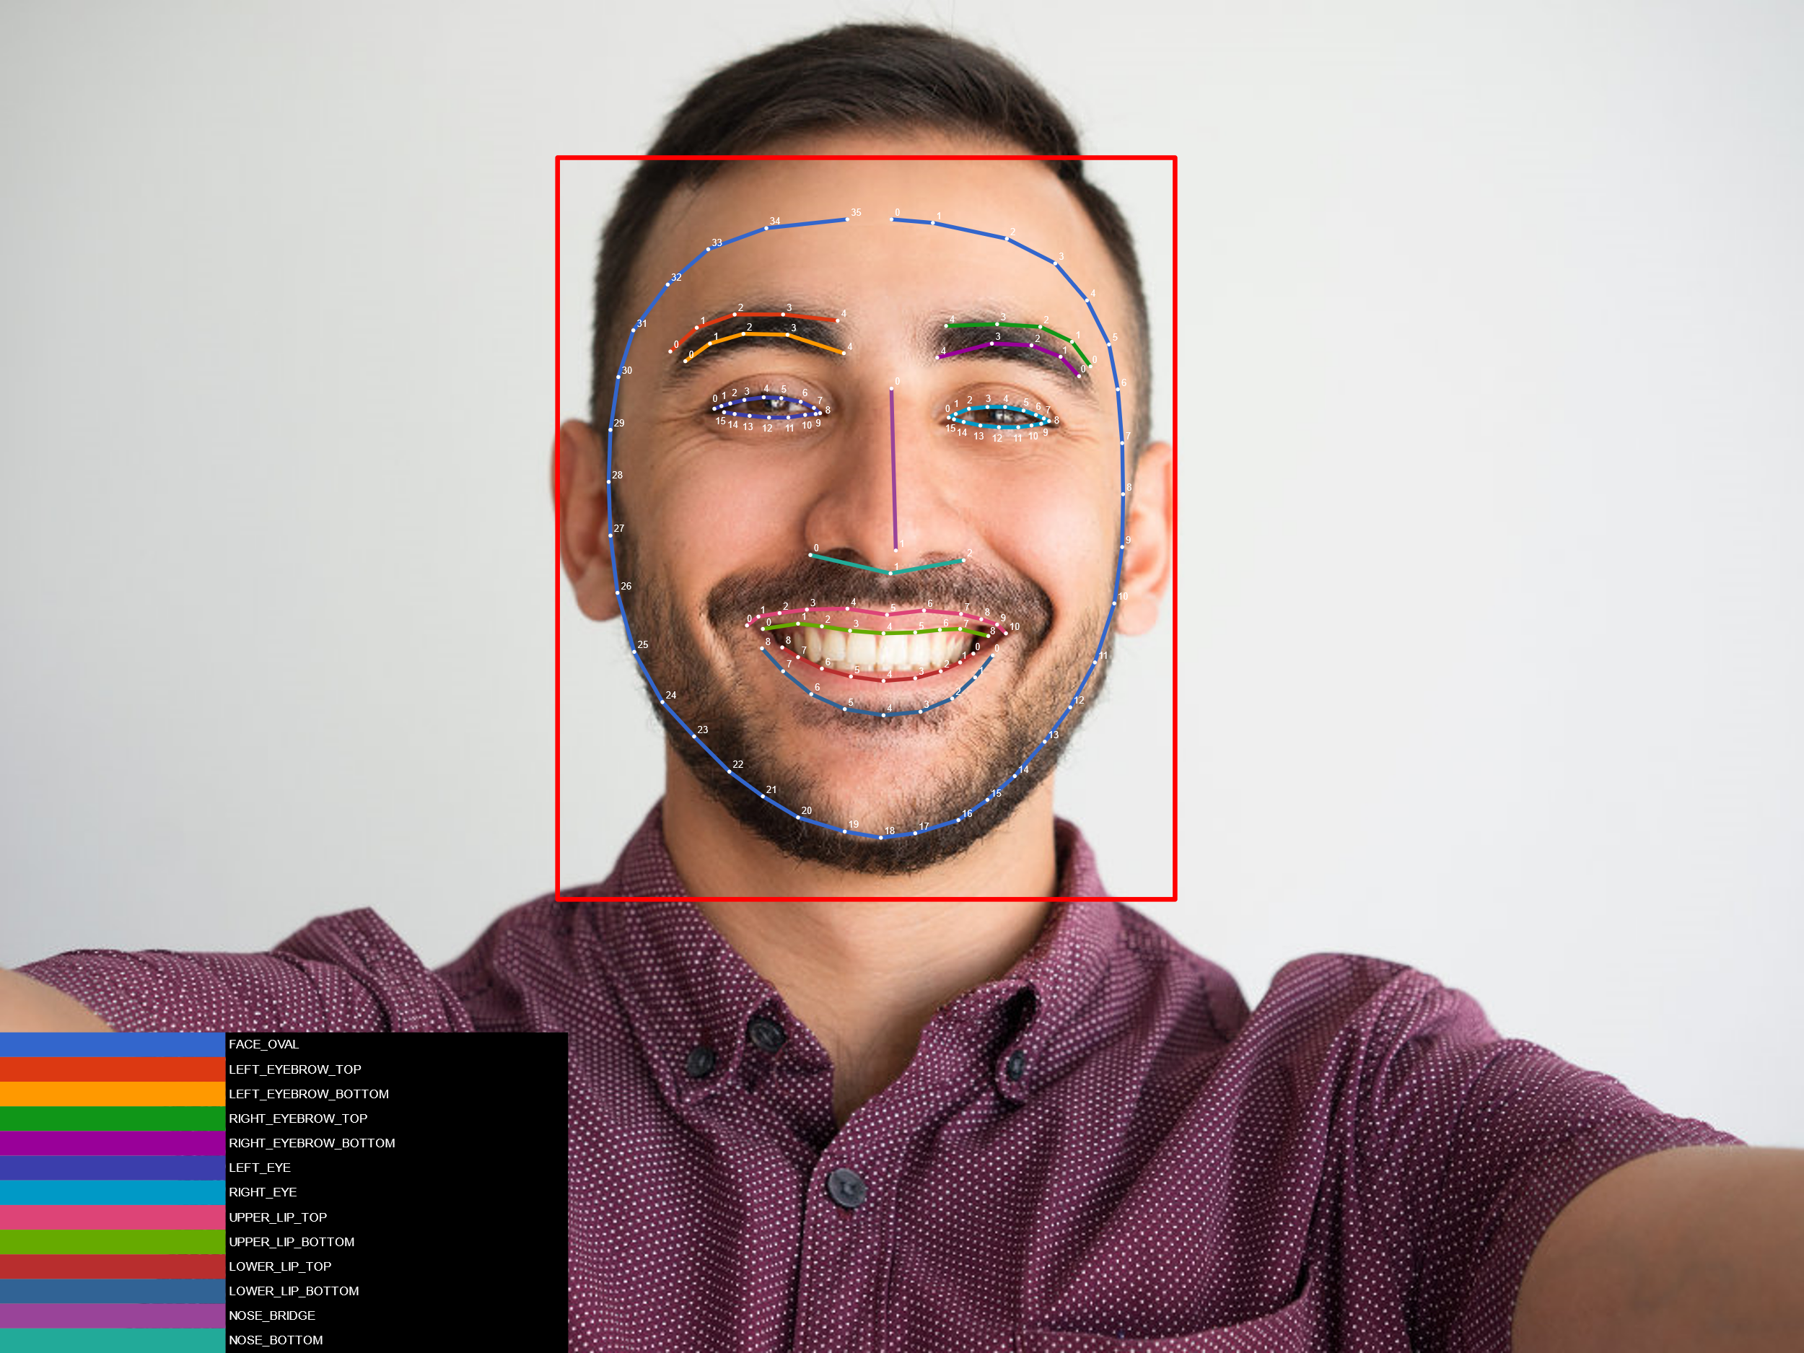
detector
get the detector
FaceDetector detector = FaceDetection.getClient(options);
get the image processed
Task<List<Face>> result =
detector.process(image)
.addOnSuccessListener(
new OnSuccessListener<List<Face>>() {
@Override
public void onSuccess(List<Face> faces) {
// Task completed successfully } })
.addOnFailureListener(
new OnFailureListener() {
@Override
public void onFailure(@NonNull Exception e) {
// Task failed with an exception } });

Slide 19
face information
basic info:
  Rect bounds = face.getBoundingBox();
  float rotY = face.getHeadEulerAngleY(); // Head is rotated to the right rotY degrees
  float rotZ = face.getHeadEulerAngleZ(); // Head is tilted sideways rotZ degrees
landmark:
mouth, ears, eyes, cheeks, and nose available
FaceLandmark leftEar = face.getLandmark(FaceLandmark.LEFT_EAR); if (leftEar != null) {
PointF leftEarPos = leftEar.getPosition();
}
classification:
getSmileProbability() (maybe null), if above 75% smiling.
getRightEyeOpenProbablitity (maybe null)
getLeftEyeOpenProbablitity (maybe null)
if contour detection was enabled:
both eyes, cheeks, nose, etc.
List<PointF> leftEyeContour = face.getContour(FaceContour.LEFT_EYE).getPoints();
List<PointF> upperLipBottomContour = face.getContour(FaceContour.UPPER_LIP_BOTTOM).getPoints();
if face tracking is enabled, you can get the face id.
face.getTrackingId(), again maybe null.

Slide 20
Face mesh detection

Slide 21
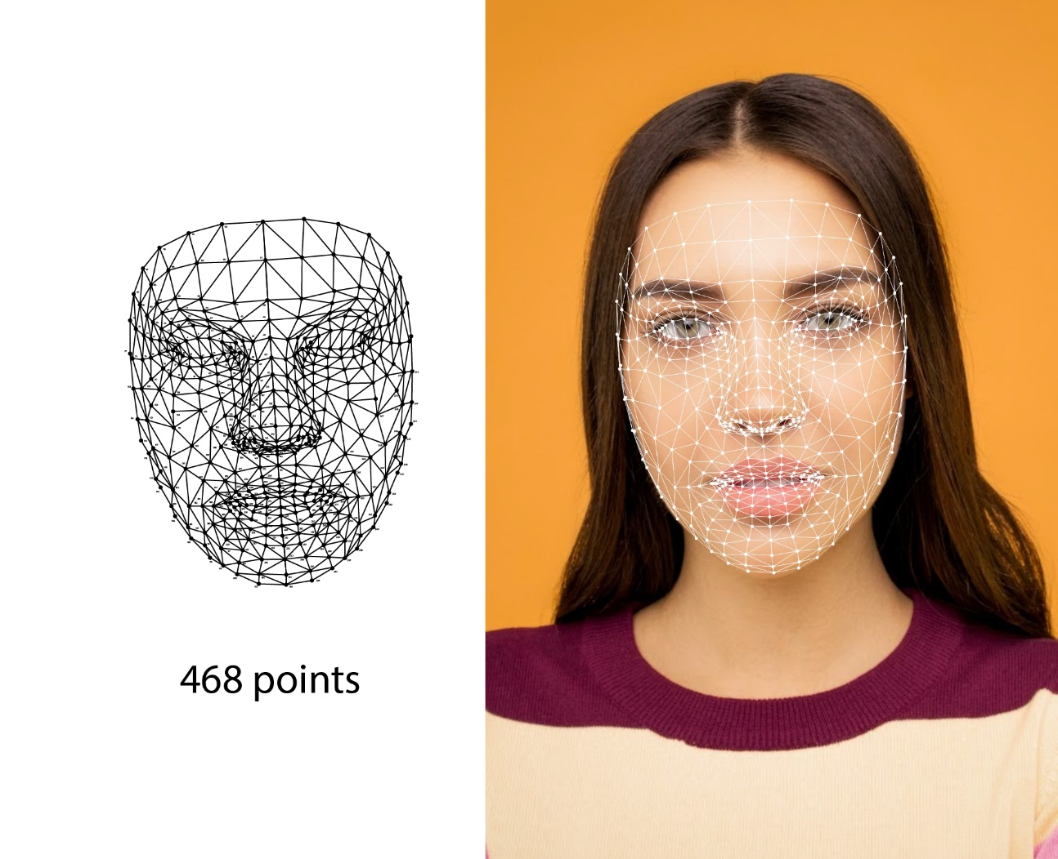
Face mesh detection
similar to face recognition, but also very different. It returns the following information:
  The bounding box is a rectangular area for a detected face.
  Face mesh info is a group of 468 3D points and edges that can be used to draw the geometry mesh for a detected face.
    Also returns triangle info, each connecting 3 points together.

Slide 22
Face Mesh detector
setup the options, default returns all or BOUNDING_BOX_ONLY.
and create the dectector
FaceMeshDetectorOptions.Builder optionsBuilder = new FaceMeshDetectorOptions.Builder();
detector = FaceMeshDetection.getClient(optionsBuilder.build());

Slide 23
Call the detector.
call the detector
it returns back a list of faceMesh objects
you can then draw or do whatever is needed with the data.
Task<List<FaceMesh>> result = detector.process(image)
.addOnSuccessListener(new OnSuccessListener<List<FaceMesh>>() {
@Override
public void onSuccess(List<FaceMesh> faceMeshs) {
if (faceMeshs == null) { return; }
for (FaceMesh faceMesh : faceMeshs) {
Rect bounds = faceMesh.getBoundingBox();
List<Triangle<FaceMeshPoint>> triangles = faceMesh.getAllTriangles();
for (Triangle<FaceMeshPoint> triangle : triangles) {
// 3 Points connecting to each other and representing a triangle area.
List<FaceMeshPoint> faceMeshPoints = triangle.getAllPoints();
}
} } } );

Slide 24
image labeling

Slide 25
Image Labeling
<meta-data
android:name="com.google.mlkit.vision.DEPENDENCIES"
android:value="ica" />
Get an image like shown before.

Slide 26
Image Labeling (2)
get a labeler
ImageLabeler labeler = ImageLabeling.getClient(ImageLabelerOptions.DEFAULT_OPTIONS);
and process it.
labeler.process(image)
.addOnSuccessListener(new OnSuccessListener<List<ImageLabel>>() {
@Override
public void onSuccess(List<ImageLabel> labels) {
// Task completed successfully } })
.addOnFailureListener(new OnFailureListener() {
@Override
public void onFailure(@NonNull Exception e) {
// Task failed with an exception } });

Slide 27
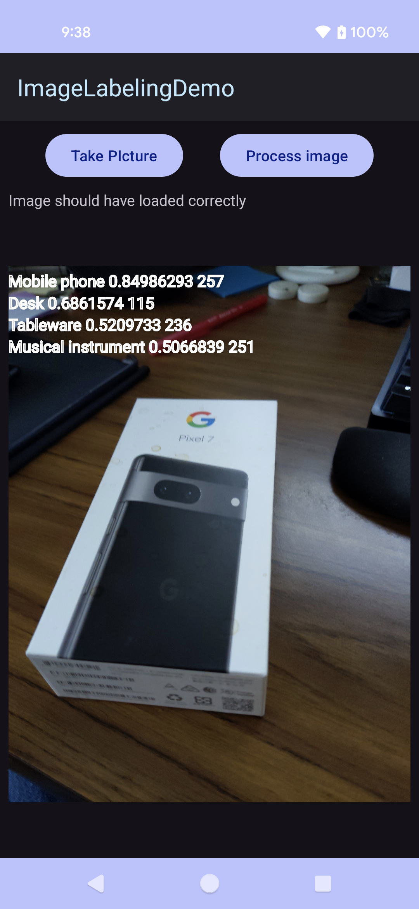
Image Labeling (3)
get the information, the base model support 400+ different labels
for (ImageLabel label : labels) {
String text = label.getText();
float confidence = label.getConfidence();
int index = label.getIndex();
}
There is a custom model version as well.

Slide 28
pose detection

Slide 29
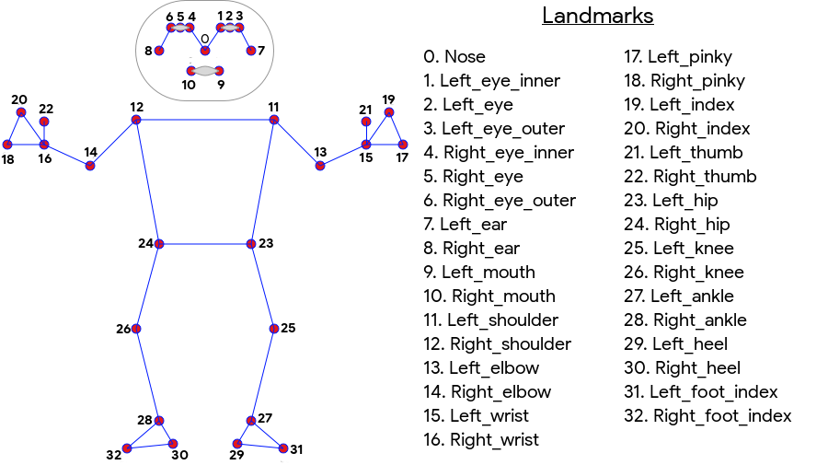
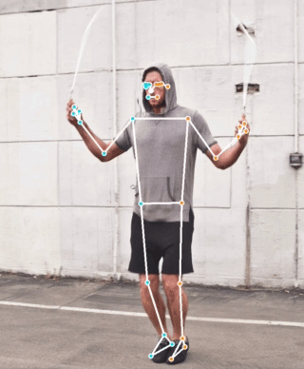
Pose Detection (beta)

Slide 30
Pose Detection (beta) 2
setup the processor for STREAM_MODE or SINGLE_IMAGE_MODE
AccuratePoseDetectorOptions options = new AccuratePoseDetectorOptions.Builder()
.setDetectorMode(AccuratePoseDetectorOptions.SINGLE_IMAGE_MODE).build();
PoseDetector poseDetector = PoseDetection.getClient(options);

Slide 31
Pose Detection (beta) 3
Provide the image like before. make if you configured stream, it's via the camera. Also the image must be at least 480x360.
and get a result.
Task<Pose> result =
poseDetector.process(image)
.addOnSuccessListener(
new OnSuccessListener<Pose>() {
@Override
public void onSuccess(Pose pose) {
// Task completed successfully } })
.addOnFailureListener(
new OnFailureListener() {
@Override
public void onFailure(@NonNull Exception e) {
// Task failed with an exception } });

Slide 32
Pose Detection (beta) 4
on success you can get the landmarks.
Get all PoseLandmarks. If no person was detected, the list will be empty
List<PoseLandmark> allPoseLandmarks = pose.getAllPoseLandmarks();
Or get specific PoseLandmarks individually. These will all be null if no person was detected
PoseLandmark leftShoulder = pose.getPoseLandmark(PoseLandmark.LEFT_SHOULDER);
PoseLandmark rightShoulder = pose.getPoseLandmark(PoseLandmark.RIGHT_SHOULDER);
… see slides before.

Slide 33
Object detection and tracking

Slide 34
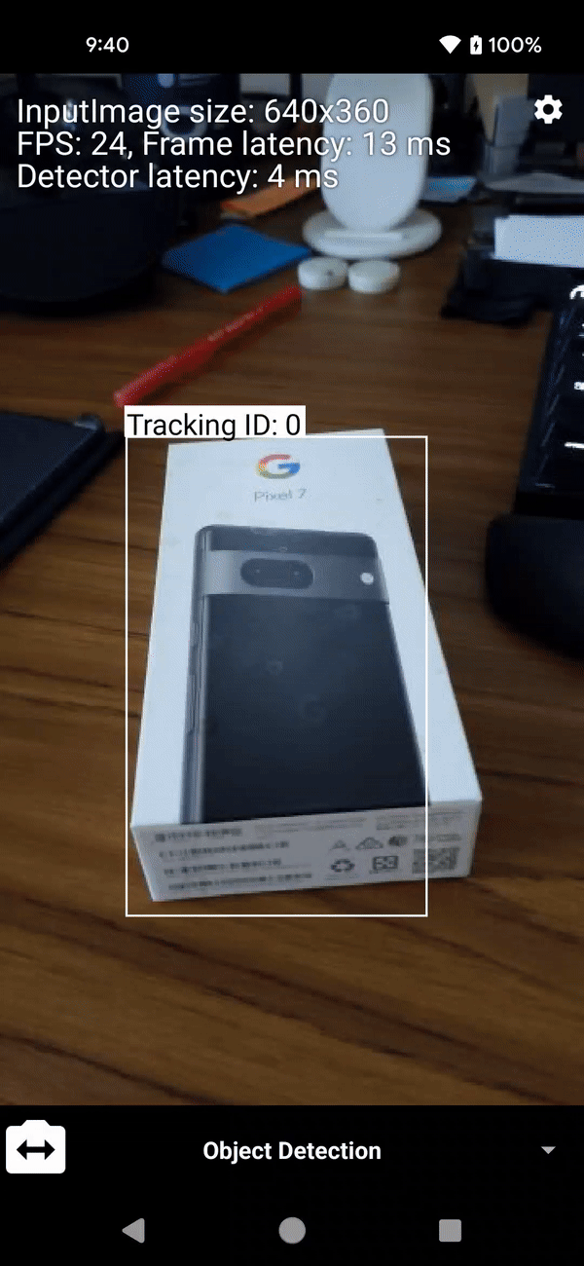
Object Detection and Tracking
as with the others, setup options, get an image, use the task to get a result, on success process the info.
DetectedObject
  bounding box and a tracking ID (ie for track that object)
  labels description, confidence, and index (predefined category)

Slide 35
text recognition v2

Slide 36
ML Text Recognition v2
With Firebase ML's text recognition API, you can recognize text in 100+ different languages and scripts. (both Android and iOS)
  With this Cloud-based API, you can automate tedious data entry and extract text from pictures of documents, which you can use to increase accessibility or translate documents.
  https://firebase.google.com/docs/ml/recognize-text
on-device text recognition is in the ML Kit.

Slide 37
Text Recognition
add to manifest.xml
<meta-data
android:name="com.google.mlkit.vision.DEPENDENCIES"
android:value="ocr" />
Get an image like others.
get the textRecognizer
TextRecognizer recognizer = TextRecognition.getClient();
and call the recognizer
Task<Text> result =
recognizer.process(image)
.addOnSuccessListener(new OnSuccessListener<Text>() {
@Override
public void onSuccess(Text visionText) {

Slide 38
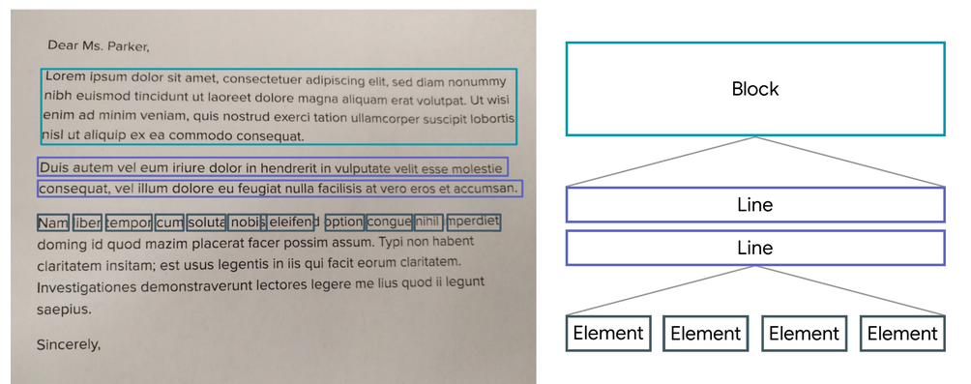
visual example.

Slide 39
Text Recognition (2)
a Text object is passed to the success listener. A Text object contains the full text recognized in the image and zero or more TextBlock objects.
  Each TextBlock represents a rectangular block of text, which contains zero or more Line objects. Each Line object contains zero or more Element objects, which represent words and word-like entities such as dates and numbers.
for (Text.TextBlock block : visionText.getTextBlocks()) {
String blockText = block.getText(); //all the text of this block
for (Text.Line line : block.getLines() ) {
String lineText = line.getText(); //all the text of this line
for (Text.Element element element : line.getElements()) {
String elementText = element.getText(); // the word of the element.
For each TextBlock, Line, and Element object, you can get the text recognized in the region and the bounding coordinates of the region.
  example: Rect elementFrame = element.getBoundingBox();

Slide 40
digital ink recognition

Slide 41
Digital Ink Recognition.
Converts handwritten text to sequences of unicode characters.
  Recognition is performed without any network connection.
Supports 300+ languages and 25+ writing systems including all major Latin languages, as well as Chinese, Japanese, Korean, Arabic, and Cyrillic. See the complete list of supported languages.
Recognizes emojis and basic shapes.
Shapes symbol recognition model.
  Recognizes basic shapes and returns the strings "RECTANGLE", "TRIANGLE", "ARROW", "ELLIPSE".

Slide 42
Digital Ink Recognition (2)
This uses the touchevent (and maybe canvas so the user can see what they are drawing), instead of an image.
create an Ink.Stroke object. very similar to a path object.
  You can include timing for better accuracy.

Slide 43
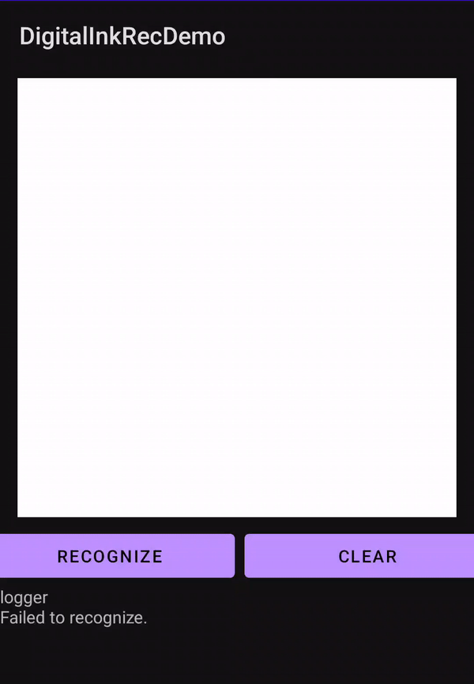
Digital Ink Recognition (3)
via the touchevent.
float x = event.getX();
float y = event.getY();
long t = System.currentTimeMillis();
int action = event.getActionMasked();
switch (action) {
case MotionEvent.ACTION_DOWN:
strokeBuilder = Ink.Stroke.builder();
strokeBuilder.addPoint(Ink.Point.create(x, y, t));
break;
case MotionEvent.ACTION_MOVE:
strokeBuilder.addPoint(Ink.Point.create(x, y, t));
break;
case MotionEvent.ACTION_UP:
strokeBuilder.addPoint(Ink.Point.create(x, y, t));
inkBuilder.addStroke(strokeBuilder.build());
strokeBuilder = null;
break;
}
Once you have a sample complete
get an ink object to send to recognizer
Ink ink = inkBuilder.build();

Slide 44
Digital Ink Recognition (4)
get the recognizer
Specify the recognition model for a language
DigitalInkRecognitionModelIdentifier modelIdentifier;
try {
modelIdentifier = DigitalInkRecognitionModelIdentifier.fromLanguageTag("en-US");
} catch (MlKitException e) { // language tag failed to parse, handle error. }
if (modelIdentifier == null) {
// no model was found, handle error.
}
DigitalInkRecognitionModel model = DigitalInkRecognitionModel.builder(modelIdentifier).build()
.setModelIdentifier(modelIdentifier)
.build();
Get a recognizer for the language
DigitalInkRecognizer recognizer = DigitalInkRecognition.getClient( DigitalInkRecognizerOptions.builder(model) ).build();
finally get results
recognizer.recognize(ink)
.addOnSuccessListener

Slide 45
Self segmentation

Slide 46
Segmenter
create a segmentater with the correct options
  STREAM_MODE or SINGLE_IMAGE_MODE
SelfieSegmenterOptions options =new SelfieSegmenterOptions.Builder()
. .setDetectorMode(SelfieSegmenterOptions.SINGLE_IMAGE_MODE)
.build();
segmenter = Segmentation.getClient(options);

Slide 47
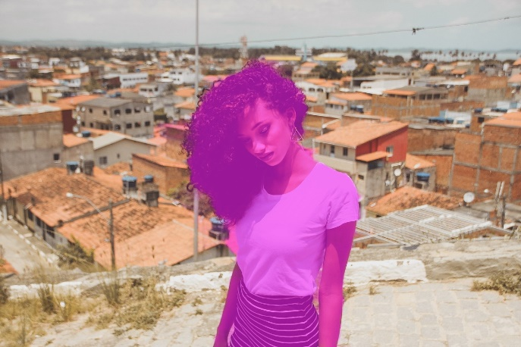
Segmenter (2)
call the task and get the mask result back.
By default, the mask will be the same size as the input image. Each pixel of the mask is assigned a float number that has a range between [0.0, 1.0]. The closer the number is to 1.0, the higher the confidence that the pixel represents a person, and vice versa.
Task<SegmentationMask> result = segmenter.process(image)
.addOnSuccessListener(new OnSuccessListener<SegmentationMask>() {
@Override
public void onSuccess(SegmentationMask result) {
// Task completed successfully
if (result == null) {
binding.logger.setText("No Subject found.");
return;
}
ByteBuffer mask = result.getBuffer();
//do something witt the image.
}
})

Slide 48
subject segmentation

Slide 49
Subject Segmentation
similar to selfie segmentation, but now it could be people, pets, or prominent objects.
Can provide back either a mask or the bitmap of each subject it finds in the picture.
SubjectSegmenterOptions options = new SubjectSegmenterOptions.Builder()
.enableMultipleSubjects(
new SubjectSegmenterOptions.SubjectResultOptions.Builder()
.enableConfidenceMask()
.build())
.build();
OR
SubjectSegmenterOptions options = new SubjectSegmenterOptions.Builder()
.enableMultipleSubjects(
new SubjectSegmenterOptions.SubjectResultOptions.Builder()
.enableSubjectBitmap()
.build())
.build();
segmenter = SubjectSegmentation.getClient(options);

Slide 50
Subject Segmentation
Task<SubjectSegmentationResult> result = segmenter.process(image)
.addOnSuccessListener(new OnSuccessListener<SubjectSegmentationResult>() {
@Override
public void onSuccess(SubjectSegmentationResult result) {
// Task completed successfully
if (result == null) { return; } //no subjects
//to get the list of all the subjects.
subjects = result.getSubjects();
for (int k = 0; k < subjects.size(); k++) {
Subject subject = subjects.get(k);
FloatBuffer mask = subject.getConfidenceMask();
//do something, like draw on the picture.
}
//to get the list of all the subject bitmaps
List<Bitmap> bitmaps = new ArrayList<Bitmap>();
for (Subject subject : subjects) {
bitmaps.add(subject.getBitmap());
}
} });
use the segmenter to get the mask (or bitmaps) for each subject it finds
then do something with them.

Slide 51
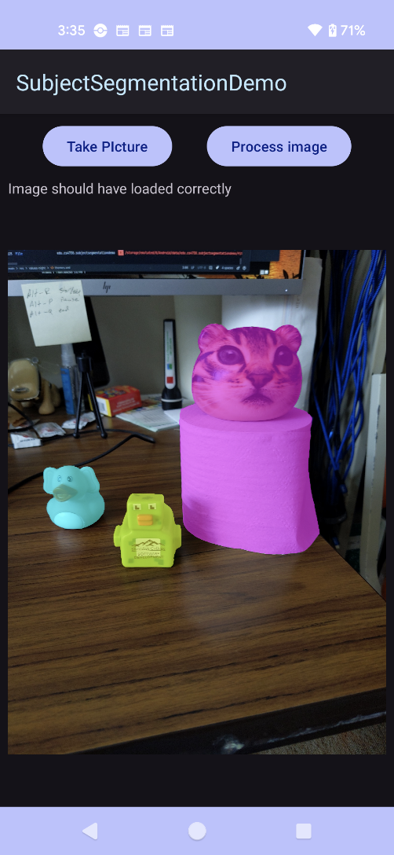
Subject Segmentation (3)
The result, in my demo is one that color each other object a different color.

Slide 52
document scanner

Slide 53
Document Scanner
Digitize physical documents from pictures.
  This is not text recognition. It's about getting "clean" documents.
allows you to use a phone to scan documents, as images and/or pdf, including a page count.
the ML allows you scan in documents then preform edge detection for optimal crop results, rotation, and editing functions to remove shadows, stains, and other filter to get clean digital images.
  No camera permissions needs.

Slide 54
Document scanner code
The code is actually very simple
  create the options
    max pages,
    editing,
      basic mode (just crop)
      filter
      FULL with adds in ML
  call a start an intent for result
    this where most of the user work happens
  read in the jpg images or pdf documents in the app.
GmsDocumentScannerOptions options = new GmsDocumentScannerOptions.Builder()
.setGalleryImportAllowed(false)
.setPageLimit(1) //just one page for this example.
.setResultFormats(GmsDocumentScannerOptions.RESULT_FORMAT_JPEG, GmsDocumentScannerOptions.RESULT_FORMAT_PDF)
//use ml to clean up the document even removing stains and fingers
.setScannerMode(GmsDocumentScannerOptions.SCANNER_MODE_FULL)
.build();
scanner.getStartScanIntent(this)
.addOnSuccessListener(intentSender ->
scannerLauncher.launch(new IntentSenderRequest.Builder(intentSender).build()))

Slide 55
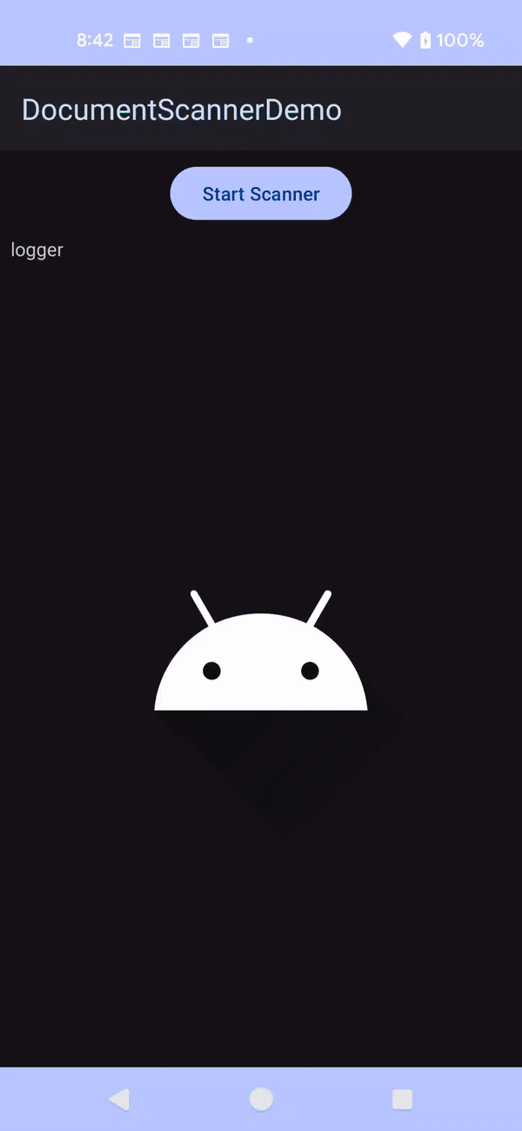
Document scanner code
public void onActivityResult(ActivityResult activityResult) {
if (activityResult.getResultCode() == RESULT_OK) {
GmsDocumentScanningResult documentScanningResult = GmsDocumentScanningResult.fromActivityResultIntent(activityResult.getData());
for (GmsDocumentScanningResult.Page page : documentScanningResult.getPages()) {
Uri imageUri = page.getImageUri();
binding.imageView.setImageURI(imageUri);
}

Slide 56
natural language

Slide 57
Natural Language
The natural language parts of the ML kit
  identity language
    you can determine the language of a string of text. can identify over one hundred different languages
  translate text
    you can dynamically translate text between more than 50 languages.
    On-device translation is intended for casual and simple translations. If you require higher fidelity, try the Cloud Translation API.
  smart replies
    can automatically generate relevant replies to messages.
  entity extraction (beta)
    Entity extraction improves the user experience inside your app by understanding text and allowing you to add helpful shortcuts based on context.

Slide 58
Identity Language
Note, how you get the text is no part of identity language. So via the camera in text recognition or the user typed it in.
we get the identifier and send it the text.
LanguageIdentifier languageIdentifier =
LanguageIdentification.getClient(); //default confidence is 0.5
to change the confidence
LanguageIdentifier languageIdentifier = LanguageIdentification.getClient(
new LanguageIdentificationOptions.Builder()
.setConfidenceThreshold(0.34f)
.build());

Slide 59
Identity Language (2)
call the identifier
languageIdentifier.identifyLanguage(text)
.addOnSuccessListener(
new OnSuccessListener<String>() {
@Override
public void onSuccess(@Nullable String languageCode) {
if (languageCode.equals("und")) {
Log.i(TAG, "Can't identify language.");
} else {
Log.i(TAG, "Language: " + languageCode); //If the call succeeds, a BCP-47 language code is passed to the success listener,
} //https://tools.ietf.org/rfc/bcp/bcp47.txt
}
})
.addOnFailureListener(
new OnFailureListener() {
@Override
public void onFailure(@NonNull Exception e) {
// Model couldn’t be loaded or other internal error. } });

Slide 60
Identity Language (3)
for a list of possible languages and confidences
LanguageIdentifier languageIdentifier =
LanguageIdentification.getClient();
languageIdentifier.identifyPossibleLanguages(text)
.addOnSuccessListener(new OnSuccessListener<List<IdentifiedLanguage>>() {
@Override
public void onSuccess(List<IdentifiedLanguage> identifiedLanguages) {
for (IdentifiedLanguage identifiedLanguage : identifiedLanguages) {
String language = identifiedLanguage.getLanguageTag();
float confidence = identifiedLanguage.getConfidence();
Log.i(TAG, language + " (" + confidence + ")");
}
}
})
.addOnFailureListener(
new OnFailureListener() {
@Override
public void onFailure(@NonNull Exception e) {
// Model couldn’t be loaded or other internal error. } });

Slide 61
Translate Text
Please note, there are lots of restrictions and attributions to using the translate.
  https://developers.google.com/ml-kit/language/translation/translation-terms
supported languages
  https://developers.google.com/ml-kit/language/translation/translation-language-support

Slide 62
Translate Text (2)
set the translate options. source and target language.
  English to German
  TranslatorOptions options =
  new TranslatorOptions.Builder()
  .setSourceLanguage(TranslateLanguage.ENGLISH)
  .setTargetLanguage(TranslateLanguage.GERMAN)
  .build();
and get a translator
translator = Translation.getClient(options);

Slide 63
download models as needed.
You will need to download the models, before you translate and remember this is a background task.
  each of which maybe 20MBs and you should only do this via wifi unless you have permission from the user.
  DownloadConditions conditions = new DownloadConditions.Builder()
  .requireWifi().build();
  translator.downloadModelIfNeeded(conditions)
  .addOnSuccessListener(new OnSuccessListener() {
  @Override
  public void onSuccess(Object o) {
  //successfully downloaded. now you can translate.
  } })
  .addOnFailureListener(new OnFailureListener() {
  @Override
  public void onFailure(@NonNull Exception e) { //failed to download model } });

Slide 64
Translate
to translate
translator.translate(text)
.addOnSuccessListener(
new OnSuccessListener<String>() {
@Override
public void onSuccess(String s) {
// s is the translated text.
} })
.addOnFailureListener(
new OnFailureListener() {
@Override
public void onFailure(@NonNull Exception e) {
//failed to translate.
} });

Slide 65
Smart Replies
You create a conversation object.
  it contents the local user messages and the remote user(s) messages
    contents timestep, userid (for multiple remote users), and message
    Note the remote user must be the last entry.
You then pass that object to a suggestedRelies task.
  if the task is successful, it will return a set of suggestions.
    you can then display the suggestions to the user.

Slide 66
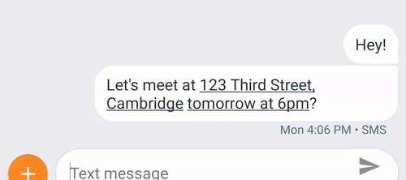
Entity Extraction (beta)
When you are displaying information to a user, you can use the entity extractor to add more context, very beta still.
add the text into an entity object and then run the extractor.
It will return "entities" objects with information about them.
In this example, an address information
others are flight, phone, money,
url, email, date/time , etc

Slide 67
References
https://console.firebase.google.com/
https://firebase.google.com/docs/ml
  Machine Learning codelab: https://firebase.google.com/docs/ml/codelabs
  For flutter:
    FlutterFire: https://github.com/FirebaseExtended/flutterfire/tree/master/packages/firebase_ml_vision
https://developers.google.com/ml-kit (it has all the links to the different projects)
https://developers.google.com/ml-kit/vision/barcode-scanning
https://developers.google.com/ml-kit/vision/face-detection
https://developers.google.com/ml-kit/vision/digital-ink-recognition
https://developers.google.com/ml-kit/vision/object-detection
https://developers.google.com/ml-kit/vision/pose-detection

Slide 68
Q
A
&

