Slide 1
Cosc 5/4730
Fragments

Slide 2
Fragments
You can think of a fragment as a modular section of an activity, which has its own lifecycle, receives its own input events, and which you can add or remove while the activity is running (sort of like a "sub activity" that you can reuse in different activities).
There is a Support Library, so your app remains compatible with devices running system versions as old as Android 1.6.
You can have more then one fragment in a layout as well.
In many ways you can think of a fragment as a custom view.
Using the fragment manager, you can easy change between fragments as well.
In the xml you use a framelayout, which the fragment is then place in.

Slide 3
Basics
The main activity is created as normal with a layout. The code the main activity is reduced to the onCreate, menu, and fragments controls.
Otherwise, everything else is handled in the fragments.
Fragments come in a couple of varieties like activities
Fragment, ListFragment (like a listView), DialogFragment, PreferenceFragment, and WebViewFragment, even a FragmentTabHost

Slide 4
How it works.
You will separate code for each fragment (normally in their own file) with their own layout.
The Activity will also have it's own code and layout
the layout is likely just a framelayout
The activity is responsible for changing fragments and communication between fragments.

Slide 5
Activity XML layout
In the xml, we using fragment and associate each fragment with a java class of fragment
Our example layout:
<fragment
android:id="@+id/frag_titles" android:layout_weight="1"
android:layout_width="0dp" android:layout_height="match_parent"
class="edu.cs4730.frag1demo.titlefrag" />
This is the most common layout , since you want to change fragments.
<framelayout
android:id="@+id/container"
android:layout_width=“match_parent" android:layout_height="match_parent"/>
frag_titles uses titlefrag.java class
this layout will have one fragment and a framelayout,
the LinearLayout of was left off for space.

Slide 6
Fragment code
In the Fragment, you have the same callback methods as an activity
onCreate(), onStart(), onPause(), and onStop()
And OnCreateView()
The system calls this when it's time for the fragment to draw its user interface for the first time. To draw a UI for your fragment, you must return a View from this method that is the root of your fragment's layout.
You can return null if the fragment does not provide a UI.
OnAttach() and OnDetach()
This is when a fragment becomes associated with an activity.

Slide 7
Fragment code (2)
You should implement at least these three
OnCreate(), onCreateView()
The onCreate() is for setup of variables
OnCreateView()
Android also says the OnPause().
See http://developer.android.com/guide/components/fragments.html for the Fragment life cycle and the other callback methods.

Slide 8
Fragment
The OnCreateView() returns a view and calls the layout associated with this fragment
R.layout.text is the layout being used for this view.
@Override
public View onCreateView(LayoutInflater inflater, ViewGroup container, Bundle savedInstanceState) {
binding = FragmentTwoBinding.inflate(inflater, container, false);
binding.tv.setText(“Hi”);
return binding.getRoot();
}
Note this uses viewbinding, which makes fragments much easier to follow. the binding is declared global to the fragment.

Slide 9
Fragments from MainActivity
In the activity, using the fragment Manager, you place a fragment in a framelayout
the framelayout id is container.
If the framelayout is empty, you use add
getSupportFragmentManager().beginTransaction()
.add(binding.container.getId(), new oneFragment())
.commit();
If you add another, then it appears on top of it showing fragments.
Changing from one fragment to another, use replace.
getSupportFragmentManager().beginTransaction()
.replace(binding.container.getId(), new twoFragment())
.commit();
See the ViewBindingFragDemo in viewbinding directory for demo code.

Slide 10
Callbacks and setters/ CONSTRUCTORS

Slide 11
Communication between fragments
we can use callbacks and setters/constructors to communicate between fragments via the activity.
The activity passes the data between them or preforms actions the fragments can’t (such as changing fragments).
Note much of these can be replaced with a modelview and livedata, which android/google is encouraging.
And Arch Navigation allows fragments to change between fragments, which really cleans up the code too.

Slide 12
Setters
The constructor takes values when the fragment is instantiated.
This is done with setArguments/getArguments in the factory methods.
A setter takes the new values and updates the variables.
The widgets/views are now updates as needed.

Slide 13
callbacks
The fragment creates a interface, which is a fragment listener.
The activity implements it.
This is likely a button click or other action.
Now the activity receives it and the data. It then preforms the necessary action.
Note, When you create a new fragment, studio has a check mark to create skeleton code for the callback in your fragment.

Slide 14
Callbacks created in the fragment
Use the onAttach() and OnDeteach() to set the variable correctly.
@Override
public void onAttach(Activity activity) {
super.onAttach(activity);
try {
mListener = (OnFragmentInteractionListener) activity;
} catch (ClassCastException e) { }
}
@Override
public void onDetach() {
super.onDetach();
mListener = null;
}
Create the interface.
public interface OnFragmentInteractionListener {
// change parameters to your needs.
public void onFragmentInteraction(String Data);
}
Declare a variable of the interface to use in the fragment.
private OnFragmentInteractionListener mListener;

Slide 15
Callbacks fragment in the fragment (2)
Lastly use the variable (carefully).
if (mListener != null) {
mListener.onFragmentInteraction(variable);
}
Likely called from some widget/view listener when the user preforms some action.

Slide 16
Callbacks used in the activity
The activity then implements the interface.
public class MainActivity extends ActionBarActivity implements myFrag.OnFragmentInteractionListener {
And somewhere in the code
@Override
public void onFragmentInteraction(String Data) { //matches the one created in fragment
//implement whatever code is necessary
//to carry out the action.
}
The activity can implement multiple interfaces for different fragments (different names) or the same one for all of them (same name).

Slide 17
Callbacks, not an Android invention.
Android calls them callbacks, but this is just the standard java interface mechanic
You can add (and may need) to any class.
The method is then just an object that is run when called.
Callback/interface vs listener
A callback or interface must have an “implements X” otherwise it won’t compile or dies a runtime.
There is no default action
A listener can work without any extra code and the default action is taken.
Normally a default action is to do nothing.

Slide 18
Listviews, fragments, and callbacks.

Slide 19
Frag com with listview.
Callback listener, via
the onItemClick methods
the Activity “sends” the information to the text fragment

Slide 20
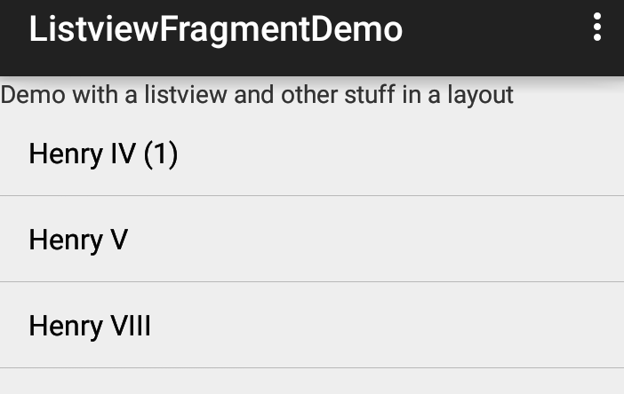
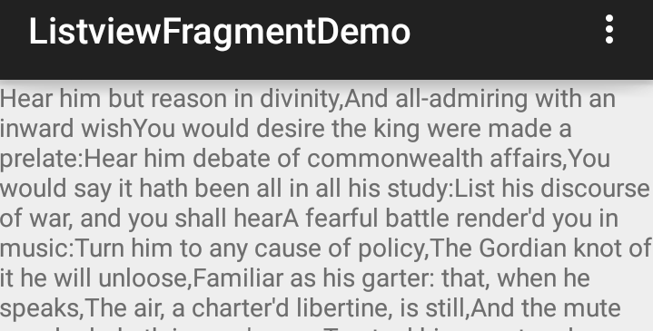
Frag com with listview (2)
Callback listener, via
the onItemClick methods
Since the text fragment is not on the screen, it adds it and sets the arguments to the fragment.
The fragment reads the position via
Get arguments, in the onStart()
method.
It then displays the correct info.
Pressing the back button, return to
listview again.

Slide 21
Later on.
We will come back and see more of this callbacks in the listview and recyclerview lectures
Note, we are going to confuse and simplify this all of this with modelview and architecture navigation.

Slide 22
Q
A
&

