Slide 1
cosc 5/4730
Basic GUI: Activities, fragments, and Views/Widgets

Slide 2
UI Design
We can spend an entire semester on just UI design. But I’m not a HCI person.
Google has become far more involved in UI design and release some design specs.
  http://developer.android.com/design/index.html
Another great place for android gui design
  http://www.behance.net/gallery/Google-Visual-Assets-Guidelines-Part-1/9028077
  http://www.behance.net/gallery/Google-Visual-Assets-Guidelines-Part-2/9084309

Slide 3
What is an Activity?
An Activity is an application component
Represents one window, one hierarchy of views
Typically fills the screen, but can be embedded in other Activity or a appear as floating window
Java class, typically one Activity in one file

Slide 4
What does an Activity do?
Represents an activity, such as ordering groceries, sending email, or getting directions
Handles user interactions, such as button clicks, text entry, or login verification
Can start other activities in the same or other apps
Has a life cycle—is created, started, runs, is paused, resumed, stopped, and destroyed

Slide 5
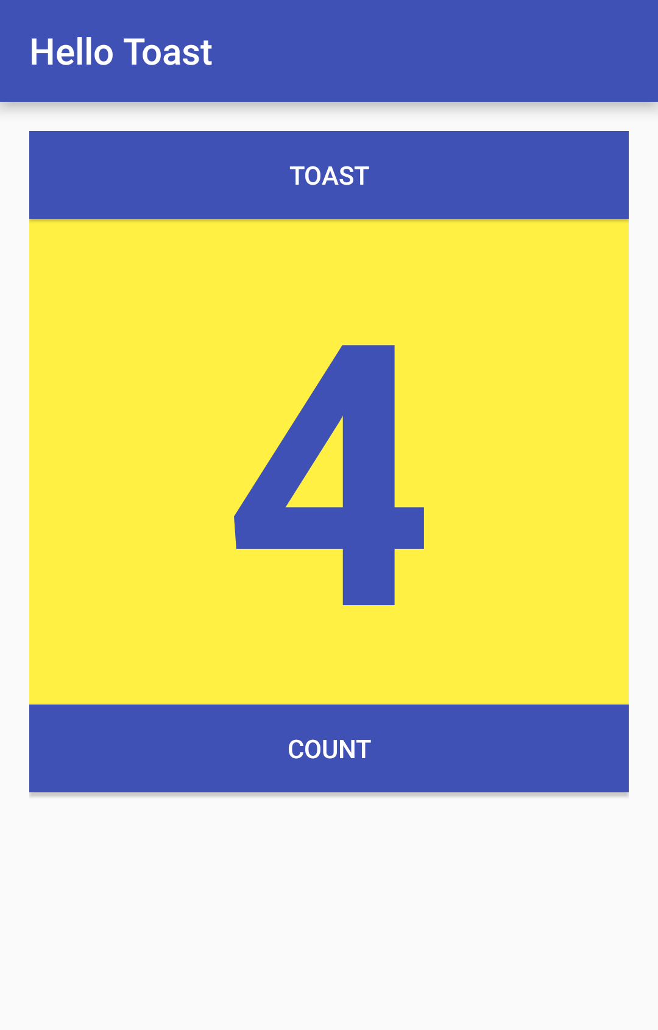
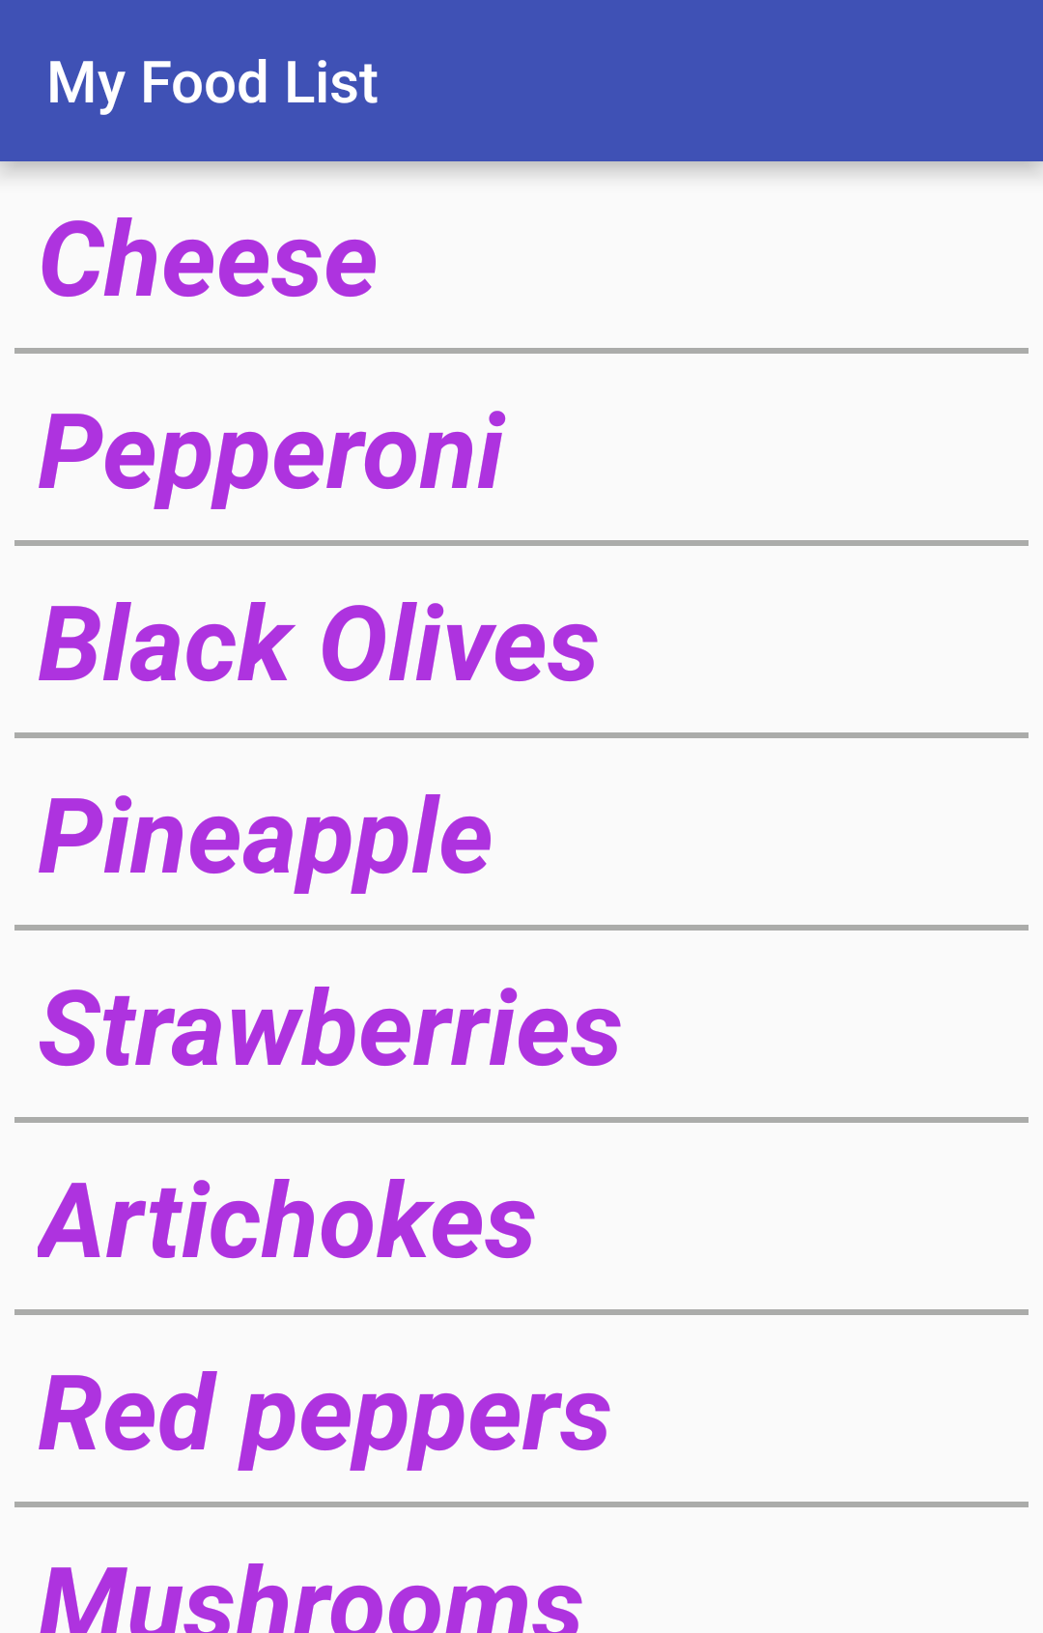
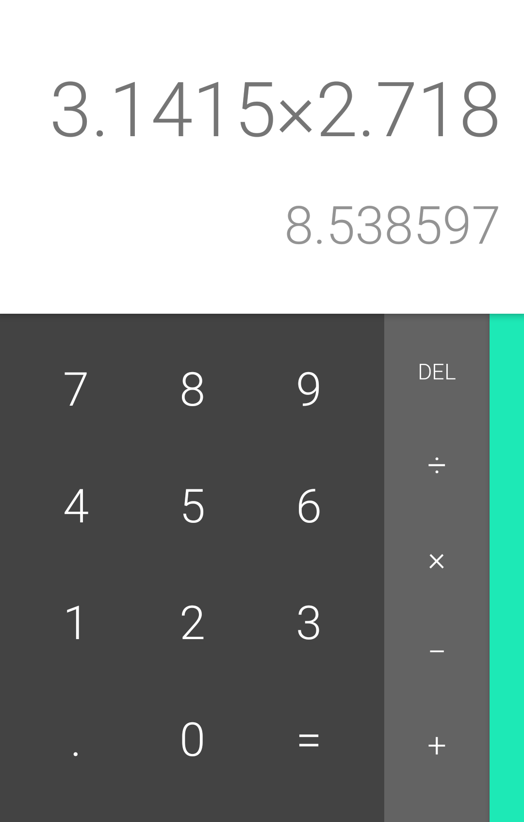
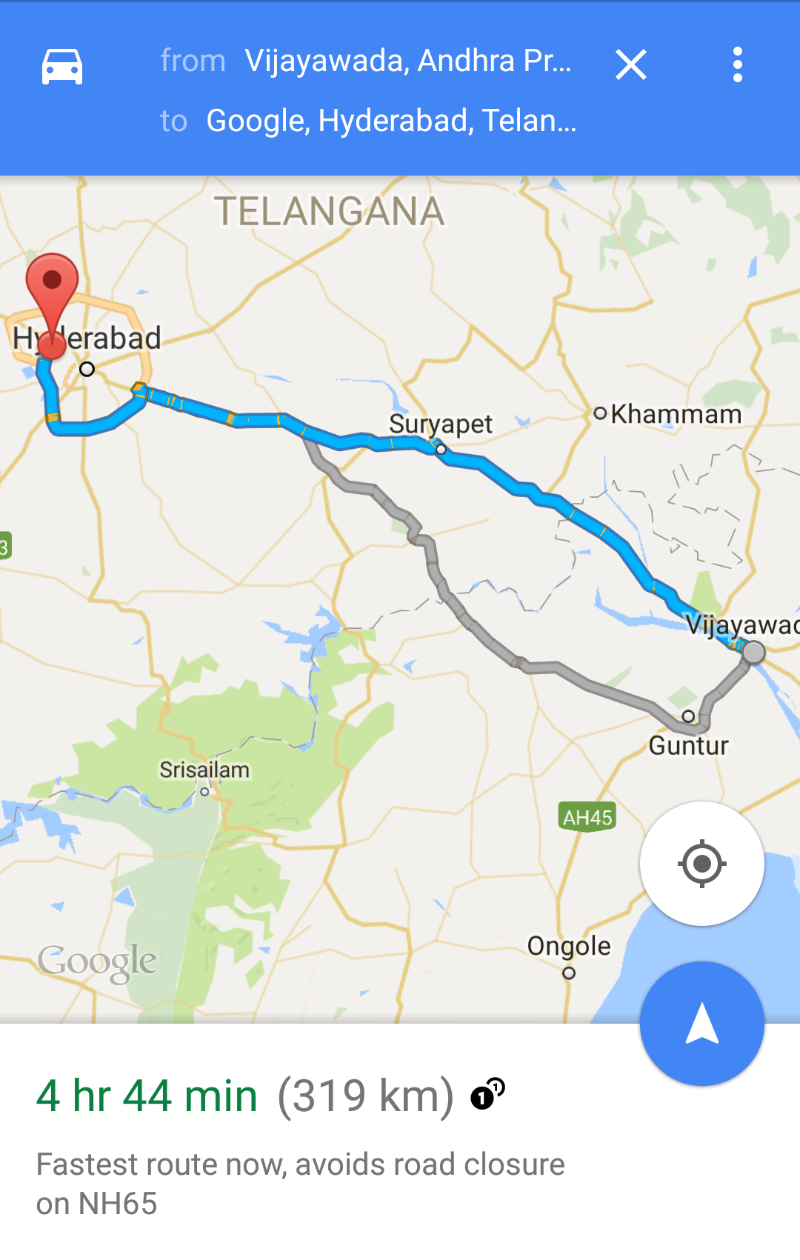
Examples of activities

Slide 6
Apps and activities
Activities are loosely tied together to make up an app
First Activity user sees is typically called "main activity"
Activities can be organized in parent-child relationships in the Android manifest to aid navigation

Slide 7
Implement new activities
Define layout in XML
Define Activity Java class
  extends AppCompatActivity
Connect Activity with Layout (and/or fragment)
  Set content view in onCreate()
Declare Activity in the Android manifest
  Studio will do all this for in when you create a new activity.

Slide 8
Define layout in XML
<?xml version="1.0" encoding="utf-8"?>
<RelativeLayout
xmlns:android="http://schemas.android.com/apk/res/android"
android:layout_width="match_parent"
android:layout_height="match_parent">
<TextView
android:layout_width="wrap_content"
android:layout_height="wrap_content"
android:text="Let's Shop for Food!" />
</RelativeLayout>

Slide 9
Define Activity Java class
public class MainActivity extends AppCompatActivity {
@Override
protected void onCreate(Bundle savedInstanceState) {
super.onCreate(savedInstanceState);
}
}

Slide 10
3. Connect activity with layout
public class MainActivity extends AppCompatActivity {
@Override
protected void onCreate(Bundle savedInstanceState) {
super.onCreate(savedInstanceState);
setContentView(R.layout.activity_main);
}
}
Resource
is layout
in this XML file
Note this superseded by viewBinding

Slide 11
Declare activity in Android manifest
<activity android:name=".MainActivity">
Note, there can be many options. orientation is a very common one.

Slide 12
4. Declare main activity in manifest
MainActivity needs to include intent-filter to start from launcher
<activity android:name=".MainActivity">
<intent-filter>
<action android:name="android.intent.action.MAIN" />
<category android:name="android.intent.category.LAUNCHER" />
</intent-filter>
</activity>

Slide 13
Screen size

Slide 14
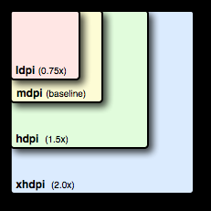
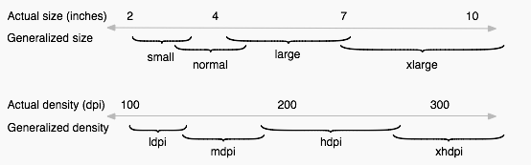
Screen Size
In the android directories, there is a res/
  drawable/ and mipmap/
    This deals with the screen density of pixels.
      The configuration qualifiers you can use for density-specific resources are ldpi (low), mdpi (medium which is the baseline), hdpi (high), and xhdpi (extra high). For example, bitmaps for high-density screens should go in drawable-hdpi/.

Slide 15
Screen Size and layouts
Scaling: medium is the baseline
  Small = mdpi*.75, high=mdpi*1.5 and xhigh=mdpi*2.0
    Pixels: Small=36, medium=48, high=72, and xhigh=96
  Note, if images will be rescaled for different sizes, if you don’t provide one. The default is the mdpi directory.
For density there are to more
  nodpi
    Resources for all densities. These are density-independent resources. The system does not scale resources tagged with this qualifier, regardless of the current screen's density.
  tvdpi
    Which is for TVs and google’s own doc’s say not to use it and use xhdpi instead.
    Except the new Nexus 7” tablet is a tvdpi device.
      1.33*mdpi or 100px image should be 133px

Slide 16
Screen Size and layouts (2)
  layout/
    This is deals with the screen size.
    Layout/ is the default
    We can have small (~ 426dp x 320dp), normal (470dp x 320 dp) which is the baseline, large (640dp x 480dp), and xlarge (960dp x 720dp)
      We can also add land (landscape) and port (portrait) orientation.
      res/layout/my_layout.xml // layout for normal screen size ("default")
      res/layout-small/my_layout.xml // layout for small screen size
      res/layout-large/my_layout.xml // layout for large screen size
      res/layout-xlarge/my_layout.xml // layout for extra large screen size
      res/layout-xlarge-land/my_layout.xml // layout for extra large in landscape orientation

Slide 17
Screen Size and layouts (3)
As of v3.2 (api 13), the size groups are deprecated for a new method.
    This is the problem: 7” tablet is actually in the 5” phone group, which is the large group.
  Provides a smallestWidth (independent of orientation) and Width (which is also takes into account orientation)
  layout-sw<N>dp and layout-w<N>dp
    Where N is the density of pixels.

Slide 18
Screen Size and layouts (4)
Typical configuration:
  320dp: a typical phone screen (240x320 ldpi, 320x480 mdpi, 480x800 hdpi, etc).
  480dp: a tweener tablet like the Streak (480x800 mdpi).
  600dp: a 7” tablet (600x1024 mdpi).
  720dp: a 10” tablet (720x1280 mdpi, 800x1280 mdpi, etc).
Smallest width (no orientation)
res/layout/main_activity.xml # For handsets (smaller than 600dp available width)
res/layout-sw600dp/main_activity.xml # For 7” tablets (600dp wide and bigger)
res/layout-sw720dp/main_activity.xml # For 10” tablets (720dp wide and bigger)
Using just width and taking orientation into account
res/layout/main_activity.xml # For handsets (smaller than 600dp available width)
res/layout-w600dp/main_activity.xml # Multi-pane (any screen with 600dp available width or more)
More information: http://developer.android.com/guide/practices/screens_support.html

Slide 19
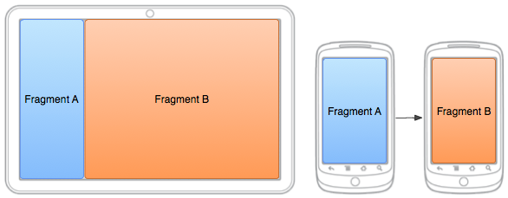
Fragments and screen size
Fragments are also used to deal with different screen sizes.
Based on the size, we have different layouts to display the fragments.
  On a smaller screen, java code is used to display fragment B as it is needed.

Slide 20
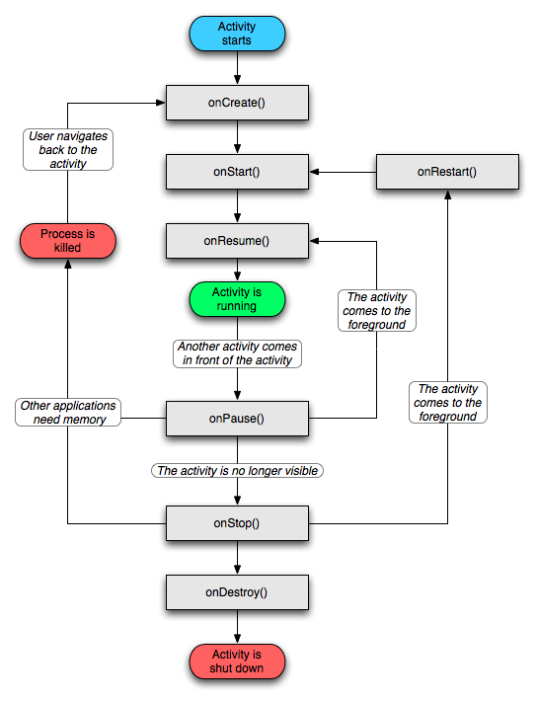
Activity Lifecycle
An activity has essentially four states:
  If an activity in the foreground of the screen (at the top of the stack), it is active or running.
  If an activity has lost focus but is still visible (that is, a new non-full-sized or transparent activity has focus on top of your activity), it is paused. A paused activity is completely alive (it maintains all state and member information and remains attached to the window manager), but can be killed by the system in extreme low memory situations.
  If an activity is completely obscured by another activity, it is stopped. It still retains all state and member information, however, it is no longer visible to the user so its window is hidden and it will often be killed by the system when memory is needed elsewhere.
  If an activity is paused or stopped, the system can drop the activity from memory by either asking it to finish, or simply killing its process. When it is displayed again to the user, it must be completely restarted and restored to its previous state.

Slide 21
Activities
Android OS keeps track of all the Activity objects running by placing them on a Activity Stack.
  When a new Activity starts, it is placed on top of the stack.
  The previous Activity is now in background.
    If only partially obscured (say dialog box), only onpause() is called
      onResume() called when the user can interact with it again
    if invisible to the user, then onpause() call, followed by onStop()
      OnRestart() called, then onStart() when it becomes visible to the user
      Or onDestroy() if the Activity is destroyed

Slide 22
Views/Widgets
android.widget
  The widget package contains (mostly visual) UI elements to use on your Application screen.
    Includes the layouts as well.
  To create your own custom View by extending or subclass View. package: android.View
Examples:
  TextView, EditText, ProgressBar and SeekBar, Button, RaidoButton, CheckButton, ImageView, and Spinner
This will cover only the basics, since every view has many attributes.
  Listeners will be listed.

Slide 23
But first Log.x for debugging
The simplest way to debug an android program is to use log.X method.
Log.e(TAG, "message ");
  Where tag is a string as well.
  .e is for error and the message will show in red.
  Also .d (debug), .i (info), .v (verbose), .w (warn)
  And my personal favorite: What a Terrible Failure
    Log.wtf(TAG, "something); //logging shows in red as well.
This logging will show in android studio. you MUST look there, if an app crashes, it will give you an idea of what just happened. Plus, any logging you add will show in the log window of android studio.

Slide 24
TextView
Displays text to the user and optionally allows them to edit it.
  A TextView is a complete text editor, however the basic class is configured to not allow editing
    see EditText for a subclass that configures the text view for editing.
2 TextViews

Slide 25
Interacting with the widgets
HelloWorld.java
main.xml
package edu.cs4730.HelloWorld;
import android.app.Activity;
import android.os.Bundle;
import android.widget.TextView;
public class HelloWorld extends Activity {
/** Called when the activity is first created. */
@Override
public void onCreate(Bundle savedInstanceState) {
super.onCreate(savedInstanceState);
setContentView(R.layout.main);
TextView myView;
myView = findViewById( R.id.textview);
myView.setText("Hello World 2!");
}
}
<?xml version="1.0" encoding="utf-8"?>
<LinearLayout xmlns:android="http://schemas.android.com/apk/res/android"
android:orientation="vertical"
android:layout_width="fill_parent"
android:layout_height="fill_parent"
>
<TextView
android:layout_width="fill_parent"
android:layout_height="wrap_content"
android:text="Hello World!“
android:id="@+id/textview"
/>
</LinearLayout>
create a variable and use the id to find it

Slide 26

EditText
EditText inherits from TextView
  This is a method to get input. Has several subclasses, autocompeteTextView and ExtractEditText
For a listener, implement the TextWatcher
  and use EditText.addTextChangedLister( TextWatcher)
  Override three methods
    void afterTextChanged(Editable s)
      This method is called to notify you that, somewhere within s, the text has been changed.
    void beforeTextChanged(CharSequence s, int start, int count, int after)
      This method is called to notify you that, within s, the count characters beginning at start are about to be replaced by new text with length after.
    void onTextChanged(CharSequence s, int start, int before, int count)
      This method is called to notify you that, within s, the count characters beginning at start have just replaced old text that had length before.

Slide 27
EditText xml
Basics:
  <EditText android:id="@+id/ETname"
  android:layout_height="wrap_content"
  android:layout_width="fill_parent"
  android:hint="Name"/>
Changing the keyboard:
  Android:inputType
    Text, textEmailAddress, TextUri, number, phone, etc
See http://developer.android.com/guide/topics/ui/controls/text.html for more ways to change the behavior of the text box.
Optional, it’s sets a hint value

Slide 28
Toast
A toast is a view containing a quick little message for the user
  When the view is shown to the user, appears as a floating view over the application. It’s for notification and doesn’t interact with the user.
      This may change in lollipop, with a dismiss button.
  Also very handy for debugging. Note, it must go through every toast. So don't toast in short loops.
Example:
  Toast.makeText(getApplicationContext(), "Hi!", Toast.LENGTH_SHORT).show();
    Toast.LENGTH_SHORT or Toast.LENGTH_LONG is how long the message will show on the screen.

Slide 29
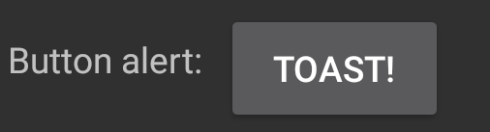
Button
inherits from TextView
represents a push-button view
implement Button.OnClickListener to listener for the push/click.
  button.setOnClickListener(View.OnClickListener)
  Override
    void onClick(View v)
      Called when a view has been clicked.

Slide 30
Button XML
<Button
android:id="@+id/Button01"
android:layout_height="wrap_content"
android:layout_width="wrap_content"
android:text=“TOAST!"/>

Slide 31
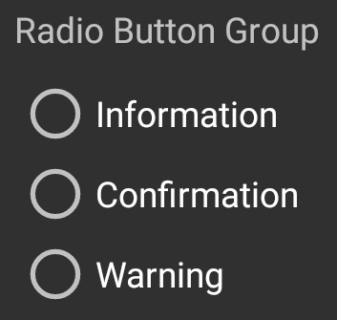
RadioButton
Inherits from CompoundButton (which inherits from Button)
  RadioButtons are normally used together in a RadioGroup
  RadioGroup is used to create multiple-exclusion scope for a set of radio buttons
    Also a Layout, which uses the same attributes as LinearLayout

Slide 32
RadioGroup
Listener for RadioGroup
  implement RadioGroup.OnCheckedChangeListener
    radioGroup.setOnCheckedChangeListener( )
  Override
    void onCheckedChanged(RadioGroup group, int checkedId)
    Called when the checked radio button has changed.
    CheckedId is RadioButton that was checked.
clearCheck() clear the selection
check(int id) sets a selection for the id
  example id like R.id.RadioButton02

Slide 33

CheckBox
A checkbox is a specific type of two-states button
  can be either checked or unchecked
  if (checkBox.isChecked()) {
  checkBox.setChecked(false);
  }
  Listener implement CompoundButton.OnCheckedChangeListener
    CheckBox.setOnCheckedChangeListener(CompoundButton.OnCheckedChangeListener listener)
  Override
    public void onCheckedChanged(CompoundButton buttonView, boolean isChecked)

Slide 34

ToggleButton
Like a checkbox or radio button
Displays checked/unchecked states as a button with a "light" indicator and by default accompanied with the text "ON" or "OFF".
  Two states: On and Off
    On shows a green button (default behavior)
    Off shows a grayed out button (default behavior)

Slide 35
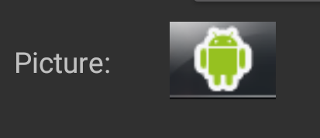
ImageView
To set a static image, this can be setup in xml using
  android:src="@drawable/phone"
    Where phone is the png image in the drawable directory of the project.
A bitmap can be setup using SetImageBitmap(Bitmap) method
Drawable getDrawable() method gives you access to the image, where you can use the draw(Canvas ) method to change/draw on the image.

Slide 36
ImageButton
inherits from ImageView
In xml can set the images
  <item android:state_pressed="true"
  android:drawable="@drawable/button_pressed" />
  <item android:state_focused="true"
  android:drawable="@drawable/button_focused" />
  <item <!-- default -->
  android:drawable="@drawable/button_normal" />
Uses the listener like the button. View.onClickListener

Slide 37
Rotation
To stop the auto rotation, edit the AndroidManifest.xml
In the <activity section
android:screenOrientation=
  portrait
  landscape
  Sensor (use accelerometers)
    appears to disable keyboard trigger events for slide keyboards
This is per activity, so if you have more then 1 activity, it each can have their own orientation.

Slide 38
AndroidManifest.xml
<?xml version="1.0" encoding="utf-8"?>
<manifest xmlns:android="http://schemas.android.com/apk/res/android"
package="com.cosc4755.TCPclient"
android:versionCode="1"
android:versionName="1.0">
<application android:icon="@drawable/icon" android:label="@string/app_name">
<activity android:name=".TCPclient"
android:label="@string/app_name">
android:screenOrientation="portrait"
<intent-filter>
<action android:name="android.intent.action.MAIN" />
<category android:name="android.intent.category.LAUNCHER" />
</intent-filter>
</activity>
</application>
<uses-sdk android:minSdkVersion="5" />
</manifest>

Slide 39
Layouts (briefly)
The layout is used the xml to set how the widgets are displayed
  LinearLayout
    either horizontally in a single column or vertically in a single row.
  RelativeLayout
    Set widgets up to be say above another widget. At the bottom of the screen for example.
  ConstraintLayout (default layout now)
    Via the support library, allows you position and size widgets in a "flexible" way. This can be very complex.
    Note, sometimes, it easier to use a the relativelayout or even a linearlayout, depends on need.
    https://developer.android.com/training/constraint-layout/index.html

Slide 40
Learn more
Android Application Fundamentals
Starting Another Activity
Activity (API Guide)
Activity (API Reference)

Slide 41
What's next?
More information and Google Code labs
Concept Chapter: 2.1 Activities and Intents
Practical: 2.1 Activities and intents

Slide 42
Q
A
&

