Slide 1
Cosc 5/4730
Material Design
Spec’s and Toolbar.

Slide 2
Material Design
First and for most, Material Design is a spec used by android to have app look similar and function in similar matter.
    About every 2 to 3 years google puts a set of spec. This years is called Material Design and is mostly for lollipop and can back ported to 4.X devices as well.
The spec’s are very long and I’m going to cover them all here.
  http://www.google.com/design/spec/material-design/introduction.html#

Slide 3
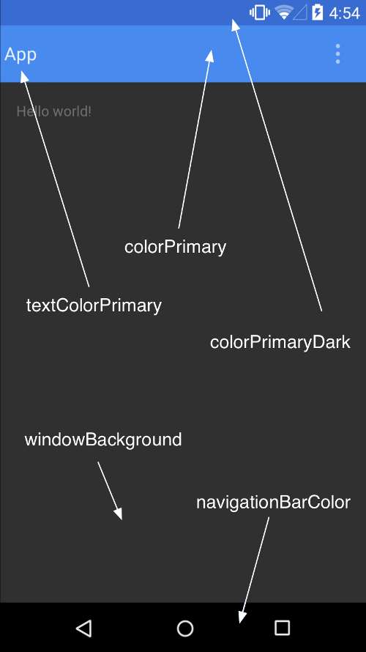
Theme and Colors
http://www.google.com/design/spec/style/color.html#color-ui-color-application
  The colorPrimary is a 500 color
  ColorPrimaryDark is a 700 color
  colorAccent is a A200 color
  textColor, textColorPrimary, textColorSecondary
  windowBackgroundColor
  navigationBarColor which is normally a colorPrimary color as well.
http://www.materialpalette.com/indigo/pink or http://www.materialpalette.com/ maybe helpful in picking colors.
Note, only ColorPrimary, colorPrimaryDark, and colorAccent are back supported in 4.4 (API 19) and below

Slide 4
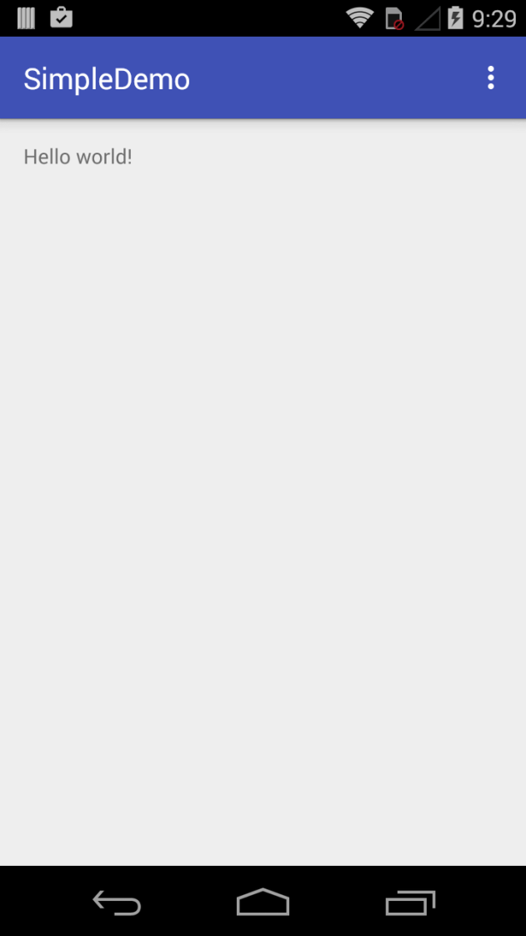
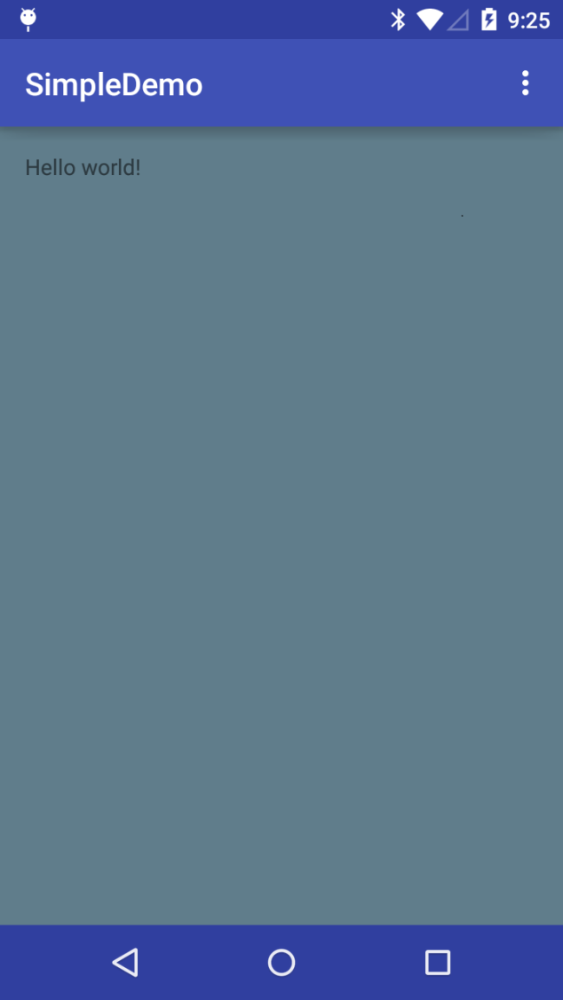
Example
android 4.4 .x android 5.0.x+

Slide 5
Theme and Colors (2)
values/styles.xml
values-v21/styles.xml
<resources>
<!-- Base application theme. -->
<style name="AppTheme" parent="AppTheme.Base">
</style>
<!– customizations for 4.4.X and before
<style name="AppTheme.Base" parent="Theme.AppCompat.Light.DarkActionBar">
<item name="colorPrimary"> @color/primaryColor</item>
<item name="colorPrimaryDark"> @color/primaryColorDark</item>
<item name="colorAccent"> @color/accentColor</item>
</style>
</resources>
<resources>
<style name="AppTheme" parent="AppTheme.Base">
<!-- Customize your theme here. -->
<item name="android:colorPrimary"> @color/primaryColor</item>
<item name="android:colorPrimaryDark"> @color/primaryColorDark</item>
<item name="android:colorAccent"> @color/accentColor</item>
<item name="android:textColorPrimary"> @color/textColor</item>
<item name="android:textColorSecondary"> @color/textColorSecondary</item>
<item name="android:navigationBarColor"> @color/navigationBarColor</item>
<item name="android:windowBackground"> @color/windowBackgroundColor</item>
</style>
</resources>
Note, since we are targeting 24 and above. you can just put everything in the values/styles.xml file now.

Slide 6
Theme and Colors (3)
Values/colors.xml
<?xml version="1.0" encoding="utf-8"?>
<resources>
<!-- a good place to try different colors is http://www.materialpalette.com/
Also googles: http://www.google.com/design/spec/style/color.html-->
<!-- 500 color -->
<color name="primaryColor">#3f51b5</color>
<!-- 700 color -->
<color name="primaryColorDark">#303f9f</color>
<!-- A200 other color -->
<color name="accentColor">#ff4081</color>
<color name="primaryColorLight">#C5CAE9</color>
<color name="textColor">#FFFFFF</color>
<color name="textColorPrimary">#212121</color>
<color name="textColorSecondary">#727272</color>
<color name="windowBackgroundColor">#607d8b</color>
<color name="navigationBarColor">#303f9f</color>
</resources>

Slide 7
DayNight theme.
The dayNight theme is part of the appcompat library.
  This works with the user's setting for light and dark themes. It will attempt to pick darker theme for dark theme or lighter for light theme. Plus understands if a user has their theme set to change for Day or Night
  Theme.AppCompat.DayNight
    Also has a noactionbar, plus the rest of the variations.
There is also a DayNight them in the androidx material library.
  This is now default in the Android template.
  Theme.MaterialComponents.DayNight
    Requires com.google.android.material:material:1.2.1+ to use.
    Also has a noactionbar, plus the rest of the variations.

Slide 8
Theme.MaterialComponents.DayNight
For the light theme, this will use the colorPrimary for the actionbar/toolbar as normal
But for the dark theme will be default to black. Also will not use the colorPrimary.
  So you should use colorSurface.
  <item name="colorSurface">@color/colorPrimaryDark</item>
  Note, I'm using a colorPrimaryDark one, since this is the dark theme.

Slide 9
Easier to show in code.
https://github.com/JimSeker/ui/tree/master/Material%20Design
  The darkTheme, simpeDemo
  go through colors, and pieces.

Slide 10
References
https://developer.android.com/training/material/theme.html

Slide 11
Q
A
&

