Slide 1
Cosc 5/4730
RecyclerView
And more.

Slide 2
RecyclerView
a more advanced and flexible version of ListView.
This widget is a container for displaying large data sets that can be scrolled very efficiently by maintaining a limited number of views.
Provides built
Layout manages for positions
default animations for common item operations, such as removal or addition of items
https://developer.android.com/training/material/lists-cards.html

Slide 3
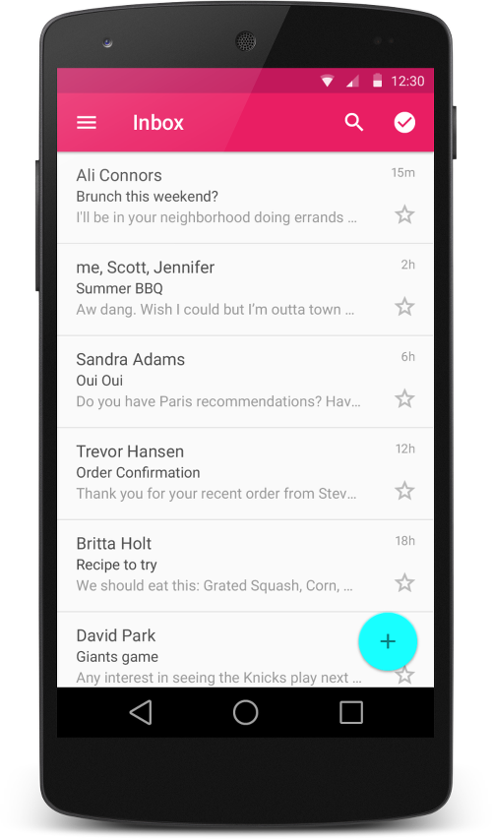
RecyclerView (2)
Like the listview, uses an adapter
We normally use a cardview as the default layout for each item in the list.
Similar to a fragment.

Slide 4
CardView
extends the FrameLayout class and lets you show information inside cards that have a consistent look across the platform.
CardView widgets can have shadows and rounded corners.
Android 5.0+ (API 21+) use card_view:cardElevation attribute.
CardView is not required with the recyclerView. They are just commonly used together.

Slide 5
Including
You need to include the them in the dependencies (build.gradle module)
implementation 'androidx.recyclerview:recyclerview:1.2.1'
implementation 'androidx.cardview:cardview:1.0.0'

Slide 6
RecyclerView
Add the following to your layout
<androidx.recyclerview.widget.RecyclerView
android:id="@+id/list"
android:scrollbars="vertical"
android:layout_width="match_parent"
android:layout_height="match_parent"/>
In your activity use the following code, (very similar to a listview)
binding.list.setLayoutManager(new LinearLayoutManager(this));
binding.list.setItemAnimator(new DefaultItemAnimator());
setup the adapter, which is myAdapter, see the next slide for code.
There is no simple adapter version, you need to extend it.
mAdapter = new myAdapter(values, R.layout.my_row, this);
binding.list.setAdapter(mAdapter);

Slide 7
Recyclerview.Adapter
public class myAdapter extends RecyclerView.Adapter<myAdapter.ViewHolder> { private List<String> myList; private int rowLayout; private Context mContext; //constructor public myAdapter(List<String> myList, int rowLayout, Context context) { this.myList = myList; this.rowLayout = rowLayout; this.mContext = context; } // Create new views (invoked by the layout manager) @Override public ViewHolder onCreateViewHolder(ViewGroup viewGroup, int i) { MyRowBinding v = MyRowBinding.inflate(LayoutInflater.from(mContext), viewGroup, false); return new ViewHolder(v); } // Return the size of your dataset (invoked by the layout manager) @Override public int getItemCount() { return myList == null ? 0 : myList.size(); }
The important ViewHolder is on the
Next slide.
And OnBindingViewHolder after that

Slide 8
Recyclerview.Adapter (2)
//viewbinding provides the references now. public static class ViewHolder extends RecyclerView.ViewHolder { public MyRowBinding viewBinding; public ViewHolder(MyRowBinding viewBinding) { super(viewBinding.getRoot()); this.viewBinding = viewBinding; } }

Slide 9
My_row.xml and cardView
<?xml version="1.0" encoding="utf-8"?>
<androidx.cardview.widget.CardView xmlns:android="http://schemas.android.com/apk/res/android"
xmlns:card_view="http://schemas.android.com/apk/res-auto"
android:layout_width="match_parent"
android:layout_height="match_parent"
android:layout_margin="5dp"
card_view:cardCornerRadius="5dp“
card_view:cardElevation="5dp"
>
<RelativeLayout
android:layout_width="match_parent"
android:layout_height="match_parent">
<ImageView
android:id="@+id/picture"
android:layout_width="match_parent"
android:layout_height="100dp"
android:scaleType="centerCrop"
android:tint="@color/photo_tint"
android:layout_centerInParent="true"
/>
<TextView
android:id="@+id/Name"
android:gravity="center"
android:background="?android:selectableItemBackground"
android:focusable="true"
android:clickable="true"
android:layout_width="match_parent"
android:layout_height="100dp"
android:textSize="24sp"
android:layout_centerInParent="true"
android:textColor="@android:color/white"
/>
</RelativeLayout>
</androidx.cardview.widget.CardView>
Note, while I'm using a cardview, you don't have too. It's just recommended by google.

Slide 10
Recyclerview.Adapter (3)
This method is where we set the data into the viewholder declared before.
@Override public void onBindViewHolder(ViewHolder viewHolder, int i) { String entry = myList.get(i); viewHolder.viewBinding.Name.setText(entry); viewHolder.viewBinding.Name.setOnClickListener(new View.OnClickListener() { @Override public void onClick(View v) { TextView tv = (TextView) v; Toast.makeText(mContext, tv.getText(), Toast.LENGTH_SHORT).show(); } }); viewHolder.viewBinding.picture.setImageResource(R.drawable.phone); }

Slide 11
Looking like

Slide 12
Addition info
RecyclerView
addOnItemTouchListener(RecyclerView.OnItemTouchListener listener)
Add an RecyclerView.OnItemTouchListener to intercept touch events before they are dispatched to child views or this view's standard scrolling behavior.
Demos:
RecyclerViewDemo is the code should here
RecyclerViewDemo2 uses the phonelist from the listview examples.
RecyclerViewDemo3 recreates all the listview demos with a recyclerview. Most do not use a cardview, but instead use the same layout as the original examples.

Slide 13
Refresh and swipes.
Swipes down from the top allows a refresh
Swipe left or right can trigger other actions
In the case, swipe right deletes an item.

Slide 14
Swipe Down/refresh
Uses the SwipeRefreshLayout wrapped around the recyclerview.
<androidx.swiperefreshlayout.widget.SwipeRefreshLayout
android:id="@+id/activity_main_swipe_refresh_layout"
… >
<androidx.recyclerview.widget.RecyclerView
android:id="@+id/list“
…
/>
</androidx.swiperefreshlayout.widget.SwipeRefreshLayout>

Slide 15
Swipe Down/refresh (2)
Java code, then setups a listener for it.
And optionally set colors for the refresh loop.
setup some colors for the refresh circle. Optional.
binding.mSwipeRefreshLayout.setColorSchemeResources(R.color.orange, R.color.green, R.color.blue);
now setup the swiperefrestlayout listener where the main work is done.
binding.mSwipeRefreshLayout.setOnRefreshListener(new SwipeRefreshLayout.OnRefreshListener() {
@Override
public void onRefresh() {
Do/Call refresh code here
}
});
When the refresh is done, make this call to turn off the refresh UI.
binding.mSwipeRefreshLayout.setRefreshing(false);

Slide 16
Swipe left/right code.
No changes to the xml are necessary.
Uses the ItemTouchHelper callbacks
First setup a simplecallback (next slide)
Then attach the recyclerview to it.
ItemTouchHelper itemTouchHelper = new ItemTouchHelper(simpleItemTouchCallback);
itemTouchHelper.attachToRecyclerView(binding.mRecyclerView);

Slide 17
ItemTouchHelper.SimpleCallback
Create the callback
ItemTouchHelper.SimpleCallback simpleItemTouchCallback = new ItemTouchHelper.SimpleCallback(0, ItemTouchHelper.RIGHT) {
For both Left and right use: ItemTouchHelper.RIGHT |ItemTouchHelper.LEFT
@Override
public boolean onMove(RecyclerView recyclerView, RecyclerView.ViewHolder viewHolder, RecyclerView.ViewHolder target) {
//likely allows to for animations? or moving items in the view I think.
return false;
}
@Override
public void onSwiped(RecyclerView.ViewHolder viewHolder, int direction) {
if (direction == ItemTouchHelper.RIGHT) {
//Now remove the item from the list (likely in the adapter)
int item = viewHolder.getAdapterPosition(); //Which item it is in the list.
// don’t forget notifyDataSetChanged(); in the adapter as well.
//you can combine this with a snackbar as simple, Do you really want to delete this.
}
}
};

Slide 18
Demo code
To see all the demo code for the swipes
See the RecyclerViewSwipeRefresh example

Slide 19
References
http://treyrobinson.net/blog/android-l-tutorials-part-3-recyclerview-and-cardview/
https://developer.android.com/training/material/lists-cards.html
https://github.com/shamanland/floating-action-button
http://stackoverflow.com/questions/24459352/how-can-i-add-the-new-floating-action-button-between-two-widgets-layouts
https://www.bignerdranch.com/blog/implementing-swipe-to-refresh/
https://medium.com/@ipaulpro/drag-and-swipe-with-recyclerview-b9456d2b1aaf

Slide 20
References
https://developer.android.com/training/material/theme.html
https://chris.banes.me/2014/10/17/appcompat-v21/
https://github.com/shamanland/floating-action-button
http://stackoverflow.com/questions/24459352/how-can-i-add-the-new-floating-action-button-between-two-widgets-layouts
http://treyrobinson.net/blog/android-l-tutorials-part-3-recyclerview-and-cardview/
https://developer.android.com/training/material/lists-cards.html

Slide 21
Q
A
&

