Slide 1
Cosc 5/4730
Image Asset
Vector Asset

Slide 2
Android Studio
It makes it very easy to add new icons to your project.
  Replace the launcher icon, add notification icons, etc.
  Image Asset creates PNG files for all the correct directories
  Vector Asset creates SVG files in the drawable directory.
    SVG is a scalar vector graphic format.

Slide 3
Vector ASSET

Slide 4

What is Vector Graphics?
Bitmap – A grid of pixels, each with its own color data
  Cannot be scaled or rotated cleanly
  JPG, PNG, GIF, etc.
Vector – Path data between many connected nodes
  Scales and rotates without loss of clarity
  SVG, AI, PDF, EPS, etc.
In the .SVG format, path data is saved as XML code

Slide 5
Android
You starting in Android 5.0 (API 21+) you can define your images as vector drawables (eg vector graphics).
  Studio will then create the images needed anything before API 21, if you set the min below 21.
  This is really handy for FAB icons and other images.
    Studio has a large number of built in vg that you can use or create you own.

Slide 6
How To

Slide 7
How To (2)

Slide 8
Using the vg
Same as you would use any graphic.
Call for it like normal, so
  "@drawable/ic_garfield_the_cat"
  ImageView, ImageButton, wherever you’d be able to draw a bitmap
  Can determine size, color, angle, etc.

Slide 9
Making a custom SVG
Can be made with programs like Inkscape, Adobe Illustrator, or found by searching the web
  Inkscape is free
Make sure filename is all lowercase!
  Studio gets mad otherwise

Slide 10
Image Asset

Slide 11
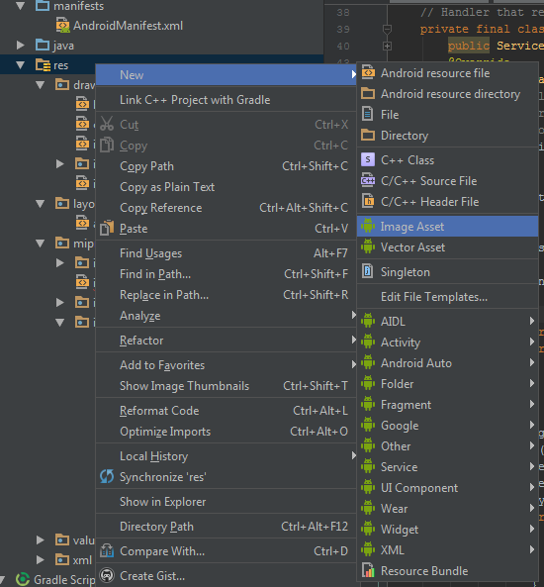
Image Asset

Slide 12
Image Asset (2)
Depending on Icon Type, it will setup all the correct directories, replacing any files with the same name.
  Example Launcher Icons, defaults to the name ic_launcher, so it will replace the current launcher icon.
    Not 2.3.3 doesn't create round launcher icons.
  Notifications Icons, will create a set of them all the correct size, based on the API version.
  ActionBar and Tab Icons, will create icons base the themes.

Slide 13
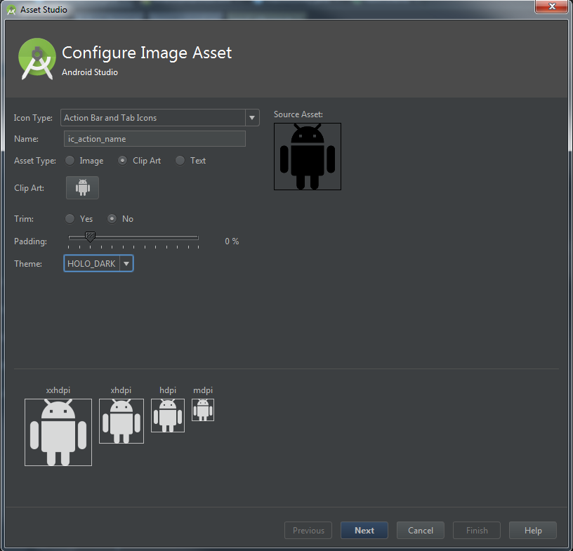
Image Asset (3)
ActionBar and Tab Icons
Notification icons

Slide 14
Q
A
&

