Slide 1
Cosc 5/4730
Android Intents

Slide 2
Intents
Android

Slide 3
Intents
An intent is an abstract description of an operation to be performed. It can be used with startActivity to launch an Activity, broadcastIntent to send it to any interested BroadcastReceiver components, and startService(Intent) or bindService(Intent, ServiceConnection, int) to communicate with a background Service.
  An activity can also receive a “new” intent, via the OnIntent(Intent) method
An Intent provides a facility for performing late runtime binding between the code in different applications. Its most significant use is in the launching of activities, where it can be thought of as the glue between activities. It is basically a passive data structure holding an abstract description of an action to be performed.

Slide 4
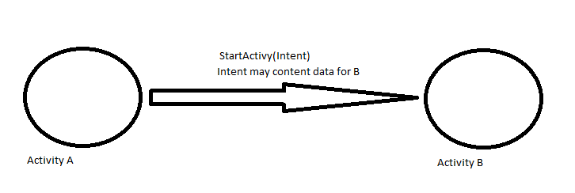
Intents
The intent
  Contains the class to be “called” by the activity
  And may contain other information needed by that class (Activity, service, Broadcast receiver, etc)

Slide 5
Start an Activity with an intent
To start a specific Activity, use an explicit Intent
Create an Intent
  Intent intent = new Intent(this, ActivityName.class);
Use the Intent to start the Activity
  startActivity(intent);

Slide 6
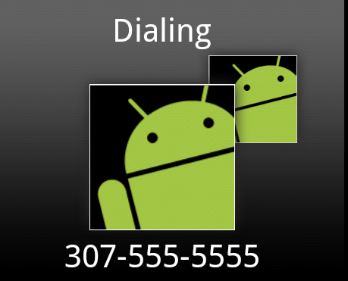
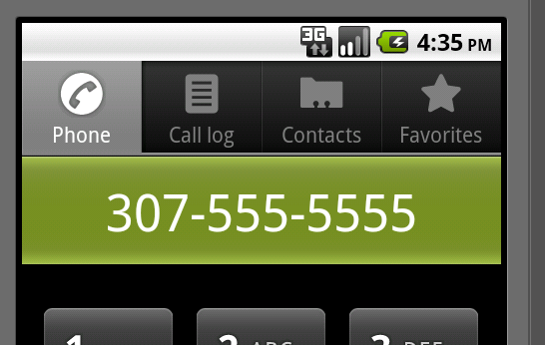
Making a call example
The intent is pretty simple
Intent dialIntent = new Intent( "android.intent.action.CALL", Uri.parse("tel:3075555555"));
  Use “android.intent.action.DIAL”
    To just bring up the dialer, but not call.
startActivity(dialIntent);
Needs <uses-permission android:name= "android.permission.CALL_PHONE"> </uses-permission>
  In the manifest.xml file.
http://developer.android.com/reference/android/Manifest.permission.html

Slide 7

Web browser intent
To start up the browser with a page location you specify
  Intent webIntent = new Intent( "android.intent.action.VIEW", Uri.parse("http://www.cs.uwyo.edu"));
  startActivity(webIntent);
<uses-permission android:name="android.permission.INTERNET"></uses-permission>

Slide 8
Other “standard” intents
You can start up the maps with an intent
  intent = new Intent(Intent.ACTION_VIEW,Uri.parse("geo:41.312927,105.587251?z=19"));
    Should show Laramie on the map. Will force closes on the simulator.
Launch the camera
  intent = new Intent("android.media.action.IMAGE_CAPTURE");
      <uses-permission android:name="android.permission.CAMERA"></uses-permission>
Show contacts
  intent = new Intent(Intent.ACTION_VIEW, Uri.parse("content://contacts/people/"));
      <uses-permission android:name="android.permission.READ_CONTACTS"></uses-permission>
  Selection a contacts returns the information to the activity
Edit a contact
  Intent = new Intent(Intent.ACTION_EDIT, Uri.parse("content://contacts/people/1"));
    Brings up Editor the first entry in the contacts list.

Slide 9
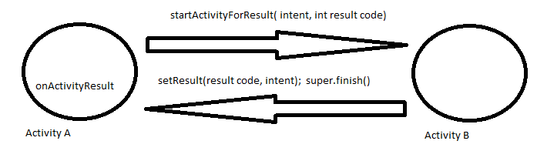
Returning data (OLD WAY, depreciated)
Instead of startActivity, use
  startActivityForResult(intent, resultCode);
    resultCode is a number you pick, that you can identify the callback with.
Override onActivityResult(int requestCode, int resultCode, Intent data) method.

Slide 10
Returning data New way.
First declare the ActivityResultLauncher<intent> variable and what happens with the result
Then call the launch method to start an Activity for a result.
  act2ActivityResultLauncher.launch(intent); //as example.

Slide 11
Passing data to a new activity.
Create an intent
  Intent i = new Intent(this, ActivityTwo.class);
  i.putExtra(“key1”, “Some data”);
  i.putExtra(“key2”, “more data”);
    Where key1, key2 are names both activities know.
  act2ActivityResultLauncher.launch( i );

Slide 12
Passing data to a new activity. (2)
ActivityTwo
  In the onCreate method
  Bundle extras = getIntent().getExtras();
  //Make sure the activity was called correctly.
  if (extras == null) {return;}
  String value1 = extras.getString(“key1");
  String value2 = extras.getString(“key2");
    Like others, many getX methods, like getInt(String key)

Slide 13
Return data.
When activityTwo finishes, it can return an Intent with data.
In the finish() method
@Override
public void finish() {
Intent data = new Intent();
data.putExtra("returnKey1", “some data ");
data.putExtra("returnKey2", “more data");
setResult(RESULT_OK, data);
super.finish();
}
Result: constants are RESULT_OK, RESULT_CANCELED, but you can also use any custom result with an int.
  When an activity fails, crashes, the result will be RESULT_CANCELED.

Slide 14
Return data (2)
ActivityResultLauncher<intent> method
ActivityResultLauncher<Intent> act2ActivityResultLauncher = registerForActivityResult(
new ActivityResultContracts.StartActivityForResult(),
new ActivityResultCallback<ActivityResult>() {
@Override
public void onActivityResult(ActivityResult result) {
if (result.getResultCode() == Activity.RESULT_OK) {
Intent data = result.getData();
//do something with the data.
} else {
//cancelled.
}
}
});

Slide 15
Kotlin version
var act2ActivityResultLauncher = registerForActivityResult<Intent, ActivityResult>(
ActivityResultContracts.StartActivityForResult()
) { result ->
if (result.resultCode == RESULT_OK) {
// There are no request codes
val data = result.data
if (data!!.hasExtra("returnKey1")) {
// we have data from returnKey1. note !! assests there will be data.
}
} else {
//result failed or was cancelled.
}
}

Slide 16
Finally.
You can see these intents working in the code provided with the lecture.
For more of google applications intents see
  http://developer.android.com/guide/appendix/g-app-intents.html
  http://developer.android.com/reference/android/content/Intent.html
  http://www.openintents.org/en/intentstable which also list some 3rd party intents as well.

Slide 17
More Intents
We will use intents all over the place
  We also put Intents in PendingIntents, which allows our intents to be launch by others
      From the notification for example.
Services, Broadcast Receivers also all use intents as we’ll see later on.
We can also setup to receive intents in the activities as well with an intent-filter.

Slide 18
Learn more
Intents and Intent Filters (API Guide)
Intent (API Reference)
Navigation

Slide 19
Q
A
&

