Slide 1
COSC 5/4730
Display Lists of data

Slide 2
Display lists of data
In Android there are three main way to display data for the user to interact with
  A Drop-Down List box, which android calls a spinner widget.
  ListView
    Used mostly to display data in a simple format, but it be can be very complex.
  RecyclerView
    The successor to a ListView, can be very simple or complex in the way it displays data
  These each take a "list" of data and use an adapter to display the data to the user.

Slide 3
Spinners (Drop down list boxes)

Slide 4
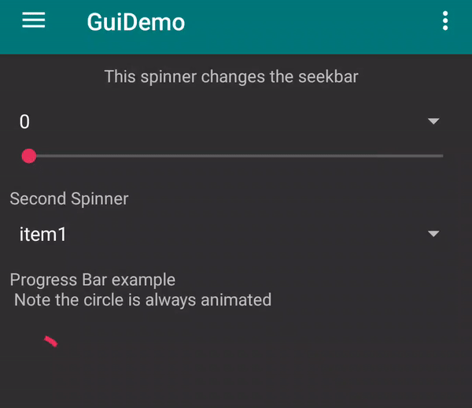
Spinner
Uses a spinner widget in the xml
  An array of data is provided
  Uses likely a builtin android adapter to display the data
    ArrayAdapter
    uses a simple layout, which can be one of the android.R.layout.X
    http://developer.android.com/intl/zh-CN/reference/android/R.layout.html for the full list
    We can get very fancy, like listview.

Slide 5
Spinner
A spinner needs "items" to fill the drop down box. This is done using an ArrayAdapter
  Using a string[] items, we can
  ArrayAdapter<String> adapter = new ArrayAdapter<String>(this,android.R.layout.simple_spinner_item, items);
  adapter.setDropDownViewResource(android.R.layout.simple_spinner_dropdown_item);
  Then use setAdapter(adapter); //fills the list
  Add listener, setOnItemSelectedListener(this)
    implement AdapterView.OnItemSelectedListener
      public void onItemSelected(AdapterView<?> parent, View view, int position, long id)
        Where position is the position in the array for the item selected.
      public void onNothingSelected(AdapterView<?> parent)

Slide 6
ListView

Slide 7
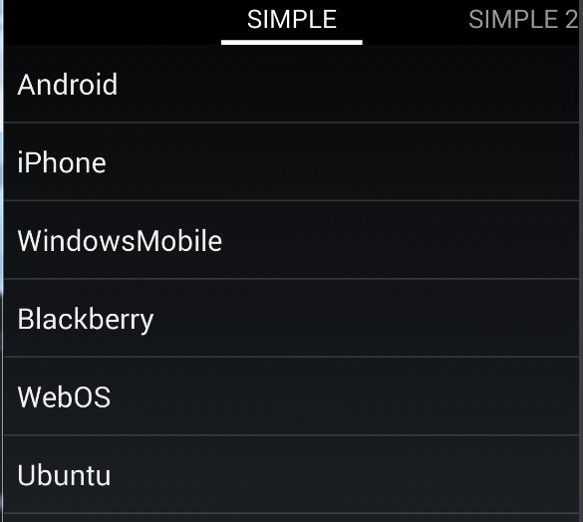
Listview
The spinner shown before is a very similar to a list view
A listView can be the only widget on the screen (no layout is needed) and can get very complex with the adapter.
  The items in the list are normally clickable.
Simple listView

Slide 8
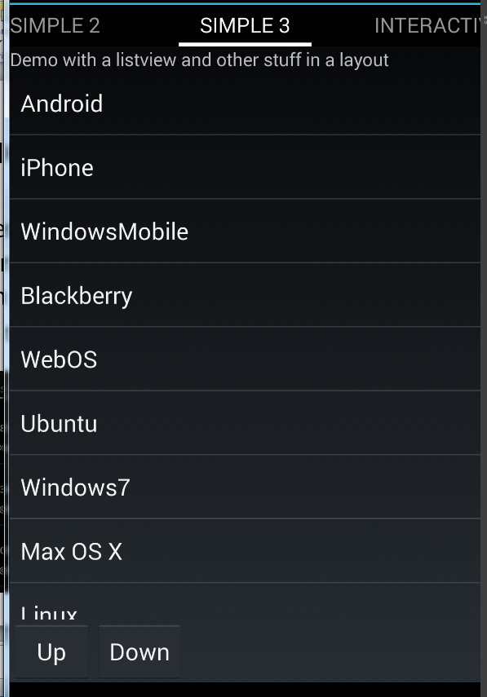
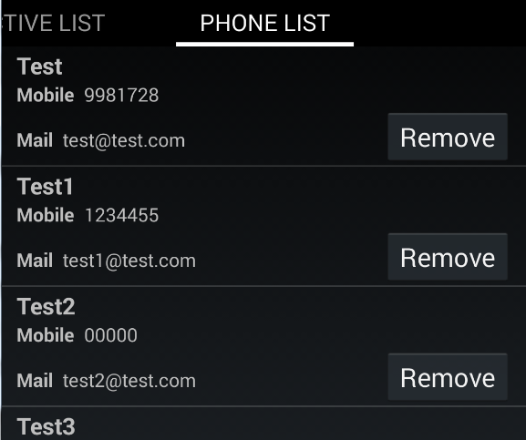
Listview continued
A listView can just be another widget in the layout as well.
Or a very complex, which multiple widgets in each item in the list
  Also true for the spinner

Slide 9
Listview and listFragment
There is a listfragment that can be used (also a listactivity too).
  It has a default layout which contains a listview.
  You use the setListAdapter(adapter) method
  And you override the OnListItemClick
Or you can just use a fragment, create the layout with a listview (and other views/widgets)
  And provide you own code to run the listview.

Slide 10
ListFragment
public class Simple extends ListFragment {
@Override
public void onActivityCreated(Bundle savedInstanceState) {
super.onActivityCreated(savedInstanceState);
// NOTE, there is no xml layout for this activity!
String[] values = new String[] { "Android", "iPhone", "WindowsMobile",
"Blackberry", "WebOS", "Ubuntu", "Windows7", "Max OS X", "Linux", "OS/2" };
ArrayAdapter<String> adapter = new ArrayAdapter<String>(requireActivity(),android.R.layout.simple_list_item_1, values);
setListAdapter(adapter);
}
//This responses to the click event.
@Override
protected void onListItemClick(ListView l, View v, int position, long id) {
String item = (String) getListAdapter().getItem(position);
Toast.makeText(this, item + " selected", Toast.LENGTH_LONG).show();
}
}
The layout is how the items
will be displayed

Slide 11
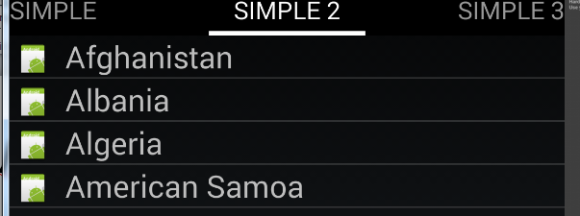
Changing the layout
ArrayAdapter<String> adapter = new ArrayAdapter<String>(requireActivity(), R.layout.rowlayout, R.id.label, values);
setListAdapter(adapter);
Uses a layout we created and the label is where the item is go. In this case with an picture.

Slide 12
rowlayout.xml
Using our custom layout, the listView displays an picture (the same picture for all items)
And we need a textview to display the “item” for each one. Which is called label in this case (you can choose whatever name).
<ImageView android:id="@+id/icon" android:layout_width="22dp"
android:layout_height="22dp" android:layout_marginLeft="4dp"
android:layout_marginRight="10dp" android:layout_marginTop="4dp"
android:src="@drawable/ic_launcher" >
</ImageView>
<TextView
android:id="@+id/label" android:layout_width="wrap_content"
android:layout_height="wrap_content"
android:text="@+id/label" android:textSize="20dp" >
</TextView>

Slide 13
More complex ListViews.
If you want to display more then one piece of information per item, then you can have not only change the layout, but extend the ArrayAdapter or BaseAdapter.

Slide 14
ArrayAdapter
The ArrayAdapter already extends the BaseAdapter and provides a lot of built in methods.
In the ListFragment (or Fragment) you would do something like this:
ArrayAdapter<Model> adapter = new InteractiveArrayAdapter(this, myModelList);
setListAdapter(adapter);
Where myModleList is a list<model>
  Where model is a class you created.

Slide 15
ArrayAdapter (2)
public class InterActive_myArrayAdapter extends ArrayAdapter<InterActive_DataModel> {
private final List<InterActive_DataModel> list;
private final Activity context;
InteractiveRowlayoutBinding binding;
public InterActive_myArrayAdapter(Activity context, List<InterActive_DataModel> list) {
super(context, R.layout.interactive_rowlayout, list);
this.context = context;
this.list = list;
}
@Override
public View getView(int position, View convertView, ViewGroup parent) {
//this will look very similar to onCreate or OnCreateView, using binding.
}
}

Slide 16
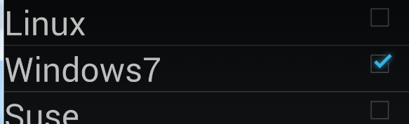
getView
So for this one, we have TextView and checkBox. The List tells us if it’s checked or not.
In getView, we create the View
if (convertView == null) {
binding = InteractiveRowlayoutBinding.inflate(context.getLayoutInflater());
} else {
binding = InteractiveRowlayoutBinding.bind(convertView);
}
binding.label.setText(list.get(position).getName());
binding.check.setChecked(list.get(position).isSelected());
binding.check.setOnCheckedChangeListener(new OnCheckedChangeListener() {
… see the code.
});
//Tag is an like a temp space, in a widget where you can set some information as an Object Class
//in this case, the position variable.
binding.check.setTag(String.valueOf(position)); //used to find the list position when we change the check mark
onBind = false; //end of setting data.
return binding.getRoot();

Slide 17
Custom ListViews
We want to very complex and provide our own interface, then normally we extend the baseAdapter to create “fragments” for each item in the ListView.
In this case a Phone class
is created to hold all the
Information, which passed
to an extended baseAdapter.

Slide 18
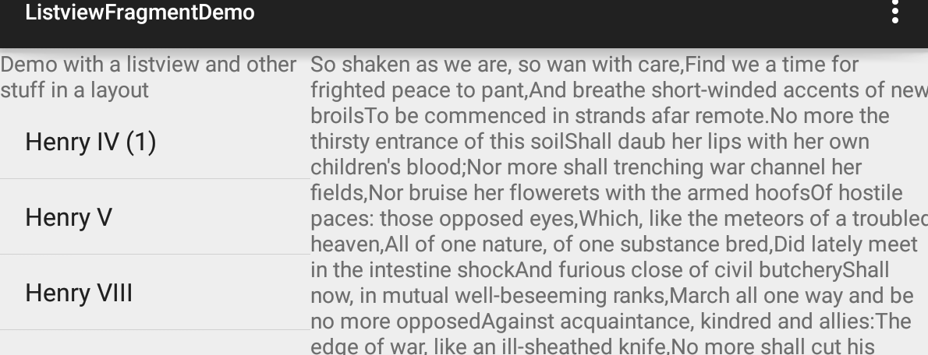
Frag com with listview.
Callback listener, via
the onItemClick methods
the Activity “sends” the information to the text fragment
OR
a modelview here and Observer here, when it's triggered, it changes the info
changes and triggers.

Slide 19
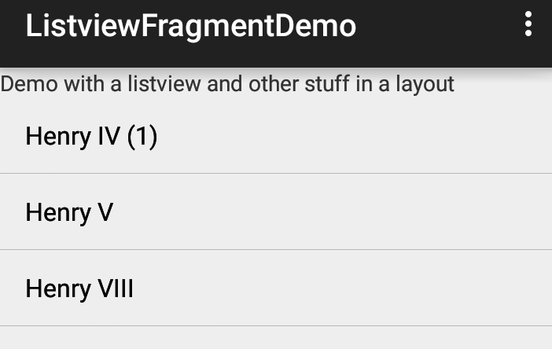

Frag com with listview (2)
Callback listener, via
the onItemClick methods
Since the text fragment is not on the screen, it adds it and sets the arguments to the fragment.
The fragment reads the position via
Get arguments, in the onStart()
method.
It then displays the correct info.
Pressing the back button, return to
listview again.

Slide 20
ModelView and LiveData with listview (2)
In the fragment there is a ModelView that has live data
When clicked, it changes the modelview. which triggers the observers.
This fragment sets observers for the
modelview. It then updates when it
changes.
Pressing the back button, return to
listview again.

Slide 21
Listview References
http://www.androidhive.info/2013/07/android-expandable-list-view-tutorial/
http://www.coderzheaven.com/expandable-listview-android-simpleexpandablelistadapter-simple-example/
http://examples.javacodegeeks.com/android/core/ui/expandablelistview/android-expandablelistview-example/
http://theopentutorials.com/tutorials/android/listview/android-expandable-list-view-example/
http://learnandroideasily.blogspot.com/2013/07/android-expandablelistview-example.html
https://developer.android.com/reference/android/widget/BaseExpandableListAdapter.html
https://developer.android.com/reference/android/widget/ExpandableListView.html

Slide 22
RecyclerViews

Slide 23
RecyclerView
a more advanced and flexible version of ListView.
This widget is a container for displaying large data sets that can be scrolled very efficiently by maintaining a limited number of views.
  Provides built
    Layout manages for positions
    default animations for common item operations, such as removal or addition of items
https://developer.android.com/training/material/lists-cards.html

Slide 24
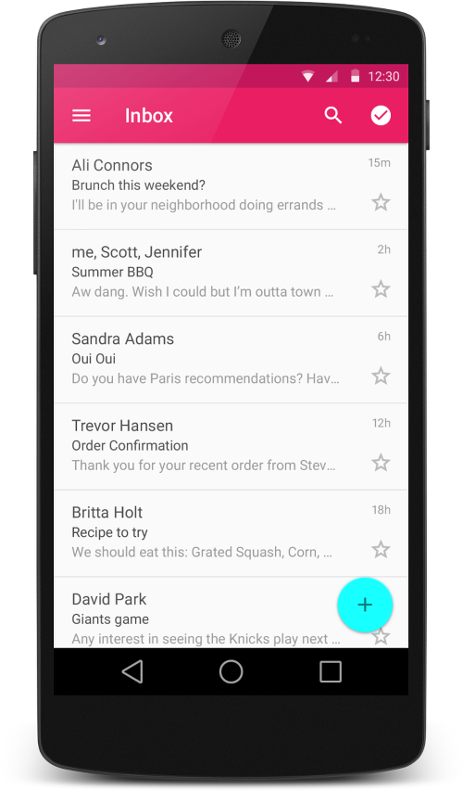
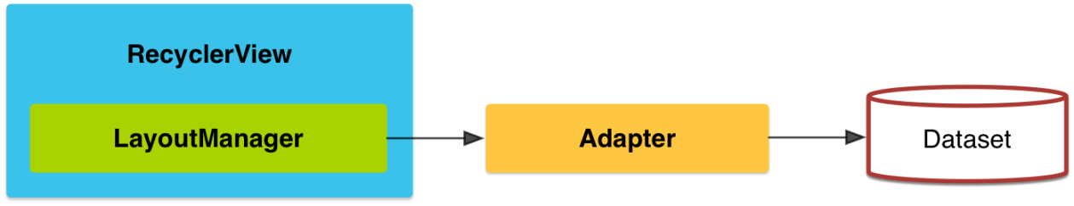
RecyclerView (2)
Like the listview, uses an adapter
We normally use a cardview as the default layout for each item in the list.
  Similar to a fragment.

Slide 25
CardView
extends the FrameLayout class and lets you show information inside cards that have a consistent look across the platform.
CardView widgets can have shadows and rounded corners.
  Android 5.0+ (API 21+) use card_view:cardElevation attribute.
CardView is not required with the recyclerView. They are just commonly used together.

Slide 26
Including
You need to include the them in the dependencies (build.gradle module)
  implementation 'androidx.recyclerview:recyclerview:1.3.2'
  implementation 'androidx.cardview:cardview:1.0.0'
    versions as of Aug 23, 2024

Slide 27
RecyclerView
Add the following to your layout
  <androidx.recyclerview.widget.RecyclerView
  android:id="@+id/list"
  android:scrollbars="vertical"
  android:layout_width="match_parent"
  android:layout_height="match_parent"/>
In your activity use the following code, (very similar to a listview)
  binding.list.setLayoutManager(new LinearLayoutManager(this));
  binding.list.setItemAnimator(new DefaultItemAnimator());
    setup the adapter, which is myAdapter, see the next slide for code.
      There is no simple adapter version, you need to extend it.
  mAdapter = new myAdapter(values, R.layout.my_row, this);
  binding.list.setAdapter(mAdapter);

Slide 28
Recyclerview.Adapter
public class myAdapter extends RecyclerView.Adapter<myAdapter.ViewHolder> {
private List<String> myList; private int rowLayout; private Context mContext;
//constructor
public myAdapter(List<String> myList, int rowLayout, Context context) {
this.myList = myList; this.rowLayout = rowLayout; this.mContext = context;
}
// Create new views (invoked by the layout manager)
@Override
public ViewHolder onCreateViewHolder(ViewGroup viewGroup, int i) {
MyRowBinding v = MyRowBinding.inflate(LayoutInflater.from(mContext), viewGroup, false);
return new ViewHolder(v);
}
// Return the size of your dataset (invoked by the layout manager)
@Override
public int getItemCount() {
return myList == null ? 0 : myList.size();
}
The important ViewHolder is on the
Next slide.
And OnBindingViewHolder after that

Slide 29
Recyclerview.Adapter (2)
//viewbinding provides the references now.
public static class ViewHolder extends RecyclerView.ViewHolder {
public MyRowBinding viewBinding;
public ViewHolder(MyRowBinding viewBinding) {
super(viewBinding.getRoot());
this.viewBinding = viewBinding;
}
}

Slide 30
My_row.xml and cardView
<?xml version="1.0" encoding="utf-8"?>
<androidx.cardview.widget.CardView xmlns:android="http://schemas.android.com/apk/res/android"
xmlns:card_view="http://schemas.android.com/apk/res-auto"
android:layout_width="match_parent"
android:layout_height="match_parent"
android:layout_margin="5dp"
card_view:cardCornerRadius="5dp“
card_view:cardElevation="5dp"
>
<RelativeLayout
android:layout_width="match_parent"
android:layout_height="match_parent">
<ImageView
android:id="@+id/picture"
android:layout_width="match_parent"
android:layout_height="100dp"
android:scaleType="centerCrop"
android:tint="@color/photo_tint"
android:layout_centerInParent="true"
/>
<TextView
android:id="@+id/Name"
android:gravity="center"
android:background="?android:selectableItemBackground"
android:focusable="true"
android:clickable="true"
android:layout_width="match_parent"
android:layout_height="100dp"
android:textSize="24sp"
android:layout_centerInParent="true"
android:textColor="@android:color/white"
/>
</RelativeLayout>
</androidx.cardview.widget.CardView>
Note, while I'm using a cardview, you don't have too. It's just recommended by google.

Slide 31
Recyclerview.Adapter (3)
This method is where we set the data into the viewholder declared before.
@Override
public void onBindViewHolder(ViewHolder viewHolder, int i) {
String entry = myList.get(i);
viewHolder.viewBinding.Name.setText(entry);
viewHolder.viewBinding.Name.setOnClickListener(new View.OnClickListener() {
@Override
public void onClick(View v) {
TextView tv = (TextView) v;
Toast.makeText(mContext, tv.getText(), Toast.LENGTH_SHORT).show();
}
});
viewHolder.viewBinding.picture.setImageResource(R.drawable.phone);
}

Slide 32
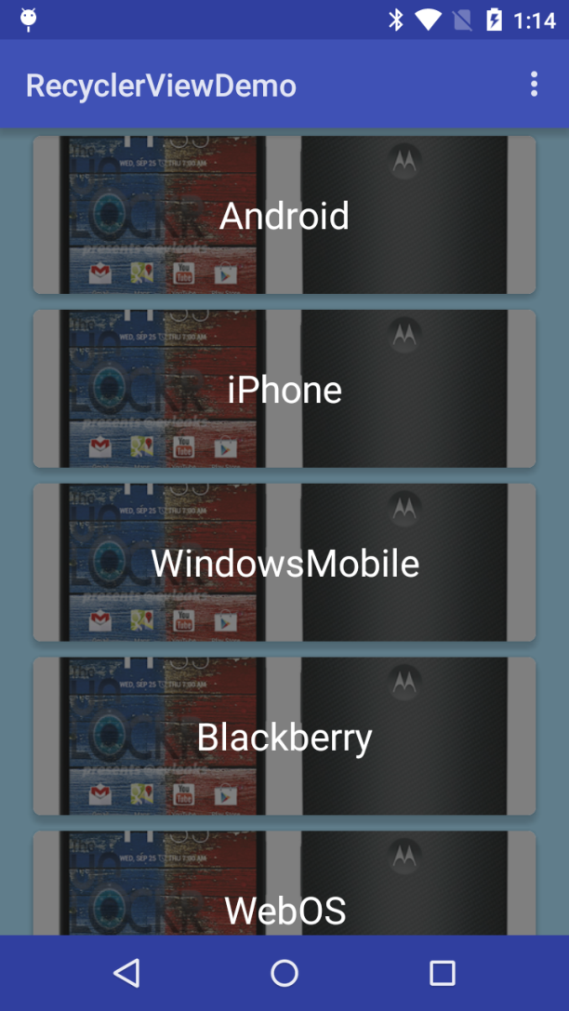
Looking like

Slide 33
Addition info
RecyclerView
  addOnItemTouchListener(RecyclerView.OnItemTouchListener listener)
    Add an RecyclerView.OnItemTouchListener to intercept touch events before they are dispatched to child views or this view's standard scrolling behavior.
Demos:
  RecyclerViewDemo is the code should here
  RecyclerViewDemo2 uses the phonelist from the listview examples.
  RecyclerViewDemo3 recreates all the listview demos with a recyclerview. Most do not use a cardview, but instead use the same layout as the original examples.

Slide 34
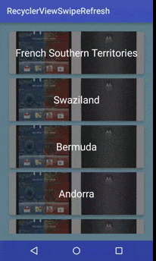
Refresh and swipes.
Swipes down from the top allows a refresh
Swipe left or right can trigger other actions
  In the case, swipe right deletes an item.

Slide 35
Swipe Down/refresh
Uses the SwipeRefreshLayout wrapped around the recyclerview.
<androidx.swiperefreshlayout.widget.SwipeRefreshLayout
android:id="@+id/activity_main_swipe_refresh_layout"
… >
<androidx.recyclerview.widget.RecyclerView
android:id="@+id/list“
…
/>
</androidx.swiperefreshlayout.widget.SwipeRefreshLayout>

Slide 36
Swipe Down/refresh (2)
Java code, then setups a listener for it.
  And optionally set colors for the refresh loop.
  setup some colors for the refresh circle. Optional.
  binding.mSwipeRefreshLayout.setColorSchemeResources(R.color.orange, R.color.green, R.color.blue);
  now setup the swiperefrestlayout listener where the main work is done.
  binding.mSwipeRefreshLayout.setOnRefreshListener(new SwipeRefreshLayout.OnRefreshListener() {
  @Override
  public void onRefresh() {
    Do/Call refresh code here
    }
  });
When the refresh is done, make this call to turn off the refresh UI.
binding.mSwipeRefreshLayout.setRefreshing(false);

Slide 37
Swipe left/right code.
No changes to the xml are necessary.
  Uses the ItemTouchHelper callbacks
First setup a simplecallback (next slide)
Then attach the recyclerview to it.
ItemTouchHelper itemTouchHelper = new ItemTouchHelper(simpleItemTouchCallback);
itemTouchHelper.attachToRecyclerView(binding.mRecyclerView);

Slide 38
ItemTouchHelper.SimpleCallback
Create the callback
ItemTouchHelper.SimpleCallback simpleItemTouchCallback = new ItemTouchHelper.SimpleCallback(0, ItemTouchHelper.RIGHT) {
For both Left and right use: ItemTouchHelper.RIGHT |ItemTouchHelper.LEFT
@Override
public boolean onMove(RecyclerView recyclerView, RecyclerView.ViewHolder viewHolder, RecyclerView.ViewHolder target) {
//likely allows to for animations? or moving items in the view I think.
return false;
}
@Override
public void onSwiped(RecyclerView.ViewHolder viewHolder, int direction) {
if (direction == ItemTouchHelper.RIGHT) {
//Now remove the item from the list (likely in the adapter)
int item = viewHolder.getAdapterPosition(); //Which item it is in the list.
// don’t forget notifyDataSetChanged(); in the adapter as well.
//you can combine this with a snackbar as simple, Do you really want to delete this.
}
}
};

Slide 39
Demo code
To see all the demo code for the swipes
See the RecyclerViewSwipeRefresh example

Slide 40
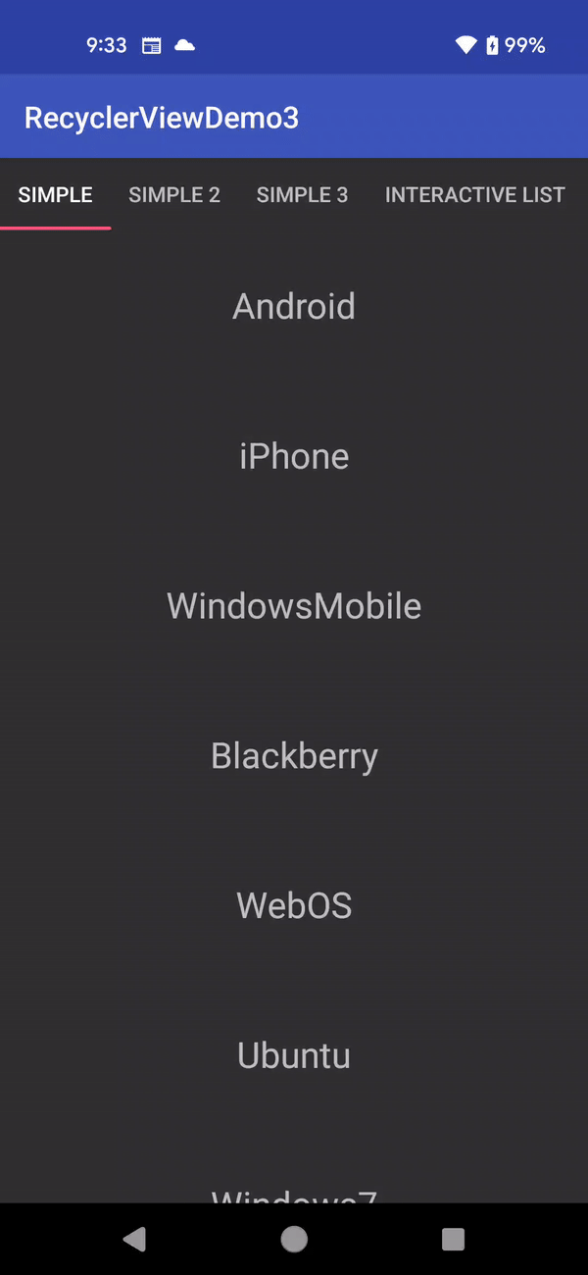
RecyclerView complexity
The layout and adapter are very similar to a fragment
Each spot can be as complex or simple as you need.
you write the complexity into the adapter.
Lastly, I've shown them all vertical, but you can use horizontal.

Slide 41
References
http://treyrobinson.net/blog/android-l-tutorials-part-3-recyclerview-and-cardview/
https://developer.android.com/training/material/lists-cards.html
https://github.com/shamanland/floating-action-button
http://stackoverflow.com/questions/24459352/how-can-i-add-the-new-floating-action-button-between-two-widgets-layouts
https://www.bignerdranch.com/blog/implementing-swipe-to-refresh/
https://medium.com/@ipaulpro/drag-and-swipe-with-recyclerview-b9456d2b1aaf

Slide 42
References
https://developer.android.com/training/material/theme.html
https://chris.banes.me/2014/10/17/appcompat-v21/
https://github.com/shamanland/floating-action-button
http://stackoverflow.com/questions/24459352/how-can-i-add-the-new-floating-action-button-between-two-widgets-layouts
http://treyrobinson.net/blog/android-l-tutorials-part-3-recyclerview-and-cardview/
https://developer.android.com/training/material/lists-cards.html

Slide 43
Q
A
&

