Slide 1
Cosc 5/4730
Android Maps v2

Slide 2
Maps V1 vs V2 and v3
In March 2013 google removed the ability to get a map key for version 1.
Version 2 had been introduced in December of 2012, which is code breaking changes.
some documentation on the web is still for version 1!
There is also maps sdk v3 beta which is deprecated.
map code dates about to 2019 and release notes from 2021
A note, says New map experiences will be update in March 2025
It appears that the "maps" v3 is part of v19.X and is not a code breaking change the maps. https://developers.google.com/maps/documentation/android-sdk/release-notes#2021-08-18

Slide 3
Google Maps API v2+
I’m not going to repeat here everything needed in the getting started guide: https://developers.google.com/maps/documentation/android/start
One thing, you must have 2 libraries imported for the play services. In you build.gradle app file
implementation 'com.google.android.gms:play-services-maps:19.0.0'
implementation 'com.google.android.gms:play-services-base:18.5.0'

Slide 4
Keys
Note your map key is going to be tied to the key you are using to compile the project.
Likely this is a debug key that android studio generated for you. It will be different on every machine unless you copy it to the new machines.
C:\Users\<username>\.android
Debug.keystore

Slide 5
AndroidManifest.xml
It gets complex, but basically you need a lot of permissions:
<uses-permission android:name="android.permission.INTERNET" />
<uses-permission android:name="android.permission.ACCESS_NETWORK_STATE"/>
<uses-permission android:name="android.permission.WRITE_EXTERNAL_STORAGE" />
<uses-permission android:name="com.google.android.providers.gsf.permission.READ_GSERVICES" />
<uses-permission android:name="android.permission.ACCESS_COARSE_LOCATION" />
<uses-permission android:name="android.permission.ACCESS_FINE_LOCATION" />
<uses-permission android:name="edu.cs4730.mapdemov2.permission.MAPS_RECEIVE" />
Then some pieces for the maps itself:
<permission
android:name="edu.cs4730.mapdemov2.permission.MAPS_RECEIVE"
android:protectionLevel="signature" />
<uses-feature
android:glEsVersion="0x00020000"
android:required="true" />
<meta-data
android:name="com.google.android.maps.v2.API_KEY"
android:value=“YOUR KEY" />
Note the red is your project package name.

Slide 6
layout
There is a mapfragment and a mapview. We’ll work with the fragment.
The layout will look something like this:
<fragment
android:id="@+id/map"
android:layout_width="match_parent"
android:layout_height="match_parent"
class="com.google.android.gms.maps.SupportMapFragment" />
You can this as a single element in a layout or with many of widgets as well.
There are also lot of settings we can use, but we come back to it later.

Slide 7
SupportMapFragment
With the layout, a map will show up when it is run.
But likely your code will want interact with the map and the user:
First which kind of map do you want to show:
Normal
Typical road map. Roads, some man-made features, and important natural features such as rivers are shown. Road and feature labels are also visible.
Hybrid
Satellite photograph data with road maps added. Road and feature labels are also visible.
Satellite
Satellite photograph data. Road and feature labels are not visible.
Terrain
Topographic data. The map includes colors, contour lines and labels, and perspective shading. Some roads and labels are also visible.
None
No tiles. The map will be rendered as an empty grid with no tiles loaded.

Slide 8
SupportMapFragment (2)
First we get the map, but this requires network access, so we have to get the map via an async call.
((SupportMapFragment) getChildFragmentManager().findFragmentById(R.id.map)).getMapAsync(this);
And implements OnMapReadyCallback
@Override
public void onMapReady(GoogleMap googleMap) {
//Now we have a map and are ready start working with it.
map = googleMap;
}

Slide 9
SupportMapFragment (3)
Now we can access and change it.
map.setMapType(GoogleMap.MAP_TYPE_NORMAL); //normal map
map.setMapType(GoogleMap.MAP_TYPE_HYBRID); //hybrid map
We can set a location and zoom to it
We can also set a click listener as well.

Slide 10
SupportMapFragment (3)
We can also set up “markers” on the map
First with need coordinates:
LatLng LARAMIE = new LatLng(41.312928,-105.587253);
LatLng is the data type that is used for the maps (mostly).
Marker larMarker = map.addMarker(new MarkerOptions().position(Laramie)
.title(“Laramie"));

Slide 11
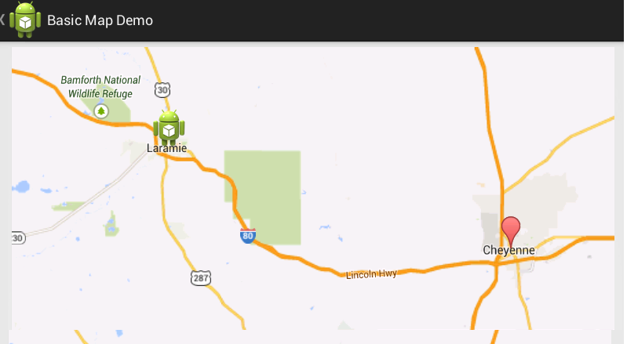
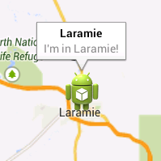
example
We can add Laramie and Cheyenne
With Laramie also changed the picture and what the user sees when you click on it.

Slide 12
More info
Marker laramie = map.addMarker(new MarkerOptions()
.position(LARAMIE)
.title("Laramie")
.snippet("I'm in Laramie!")
.icon(BitmapDescriptorFactory.fromResource(R.drawable.ic_launcher))
);

Slide 13
The icon for the marker.
You can also the defaults as well, which will show the default red, by leaving off the icon part.
MarkerOptions()
.position(LARAMIE)
.title("Laramie")
.snippet("I'm in Laramie!"));

Slide 14
The icon for the marker (2)
// Blue color icon
marker.icon(BitmapDescriptorFactory.defaultMarker(BitmapDescriptorFactory.HUE_BLUE));

Slide 15
Basic Click listener
The OnMapClick Listener allows you to capture any clicks on the screen and see the Lat and Long of the position.
map.setOnMapClickListener(new OnMapClickListener() {
@Override
public void onMapClick(LatLng point) {
Toast.makeText(getApplicationContext(), "Lat: " + point.latitude+ " Long:" +point.longitude, Toast.LENGTH_SHORT).show();
}
});

Slide 16
Basic Click listener (2)

Slide 17
Marker Listener
You can override the default marker listener which will show the snippet info
map.setOnMarkerClickListener( new OnMarkerClickListener() {
@Override
public boolean onMarkerClick(Marker myMarker) {
Toast.makeText(getApplicationContext(), "Clicked the " +myMarker.getTitle() + " Marker", Toast.LENGTH_SHORT).show();
//return true; // don’t show default action.
return false; //show the default action too.
}
});

Slide 18
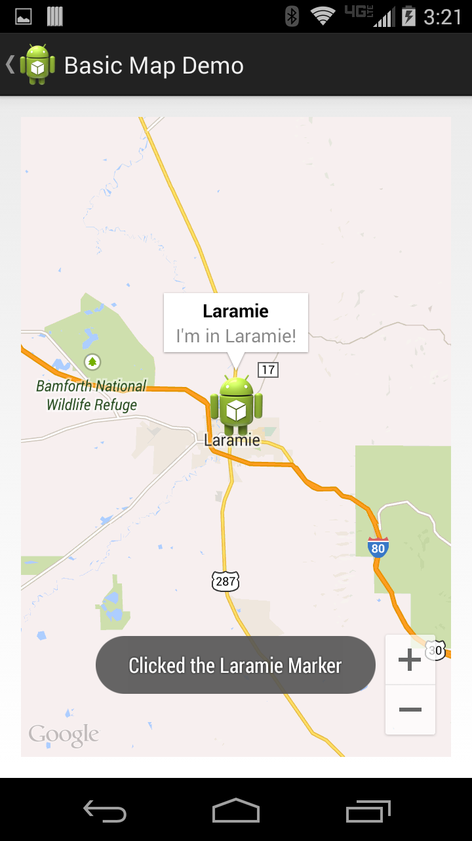
Marker Listener (2)
Example:
Default action
And a marker listener
With a toast.

Slide 19
Settings in XML
We can setup most of the settings in the xml as well.
<fragment xmlns:android="http://schemas.android.com/apk/res/android" xmlns:map="http://schemas.android.com/apk/res-auto" android:id="@+id/map" android:layout_width="match_parent" android:layout_height="match_parent" class="com.google.android.gms.maps.SupportMapFragment" map:cameraBearing="112.5" map:cameraTargetLat="-33.796923" map:cameraTargetLng="150.922433" map:cameraTilt="30" map:cameraZoom="13" map:mapType="normal" map:uiCompass="false" map:uiRotateGestures="true" map:uiScrollGestures="false" map:uiTiltGestures="true" map:uiZoomControls="false" map:uiZoomGestures="true"/>
https://developers.google.com/maps/documentation/android/reference/com/google/android/gms/maps/UiSettings

Slide 20
Sample code (so far)
mapDemoV2 in https://github.com/JimSeker/maps
The BasicMapActivity
Shows the basics with some controls
The CompassActivity
The layout is compassactivity.xml
Note, it puts up a compass, but the map doesn't "move automatically", the user change turn the map on the screen and the compass will react that that change.

Slide 21
Drawing on maps

Slide 22
Drawing.
You can add Polylines, Polygons (with holes as needed), and Circles
We can then customize the appearance of the color and of the shapes
We are going to focus on Polygons
For the others see:
https://developers.google.com/maps/documentation/android/shapes

Slide 23
Adding a shape
Polygon polygon = map.addPolygon( PolygonOptions polygonoptions);
We need to setup the poygonoptions in the next slides.
We can also add a polygonclicklister so if the user clicks this area we can respond.
PolygonOptions.setclickable(true) is required.
then use the returned polygon.setTag( data), which we can retrieve later.
Data could be the data or just a index to look it up in a data structure.

Slide 24
PolygonOptions
Here set the options and list of coordinates (as LatLng).
PolygonOptions po = new PolygonOptions();
po.add( LatLng) OR .add (LatLng, LatLng, …);
.add(new LatLng(0, 0), new LatLng(0, 5), new LatLng(3, 5))
po.strokeColor(Color); //a 32-bit ARGB color
po.fillColor( Color); //a 32-bit ARGB color
https://developers.google.com/maps/documentation/android/reference/com/google/android/gms/maps/model/PolygonOptions

Slide 25
OnPolygonClickListener
Now if we add a click listener
map.setOnPolygonClickListener(new GoogleMap.OnPolygonClickListener() {
@Override
public void onPolygonClick(Polygon polygon) {
//retrieve the "data" we set before.
"data" = polygon.getTag();
}

Slide 26
XML (kml) parsing
Android

Slide 27
XML parsing
Since a lot of map data can be found in XML files (called kml)
We need to be able to parse xml files for this project as well.
There is an xml parser in android, called sax.
First we setup the SAX parser and create a Handler to process our k/xml files.
Uses the following packages javax.xml.parsers.SAXParser, javax.xml.parsers.SAXParserFactory, and org.xml.sax.*

Slide 28
Example k/xml file
<?xml version="1.0" encoding="UTF-8"?>
<kml xmlns … >
<Document>
<Placemark id="ID_00000">
<name>
Absaroka
</name>
<coordinates>
-109.3,44.70,0 -109.9,44.70,0 -109.9,44.20,0
-109.3,44.2,0 -109.3,44.70,0
</coordinates>
</Placemark>
</Document>
</kml>
This is an example of what an kml file can look like
It has a placemark with an id,
the name of the placemakr is absaroka
and the coordinates of absaroka are
-109.3,44.70,0 -109.9,44.70,0 -109.9,44.20,0
-109.3,44.2,0 -109.3,44.70,0
Note this can be on multiple lines or one line. There is no speciation for it.
Note I've removed many tags to create a simple example.
We need to setup a parser for the information that we would like to pull out of the kml document.

Slide 29
Initial setup of SAX
create the factory
SAXParserFactory factory = SAXParserFactory.newInstance();
create a parser
SAXParser parser = factory.newSAXParser();
create the reader (scanner)
XMLReader xmlreader = parser.getXMLReader();

Slide 30
setup of SAX to parse
Assign our handler, on the next slides
xmlreader.setContentHandler(MyDefaultHander);
Perform the synchronous parse of the data
xmlreader.parse(InputSource OurSource);
Example: InputSource is = new InputSource( getResources().openRawResource(R.raw.cats));
At this point the parse of the data is done or it failed, throwing an Exception that we should handle.

Slide 31
DefaultHandler
Part of the org.xml.sax.helpers package.
This part handles our xml parsing, we add the pieces necessary to pull out the information we want from the xml file.
This is done by override several methods
startDocument(), endDocument(), startElement, endElement, and characters.
There are more methods, we this is the minimum methods to process out the xml.

Slide 32
DefaultHandler (2)
startDocument()
Receive notification of the beginning of the document.
Setup whatever data structure you are using to hold all the data from the xml document.
endDocument()
Receive notification of the end of the document.
Finalized your data structure, as necessary.

Slide 33
DefaultHandler (3)
startElement
Called when a start tag is found
Examples: <kml>, <name>, <Placemark>
endElement
Called when an end tag is found
Examples: </kml>, </name>, </Placemark>
charaters
Called when data is found. This is when data is found between a start and end tag.

Slide 34
Example k/xml file and calls
StartDocument call
<?xml version="1.0" encoding="UTF-8"?>
<kml xmlns … > StartElement called
<Document> StartElement called
<Placemark id="ID_00000"> StartElement called
<name> StartElement called
Absaroka characters called
</name> endElement called
<coordinates> StartElement called
-109.3,44.70,0 -109.9,44.70,0 -109.9,44.20,0 characters called
-109.3,44.2,0 -109.3,44.70,0 characters called
</coordinates> endElement called
</Placemark> endElement called
</Document> endElement called
</kml> endElement called
endDocument called

Slide 35
Dealing the calls.
So in your StartElement you going to have to setup “something”, so you know where to put the data.
Boolean variables are handy.
In characters, check the variables, so you know what the data is based on the startelement
Remember this maybe called several times in a row.
And in EndElement, finished the data as needed and set the Boolean to false.

Slide 36
At this point.
We’ll look at the source code MapDemo to see how this is all working.
In the SaxHandler.java

Slide 37
Finally we get
Note as the user zooms in out and the areas will stay correct as well.
we the click listeners, we can get info back about the areas well.

Slide 38
Sample code
The DrawMapActivity
Uses /raw/cats kml file
Also dogs, if you want to try it.
Needs the dataSet.java (simple array list of placemarks)
Placemarks.java holds information about a place including the coordinates
saxHandler.java which handler to read the kml file.

Slide 39
Final note
We can also add image overlays like areas,
GroundOverlays
https://developers.google.com/maps/documentation/android-sdk/groundoverlay
And Tile Overlays
this is why you would want "None" displayed with the map, because you are provides the overlays instead.
You could create you own world/map this way, but is based on your position and movements on real location and movement.
https://developers.google.com/maps/documentation/android-sdk/tileoverlay

Slide 40
References
https://developers.google.com/maps/documentation/android-sdk/intro
https://developers.google.com/maps/documentation/android/start
http://www.vogella.com/articles/AndroidGoogleMaps/article.html
http://www.androidhive.info/2013/08/android-working-with-google-maps-v2/
http://wptrafficanalyzer.in/blog/google-maps-in-android-application-with-new-google-maps-android-api-v2-using-supportmapfragment/

Slide 41
Q
A
&

