Slide 1
Cosc 5/4730
Android Navigation:
Menus, ActionBar/ToolBar, and Navigation Drawer

Slide 2
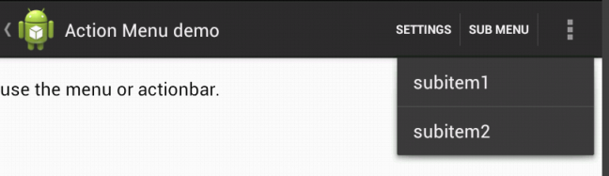

Navigation visual
Back Button
Action Buttons
ActionBar/
ToolBar
Menu
Navigation Drawer
Note: If there is physical menu button, then the menu does not show on the screen

Slide 3
ActionBar/toolbar and Menus
The default activity in Andriod Studio is an AppCompatActivity (via androidx.appcompat:appcompat)
  This provides an ActionBar and menu
  For the purpose of this lecture, that is what I’m going to use. We have full support for fragments, ActionBar, and menus
    There is an older menu system from api 1, that still works, but I’m not covering it.
  Note, Android prefers you to use the new ToolBar (androidx.appcompat) which replaces the ActionBar.
    The toolbar is functionally the same as an ActionBar.
    The toolbar supports Material Design elements that the actionBar can not.

Slide 4
toolbar
The ActionBar has been basically replaced in lollipop with the ToolBar.
  Allows you to move the “ActionBar” and change it size too.
  One thing is you can now have more then one toolbar as well.
Requires a style change.
    <style name="AppTheme.Base" parent= "Theme.AppCompat.DayNight.NoActionBar">
  OR
    <style name="AppTheme.Base" parent= "Theme.MaterialComponents.DayNight.NoActionBar">

Slide 5
toolbar
In a xml layout:
<androidx.appcompat.widget.Toolbar …
android:layout_width="match_parent"
android:layout_height="wrap_content"
… likely more theme/style attributes.
</androidx.appcompat.widget.Toolbar>

Slide 6

Toolbar (java)
use the androidx.toolbar instead of the default one.
toolbar = (Toolbar) findViewById(R.id.app_bar);
setSupportActionBar(toolbar);
Now this is the ActionBar and you use all the same methods as before
  Which all my examples already use the SupportActionBar, so everything works.

Slide 7
Toolbar
If you want second (or more) toolbar, say at the bottom
  Then you have to control that via the toolbar and not as actionbar. Because there can be only one “actionbar”.
Note, you can leave the style with an ActionBar and everything will work as well.

Slide 8
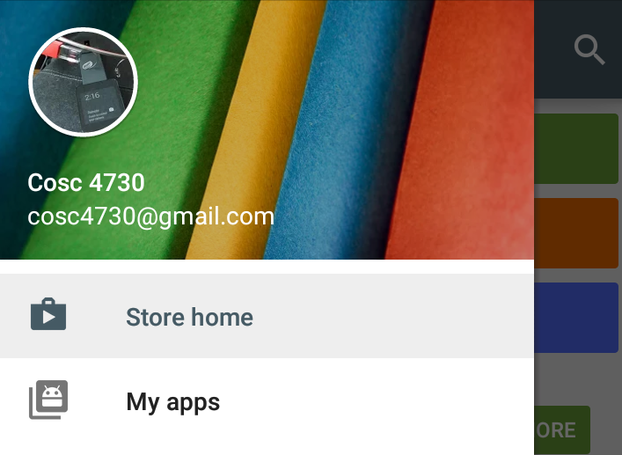
Navigation Drawer Layout
This is all but the default method that google wants you to use for navigation (sort of,has new gestures and google now suggests a bottom navigation view if possible)
  As well as menus.
  So you can use listview/recyclerview or the new NavView.
  Play store as example:

Slide 9
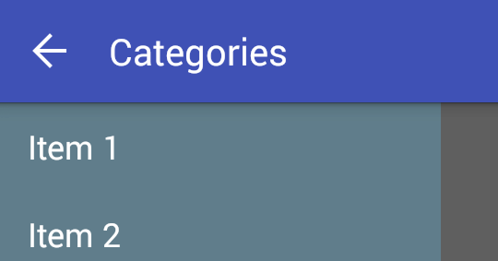

Navigation Drawer Layout (2)
Using the toolbar instead of the actionbar,
  The navigation bar provides the function as google wants: the drawer layout covers the toolbar when it is open.
  ActionBar ToolBar

Slide 10
We’ll come back to the navigation drawer and toolbar, but first

Slide 11
Menus
Android

Slide 12
Menus
Menus are created via an xml document
  First create a menu xml (normally in res/menu) with menu as the type.
    You can add items (and sub menus). You can also group the items as well.
Menus are currently out of favor and most documents say to use a navigation drawer or bottom navigation.
Menu example code is repo ui in directory Navigation

Slide 13
Menu.xml example:
<group android:id="@+id/group1">
<item android:id="@+id/item1"
android:orderInCategory="5"
android:title="item1"/>
<item android:id="@+id/item2"
android:orderInCategory="10"
android:title="item2"/>
<item android:id="@+id/item3"
android:orderInCategory="1"
android:title="item3"/>
<item android:id="@+id/item4"
android:orderInCategory="3"
android:title="item4"/>
<item android:id="@+id/item5"
android:orderInCategory="2"
android:title="item5"/>
</group>
Note the orderInCategory determines the order of display, so this will show:
Item3
Item5
Item4
Item1
item2

Slide 14
Sub menus in xml
Create and item that will be the submenu heading
  Then create a menu instead of the item tags.
<menu>
<item>
...
<menu>
...
</menu>
...
</item>
</menu>

Slide 15
Menu Java code
Use onCreateOpensMenu and onOptionsItemSelected
    Which android studio creates for you by default
  @Override
  public boolean onCreateOptionsMenu(Menu menu) {
  // Inflate the menu; this adds items to the action bar if it is present.
  getMenuInflater().inflate(R.menu.menu, menu);
  return true;
  }
  @Override
  public boolean onOptionsItemSelected(MenuItem item) {
  // Handle action bar item clicks here.
  int id = item.getItemId();
  if (id == R.id. item1) { //assuming previous xml document
  return true; //do something here to handle the menu.
  } … //handle the rest.
  return super.onOptionsItemSelected(item);
  }

Slide 16
Popup menus.
Add a click listener (or longtouch, whatever) to anything.
  We are using a TextView, so make sure it clickable
  It will then call our code, called showPopupMenu(View v)
    Note this is not an override, just a method we are using
  public void onClick(View v) {
    showPopupMenu(v);
  }

Slide 17
showPopupMenu
private void showPopupMenu(View v){
PopupMenu popupM = new PopupMenu(this, v);
popupM.inflate(R.menu.popup);
popupM.setOnMenuItemClickListener(new PopupMenu.OnMenuItemClickListener() {
@Override
public boolean onMenuItemClick(MenuItem item) {
//do something
return true;
}
});
popupM.show();
}

Slide 18
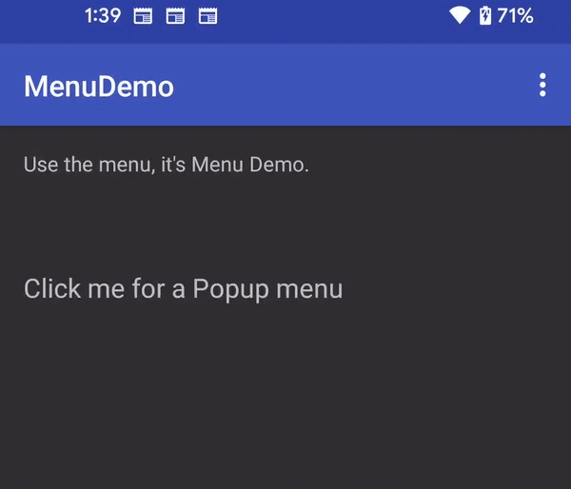
Popup Menus Visual

Slide 19
Fragments and Menus
Fragments can contribute to the menu as well
  Including if there is no menu.
  In the OnCreate() method of the fragment, you must add
    setHasOptionsMenu(true);
      Otherwise the menu methods will not be called.
A note, when the fragment is showing, the menu will be there and when the fragment is “removed”, then those menu items are removed as well.
  Remember, fragments are nice, because of the encapsulation.

Slide 20
Fragments and Menus (2)
Override the following, note the onCreateOptionsMenu is a little different
@Override
public void onCreateOptionsMenu(Menu menu, MenuInflater inflater) {
super.onCreateOptionsMenu(menu, inflater);
inflater.inflate(R.menu.frag2menu, menu);
}
@Override
public boolean onOptionsItemSelected(MenuItem item) {
switch (item.getItemId()) {
case R.id.frag2item:
//do something.
return true;
}
return super.onOptionsItemSelected(item);
}

Slide 21
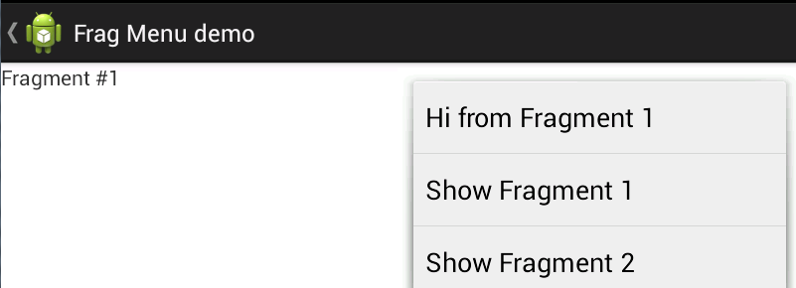
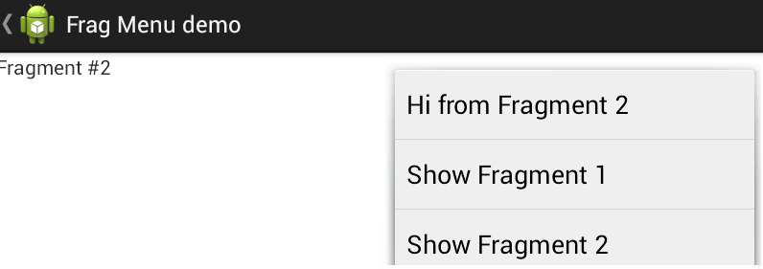
Fragment Example
The show Fragment X is menu from the activity.

Slide 22
Menu creation
Menu items can be changed later by
  invalidateOptionsMenu();
  Which calls the onCreateOptionsMenu method again.
  So if you need to change, enable/disable menu items, you can do it pretty easily.

Slide 23
ActionBAR (but really a toolbar)
Android

Slide 24
“ActionBar”
The Actionbar can provide a “Back” button to the parent Activity.
We can also add “buttons”, except they are menu items, via the xml
  Note I’m using text, but it could just easily be an icon (or both!)
  We can also add sub menu to the ActionBar that drop down when clicked.

Slide 25
Xml code
From Googles page: http://developer.android.com/guide/topics/resources/menu-resource.html
  Using the xmlns:app="http://schemas.android.com/apk/res-auto"
app:showAsAction=
  ifRoom
    Only place this item in the Action Bar if there is room for it.
  withText
    Also include the title text (defined by android:title) with the action item. You can include this value along with one of the others as a flag set, by separating them with a pipe |.
  never
    Never place this item in the Action Bar.
  always
    Always place this item in the Action Bar. Avoid using this unless it's critical that the item always appear in the action bar. Setting multiple items to always appear as action items can result in them overlapping with other UI in the action bar.
  collapseActionView
    The action view associated with this action item (as declared by android:actionLayout or android:actionViewClass) is collapsible.
      Introduced in API Level 14.

Slide 26
Xml code example
<menu … xmlns:app="http://schemas.android.com/apk/res-auto" >
<item android:id="@+id/actionmenu_settings"
app:showAsAction="ifRoom"
android:title="@string/action_settings"/>
<item android:id="@+id/submenu"
android:title="sub menu"
app:showAsAction="always" >
<menu>
<item android:id="@+id/asubitem1"
android:orderInCategory="1"
android:title="subitem1"/>
<item android:id="@+id/asubitem2"
android:orderInCategory="2"
android:title="subitem2"/>
</menu>
</item>
<item android:id="@+id/amenuitem1"
android:title="item1"/>
<item android:id="@+id/amenuitem2"
android:title="item2"/>
</menu>
Show if room, if not show in normal
menu
Always shows and creates a
Drop menu (separate from standard
Menu)
Normal menu items

Slide 27
End result
This shows how it can look
  The sub menu item has been clicked to show the sub menu.

Slide 28
Action Bar
We can also have “buttons” as well and change them as needed, programmatically.
This example uses the ViewPager2 and fragment examples and adds buttons for Previous and Next
  also finish, but that doesn’t do anything
The buttons may show at the bottom of the screen if there is not enough space on the actionbar.

Slide 29
Java code
We need to use the invalidateOptionsMenu(); every time the page is changed, so
  Using the ViewPager2. registerOnPageChangeCallback(…)
Otherwise, the main work is in the onCreateOptionsMenu(Menu menu)

Slide 30
OnCreateOptionsMenu
public boolean onCreateOptionsMenu(Menu menu) {
super.onCreateOptionsMenu(menu);
getMenuInflater().inflate(R.menu.activity_screen_slide, menu);
Enable the previous menu item, if we are not on the first page (xml).
menu.findItem(R.id.action_previous).setEnabled(viewPager.getCurrentItem() > 0);
Add either a "next" or "finish" button to the action bar, depending on which page is currently selected. Done programmatically.
MenuItem item = menu.add(Menu.NONE, R.id.action_next, Menu.NONE,
(viewPager.getCurrentItem() == mPagerAdapter.getCount() - 1)
? R.string.action_finish
: R.string.action_next);
item.setShowAsAction(MenuItem.SHOW_AS_ACTION_IF_ROOM | MenuItem.SHOW_AS_ACTION_WITH_TEXT);
return true;
}

Slide 31
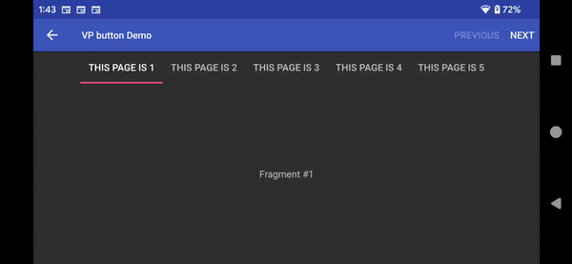
And the result looks like

Slide 32

Other things xml .
android:titleCondensed="string“
android:icon="@[package:]drawable/drawable_resource_name“
android:onClick="method name“
android:actionLayout="@[package:]layout/layout_resource_name"
android:actionViewClass="class name"
android:actionProviderClass="class name"
android:alphabeticShortcut="string"
android:numericShortcut="string"
android:checkable=["true" | "false"]
The layout allows you to add say a search bar to the top.

Slide 33
Navigation Drawer

Slide 34
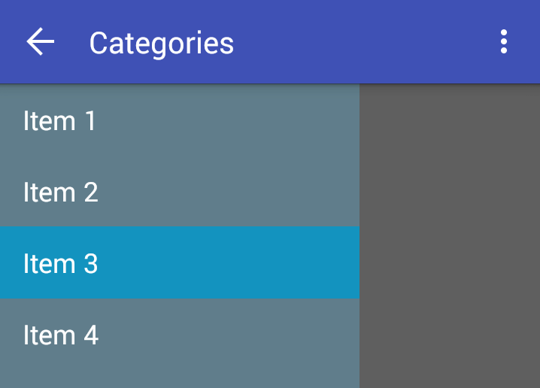
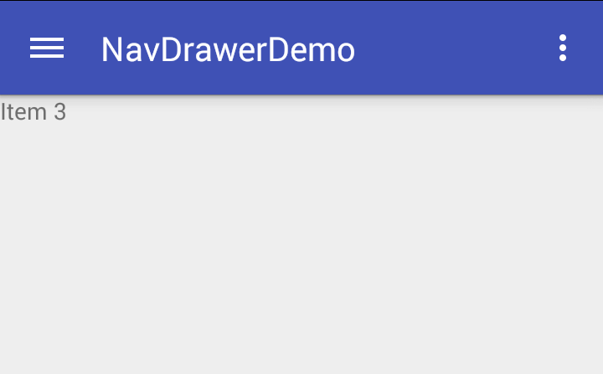
Navigation Drawer
Provides a slider window that allows you have navigation, like a listview, but not always on screen.
Closed (actionbar) Opened

Slide 35
Navigation Drawer
It uses a Drawer layout that takes two “views”
  Both views are likely layouts or fragments
  View/layout 1 is the main content.
      The one that shows when the drawer is closed.
  View/layout 2 is the drawer content.
      What shows when the drawer is open.
        Mostly like has a listview as well.

Slide 36
Navigation Drawer xml code
<androidx.drawerlayout.widget.DrawerLayout … android:id="@+id/drawer_layout"
android:layout_width="match_parent" android:layout_height="match_parent">
<!-- As the main content view -->
<…Layout
android:layout_width="match_parent"
android:layout_height="match_parent">
<!-- whatever views/widgets needed -->
</…Layout>
<!– drawer content view -->
<ListView android:id="@+id/left_drawer"
android:layout_gravity="start" //default left to right and switch for right to left languages.
android:choiceMode="singleChoice"/>
</androidx.drawerlayout.widget.DrawerLayout>

Slide 37
DrawerLayout Java
The listview is setup like normal
  Except on a selection, we also close the drawer.
  mDrawerLayout = (DrawerLayout) findViewById(R.id.drawer_layout);
  In the setOnItemClickListener use mDrawerLayout.closeDrawers();
We need to tie the drawer to the actionbar, so the icons show, uses the ActionBarDrawerToggle.

Slide 38
DrawerLayout Java (2)
enable ActionBar app icon to behave as action to toggle nav drawer
getSupportActionBar().setDisplayHomeAsUpEnabled(true);
getSupportActionBar().setHomeButtonEnabled(true);
ActionBarDrawerToggle ties together the proper interactions between the sliding drawer and the action bar app icon
mDrawerToggle = new ActionBarDrawerToggle(this, /* host Activity */
mDrawerLayout, /* DrawerLayout object */
R.string.drawer_open, /* "open drawer" description for accessibility */
R.string.drawer_close /* "close drawer" description for accessibility */
) {
public void onDrawerClosed(View view) {
getSupportActionBar().setTitle(R.string.app_name); //change the title back , when closed.
invalidateOptionsMenu(); // creates call to onPrepareOptionsMenu()
}
public void onDrawerOpened(View drawerView) {
getSupportActionBar().setTitle("Categories"); //change the name, when opened.
invalidateOptionsMenu(); // creates call to onPrepareOptionsMenu()
} };
mDrawerLayout.setDrawerListener(mDrawerToggle);

Slide 39
DrawerLayout Java (3)
Lastly, these two or it doesn’t drawer correctly in the actionbar/toolbar.
/**
* When using the ActionBarDrawerToggle, you must call it during
* onPostCreate() and onConfigurationChanged()...
*/
@Override
protected void onPostCreate(Bundle savedInstanceState) {
super.onPostCreate(savedInstanceState);
// Sync the toggle state after onRestoreInstanceState has occurred.
mDrawerToggle.syncState();
}
@Override
public void onConfigurationChanged(Configuration newConfig) {
super.onConfigurationChanged(newConfig);
// Pass any configuration change to the drawer toggls
mDrawerToggle.onConfigurationChanged(newConfig);
}

Slide 40
DrawerLayout Java (4)
Lastly, a fix to the menu as well.
public boolean onOptionsItemSelected(MenuItem item) {
// The action bar home/up action should open or close the drawer.
// ActionBarDrawerToggle will take care of this.
if (mDrawerToggle.onOptionsItemSelected(item)) {
return true;
}
…

Slide 41
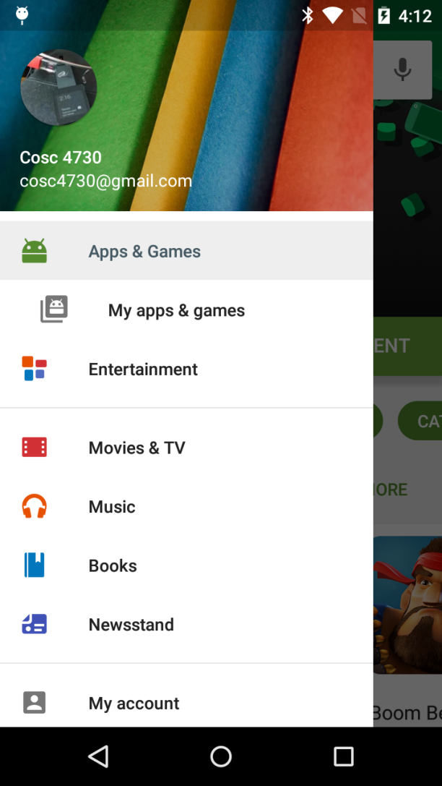
NavigationView
The support NavigationView is newer and is to make coding easier.
  It takes a drawer header layout
  And a xml menu file for the list
When a user clicks on a item, it can be handled similar to menus

Slide 42
NavigationView xml
Example of the code
  Note implementation 'com.google.android.material:material:1.2.1'+
<com.google.android.material.navigation.NavigationView
android:id="@+id/navview"
android:layout_width="wrap_content"
android:layout_height="match_parent"
android:layout_gravity="start"
app:headerLayout="@layout/drawer_header" //header xml.
app:menu="@menu/drawer" /> //items to display.

Slide 43
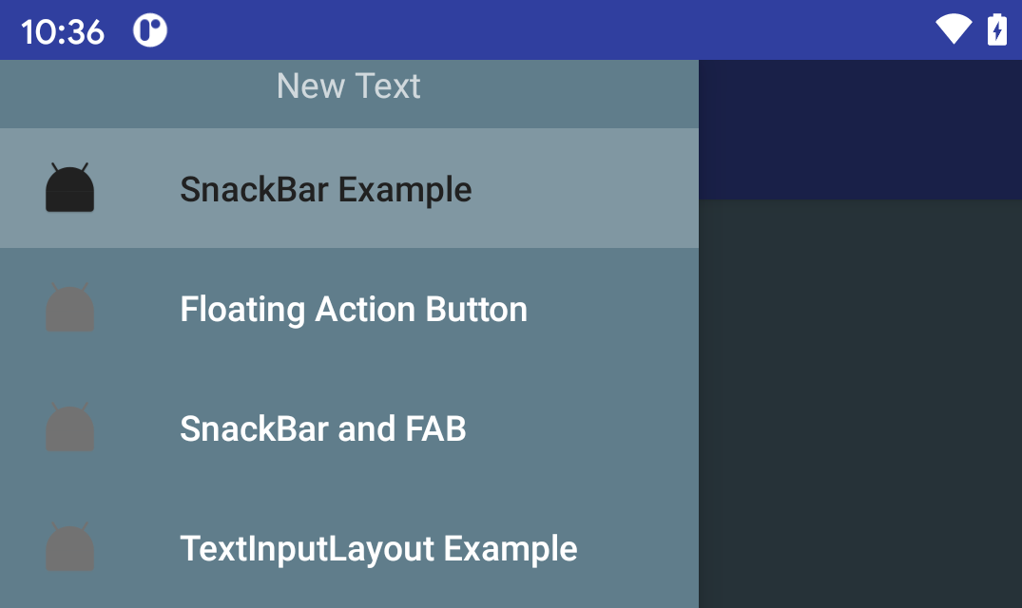
NavigationView xml (2)
@layout/drawer_header
<LinearLayout xmlns:android="http://schemas.android.com/apk/res/android"
android:orientation="vertical" android:layout_width="match_parent"
android:layout_height="match_parent">
<TextView
android:layout_width="wrap_content"
android:layout_height="wrap_content"
android:text="New Text"
android:id="@+id/textView2"
android:layout_gravity="center_horizontal" />
</LinearLayout>
@menu/drawer
<menu xmlns:android="http://schemas.android.com/apk/res/android">
<group android:checkableBehavior="single">
<item
android:id="@+id/navigation_item_1"
android:checked="true"
android:icon="@mipmap/ic_launcher"
android:title="@string/navigation_item_1"/>
<item
android:id="@+id/navigation_item_2"
android:icon="@mipmap/ic_launcher"
android:title="@string/navigation_item_2"/>
<item
android:id="@+id/navigation_item_3"
android:icon="@mipmap/ic_launcher"
android:title="@string/navigation_item_3"/>
<item
android:id="@+id/navigation_item_4"
android:icon="@mipmap/ic_launcher"
android:title="@string/navigation_item_4"/>
</group>
</menu>

Slide 44
NavigationView (java)
mNavigationView = findViewById(R.id.nav_view);
mNavigationView.setNavigationItemSelectedListener(new NavigationView.OnNavigationItemSelectedListener() {
@Override
public boolean onNavigationItemSelected(@NonNull MenuItem menuItem) {
    we could just as easily call onOptionsItemSelected(menuItem) and how it deal with it. this is just menu items.
int id = menuItem.getItemId();
if (id == R.id.navigation_item_1) { …; return true; //handled}
else if (id == R.id.navigation_item_2) { … ; return true; //handled}
…
return false; //we didn't handle the click.
}
});

Slide 45
Demos
The NavDrawerFragDemo
  Uses the Shakespeare fragments from listview demos in the Drawerlayout
    Note the ListFragment, since you need to change the text color correctly, for a dark background and light text color.
    Also changing the listview rowlayout.
NavDrawer is google example, show a listview and fragment.
  Some corrections for the newer version of the drawerlayout.
In the rep ui is the navigation directory.

Slide 46
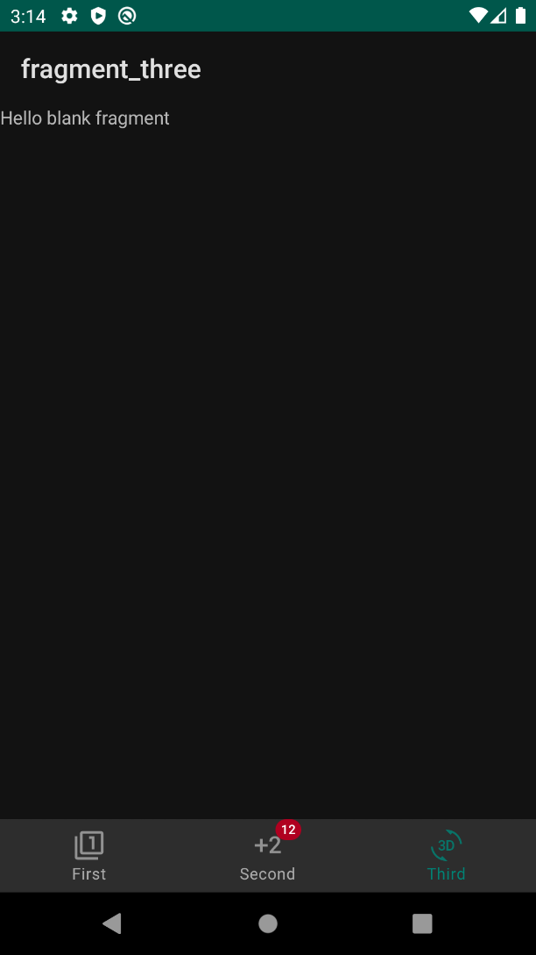
BottomNavigationView
Bottom navigation bars make it easy for users to explore and switch between top-level views in a single tap.
  They should be used when an application has three to five top-level destinations.
  The bar can disappear on scroll, based on HideBottomViewOnScrollBehavior, when it is placed within a CoordinatorLayout and one of the children within the CoordinatorLayout is scrolled.
  This behavior is only set if the layout_behavior property is set to HideBottomViewOnScrollBehavior.
The third item is checked in this example.

Slide 47
Bottom Navigation

Slide 48
BottomNavigationView xml
implementation 'com.google.android.material:material:1.1.0'
<com.google.android.material.bottomnavigation.BottomNavigationView
android:id="@+id/nav_view"
…
app:menu="@menu/bottom_nav_menu" />
Uses a menu xml document
example:
<menu … >
<item android:id="@+id/action_first"
android:title="First"
android:icon="@drawable/ic_action_one" />
<item android:id="@+id/action_second"
android:title="Second"
android:icon="@drawable/ic_action_second" />
<item android:id="@+id/action_third"
android:title="Third"
android:icon="@drawable/ic_action_third" />
</menu>
Examples in ui repo, in the advanced directory

Slide 49
BottomNavigationView java
BottomNavigationView navView = findViewById(R.id.nav_view);
navView.setOnItemSelectedListener(
new NavigationBarView.OnItemSelectedListener() {
public boolean onNavigationItemSelected(MenuItem item) {
//item.setChecked(true); //to have the bottom view change.
return false;
}
}
);

Slide 50
BottomNavigationView Arch Nav.
As you would expect it is also designed to work with the new architecture Navigation as well.
The example in the UI advanced BottomNavigationViewDemo has all the code for the Navigation as well as non version.

Slide 51
BottomNavigationView Arch Nav.
Build the standard map with all the fragments, but you don't need any arrows.
  I used the same id names as the menu items, so action_first, action_second, action_third. I'd recommend this to min the confusion of names.
We need to map the menu and the actions together for the nav controller. This is done in code, instead of xml.
First build configuration.
AppBarConfiguration appBarConfiguration = new AppBarConfiguration.Builder(
R.id.action_first, R.id.action_second, R.id.action_third)
.build();
and then add all into the controller to do the work for you.
NavController navController = Navigation.findNavController(this, R.id.nav_host_fragment);
NavigationUI.setupActionBarWithNavController(this, navController, appBarConfiguration);
NavigationUI.setupWithNavController(navView, navController);
And you no longer need the listener for the section, since the controller is now doing the work.
This is in the BottomNavigationViewDemo in the advanced directory of the UI repo other examples are in
Material Design directory

Slide 52
References
http://developer.android.com/guide/topics/resources/menu-resource.html
http://developer.android.com/reference/android/app/Fragment.html#onOptionsItemSelected%28android.view.MenuItem%29
http://developer.android.com/guide/topics/ui/actionbar.html
http://stackoverflow.com/questions/26491689/how-do-i-declare-an-extended-height-toolbar-action-bar-on-android-lollipop
http://blog.xamarin.com/android-tips-hello-toolbar-goodbye-action-bar/
https://chris.banes.me/2014/10/17/appcompat-v21/

Slide 53
Q
A
&

