Slide 1
Cosc 4730
Android
Notifications

Slide 2
Notifications
There are a couple of ways to notify users without interrupting what they are doing
The first is Toast, use the factory method
Can be used by just about any app, even one without screen.
Toast.makeText(getBaseContext(), "Text to display to user", Toast.LENGTH_SHORT).show();
getBaseContext() or getContext()
Toast.LENGTH_SHORT or Toast.LENGTH_LONG is the duration it will be displayed.
may require the POST_NOTIFICATION permission

Slide 3
Permissions.
starting in API 33 you must ask the user for permission
App on android 13, but targeting lower API, the phone will ask by default for you. if you target API 33, you must ask, or it will be denied by default.
androidmanifest.xml file
<uses-permission android:name="android.permission.POST_NOTIFICATIONS"/>
ask for permission like you would for all the other permissions.
This is also needed for toasts from home screen widgets and background services. You don’t need a channel for toasts.

Slide 4
channels

Slide 5
Notification channels.
starting with API 26, a channel is required.
Channels allow you (and the user) to setup how all the notifications will look (or even if they are allowed), so you don't have setup for each individual notification.
include: importance, lights, sound, vibration, etc
You name and describe a channel. It's recommended you have likely 2 channels, one for general notifications and one for only important notifications. Again, the user could just turn them off too.

Slide 6
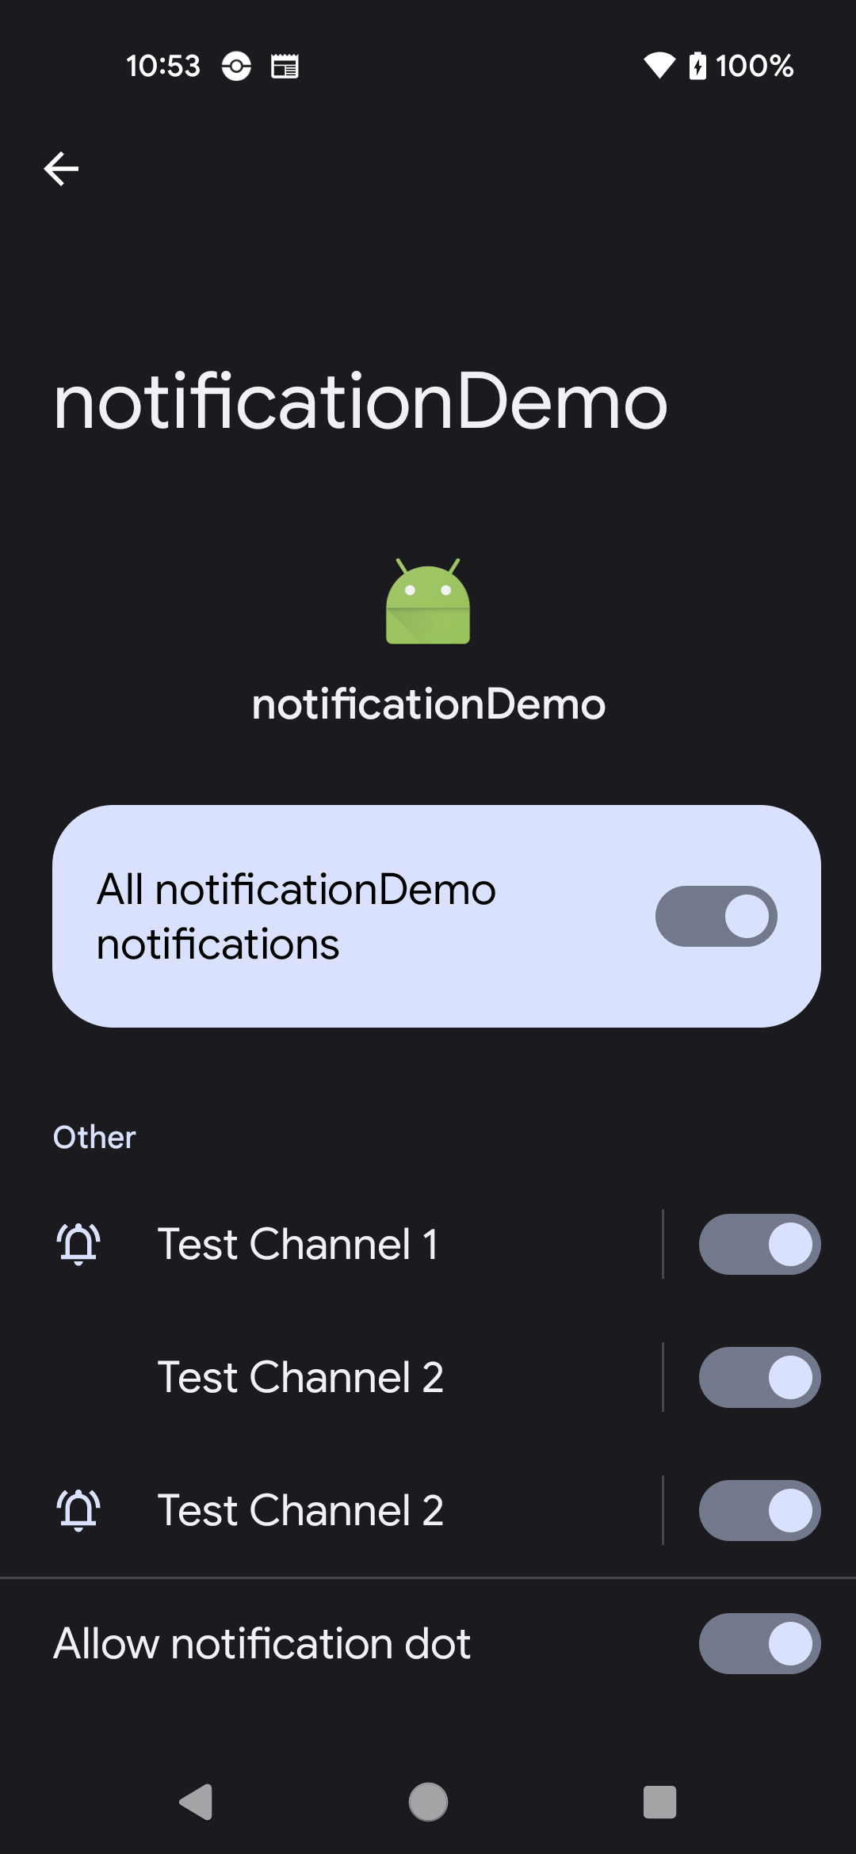
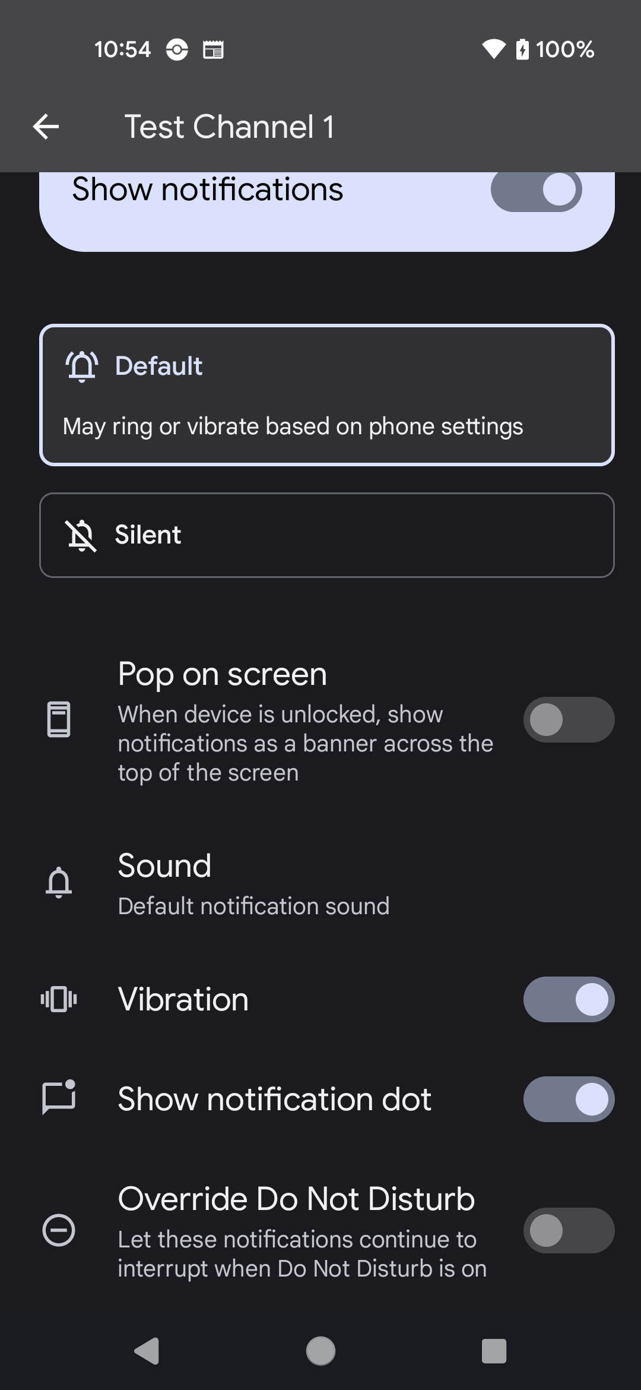
Channels as user sees them.
The user can change all the settings as well, including turning of a notification channel.

Slide 7
Coding them.
public static String id1 = "test_channel_01";
NotificationChannel mChannel = new NotificationChannel(id1, getString(R.string.channel_name), //name NotificationManager.IMPORTANCE_DEFAULT); //importance level // Configure the notification channel. mChannel.setDescription(getString(R.string.channel_description)); mChannel.enableLights(true); // Sets the notification light color for notifications posted to this channel, if the device supports this feature. mChannel.setLightColor(Color.RED); mChannel.enableVibration(true); mChannel.setShowBadge(true); mChannel.setVibrationPattern(new long[]{100, 200, 300, 400, 500, 400, 300, 200, 400}); nm.createNotificationChannel(mChannel);

Slide 8
importance
important level:
NotificationManager.IMPORTANCE_HIGH
shows everywhere, makes noise and peeks. May use full screen intents.
NotificationManager.IMPORTANCE_DEFAULT
shows everywhere, makes noise, but does not visually intrude.
NotificationManager.IMPORTANCE_LOW
Shows in the shade, and potentially in the status bar (see shouldHideSilentStatusBarIcons()), but is not audibly intrusive.
NotificationManager.IMPORTANCE_MIN
only shows in the shade, below the fold.
There is also a NotificationManager.IMPORTANCE_MAX is not well explained.
it says unused, but acts like HIGH, but is also listed as depreciated in other places.

Slide 9
Sounds
sound
To use a different sound with your notifications, pass a Uri reference to the setSound() method. The following example uses a known audio file saved to the device SD card:
mchannel.setSetound(Uri.parse("file:///sdcard/notification/ringer.mp3") );
the audio file is chosen from the internal MediaStore's ContentProvider:
mchannel.setSound(Uri.withAppendedPath( Audio.Media.INTERNAL_CONTENT_URI, "6") );

Slide 10
vibration
Adding vibration
To use the default pattern
mchannel.setDefaults(Notification.DEFAULT_VIBRATE);
For sound and virbrate mchannel.setDefaults(Notification.DEFAULT_VIBRATE | Notification.DEFAULT_SOUND);
To define your own vibration pattern, pass an array of long values to the vibrate field:
long[] pattern = {0,100,200,300}; //wait to turn on, on length, off length, on length, …
mchannel.setVibrate(pattern);
You'll need to add <uses-permission android:name="android.permission.VIBRATE"/> in the AndroidManifest.xml

Slide 11
lights
Adding flashing lights
To use the default light setting
mchannel.setDefaults(Notification.DEFAULT_LIGHTS); //for everything, Notification.DEFAULT_ALL
To define your own color and pattern,
mChannel.setLightColor(Color.BLUE); //for blue
OR
mChannel.setLights (int argb, //color
int onMs, //length on in milliseconds
int offMs); //length off in milliseconds

Slide 12
creating notifications

Slide 13
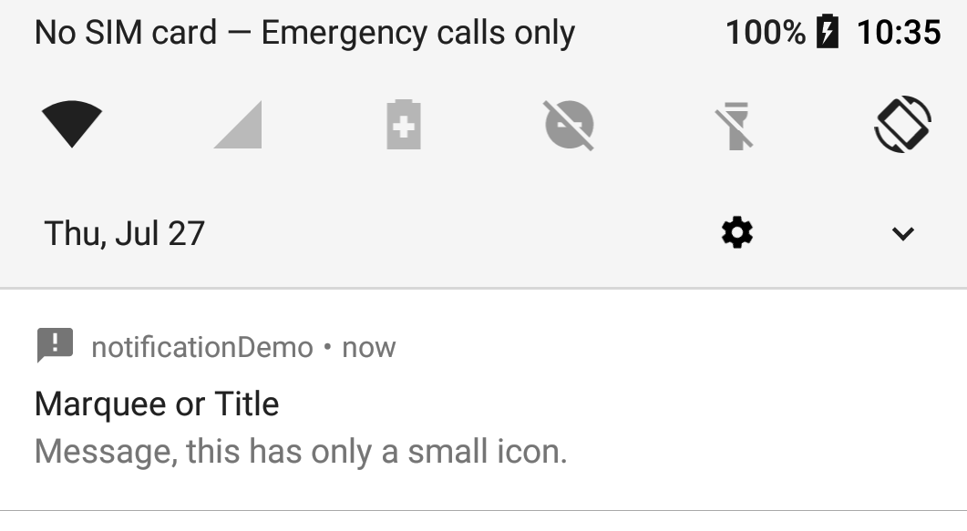
Status Bar Notifications
Our Notification
A status bar notification adds an icon to the system's status and an expanded message in the "Notifications" window.
You can also configure the notification to alert the user with a sound, a vibration, and flashing lights on the device.
When the user selects the expanded message, Android fires an Intent that is defined by the notification (usually to launch an Activity).

Slide 14
Basics of notifications
First get the NotificationManager
retrieve a reference to the NotificationManager with getSystemService()
Create a Notification object
Min requirements are an icon, text, and time of the event.
Note, time of event is the time currently or in past.
For “future” events we have to use alarms, which is covered later.
Pass it your Notification object with notify() via the notification manager.
Also send an ID number. This ID is used by your app, doesn’t have to unique, but should be if you want more then one.
The system will show your notification on the status bar and the user will interact with it.

Slide 15
Creating a "simple" notification.
nm = (NotificationManager) getSystemService(Context.NOTIFICATION_SERVICE); Intent notificationIntent = new Intent(getApplicationContext(), receiveActivity.class); PendingIntent contentIntent = PendingIntent.getActivity(MainActivity.this, NotID, notificationIntent, PendingIntent.FLAG_IMMUTABLE); Notification noti = new NotificationCompat.Builder(getApplicationContext(), id2).setSmallIcon(R.drawable.ic_announcement_black_24dp) //.setLargeIcon(BitmapFactory.decodeResource(getResources(), R.drawable.ic_launcher)) .setWhen(System.currentTimeMillis()) //When the event occurred, now, since noti are stored by time. .setContentTitle("Marquee or Title") //Title message top row. .setContentText("Message, this has only a small icon.") //message when looking at the notification, second row .setContentIntent(contentIntent) //what activity to open. .setAutoCancel(true) //allow user tp cancel when pressed. .setChannelId(id2).build(); //add channel and finally build and return a Notification. //Show the notification nm.notify(NotID, noti);

Slide 16
Canceling notifications
To cancel a specific notification
mNotificationManager.cancel(ID_number);
To cancel all notifications (just your app)
mNotificationManager.cancelAll();
Also, good practice to set auto cancel
.setAutoCancel(true)
which the user clicks it, the notification will clear.

Slide 17
INSISTENT flag.
INSISTENT flag. It will vibrate and replay the sound until the user opens it.
Should be flag "uh pick me! PICK ME!" And it there is not a factory method in the builder. It has to be set after the notification is set.
Notification noti = builder.build();
noti.flags = Notification.FLAG_INSISTENT;

Slide 18
notification types

Slide 19
More notifications types
Nonfictions can have buttons (up to 3 of them)
Reply field (say for sms methods)
Different styles,
Expended text (instead of one line), for say email.
Inbox style, with multi lines of
Image field for a picture.
A progress bar
An activity bar
Some things won't display on 4.1 and below
Buttons for example.
On Android 11+ with the new notifications displays, you may need to click the down arrow to see the whole message.

Slide 20
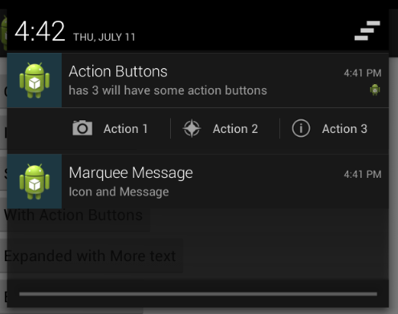
Action Buttons
Add the following to your notification
addAction(int icon, CharSequence title, PendingIntent intent)
Icon and title for the button
The intent should be completely different intent from the setContentIntent(intent), so you know which button was clicked.
See the example code, where I have four intents for the example with three buttons.

Slide 21
Expanded text
This one we need change the style of the notification. First use the builder to create the default notification like normal
NotificationCompat.Builder builder = new NotificationCompat.Builder(ge …;
Now change to another style and add more text
Notification noti = new NotificationCompat.BigTextStyle(builder)
.bigText(“…”) //lots text here.
.build();

Slide 22
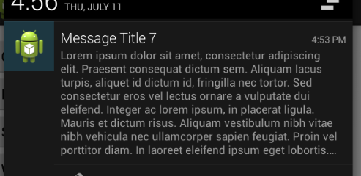
Expanded text (2)
And we can get something like this

Slide 23
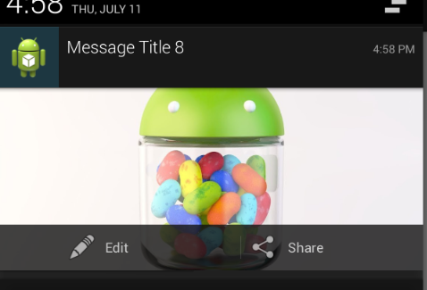
Expanded with image.
Same idea, except style is
Notification noti = new NotificationCompat.BigPictureStyle(builder)
.bigPicture(BitmapFactory.decodeResource(getResources(), R.drawable.jelly_bean))
.build();
Note two addAction(..) methods
were added in the builder.

Slide 24
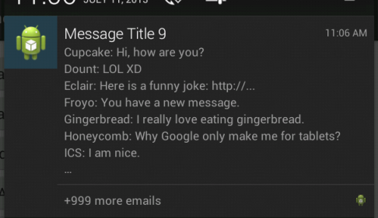
Style of an inbox
Inbox style and use addline and setSummaryText
Notification noti = new NotificationCompat.InboxStyle(build)
.addLine("Cupcake: Hi, how are you?")
.addLine("Jelly Bean: Yummy")
.setSummaryText("+999 more emails")
.build();

Slide 25
Progress bar
Uses the .setprogress(int max, int current, boolean show) method
Also needs a thread or asynctask of some kind, since you are code is one updating the notification with a updated progress bar.
First setup a standard notification, so something like:
NotificationCompat.Builder mBuilder = new NotificationCompat.Builder(getApplicationContext())
.setOngoing(true) //user can't remember the notification.
.setSmallIcon(R.drawable.ic_announcement_black_24dp)
.setContentTitle("Progress Bar") //Title message top row.
.setContentText("making progress I hope"); //message when looking at the notification, second row

Slide 26
Progress bar (2)
Now in the run method of the thread
for (incr = 0; incr <= 100; incr += 5) {
//set the progress.
mBuilder.setProgress(100, incr, false);
// Displays the progress bar for the first time.
nm.notify(NotID, mBuilder.build());
// simulate work with a Sleeps the thread, simulating an operation that takes time
try {
Thread.sleep(2 * 1000);
} catch (InterruptedException e) {
Log.d(TAG, "sleep failure");
}
}

Slide 27
Progress bar (3)
Finally when complete
mBuilder.setContentText("Done")
//allow use to clear it.
.setOngoing(false)
// Removes the progress bar
.setProgress(0, 0, false);
//update the notification.
nm.notify(NotID, mBuilder.build());

Slide 28
Activity bar
Same as progress, but no max or current position
// Sets an activity indicator for an operation of indeterminate length
mBuilder.setProgress(0, 0, true);
When complete, set to false.

Slide 29
android 5 notifications
In Lollipop three new pieces were added.
setVisibility() and specify one of these values:
VISIBILITY_PRIVATE: Shows basic information, such as the notification’s icon, but hides the notification’s full content.
VISIBILITY_PUBLIC: Shows the notification’s full content.
VISIBILITY_SECRET: Shows nothing, excluding even the notification’s icon.
addPerson(): Enables you to add one or more people who are relevant to a notification.

Slide 30
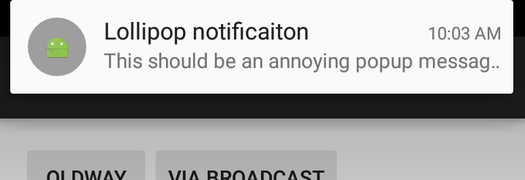
Heads up notifications
Adding the following
.setPriority(Notification.PRIORITY_MAX)
.setVibrate(new long[]{1000, 1000, 1000, 1000, 1000})
We can produce this kind of notification:

Slide 31
More

Slide 32
But I want to notify a user later!
There is no native way to that with the notifications.
You need to use an AlarmManager and calendar object.
And a broadcast receiver. Which we will cover first and then come back to it.
see demo 2 for the alarm manager and broadcast receiver.

Slide 33
Demo code
notificiationDemo.zip
notificationDemo project
All the different notifications listed in here
Lots of buttons to try out each one.
Alarms and the broadcastReceiver
notificationDemo2 project
Need first one installed
Sends to the broadcast receiver
And uses an alarm to send to the broadcast receiver
You may also find http://developer.android.com/guide/topics/ui/notifiers/notifications.html helpful.

Slide 34
Notifications add on Android 7.0
Notifications have added compatibility with android auto and wear.
Allows for remoteinput (reply)
Has the notification been read
Has the notification been deleted
How many notifications are there.
This uses notificationDemo3 example in notifications repo.

Slide 35
Android Auto
Add this to your androidmanifest.xml inside the between <application> tags, before the <activity>
<meta-data android:name= "com.google.android.gms.car.application" android:resource="@xml/automotive_app_desc"/>
Where the xml file has the following lines:
<?xml version="1.0" encoding="utf-8"?>
<automotiveApp>
<uses name="notification"/>
</automotiveApp>
Then Ensure that Message notifications are extended using
NotificationCompat.Builder.extend(new CarExtender()...)
This is just part of the notification build.

Slide 36
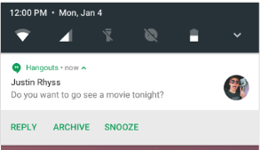
Notifying the app about notifications.
For read and delete
Basically the same idea
Create a pentingintent
Put the message id in the intent.
Have a broadcast receiver
The pentingintent will be sent to the receiver and you know which notification it was, based on the id number.

Slide 37
Read example
The Pendingintent
PendingIntent.getBroadcast(getActivity().getApplicationContext(),
NotificationNum,
new Intent()
.addFlags(Intent.FLAG_INCLUDE_STOPPED_PACKAGES)
.setAction("edu.cs4730.notification3.ACTION_MESSAGE_READ")
.putExtra("conversation_id", NotificationNum),
PendingIntent.FLAG_UPDATE_CURRENT);
Then as the notification is being build
.setContentIntent(readPendingIntent)
Delete uses
.setDeleteIntent(DeletePendingIntent):

Slide 38
Read example (2)
Either declare a broadcast receiver static or dynamic
private BroadcastReceiver mReadReceiver = new BroadcastReceiver() { @Override public void onReceive(Context context, Intent intent) { Log.d(TAG, "onReceiveRead"); int conversationId = intent.getIntExtra(CONVERSATION_ID, -1); if (conversationId != -1) { //now you know, do what? } } };
In onResume
registerReceiver(mReadReceiver, new IntentFilter("edu.cs4730.notification3.ACTION_MESSAGE_READ"));

Slide 39
remoteInput
the same idea, but far more complex
Build a RemoteInput for receiving voice input in a Car Notification or text input on
devices that support text input (like devices on Android N and above).
Building a Pending Intent for the reply action to trigger
Build an Android N compatible Remote Input enabled action.
Create the UnreadConversation builderand populate it with the participant name, read and reply intents.
Then in the notification builder, add it with the extend (and carextender() for compatilibity).
This is best all seen in the example code, instead of here.

Slide 40
remoteInput (2)
Again, we need broadcast receiver for the reply and the intentfilter (like read)
In the receiver we can get the reply message from the remoteinput intent and the message id
Finally, we need to update the notification that we have received it, so we build a simple notification, using the same id number.
Note, for android 8.X, if you are using sound/vibrate, use .setOnlyAlertOnce(true) in the update.

Slide 41
References for android 7.x notifications
https://developer.android.com/guide/topics/ui/notifiers/notifications.html
https://developer.android.com/about/versions/nougat/android-7.0.html#notification_enhancements
https://github.com/googlesamples/android-MessagingService
https://github.com/googlesamples/android-ActiveNotifications/

Slide 42
Example
notificationDemo3
Show how to setup a read, delete, and reply for notifications.
You may need to review notifications to under some of what is going on.

Slide 43
References
http://stackoverflow.com/questions/1198558/how-to-send-parameters-from-a-notification-click-to-an-activity
http://mobiforge.com/developing/story/displaying-status-bar-notifications-android
http://developer.android.com/reference/android/support/v4/app/NotificationCompat.Builder.html
http://mobiforge.com/developing/story/displaying-status-bar-notifications-android
http://stackoverflow.com/questions/12006724/set-a-combination-of-vibration-lights-or-sound-for-a-notification-in-android
http://developer.android.com/reference/android/app/Notification.html
http://developer.android.com/about/versions/android-5.0.html#Notifications
http://www.intertech.com/Blog/android-development-tutorial-lollipop-notifications/

Slide 44
Q
A
&

