Slide 1
Cosc 4730
Android
Notifications (Part 2)
Plus Alarms and BroadcastReceivers

Slide 2
Notifications add on Android 7.0
Notifications have added compatibility with android auto and wear.
Allows for remoteinput (reply)
Has the notification been read
Has the notification been deleted
How many notifications are there.
This lecture will use notificationDemo3 example in notifications repo.

Slide 3
Android Auto
Add this to your androidmanifest.xml inside the between <application> tags, before the <activity>
<meta-data android:name= "com.google.android.gms.car.application" android:resource="@xml/automotive_app_desc"/>
Where the xml file has the following lines:
<?xml version="1.0" encoding="utf-8"?>
<automotiveApp>
<uses name="notification"/>
</automotiveApp>
Then Ensure that Message notifications are extended using
NotificationCompat.Builder.extend(new CarExtender()...)
This is just part of the notification build.

Slide 4
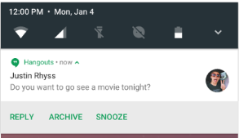
Notifying the app about notifications.
For read and delete
Basically the same idea
Create an pentingintent
Put the message id in the intent.
Have a broadcast receiver
The pentingintent will be sent to the receiver and you know which notification it was, based on the id number.

Slide 5
Read example
The Pendingintent
PendingIntent.getBroadcast(getActivity().getApplicationContext(),
NotificationNum,
new Intent()
.addFlags(Intent.FLAG_INCLUDE_STOPPED_PACKAGES)
.setAction("edu.cs4730.notification3.ACTION_MESSAGE_READ")
.putExtra("conversation_id", NotificationNum),
PendingIntent.FLAG_UPDATE_CURRENT);
Then as the notification is being build
.setContentIntent(readPendingIntent)
Delete uses
.setDeleteIntent(DeletePendingIntent):

Slide 6
Read example (2)
Either declare a broadcast receiver static or dynamic
private BroadcastReceiver mReadReceiver = new BroadcastReceiver() { @Override public void onReceive(Context context, Intent intent) { Log.d(TAG, "onReceiveRead"); int conversationId = intent.getIntExtra(CONVERSATION_ID, -1); if (conversationId != -1) { //now you know, do what? } } };
In onResume
registerReceiver(mReadReceiver, new IntentFilter("edu.cs4730.notification3.ACTION_MESSAGE_READ"));

Slide 7
remoteInput
basically the same idea, but far more complex
Build a RemoteInput for receiving voice input in a Car Notification or text input on
devices that support text input (like devices on Android N and above).
Building a Pending Intent for the reply action to trigger
Build an Android N compatible Remote Input enabled action.
Create the UnreadConversation builderand populate it with the participant name, read and reply intents.
Then in the notification builder, add it with the extend (and carextender() for compatilibity).
This is best all seen in the example code, instead of here.

Slide 8
remoteInput (2)
Again, we need broadcast receiver for the reply and the intentfilter (like read)
In the receiver we can get the reply message from the remoteinput intent and the message id
Finally, we need to update the notification that we have received it, so we build a simple notification, using the same id number.
Note, for android 8.X, if you are using sound/vibrate, use .setOnlyAlertOnce(true) in the update.

Slide 9
References for android 7.x notifications
https://developer.android.com/guide/topics/ui/notifiers/notifications.html
https://developer.android.com/about/versions/nougat/android-7.0.html#notification_enhancements
https://github.com/googlesamples/android-MessagingService
https://github.com/googlesamples/android-ActiveNotifications/

Slide 10
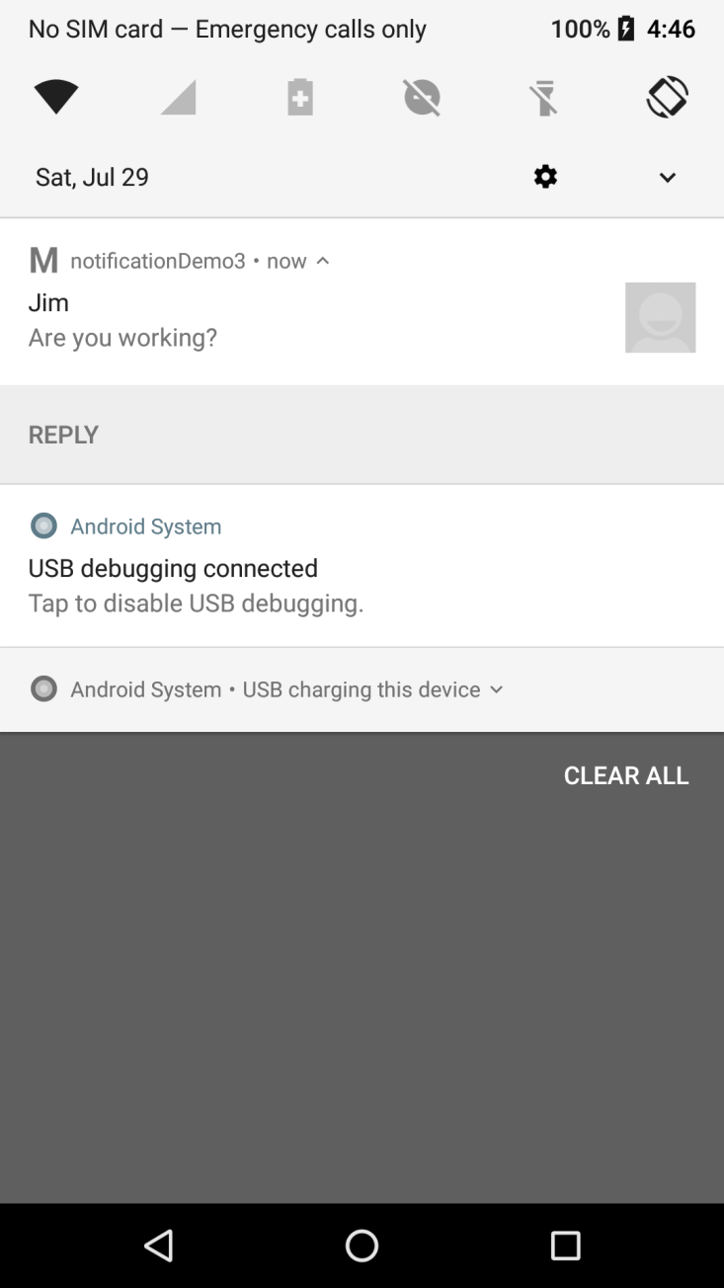
Example
notificationDemo3
Show how to setup a read, delete, and reply for notifications.
You may need to review notifications to under some of what is going on.

Slide 11
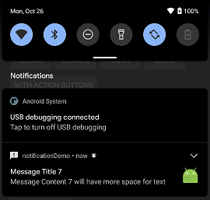
Android 11
Android 11 changed the way the notifications are displayed
but are no changes were made to the API.

Slide 12
But I want to notify a user later!
There is no native way to that with the notifications.
You need to use an AlarmManager and calendar object.
And a broadcast receiver. Which we will cover first and then come back to it.

Slide 13
Calendar

Slide 14
Calendar object
It a pretty simple object,
Used briefly in the GUI demo for the date/time pickers.
Get an intance, which has the current time set.
Calendar calendar = Calendar.getInstance();
Use a get(..) and set(..) to change the information as needed.
Set using the following constants Calendar.YEAR, Calendar.MONTH, Calendar.DAY_OF_MONTH, Calendar.HOUR_OF_DAY, Calendar.MINUTE, Calendar.SECOND
Say I want to set the calendar to 4:40am
calendar.set(Calendar.HOUR_OF_DAY, 4);
calendar.set(Calendar.MINUTE, 40);
calendar.set(Calendar.SECOND, 0);
As note, if it is already passed 4:40am, there would be a problem later
Say I want to set it for 2 minutes from now.
calendar.set(Calendar.MINUTE, calendar.get(Calendar.MINUTE) +2);

Slide 15
AlarmManager

Slide 16
AlarmManager
These allow you to schedule your application to be run at some point in the future. When an alarm goes off, the Intent that had been registered for it is broadcast by the system, automatically starting the target application if it is not already running.
We get an in AlarmManager service
Set an intent and pendingIntent for the activity (or say a broadcast receiver) to call.
A time in Milliseconds when to send the intent
And that we want a “wakeup call” at that time.
Get the AlarmManager
AlarmManager alarmManager = (AlarmManager) getSystemService(ALARM_SERVICE);

Slide 17
Example code
Using the calendar object for 2 minutes later.
Create the intent and pendingIntent
Intent notificationIntent = new Intent("edu.cs4730.notificationdemo.DisplayNotification");
PendingIntent contentIntent = PendingIntent.getActivity(MainActivity.this, NotID, notificationIntent, 0);
Now set the alarm
alarmManager.set(AlarmManager.RTC_WAKEUP, calendar.getTimeInMillis(), contentIntent);

Slide 18
Example code (2)
What is this:
Intent("edu.cs4730.notificationdemo.DisplayNotification");
We could also just give a Activity name.
It comes from the manifest file where we describe the activity or broadcast receiver. This case an activity.
<activity android:name=".DisplayNotification" … />
<intent-filter>
<action android:name="edu.cs4730.notificationdemo.DisplayNotification" />
<category android:name="android.intent.category.DEFAULT" />
</intent-filter>
</activity>

Slide 19
Finally!
The displayNotification activity is called when the alarm goes off. And it’s the displayNotification activity that now creates and notification.

Slide 20
Broadcast Receiver

Slide 21
Example
public class myBroadcastReciever extends BroadcastReceiver {
private static final String ACTION = "edu.cs4730.notificationdemo.broadNotification";
@Override
public void onReceive(Context context, Intent intent) {
String info= "no bundle";
if (intent.getAction().equals(ACTION)){ //is it our action
Bundle extras = intent.getExtras();
if (extras != null) {
info = extras.getString("mytype");
if (info == null) {
info = "nothing";
}
Likely toast or start an activity or notification. Whatever is needed now.
}}}

Slide 22
Demo code
notificationDemo project
All the different notifications listed in here
Lots of buttons to try out each one.
Alarms and the broadcastReceiver
notificationDemo2 project
Need first one installed
Sends to the broadcast receiver
And uses an alarm to send to the broadcast receiver
notificiationDemo3.zip
Android 7.0 notificaitons.
You may also find http://developer.android.com/guide/topics/ui/notifiers/notifications.html helpful.

Slide 23
References
http://developer.android.com/reference/android/app/Notification.html
http://developer.android.com/reference/android/content/BroadcastReceiver.html
http://stackoverflow.com/questions/12372654/how-to-trigger-broadcast-receiver-from-notification
http://www.vogella.com/articles/AndroidBroadcastReceiver/article.html
https://developer.android.com/guide/topics/ui/notifiers/notifications.html

Slide 24
Q
A
&

