Slide 1
Cosc 5/4730
Android: androidx Preferences and user settings data

Slide 2
Support preference
Support preference setup
implementation "androidx.preference:preference:1.2.1"
Almost everything works the same.
in the xml, change it to <androidx.preference.PreferenceScreen
You also need to add theme to the style.xml or it will force close.
<item name="preferenceTheme">@style/PreferenceThemeOverlay</item>

Slide 3
A note
The support preference libraries were setup so api 8+ would support all the new preferences that happened in API 14.
Initially, androidx preferences were put in the legacy group as well.
But it was moved out of legacy and new features are being added the androidx.preference library
https://developer.android.com/guide/topics/ui/settings
Then in API 29+ native preferences were depreciated. This lecture will only cover the android.preferences, not the native preference system.

Slide 4
Preferences
It’s normally a good idea to allow a user to setup some preferences for an application
Example: Username
It’s saved data between runs about how the application should run.
This adds a level of professionalism as well to the app, since the preferences are handled just same as preferences for the rest of device, including look and feel.
androidx.preference it's PreferenceFragmentCompat. there is no prefenceActivity
The bulk of the work is in the xml document

Slide 5
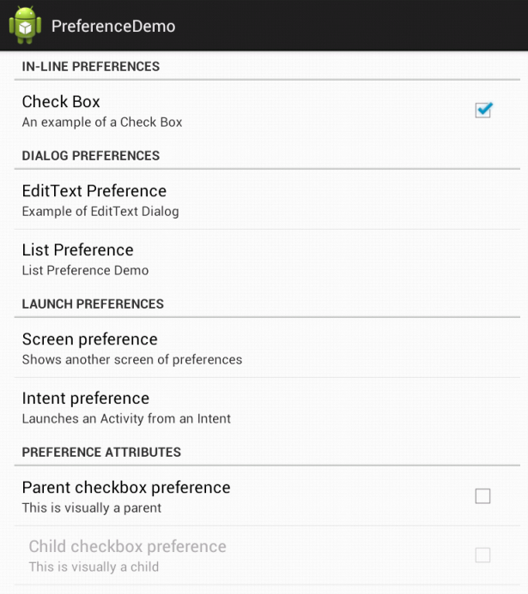
PreferenceFragment
public class myPreferenceFragment extends PreferenceFragmentCompat { @Override public void onCreatePreferences(Bundle bundle, String rootKey) { setPreferencesFromResource(R.xml.preferences, rootKey); } }

Slide 6
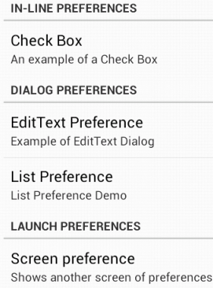
Preferences xml
You need to create an xml for the preferences
Preferences are kept be application sessions by default.
<androidx.preference.PreferenceScreen …>
<PreferenceCategory …>
… in-line preference
</PreferenceCategory>
<PreferenceCategory …>
… </PreferenceCategory>
</androidx.preference.PreferenceScreen>

Slide 7
CheckBoxPerference
On (true) or off (false)
<CheckBoxPreference
android:key="checkbox_preference“
key used by application to find out the value.
android:title="Check Box"
android:summary="An example of a Check Box" />
Also, you can also set a default value as well.
android:defaultValue="false" Ie off by default

Slide 8
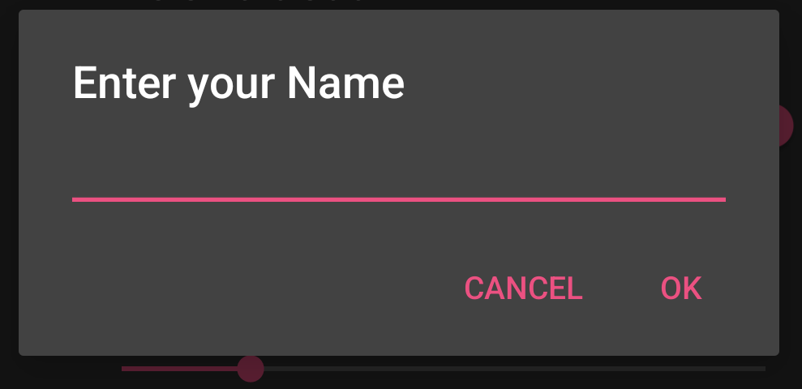
EditTextPreference
<EditTextPreference
android:key="edittext_preference"
android:title="EditText Preference“
android:defaultValue=""
android:summary="Example of EditText Dialog"
android:dialogTitle="Enter your Name" />

Slide 9
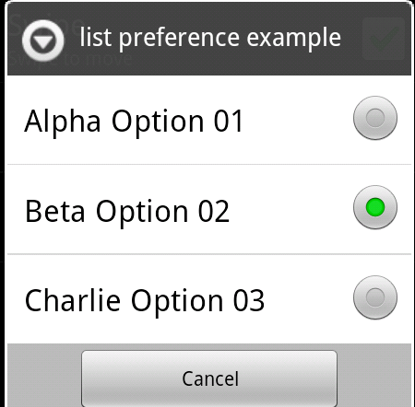
ListPreference
<ListPreference
android:entries="@array/entries_list_preference"
android:entryValues="@array/entryvalues_list_preference"
android:dialogTitle="list preference example“
android:summary="List preference demo"
android:key="list_preference"
android:title="list perference"
/>

Slide 10
Arrays and xml
In the values directory
created a file called “arrays.xml”
<resources>
<string-array name="entries_list_preference">
<item>Alpha Option 01</item>
<item>Beta Option 02</item>
item>Charlie Option 03</item>
</string-array>
<string-array name= "entryvalues_list_preference">
<item>alpha</item>
<item>beta</item>
<item>charlie</item>
</string-array>
</resources>

Slide 11
Switch preference
It's a toggle
<SwitchPreference android:key="switch_key" android:title="switch Preference" android:defaultValue="true" />
Note this is available in androidx, but in v7 is switchprefencecompat

Slide 12
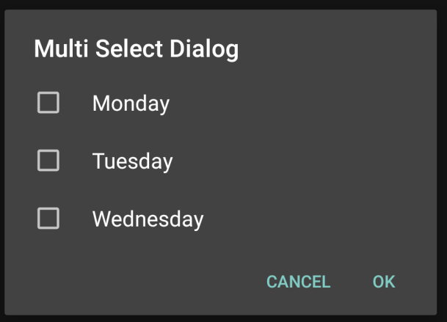
Multiselect
<MultiSelectListPreference
android:dialogTitle="Multi Select Dialog"
android:key="multiselect_key"
android:summary="Does this show?"
android:title="Multi Select Title"
android:entries="@array/weekdays"
android:entryValues= "@array/weekdays_values"
android:defaultValue= "@array/empty_array"
/>
Arrays.xml file
<string-array name="weekdays">
<item>Monday</item>
<item>Tuesday</item>
<item>Wednesday</item>
</string-array>
<string-array name="weekdays_values">
<item>Mon</item>
<item>Tue</item>
<item>Wed</item>
</string-array>
<string-array name="empty_array">
</string-array>

Slide 13
Access the preference
In your java code, likely in onResume(…)
onResume is called when you app gets the screen back from the preferences screen!
Also called when the application starts.
code look something like this:
SharedPreferences prefs = PreferenceManager.getDefaultSharedPreferences (getBaseContext());
Now you get the preferences with
abstract Map<String, ?> getAll() OR
getBoolean(key, defaultvalue), getInt(key,defvalue), getString(key, defaultvalue), …

Slide 14
preference example
prefs is declared on last slide
boolean useSensor = prefs.getBoolean(“sensorPref” , false);
get the sensorPref key, if not found, default is false.
string text = prefs.getString(“textPref”, “”);
string list = prefs.getString(“list_preference”,””);
Note, if you had set integer or floats as the entryValues, then you want to get them as getInt or getFloat.

Slide 15
MultiSelectList preference values.
Getting the values from a multiselectListPreference.
mMultiSelectListPreference = (MultiSelectListPreference) getPreferenceScreen().findPreference("multiselect_key");
This returns a Set<String> with the name listed which were selected.
Note, you can't guarantee order in the set.
This will create a simple string, for the summary.
String list = ""; Set<String> selections = mMultiSelectListPreference.getSharedPreferences() .getStringSet("multiselect_key", null); for(String s: selections) { list += s + " "; } mMultiSelectListPreference.setSummary("selection is " + list );

Slide 16
Compatibility (without fragments)
getSupportFragmentManager().beginTransaction().replace(android.R.id.content, new PrefFrag()).commit();
android.R.id.content allows you to display the fragment even if you are not using fragments.

Slide 17
"advanced" preferences

Slide 18
"Next screen"
In the preferences.xml file
<Preference app:title="Advanced Support Preferences" app:summary="Sample preferences with advanced attributes" app:fragment="edu.cs4730.supportprefencedemo.AdvancedPreferenceFragment"/>
Clicking it will call a new fragment, more preferences, using the back button will go back.

Slide 19
Intents and Children preferences
<PreferenceCategory app:initialExpandedChildrenCount="1" app:key="advanced" app:title="Advanced attributes"> <Preference app:summary="Launches another Activity from the here" app:title="Intent Preference"> <intent android:action="android.intent.action.VIEW" android:data="http://developer.android.com/"/> </Preference>

Slide 20
Children preferences (2)
children preferences are only available to when the parent preference is on.
<CheckBoxPreference app:key="parent_checkbox_preference" app:summary="This determines if the below check is enabled or not" app:title="Parent Checkbox Preference"/> <!-- The visual style of a child is defined by this styled theme attribute. --> <CheckBoxPreference app:dependency="parent_checkbox_preference" app:key="child_checkbox_preference" app:layout="?android:attr/preferenceLayoutChild" app:summary="Visual only if the above checkbox is clicked" app:title="Child Checkbox Preference"/>

Slide 21
Example code
The SupportPreferenceDemo (java and Kotlin) has the code from all in.
myPreferenceFragment and AdvancedPreferenceFragment shows everything covered so far.
Next is Live updates
It's all the same xml, but using the PreferenceupdateFragment.

Slide 22
Preferences android:summary
It maybe that instead of you want a the current value listed, instead of the descriptions as I have listed here.
You will need to implement a listener in PreferenceFragment called OnSharedPreferenceChangeListener
See the dialog example for how to implement the code.

Slide 23
Code
Setup some variables in onCreatePreferences(…) of the fragment.
// Get a reference to the preferences, so we can dynamically update the preference screen summary info.
Example from the code example:
mEditTextPreference = getPreferenceScreen().findPreference("edittext_preference");
mListPreference = getPreferenceScreen().findPreference("list_preference");
Implement the OnSharedPreferenceChangeListener in the fragment
@Override
public void onSharedPreferenceChanged(SharedPreferences sharedPreferences, String key) {
if (key.equals("textPref")) { //where textPref is the key used in the xml.
mEditTextPreference.setSummary( "Text is " + sharedPreferences.getString("textPref", "Default"));
} else if (key.equals("list_prefrence")) {
mListPreference.setSummary("Current value is " + sharedPreferences.getString(key, "Default"));
}
}
OnResume will also want to pull all the preferences and set them in the summary as well.

Slide 24
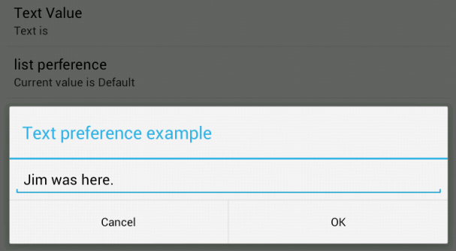
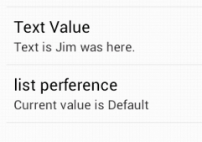
Code (2)
Setup to read and setup the summary fields in the onResume() and setup the listener.
Remove the listener in the onPause()

Slide 25
preferences xml
Only covered a good subset of the preferences xml, but this is not a complete list.
see https://developer.android.com/reference/androidx/preference/package-summary for more information.

Slide 26
References
https://developer.android.com/jetpack/androidx/releases/preference
https://developer.android.com/guide/topics/ui/settings
http://developer.android.com/reference/android/preference/PreferenceActivity.html
http://developer.android.com/reference/android/preference/PreferenceFragment.html
older and maybe less useful now.
http://stackoverflow.com/questions/7112706/preferencefragment-alternative-for-the-android-compatibility-api
http://android-er.blogspot.com/2012/07/example-of-using-preferencefragment.html
http://gmariotti.blogspot.com/2013/01/preferenceactivity-preferencefragment.html
http://www.cs.dartmouth.edu/~campbell/cs65/lecture12/lecture12.html
https://stackoverflow.com/questions/32487206/inner-preferencescreen-not-opens-with-preferencefragmentcompat and the github example code at https://github.com/madlymad/PreferenceApp

Slide 27
Q
A
&

