Slide 1
Cosc 5/4730
SQLite
Cursors, adapters
With Content Providers as well.

Slide 2
SQLite
For the sql language syntax , please see SQlite documentation
http://www.sqlite.org
We will be using the androidx version, add to app build.gradle
implementation ("androidx.sqlite:sqlite:2.4.0") or newer
implementation ("androidx.sqlite:sqlite-framework:2.4.0") or newer

Slide 3
SQLite and Android
Package
androidx.sqlite.db.SupportSQLiteDatabase
The Model
“Database” class
SupportSQLiteOpenHelper class
The controller:
Declares a local variable for the database class
With large amounts of data, this can slow the UI, so it should be done in AsyncTask (or thread)
Or
uses the content provider to access/change the data
Access with modelview or loaders (built in threads) and an AsyncTask for rest.

Slide 4
SQLiteOpenHelper
This is simple but very important class that you need to extend.
It is the one that actually creates the database and the table(s) in the database.
And if the structure of the database changes, it upgrades the database (ie any tables that need changed).
This is also very you set constants for the column names, table names, etc.
These should be a separate class, for easy of use later.

Slide 5
Extend SupportSQLiteOpenHelper.Callback
A helper class to manage database creation and version management.
You create a subclass implementing onCreate(SQLiteDatabase), onUpgrade(SQLiteDatabase, int, int) and optionally onOpen(SQLiteDatabase)
This class takes care of opening the database if it exists, creating it if it does not, and upgrading it as necessary.
Transactions are used to make sure the database is always in a sensible state.

Slide 6
Extend SQLiteOpenHelper (2)
public class mySQLiteHelper extends extends SupportSQLiteOpenHelper.Callback {
public static final String KEY_NAME = "Name";
public static final String KEY_SCORE = "Score";
public static final String KEY_ROWID = "_id";
private static final String DATABASE_NAME = "myScore.db";
public static final String DATABASE_TABLE = "HighScore";
private static final int DATABASE_VERSION = 1;
// Database creation sql statement
private static final String DATABASE_CREATE =
"CREATE TABLE HighScore ("+
KEY_ROWID + " integer PRIMARY KEY autoincrement," +
KEY_NAME+" TEXT, "+
KEY_SCORE+" INTEGER );";
//three requirement methods
mySQLiteHelper() {
super(DATABASE_VERSION);
}
@Override
public void onCreate(SupportSQLiteDatabase db) {
//NOTE only called when the database is initial created!
db.execSQL(DATABASE_CREATE);
}
@Override
public void onUpgrade(SQLiteDatabase db, int oldVersion, int newVersion) {
//Called when the database version changes, Remember the constant from above.
db.execSQL("DROP TABLE IF EXISTS "+DATABASE_TABLE);
onCreate(db);
}
}

Slide 7
SQL language
Android sqlite uses sql, but there are two types
Query and "other"
Where other is insert, delete, update, etc.
There are two query methods
using this "select Name, Score from HighScore where name='jim';"
Cursor = query(String query, String[] bindArgs)
So db.query("select Name, Score from HighScore where name='jim' ", null);
Cursor = query(SupportSQLiteQuery query)
https://developer.android.com/reference/androidx/sqlite/db/SupportSQLiteDatabase

Slide 8
SupportSQLiteQuery
Build via the SupportSQLiteQueryBuilder
SupportSQLiteQueryBuilder qb = SupportSQLiteQueryBuilder.builder(TableName);
qb.columns(projection); //columns
qb.selection(selection, selectionArgs);
qb.orderBy(sortOrder);
finally create the query and do the query.
db.query(qb.create());

Slide 9
SQLiteDatabase methods
void execSQL(String sql)
Execute a single SQL statement that is not a query.
We also have the convenience methods
int delete(String table, String whereClause, Object[] whereArgs)
long insert(String table, int conflictAlgorithm, ContentValues values)
update(String table, int conflictAlgorithm, ContentValues values, String whereClause, Object[] whereArgs)
ConflictAlgorithm
SQLiteDatabase.CONFLICT_NONE, SQLiteDatabase.CONFLICT_ROLLBACK, SQLiteDatabase.CONFLICT_ABORT, SQLiteDatabase.CONFLICT_FAIL, SQLiteDatabase.CONFLICT_IGNORE, SQLiteDatabase.CONFLICT_REPLACE.

Slide 10
SQLiteDatabase example
insert
ContentValues initialValues = new ContentValues();
initialValues.put(mySQLiteHelper.KEY_NAME, name);
initialValues.put(mySQLiteHelper.KEY_SCORE, value);
db.insert(mySQLiteHelper.TABLE_NAME, CONFLICT_FAIL, initialValues);

Slide 11
"Database" class.
This is the class where you put all the methods you will need to access/change/etc the tables in your database.
This class doesn’t extend anything.
It keeps your code far more readable
Remember, this is the Model (ie data) in the MVC
Later on, the model could be the content provider method, instead of the "database" class.
or changed into a viewmodel. (android viewmodel, since it needs context).

Slide 12
Now our methods
private SupportSQLiteOpenHelper helper;
private SupportSQLiteDatabase db;
constructor
public ScoreDatabase(Context ctx) {
SupportSQLiteOpenHelper.Factory factory = new FrameworkSQLiteOpenHelperFactory();
SupportSQLiteOpenHelper.Configuration configuration = SupportSQLiteOpenHelper.Configuration.builder(ctx)
.name(mySQLiteHelper.DATABASE_NAME)
.callback(new mySQLiteHelper())
.build();
helper = factory.create(configuration);
}
closes the database
public void close() {
db.close();
}
opens the database
public void open() throws SQLException {
db = helper.getWritableDatabase();
}

Slide 13
Now our methods (2)
insert into the database
public long insertName(String name, Integer value) {
ContentValues initialValues = new ContentValues();
initialValues.put(mySQLiteHelper.KEY_NAME, name);
initialValues.put(mySQLiteHelper.KEY_SCORE, value);
return db.insert(mySQLiteHelper.DATABASE_TABLE, null, initialValues);
}
updates a row
public boolean updateRow(String name, int score) {
ContentValues args = new ContentValues();
args.put(KEY_SCORE, score);
//returns true if one or more updates happened, otherwise false.
return db.update(DATABASE_TABLE, args, KEY_NAME + "= \'" + name+"\'", null) > 0;
}

Slide 14
Now our methods (3)
This is our helper method that builds a SupportSQLiteQuery and executes the query.
public Cursor qbQuery(String TableName, String[] projection, String selection, String[] selectionArgs, String sortOrder) {
SupportSQLiteQueryBuilder qb = SupportSQLiteQueryBuilder.builder(TableName);
qb.columns(projection);
qb.selection(selection, selectionArgs);
qb.orderBy(sortOrder);
//using the query builder to manage the actual query at this point.
return db.query(qb.create());
}

Slide 15
Now our methods (4)
retrieves all rows, using the helper method from last slide.
public Cursor getAllNames() {
Cursor c = qbQuery(mySQLiteHelper.TABLE_NAME, //table name
new String[]{mySQLiteHelper.KEY_ROWID, mySQLiteHelper.KEY_NAME, mySQLiteHelper.KEY_SCORE}, //projection, ie columns.
null, //selection, we want everything.
null, // String[] selectionArgs, again, we want everything.
mySQLiteHelper.KEY_NAME// String sortOrder by name as the sort.
);
if (c != null ) //make sure db is not empty!
c.moveToFirst();
return c;
}

Slide 16
Now our stuff (5)
//retrieve one entry, using RAW method as an example (ie sql statement)
public Cursor get1nameR(String name) {
//public Cursor query (String sql, Object[] bindArgs)
//sql the SQL query. The SQL string must not be ; terminated
//BindArgs You may include ?s in where clause in the query, which will be replaced by the values from selectionArgs. The values will be bound as Strings.
Cursor mCursor =
db.query("select Name, Score from HighScore where Name=\'" + name + "\'", null);
if (mCursor != null) {
mCursor.moveToFirst();
}
return mCursor;
}

Slide 17
Now our stuff (6)
a convenience method to delete something from the database.
public int Delete(String TableName, String selection, String[] selectionArgs) {
return db.delete(TableName, selection, selectionArgs);
}
remove all entries from the CurrentBoard
public void emptydb() {
db.delete(mySQLiteHelper.TABLE_NAME, null, null);
}
There are more examples in the sqliteDBDemo and sqliteDemo code

Slide 18
The Activity class.
create an activity class and add
ScoreDatabase db = new ScoreDatabase(this);
Access and use the DB.
db.open();
id = db.insertName("Jim", 3012);
note if (id == -1) then it failed to insert
//whatever else you want to do.
db.close();

Slide 19
Cursor notes
The queries all return a Cursor, so you need to pull the information out of it.
In my example, there are 3 columns in table
getAllNames() requests all three.
Cursor c = db.getAllNames();
String str = “Name: " + c.getString(1); //name
str += " Score:" + c.getInt(2); //score

Slide 20
Cursor notes (2)
The Score column is an integer, so I could use .getInt(1) as well.
Cursor has several useful methods
double getDouble(int columnIndex), float getFloat(int columnIndex), int getInt(int columnIndex), long getLong(int columnIndex), short getShort(int columnIndex), String getString(int columnIndex)
String[] getColumnNames()
Returns a string array holding the names of all of the columns in the result set in the order in which they were listed in the result.
int getCount()
Returns the numbers of rows in the cursor.
int getColumnCount()
Return total number of columns

Slide 21
Column names and numbers.
For better code and more readable code
Don’t use column numbers. There is a method in the cursor class to find the column numbers for you.
cursor.getColumnIndex(“name”) will return the column number for column name.

Slide 22
Example with Cursor
db.open();
Cursor c = db.getAllNames();
for(c.moveToFirst(); !c.isAfterLast(); c.moveToNext()) {
label1.setText(
c.getString(c.getColumnIndex(mySQLiteHelper.KEY_NAME))
+ " " +
c.getInt(c.getColumnIndex(mySQLiteHelper.KEY_SCORE)) );
}
db.close();
}
Remember these are the variable name for the column names,
if we decide to change the column names, we don’t have
Search through the code to change them.

Slide 23
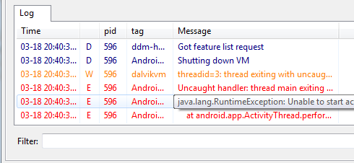
Debugging a "stopped unexpectedly"
bring up the logcat or "run"
There will you give a way to debug your app, including what caused
Check the log for Errors (in red)

Slide 24
debugging the database
The system stores databases in the /data/data/package_name/databases folder by default.
In a command line using the adb (Android Debug Bridge - found in the android sdk tools library) you can access the databases on a running emulator like below
adb -s emulator-5554 shell
assuming 5554 is your emulator
sqlite3 /data/data/package_name/databases/database_name
After this you can type normal SQL commands to test the content. For example:
SELECT * FROM table_name;
The output format is pretty ugly, but workable .

Slide 25
References
Creating an using Databases with android
http://www.devx.com/wireless/Article/40842
Android Tutorials
http://www.helloandroid.com/tutorials
http://www.helloandroid.com/ Some good general help
Android developer site
http://developer.android.com/intl/zh-CN/reference/android/database/sqlite/package-summary.html

Slide 26
Cursors, Listviews, Expandablelistview, and adapters

Slide 27
Overview picture

Slide 28
ListView and CursorAdatpers
Using ListViews to display information from databases makes a lot of sense.
We can use a SimpleCursorAdapter (or CursorAdapter) to display the information
Basics:
Get the data in a cursor
There must be a column called _id and it’s an unique integer.
Tell the adapter a layout to display it in
Set the adapter in the listview.

Slide 29
SimpleCursorAdapter
Get the cursor with data
Cursor cursor = db.getAllNames();
Bind the column names to the textview names in the layout
Don’t need to list _id, it’s required and does not display.
String[] columns = new String[] {mySQLiteHelper.KEY_NAME, mySQLiteHelper.KEY_SCORE};
the XML defined views which the data will be bound to
int[] to = new int[] {R.id.name,R.id.score};

Slide 30
SimpleCursorAdapter (2)
Now setup the adapter:
dataAdapter = new SimpleCursorAdapter(
getBaseContext(),
R.layout.highscore, //layout
cursor, //data
columns, //column names
to, //layout id to bind to
0); //flags
Now setup it to the listview
listView.setAdapter(dataAdapter);

Slide 31
SimpleCursorAdapter (3)
Click listener
listView.setOnItemClickListener(new OnItemClickListener() {
@Override
public void onItemClick(AdapterView<?> listView, View view, int position, long id) {
Get the cursor, positioned to the corresponding row in the result set
Cursor cursor = (Cursor) listView.getItemAtPosition(position);
Get the name of the item that was clicked.
String name = cursor.getString( cursor.getColumnIndexOrThrow( mySQLiteHelper.KEY_NAME)); //use column name instead to make it easy.
display the name in a toast or whatever you need to.
Toast.makeText(getApplicationContext(), name, Toast.LENGTH_SHORT).show();
}
});

Slide 32
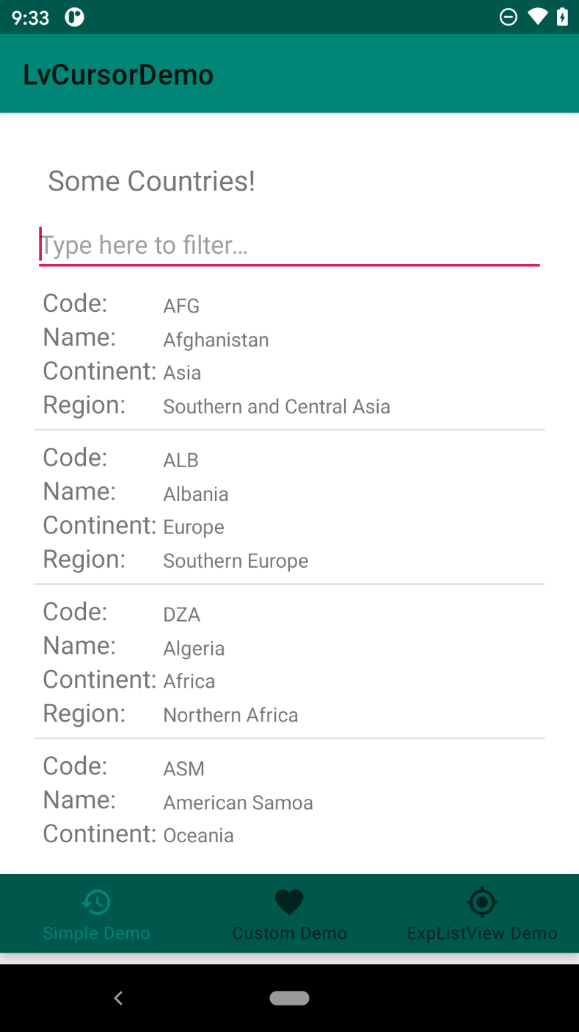
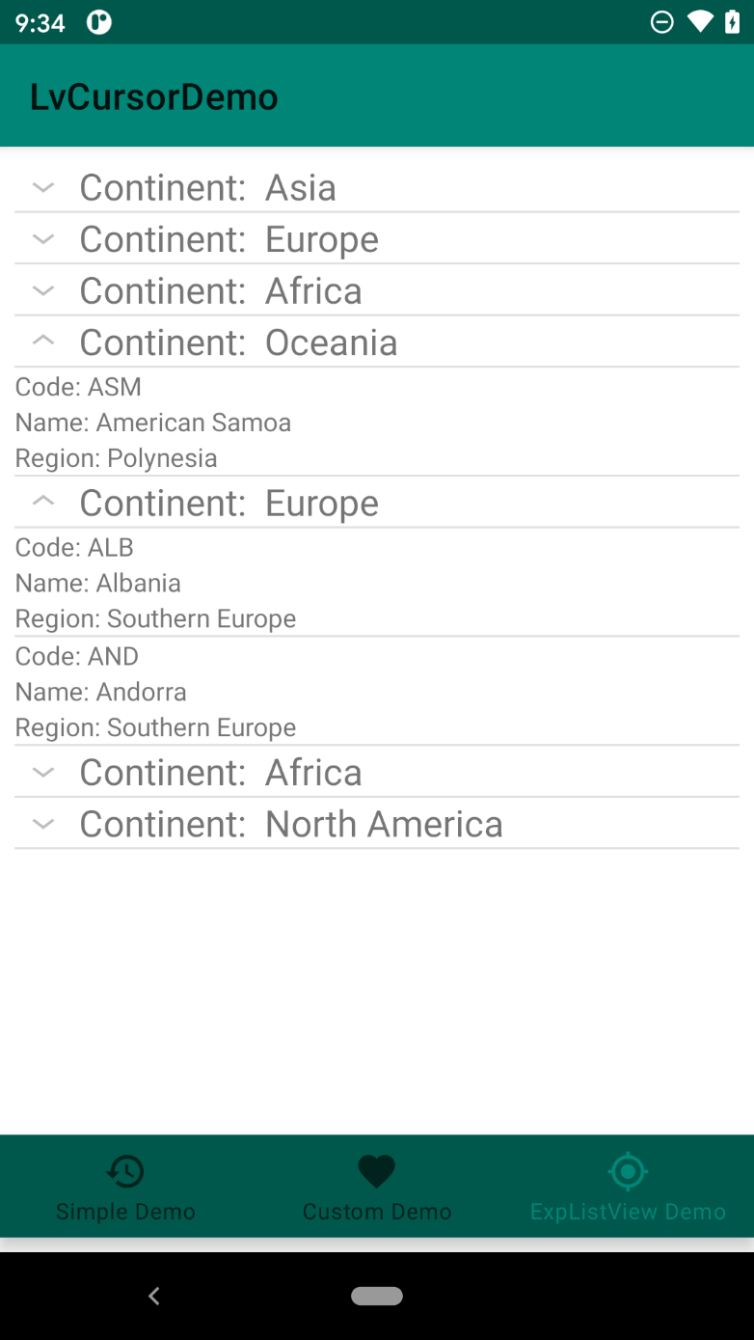
Displays
Display with
Basic Expandable

Slide 33
ExpandableListView (2)
The ExpandableListView is the same as previous.
This time around using an extended SimpleCursorTreeAdapter
We want to cursor to manage the database queries.

Slide 34
SimpleCursorTreeAdapter
You must implement two methods
Constructor and getChildrenCursor.
My constructor is just a pass through:
public MySimpleCursorTreeAdapter(Context context,
Cursor groupCursor, int groupLayout,
String[] groupFrom, int[] groupTo,
int childLayout, String[] childrenFrom,
int[] childrenTo) {
super(context, groupCursor, groupLayout, groupFrom, groupTo, childLayout, childrenFrom, childrenTo);
}

Slide 35
Cursor groupCursor and constructor
myCursorAdapter = new MySimpleCursorTreeAdapter(this,
gcursor, //this is the cursor with the group items.
R.layout.evl_group_row, //header/group/parent layout
new String[] { CntDbAdapter.KEY_CONTINENT }, // Name of the columns in DB.
new int[] {R.id.evl_row_name }, //name of views in layout.
R.layout.evl_child_row, //child layout
new String[] { CntDbAdapter.KEY_CODE, //name of the columns in DB in order
CntDbAdapter.KEY_NAME, CntDbAdapter.KEY_REGION },
new int[] { R.id.evl_code, R.id.evl_name, R.id.evl_region} //name of the layoud ids.
);

Slide 36
SimpleCursorTreeAdapter (2)
Then just implement the
Cursor getChildrenCursor(Cursor groupCursor) {
Given the group, we return a cursor for all the children within that group
so get the Continent out of the cursor and then query for these items and go with it.
String inputText = groupCursor.getString(1);
Cursor mCursor = dbHelper.fetchChild(inputText);
return mCursor;
}

Slide 37
Layouts
Like before
We need the main layout
A group layout for group items
A child layout for the children item.

Slide 38
Recyclerview

Slide 39
RecyclerView
Recyclerview does not (currently?) have a cursor adapter.
Instead you extend the "standard" adapter like always.
See sqliteDBDemo and sqliteDBViewModelDemo both use a recyclerview
Note, in legacy directory, there is sqlDemo3. there is code a third party created that does understand cursors and observers (works for loaders and modelview)

Slide 40
Loader and content provider (Loaders are Deprecated in API 28)

Slide 41
Data Access

Slide 42
ContentProvider and sqlite
Most of the examples on the web show a database with a ContentProvider.
This really is what they were originally designed for.
Instead of creating a “Database” class, you can create a ContentProvider. You will need to implement the methods, which are more generic then the ones I show you earlier.
And we need to add a bit of information for notifications, which then allows Loaders to work their “magic”.

Slide 43
ContentProvider Example
@Override
public Cursor query(Uri uri, String[] projection, String selection, String[] selectionArgs, String sortOrder) {
SQLiteQueryBuilder qb = new SQLiteQueryBuilder();
qb.setTables(mySQLiteHelper.DATABASE_TABLE);
switch (uriMatcher.match(uri)) {
case SCORE: //nothing to do
break;
case SCORE_ID: //set the where piece correctly
selection = selection + "_id = " + uri.getLastPathSegment();
break;
default: //bad call, throw exception
throw new IllegalArgumentException("Unknown URI " + uri);
}
//pass all that information to the query and return the info.
SQLiteDatabase db = myDB.getReadableDatabase();
Cursor c = qb.query(db, projection, selection, selectionArgs, null, null, sortOrder);
c.setNotificationUri(getContext().getContentResolver(), uri); //for notifications and loader classes if used.
return c;
}

Slide 44
ContentProvider Example (2)
There is similar methods for the insert, delete, update, etc in the myDBContentProvider file
I tried to make it as generic as possible for reuse, except you’ll need to change the column names and table name.

Slide 45
Loaders
From Google page: (and deprecated in API 28)
Introduced in Android 3.0 (and in support.v4), loaders make it easy to asynchronously load data in an activity or fragment. Loaders have these characteristics:
They are available to every Activity and Fragment.
They provide asynchronous loading of data.
They monitor the source of their data and deliver new results when the content changes.
They automatically reconnect to the last loader's cursor when being recreated after a configuration change. Thus, they don't need to re-query their data.
Used with the notifications setup in the ContentProviders if using a custom ContentProvider.

Slide 46
Loaders (2)
First you initial the loader and give it a number
You implement the three call backs (which are actually an AsyncTask)
This deal with changing data and initial data load
If at some point you need toss all the data, call the restartLoader to have it do a new query.
Not shown my example.

Slide 47
LoaderManager Callbacks
onCreateLoader()
Instantiate and return a new Loader for the given ID.
onLoadFinished()
Called when a previously created loader has finished its load.
onLoaderReset()
Called when a previously created loader is being reset, thus making its data unavailable.

Slide 48
Basic code changes
In the onCreate or where ever you setup the listview two changes
One add the loader initializer
getLoaderManager().initLoader(ID_num, null, this);
Set the adapter to a null cursor and set a flag.
dataAdapter = new SimpleCursorAdapter(
getActivity().getApplicationContext(), R.layout.scorelist,
null, //null cusor, set in the Loader
columns, to,
CursorAdapter.FLAG_REGISTER_CONTENT_OBSERVER);
Everything else is done in the loader call backs.

Slide 49
LoaderManager Callbacks example
Add implements LoaderManager.LoaderCallbacks<Cursor> to the class definition.
The onCreateLoader now makes the query via a cursorLoader
@Override
public Loader<Cursor> onCreateLoader(int id, Bundle args) {
//I’m ignoring the id, because don’t care, and bundle because no data.
//setup the information we want for the contentprovider.
String[] projection = new String[] { MainActivity.KEY_ROWID, MainActivity.KEY_NAME, MainActivity.KEY_SCORE};
String SortOrder = MainActivity.KEY_SCORE;
CursorLoader cursorLoader = new CursorLoader(getActivity(),
CONTENT_URI, projection, null, null, SortOrder);
return cursorLoader;
}

Slide 50
LoaderManager Callbacks example (2)
The last two methods are very simple, set the adapter to the cursor
@Override
public void onLoadFinished(Loader<Cursor> loader, Cursor cursor) {
// once the data has been loaded, now we set the cursor in the adapter
dataAdapter.swapCursor(cursor);
}
@Override
public void onLoaderReset(Loader<Cursor> loader) {
// called when the data is no longer valid, so remove the cursor
dataAdapter.swapCursor(null);
}
A note, loader.getId() will tell you which ID it is. But since I’m only use one, I didn’t worry about the ID number.

Slide 51
Result
If the data changes in the contentProvider
Using the notifies setup in the contentProvider
The data will be updated in the background and displayed in the listview.
“magic”, you don’t have put in code to update the listview, because it will do it by itself now.

Slide 52
LiveData and ViewModel

Slide 53
LiveData
In order to use the LiveData, we have to extend the class
MultableLiveData<Cursor>
There are two methoods
OnActive() when class just started or is woken up
Get the data and set it via setValue
Register a listener for the content provider when data changes.
OnInActive() when this class goes inactive (ie shutdown, sleeps, etc)
unregister the listener
Use the constructor to get context and setup the Observer pieces.
Note an AndroidModelView will have to used, since we need context.

Slide 54
ModelView
The AndroidViewModel
pretty simple and standard
declare the extended class.
in the constructor for AndroidViewModel, use new to start the extended liveData class
myLiveData = new ContentProviderLiveData(application, CONTENT_URI);
Provide a "getData()" method so the observers can be set in the classes.

Slide 55
setting the observer.
The observer will be as a Observer<Cursor>
since we extended MultableLiveData<Cursor>
in the Onchanged method you can set the new data cursor.
and the adapter does the rest.
See the sqliteDemo4 for full set of code.

Slide 56
Examples

Slide 57
Example code
Sqlite Demos
SQLiteDBDemo
Simple database, with a recyclerview and a simple adapter.
sqliteDBViewModelDemo
uses a SupportSQLiteDatabase, enters data and displays it via a recyclerview.
It uses a ViewModel to update the display when data is added.
ContentProSQliteDBDemo
shows how to create a content provider using an SQLite database. displays in a listview, recyclerview and a spinner.
ContentProviderRemoteDemo
connects to a "remote" content provider.
either the ContentProSQliteDBDemo or ContentProviderRoomDemo in Architecture repo.
It then will display the data in recyclerview and can add data via a FAB.

Slide 58
Example code (2)
LvCursorDemo
Three tabs with a simple DB of countries
On with a simple listview
One with a custom listview
Last one with a expandablelistview sorted by Continent.
Uses an extended SimpleCursorTreeAdapter

Slide 59
References
http://developer.android.com/guide/components/loaders.html
http://mobile.tutsplus.com/tutorials/android/android-sdk_loading-data_cursorloader/
http://about-android.blogspot.com/2010/04/content-provider-example-2.html
http://thinkandroid.wordpress.com/2010/01/13/writing-your-own-contentprovider/

Slide 60
Q
A
&

