Slide 1
Cosc 5/4730
Game Design

Slide 2
A short game design primer.
A game or animation is built on an animation loop.
  Instance variables of “objects” are updated
  User interaction may change “objects”
    Depends on game state (is user playing, demo mode, etc).
  Code then draws/paints/repaints the game screen
  Code loop sleeps for a short period of time, which controls the game rate.

Slide 3
Basic Game layout
Assuming a game where app does something based on a user’s “move” (like Tic-Tac-Toe)
  0. Initial setup of the game, variables etc.
    Display splash screen if needed.
  Now wait for user input
    Easily done with input listeners
  2. Based on user input
    Determine if valid move
    Change game state, move stuff around
    Determine if end of game state(winner, loser, tie)
    If end of game
      Call end of game code (reset for next game or exit app)
    Else
      Update screen and return to 1.

Slide 4
Basic Game layout (2)
Where the app is more of an arcade, like space invaders or pong
  Initial setup of the game, variables etc.
    Display splash screen if needed.
  Initialize the animation thread
  Start the animation thread
    Like in the android SurfaceView or TextureView

Slide 5
Basic Game layout (3)
Animation thread does all the work now, but the main code is not stop.
  For 2+ player over the “network” games another thread is listening for the other players moves as well.
While(game_running) {
  Verify game state, “move” objects, etc
    This also where end of game is determine and game_running will be set to false.
  Check for user input (maybe listeners or manually)
    They may not be any, but the game continues.
  Update screen
  Sleep for a period of time to control the game refresh rate
}
End of game code for play again or exit app.

Slide 6
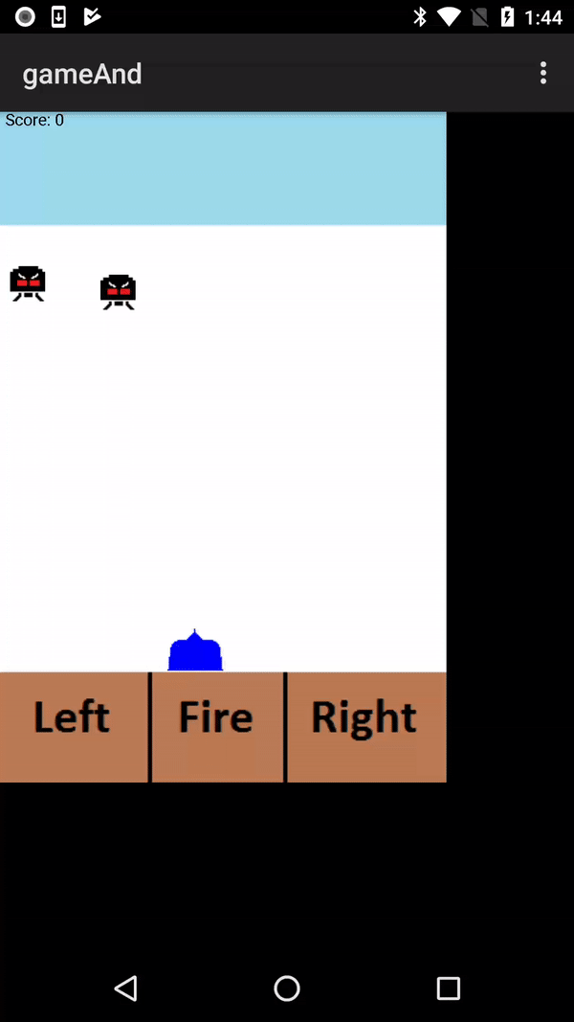
Example Game
The example for the rest of the lecture will be a simple space invaders game.
  Your ship at the bottom can move left and right
  You can have at most 3 shots on the “board” at any given time
  There will be at most 5 aliens on the screen at any time.
    If no aliens, then 1 is generated.
The game ends if an aliens lands.

Slide 7
A Note on touch
Where to touch
In games, you almost never want people to touch the objects
  Their hand/finger will now cover the screen
  Makes it difficult to see
Whenever possible find a way to have an offset location that won’t cause the screen to be covered by the touch event.
  There should also be some audible/visual way to see they are touching the correct spot as well.

Slide 8
A Note on touch (2)
Where to touch
Another way would be to have the user touch where the wanted to ship to move too

Slide 9
Android Game
Using the surfaceView
Screen size issues with the surfaceView
Simulator issues
  The game runs very slow in the simulator
  But at the “correct” speed on device.

Slide 10
SurfaceView myThread
Used to control the speed of the game.
In the SurfaceView code in previous lecture:
  Add checkGameState()
    Moves ship, aliens, checks for collisions, etc…
Input handled by overriding listeners
  onKeyDown and onTouchEvent
We use the sleep to control the game speed.

Slide 11
Overriding OnDraw
we override the method that draws the game.
  onDraw(Canvas c)
  Since the surfaceView fills the whole screen:
    We have to draw the background and score
  Draws the objects (ship, aliens, shots) on the screen
    Use the canvas draw methods to draw the text and all the images
  If gameover, also draws “GAME OVER” on the screen.

Slide 12
checkGameState
Move the ship (based on User input)
  make sure ship doesn’t go out of “bounds”
add new shots (based on User input)
  remove shot if reaches top of the screen.
Move any aliens (not out of bounds either)
  Add a new alien to the screen if are no aliens
  add new aliens up to 5 (added on random number of 97 out of 100)
Move shots
Check for collisions
  remove alien and shot if they collide
  add to score.

Slide 13
checkGameState (2)
If while moving an alien, it reaches the bottom
  set gameover variable to true.
  This will be the last time checkGameState is called.
  As note, the user uses the menu to exit the game, so game over will display.

Slide 14
Menu
Menu code is not written in the surfaceView code.
  In the Activity code. Only exits the game
  If we wanted the menu to interact with the game, we’ll need to change the way the surfaceView is declared in the activity.

Slide 15
Look at the AlienInvader code

Slide 16
For lastly.
Of course, while this is a “complete” game
  The aliens should be able to shot at the ship.
  The aliens tend to collide with each other.
    And randomly head down the screen.
  Nothing happens when an alien collides with a ship either! Should also have lives.
    Add a loop to check and see if an alien collided with the ship and a variable for lives.
  The android code does not use the accelerometer, instead only uses touch.

Slide 17
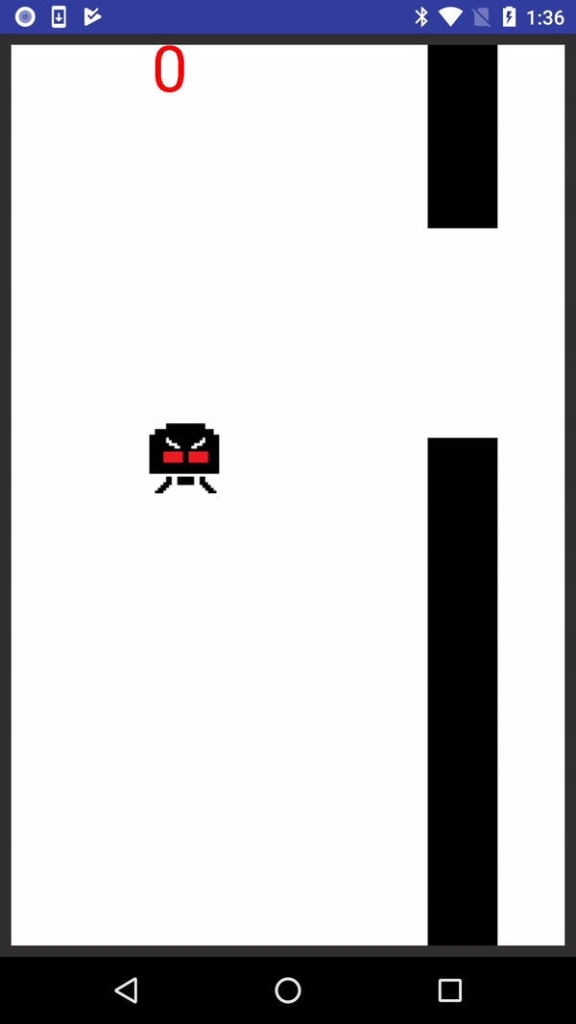
TextureView Example game
FlappyAlien uses a TextureView
Otherwise, basically the same code surfaceView
  OnDraw() is myDraw() since there is no onDraw method to override.
FlappyAlien is a simple FlappyBird clone.

Slide 18
Look at the FlappyAlien code

Slide 19
Useful References
So useful information:
  Math & Physics http://www.gamedev.net/reference/list.asp?categoryid=28
  Essential Math for Games Programmers
    http://www.essentialmath.com/
  2D Game Physics 101
    http://www.rodedev.com/tutorials/gamephysics/

Slide 20
Q
A
&

