Slide 1
Delightful User Experience
Android Developer Fundamentals V2
Lesson 5

Slide 2
5.2 Material Design

Slide 3
Contents
The Material Metaphor
Imagery
Typography
Color
Motion
Layout
Components

Slide 4
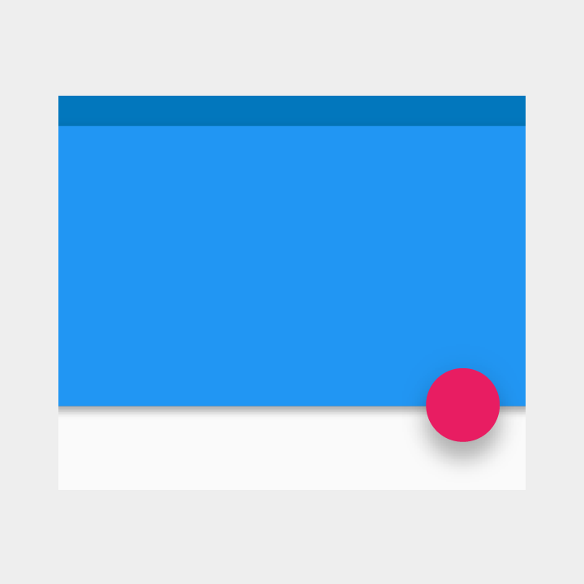
The Material Metaphor

Slide 5
What is Material Design?
Design guidelines
Visual language
Combine classic principles of good design with innovation and possibilities of technology and science
Material Design Spec

Slide 6
Material metaphor
Three-dimensional environment containing light, material, and shadows
Surfaces and edges provide visual cues grounded in reality
Fundamentals of light, surface, and movement convey how objects move, interact, and exist in space and in relation to each other

Slide 7
Material design in your app
Elements in your Android app should behave similarly to real world materials
Cast shadows
Occupy space
Interact with each other

Slide 8
Bold, graphic, intentional
Choose colors deliberately
Fill screen edge to edge
Use large-scale typography
Use white space intentionally
Emphasize user action
Make functionality obvious

Slide 9
Imagery

Slide 10
Imagery
Images help you communicate and differentiate your app
Should be
Relevant
Informative
Delightful
Best practices
Use together with text
Original images
Provide point of focus
Build a narrative

Slide 11
Typography

Slide 12
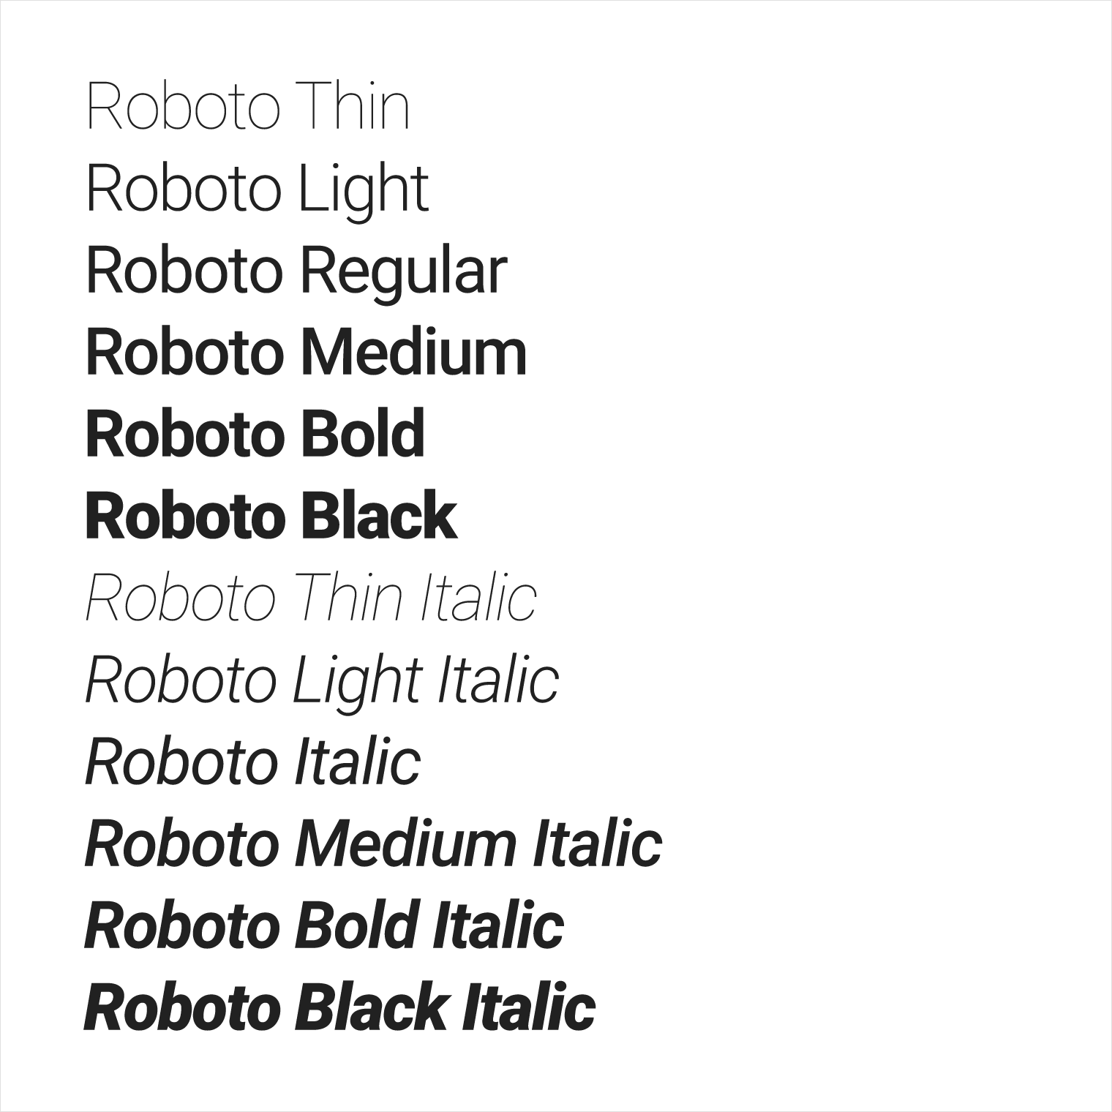
Roboto typeface
Roboto is the standard typeface on Android
Roboto has 6 weights
Thin
Light
Regular
Medium
Bold
Black

Slide 13
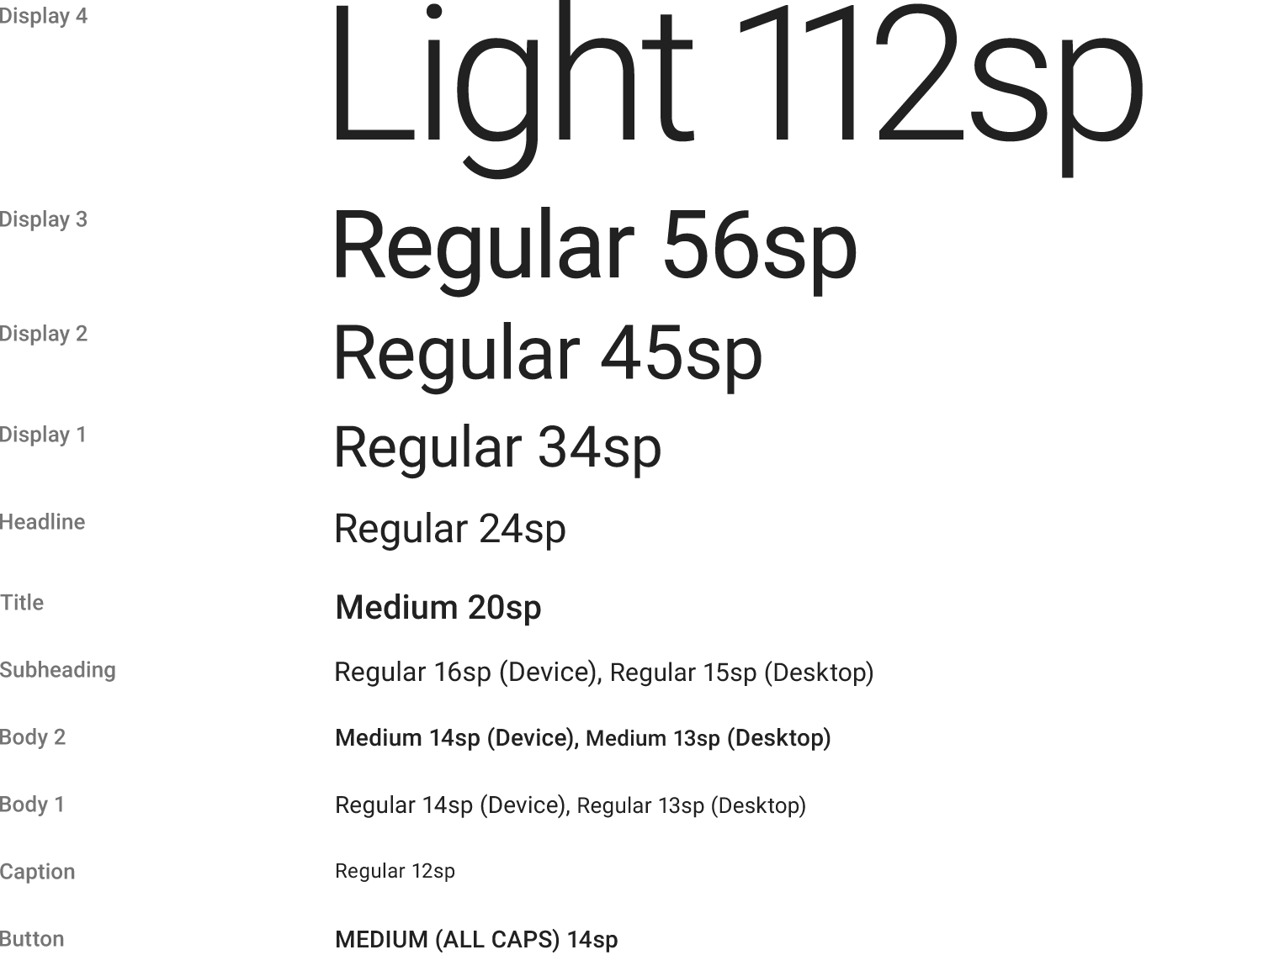
Font styles and scale
Display 4
Display 3
Display 2
Display 1
Headline
Title
Subheading
Body 2
Body 1
Caption
Button
Too many sizes is confusing and looks bad
Limited set of sizes that work well together

Slide 14
Setting text appearance
android:textAppearance=
"@style/TextAppearance.AppCompat.Display3"

Slide 15
Fonts as resources
Bundle fonts as resources in app package (APK)
Create font folder within res, add font XML file to font
To access font resource:
@font/myfont
R.font.myfont
Android 8.0 (API level 26) — Android 4.1 (API level 16) and higher, use the Support Library 26
See Fonts in XML

Slide 16
Downloadable fonts
Download fonts from provider app
Reduces APK size
Increases the app installation success rate
Improves the overall system health, saves cellular data, phone memory, and disk space
Android 8.0 (API level 26) — API level 14 and higher, use Support Library 26
See Downloadable Fonts

Slide 17
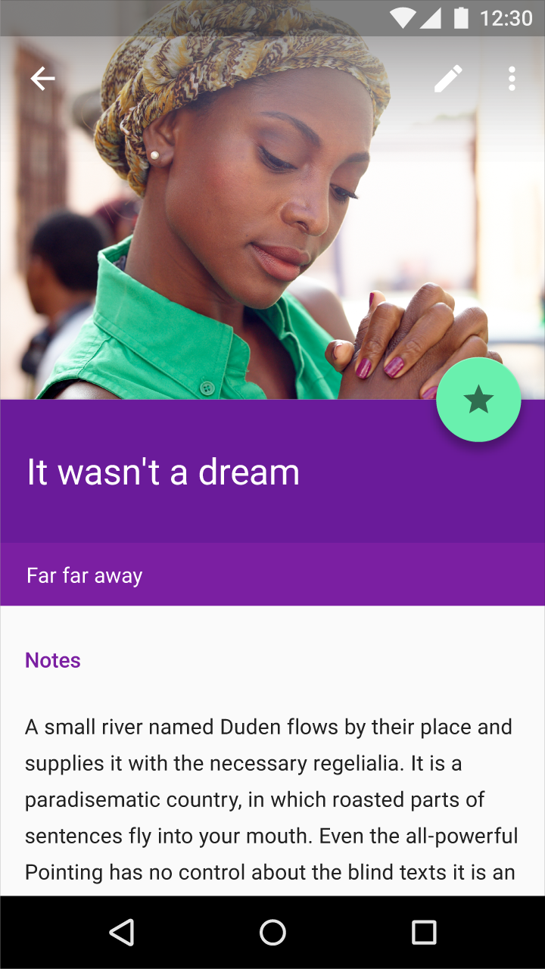
Color

Slide 18
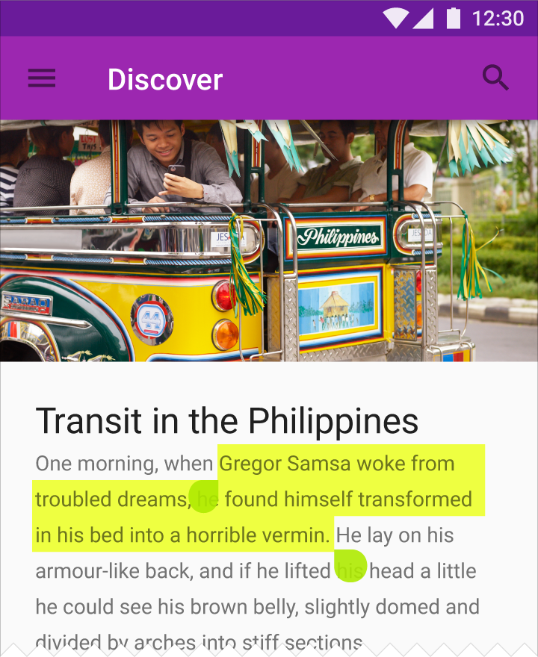
Color
Bold hues
Muted environments
Deep shadows
Bright highlights

Slide 19
Color palette
Material Design recommends using
a primary color
along with some shades
and an accent color
Create a bold user experience for your app
Material Design Color Palette

Slide 20
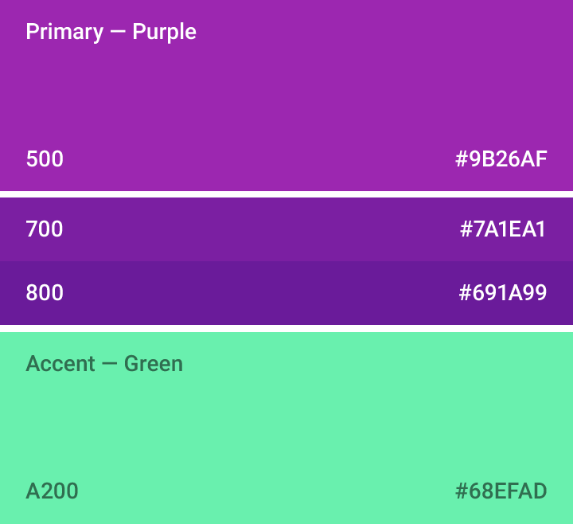
Color palette for your project
Android Studio creates a color palette for you
AppTheme definition in styles.xml
colorPrimary—AppBar, branding
colorPrimaryDark—status bar, contrast
colorAccent—draw user attention, switches, FAB
Colors defined in colors.xml
Color selection tool

Slide 21
Text color and contrast
Good choice
Contrast for visual separation
Contrast for readability
Contrast for accessibility
Not all people see colors the same
Theme handles text by default
Theme.AppCompat.Light—text will be near black
Theme.AppCompat.Light.DarkActionBar—text near white
Good choice
Bad choice
Bad choice
Bad choice
Good choice

Slide 22
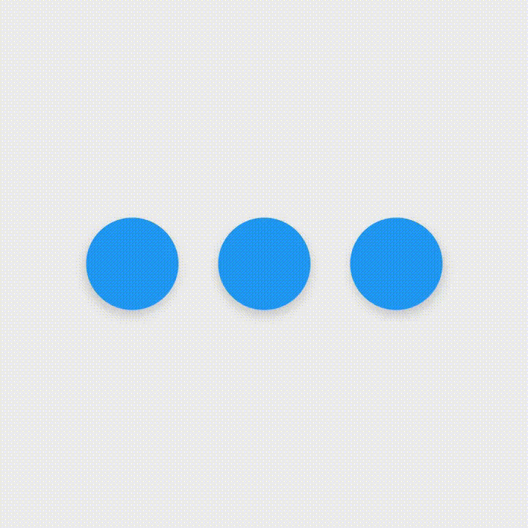
Motion

Slide 23
Motion
Motion in Material Design describes
Spatial relationships
Functionality
Intention
Motion is
Responsive
Natural
Aware
Intentional
Notes:
Responsive
Material is full of energy. It quickly responds to user input precisely where the user triggers it.
Aware
Material is aware of its surroundings, including the user and other material around it. It can be attracted to objects and respond appropriately to user intent.
Natural
Material depicts natural movement inspired by forces in the real world.
Intentional
Material in motion guides focus to the right spot at the right time.

Slide 24
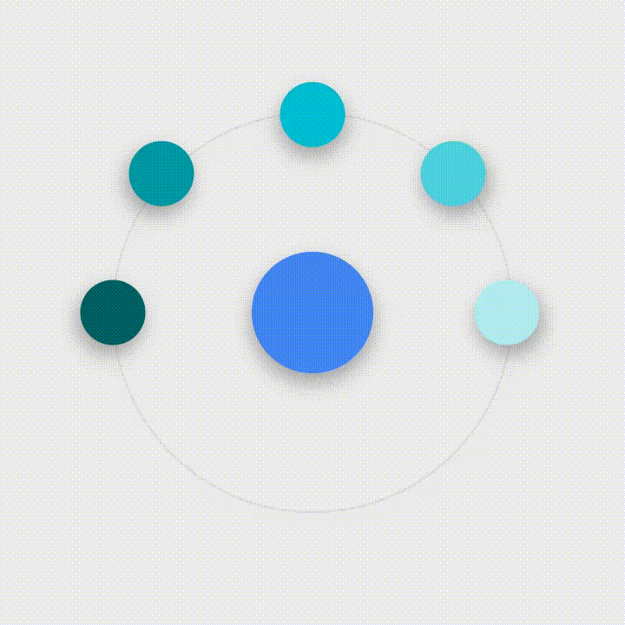
Motion in your app
Maintain continuity
Highlight elements or actions
Transition naturally between actions or states
Draw focus
Organize transitions
Responsive feedback
Touch feedback
Responsive interaction

Slide 25
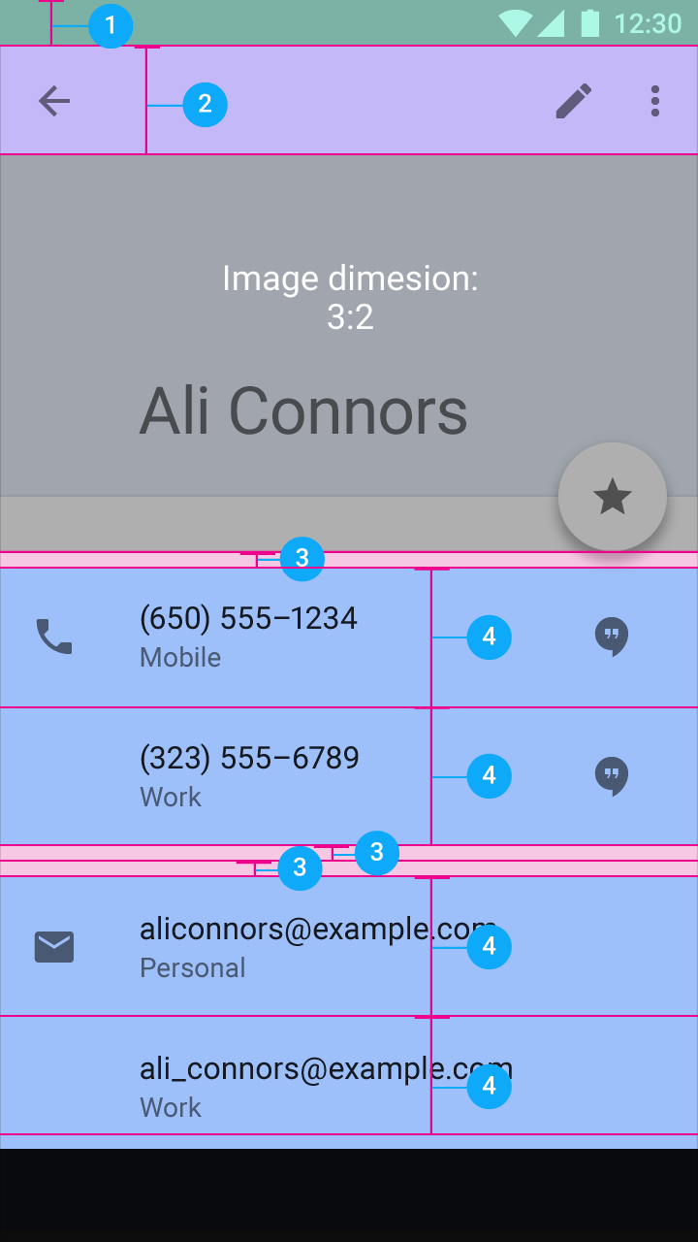
Layout

Slide 26
Layout for Material Design
Density independent pixels for views—dp
Scalable pixels for text—sp
Elements align to a grid with consistent spacing
Plan your layout
Use templates for common layout patterns

Slide 27
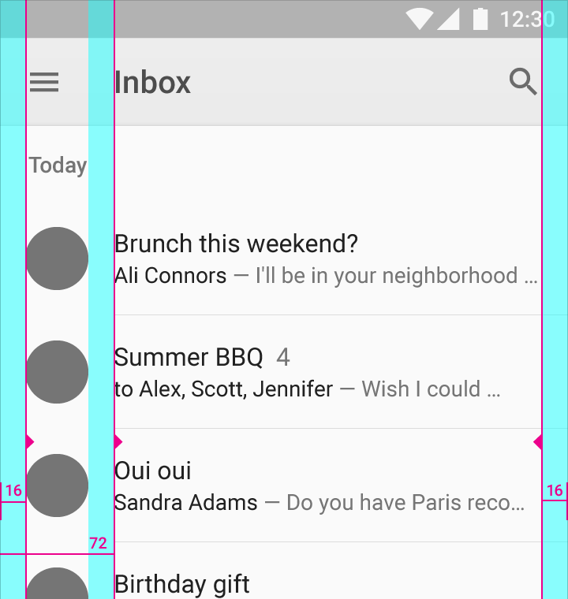
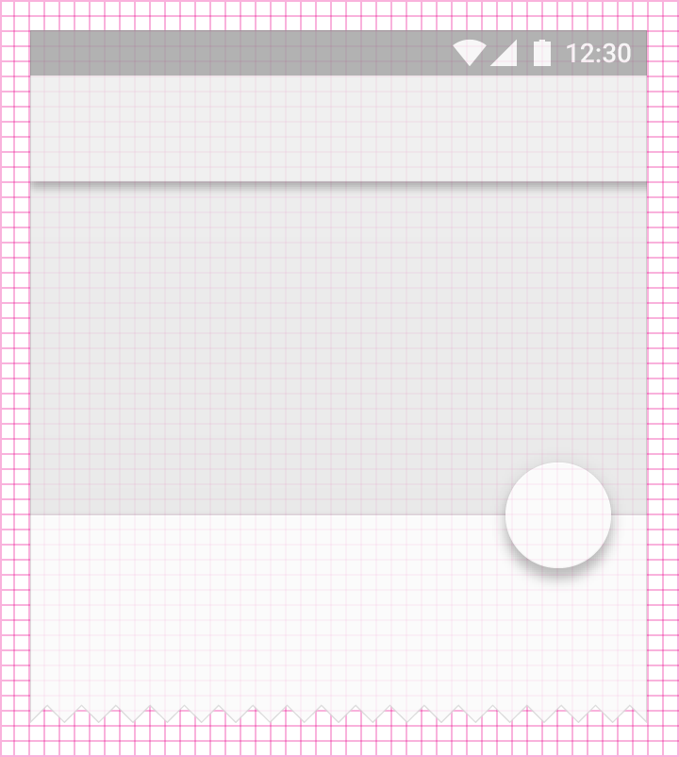
Layout planning
Spacing
Grid alignment
Sizing

Slide 28
Components

Slide 29
Components
Material Design has guidelines on the use and implementation of Android components
Bottom Navigation
Buttons
Cards
Chips
Data Tables
Dialogs
Dividers
Sliders
Snackbar
Toasts
Steppers
Subheaders
Text Fields
Toolbars

Slide 30
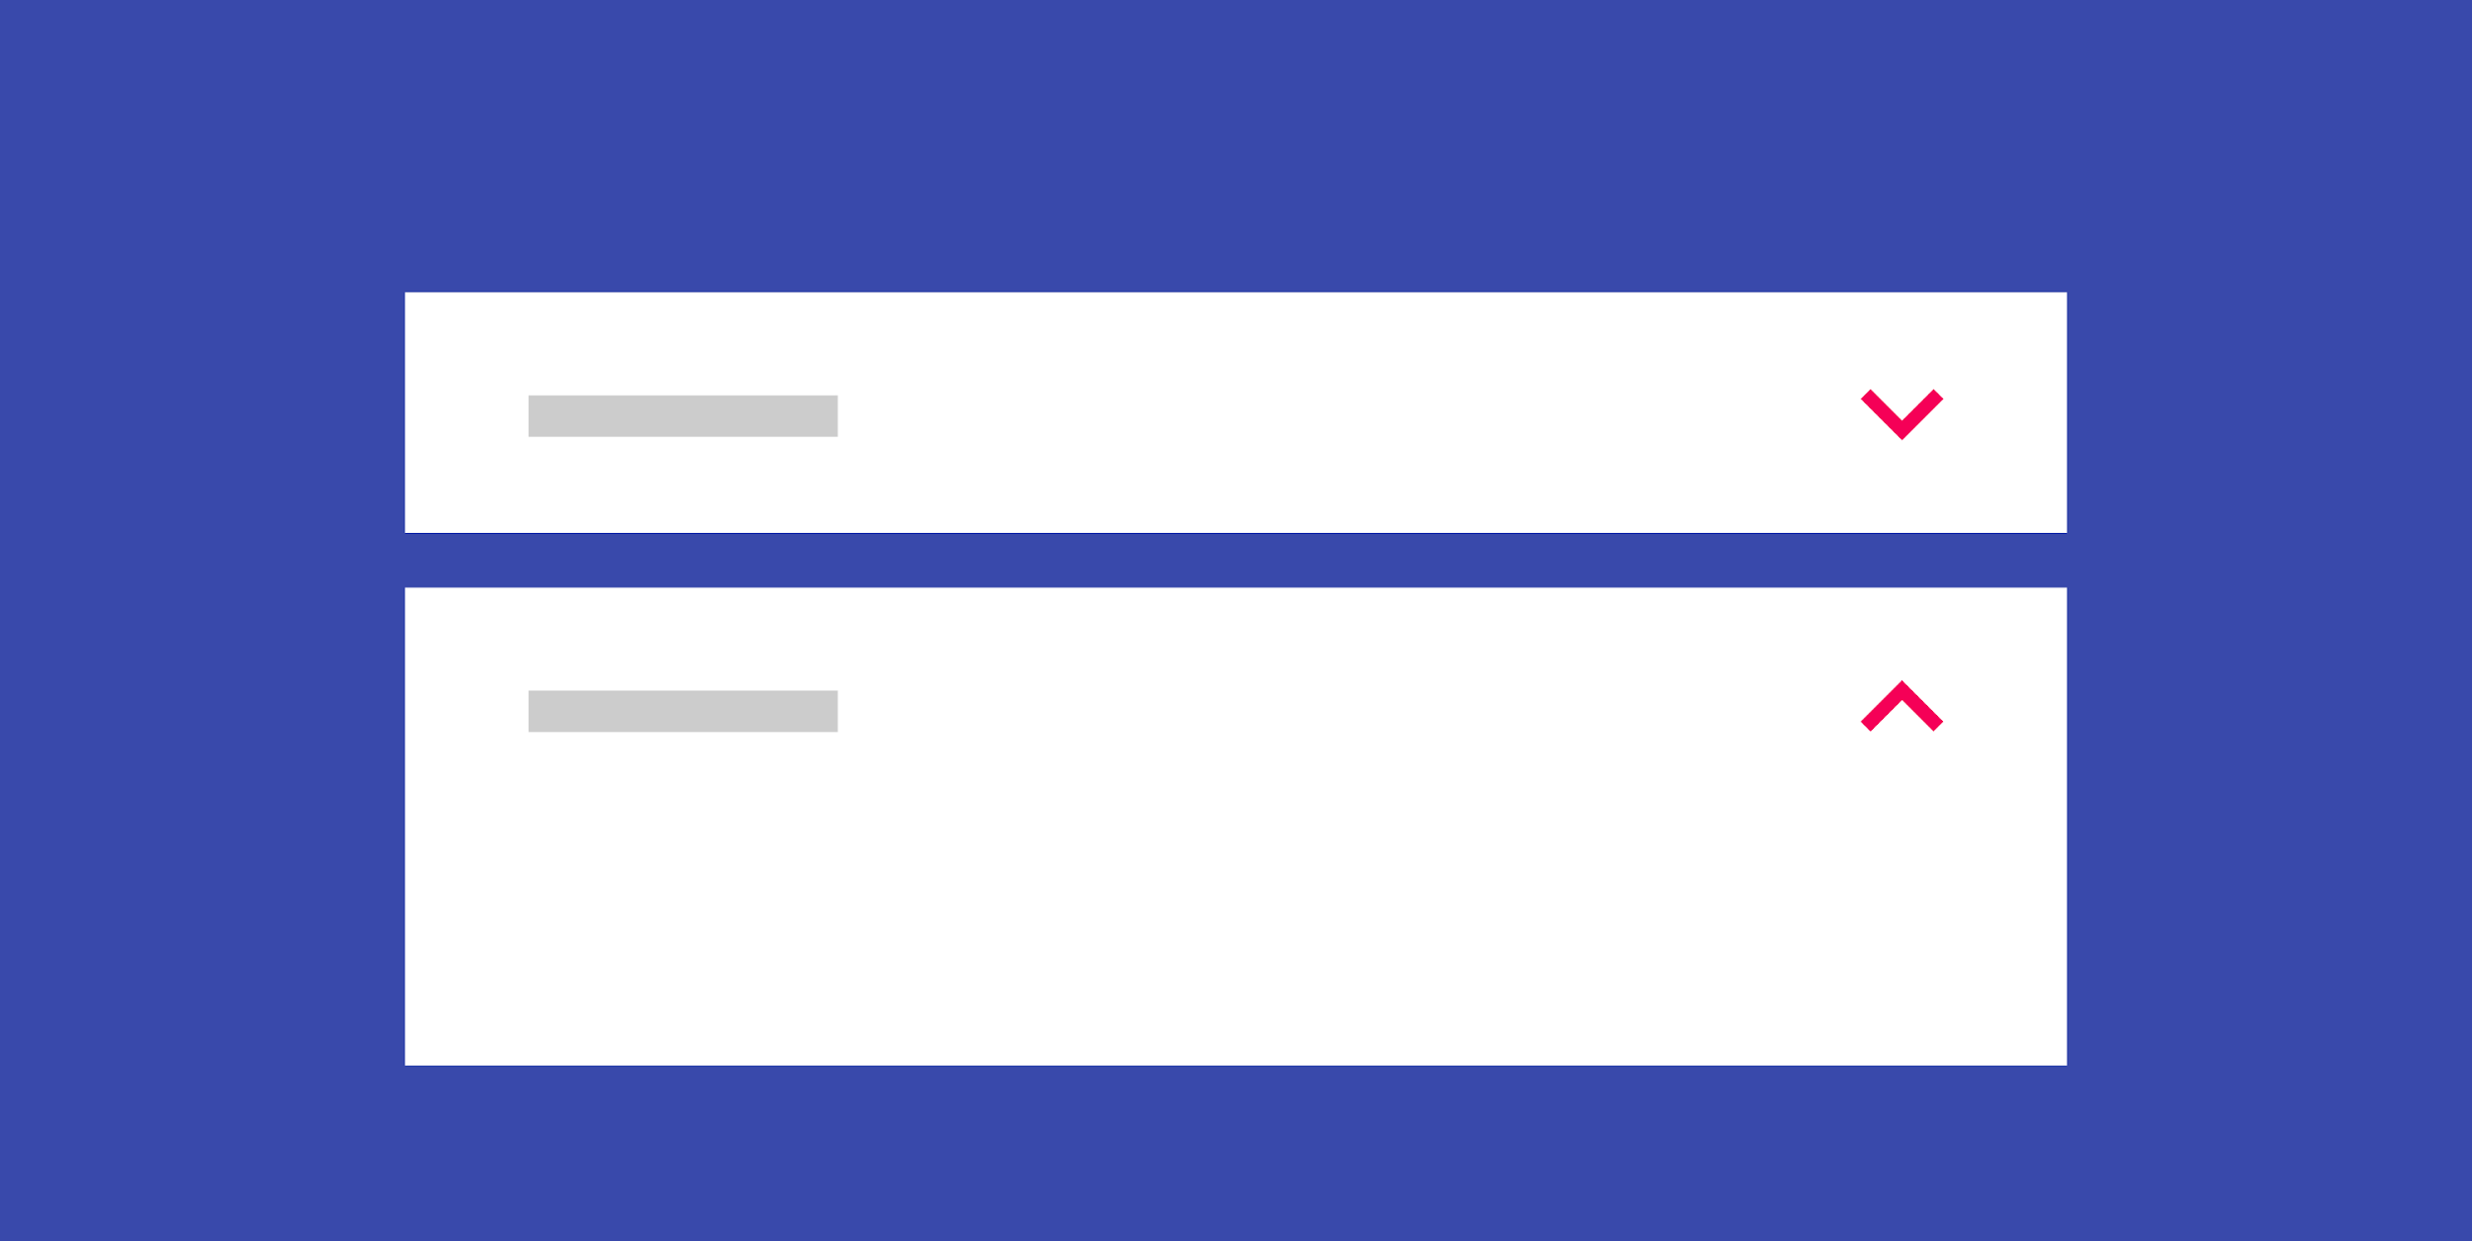
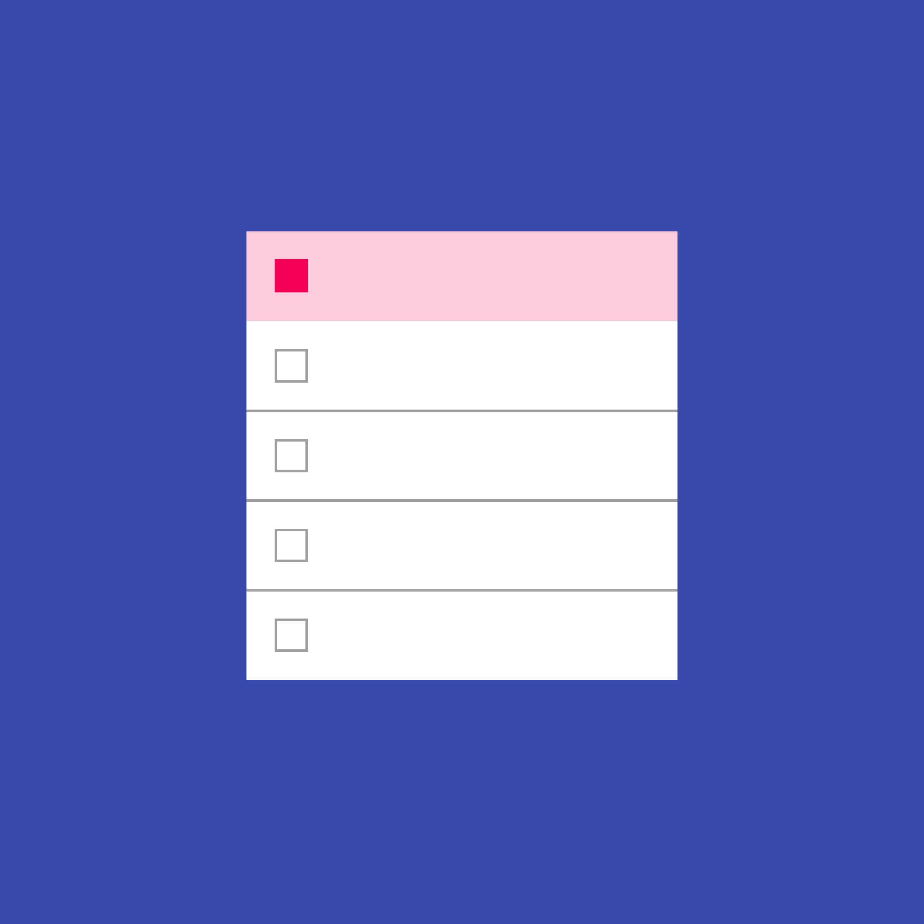
More components
Expansion Panels
Grid Lists
Lists
Menus
Pickers
Progress Bars
Selection Controls

Slide 31
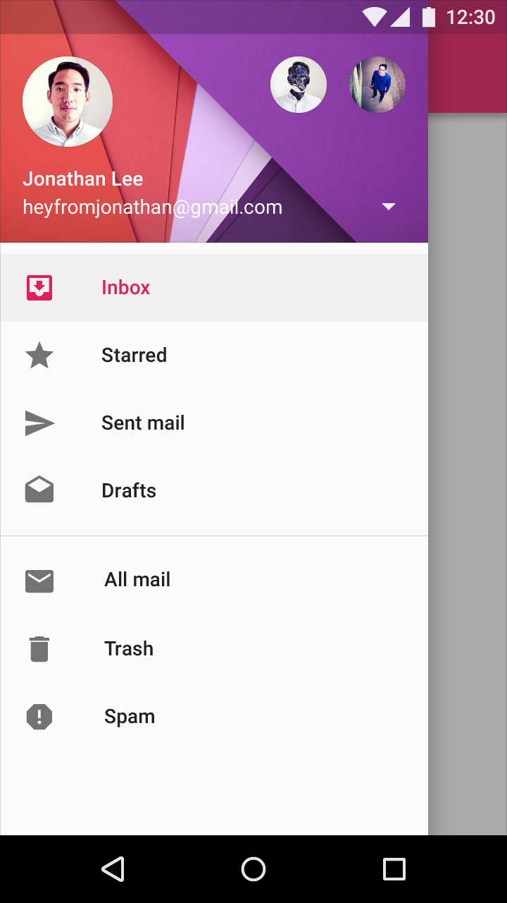
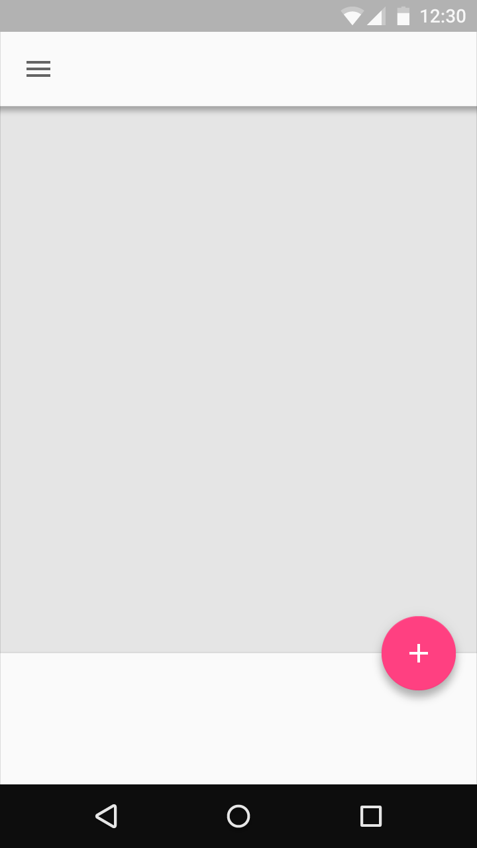
Consistency helps user intuition
FAB
Tabs
Snackbar
Navigation Drawer

Slide 32
Learn more
Material Design Guidelines
Material Design Guide
Material Design for Android
Material Design for Developers
Material Palette Generator
Cards and Lists Guide
Floating Action Button Reference
Defining Custom Animations
View Animation

Slide 33
What's Next?
Concept Chapter: 5.2 Material Design
Practical: 5.2 Cards, and colors

Slide 34
END

