Slide 1
COSC 5/4735
Introduction to Unity

Slide 2
What is Unity?
Unity is a multi-platform, integrated IDE for scripting games, and working with 3D virtual worlds (https://unity3d.com/)

Slide 3
Why do we care?
You have already gone over drawing 3D objects using OpenGL.
But that doesn’t mean that this is the only way (or easiest way) to accomplish this.
There are advantages to using Unity which can seamlessly allow you to do some pretty robust things.

Slide 4
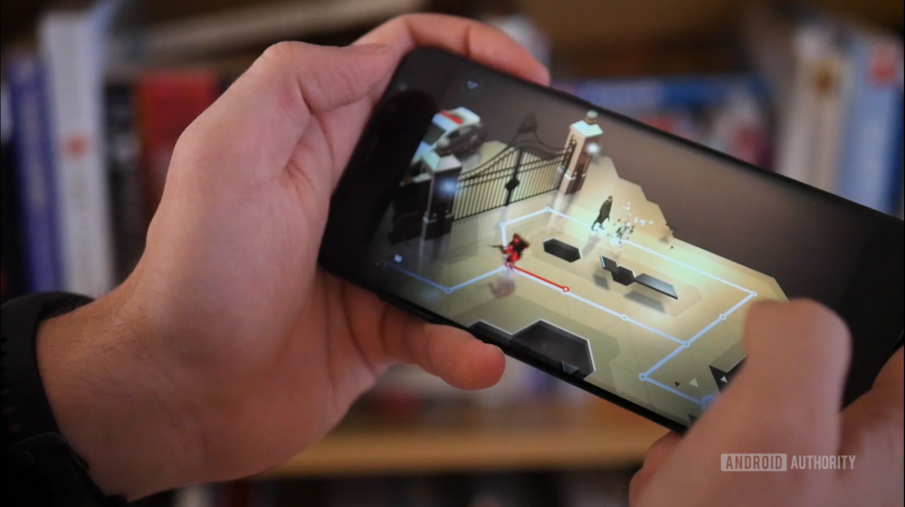
Why do we care?
Also, let’s face it. We’re nerds!
We like playing games and by extension, like making games too.

Slide 5
Getting started with Unity
https://unity.com/ -> Get Started
“Whether you are working toward a career in games or interactive content, or are one of the many educators who teach the valuable skills that will enable students to achieve their goals and become the successful creators of tomorrow, we are dedicated to supporting you.”

Slide 6
Basics of Unity

Slide 7
What we are going to cover today:
Creating Objects/Object scripting
Object relationships
Object physics
Using the Asset Store

Slide 8
Creating Objects
Demo – Adding Objects to Our Environment

Slide 9
Scene navigation and short cuts.

Slide 10
making a cube and color it.
In the hierarchy window, right click, 3DObject ->cube
press F to bring front and center if you want
the Project window, right click, create->material.
click it if needed, rename as needed, and click the white square to choose a new color.
This also where could use a bitmap to add textures and other things.

Slide 11
Object Scripting
So we have some objects in our environment, GREAT!
Problem is, this is still not a very interesting Unity application.
We want to be able to transform objects dynamically (whether prompted by user input or on a set interval).
To do this, we can add scripts to our objects which allow us to programmatically dictate object behavior.

Slide 12
Object Scripting
NOTE: Unity uses C# for programming scripts
Thankfully, there is a dedicated community for Unity programming and a variety of online tutorials and videos!
https://unity3d.com/learn/tutorials

Slide 13
Object Scripting - Basics

Slide 14
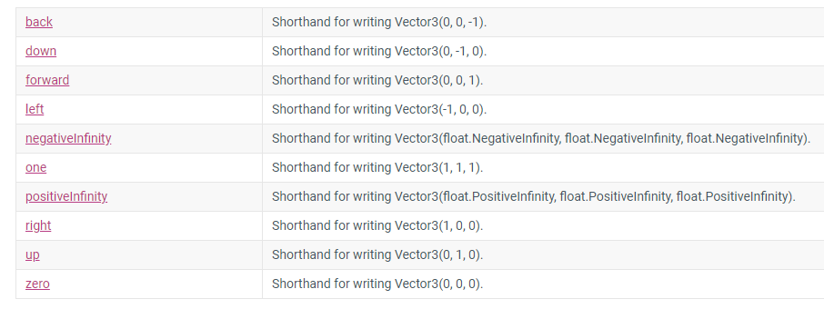
Vectors
v1 = new Vector3(1,1,1);
Alternatively: Vector3.up

Slide 15
Demo – Adding Basic Scripts

Slide 16
Making a script
In the assests window
right click, create->C# script
rename as needed.

Slide 17
Blank Script – Start vs Update
public class ScriptName : MonoBehaviour
{
// Start is called before the first frame update
void Start()
{}
// Update is called once per frame
void Update()
{}
}

Slide 18
Translation
General form:
public void Translate(Vector3 translation);
Example:
// Move the object forward along its z axis 1 unit/second.
transform.Translate(Vector3.forward * Time.deltaTime);

Slide 19
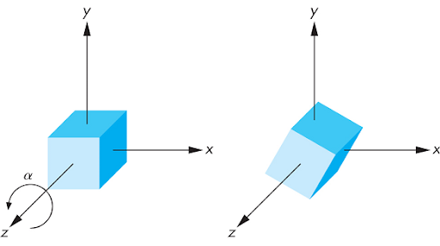
Rotation
General form:
public void Rotate(Vector3 eulers, Space relativeTo = Space.Self);
Example:
transform.Rotate(-1 * Vector3.up * 85.0f * Time.deltaTime);

Slide 20
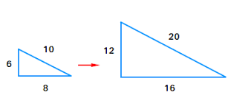
Scale
General form:
public Vector3 localScale;
Example:
transform.localScale += new Vector3(1.0f, 1.0f, 1.0f) * Time.deltaTime;

Slide 21
Object Relationships
Understanding the parent/child relationship between objects
Table example
Camera mounted on object example
We need to consider what our objects are and how they should interact with other objects in our scene.
Demo – Camera Attachment and Adding Object Tags

Slide 22
Object Physics
The real world isn’t just floating cubes.
Sometimes we want objects to have physics and respond to collision events.
However, physics does not necessarily have to emulate real world physics (i.e. sometimes a floating cube is acceptable).
Demo – Collision Detection

Slide 23
collision code
One or all of the object involved in the collision must have a collusion method.
First make sure you have a rigidbody component added as well. and likely you need a floor for the gravity.
private void OnCollisionEnter(Collision collision)
{
Debug.Log("Do something");
if (collision.gameObject.name == "Cube")
{
this.GetComponent<Renderer>().material.color = Color.red;
}
}

Slide 24
Trigger code?
collision code is for when things use the physics engine. but if you are just manually moving them, then you can use trigger instead.
In this case, rigidbody is not needed, but in the collider component, click the istrigger box
private void OnTriggerEnter(Collider colider)
{
Debug.Log("Do something here");
if (colider.gameObject.name == "Cube" )
{
this.GetComponent<Renderer>().material.color = Color.red;
}
}

Slide 25
Using the Asset Store
What do you do when you are not a creative/talented individual but you also enjoy making cool things?
You utilize other people who complement your weaknesses of course!
The Unity Asset store provides a wide variety of external things (objects, textures, etc.) that you can then import into your Unity project.

Slide 26
Using the Asset Store
Demo – Asset Store

Slide 27
Add controls and moving.
https://cgcookie.com/questions/11010-where-to-find-assets-for-those-watching-in-2019-2020
Add a “character” to walk around our environment.
Project -> Assets->Characters-> FirstPersonCharacter->Prefabs->FPSController
Note, the link above tells you the fix, but you also need to remove the mainCamera as well.
Now we need to add mobile controls
Project -> Assets -> CrossPlatformInput -> Prefabs -> DualTouchControls -> Jump
Gives move, jump, and look around control.
Or add MobileSingleStrikControl: JumpButton and MobileJoyStick

Slide 28
This is just the beginning…
There is so much more you can do in Unity.
If you find this interesting, consider taking the Virtual Reality Systems course offered by Dr. Banic.
Alternative, just jump in! There are a ton of online resources and tutorials to get you started.

Slide 29
Q
A
&

