Slide 1
Cosc 4735
Activity Recognition

Slide 2
permissions.
Note, starting in android 10, you need
android.permission.ACTIVITY_RECOGNITION
and ask permission from the user as well.
before android 10 you only need an automatic permission of
com.google.android.gms.permission.ACTIVITY_RECOGNITION

Slide 3
Activity Recognition
Google has release a set of APIs two allow an application to attempt figure out what activity the user is doing, based on the movement of the device (ie phone).
IN_VEHICLE The device is in a vehicle, such as a car.
ON_BICYCLE The device is on a bicycle.
ON_FOOT The device is on a user who is walking or running.
RUNNING The device is on a user who is running.
STILL The device is still (not moving).
TILTING The device angle relative to gravity changed significantly.
UNKNOWN Unable to detect the current activity.
WALKING The device is on a user who is walking.
As note, a user can be in_vehicle and walking. Ie walking on a bus.
As of Jan 27, 2016 these are the only activities detected.

Slide 4
What can we do with this info?
Google’s short video on it:
https://youtu.be/S8sugXgUVEI
Basically, the app can react to whatever the person is doing.
Well, what the phone is doing or not doing.

Slide 5
Compile
Need to add app module file a compile directive
In the dependencies section add
implementation 'com.google.android.gms:play-services-location:18.0.0'
implementation 'com.google.android.gms:play-services-base:17.6.0'
or newer viersions.
Activity Recognition is under the location services currently.

Slide 6
Setup
Setup the Client for the API
older version required a client first.
Now you get the client at the same time
ActivityRecognition.getClient(this).

Slide 7
Request Activity Updates
Build the request
ActivityRecognition.getClient(this ).requestActivityUpdates(DETECTION_INTERVAL_IN_MILLISECONDS, getActivityDetectionPendingIntent());
where get ActivityDetecitonPendingIntent returns a pending Intent.
addSuccessListener and/or addOnFailureListener tell you updates have started
An update of zero milliseconds will detect as fast as possible, but impact battery life.

Slide 8
PendingIntent
Instead of having this in a service (which can be battery drain), it’s all down with a PendingIntent
You specify what is supposed to get the data
A service (or intent service), broadcast receiver, or an activity.
For my example code, I wanted it to go the activity I was using, so
Intent intent = new Intent(this, MainActivity.class);
I wanted to use the current running Activity and not start a new one, so Also add android:launchMode="singleTop“ to activity in Manifest file as well.
intent.addFlags(Intent.FLAG_ACTIVITY_SINGLE_TOP);
And recreate the pending Intent.
return PendingIntent.getActivity(this, 0, intent, PendingIntent.FLAG_UPDATE_CURRENT);
To start a service it would look like this
Intent intent = new Intent(this, DetectedActivitiesIntentService.class);
return PendingIntent.getService(this, 0, intent, PendingIntent.FLAG_UPDATE_CURRENT);
OR
use a broadcast receiver in your activity, which simplies the activity intent and doesn't need a service
return PendingIntent.getBroadcast(MainActivity.this, 0, intent, PendingIntent.FLAG_MUTABLE);
then declare a boardcastReceiver in your MainActivity. this what the AcitivityRecognitionDemo does.

Slide 9
Result intent
Now the app receives the intent to the spot specified and get the info.
In my example to an override onNewIntent
ActivityRecognitionResult result = ActivityRecognitionResult.extractResult(intent);
Now the app can get a list of the activity and/or the most probablyActivity as well as the probably of the activity.
The doc’s differ, but between 50 and 75 probably is very likely. Under 50, it is not sure at all.
And note, two activities maybe over 75% such as in a vehicle and walking.

Slide 10
Result intent (2)
Get most probable
DetectedActivity probably = result.getMostProbableActivity();
Probably.getConfidence() >= 50 //or 75
Then the device is likely “doing that” activity.
Probably.getType() returns a constant value
Use DetectedActivity.IN_VEHICLE, DetectedActivity.ON_BICYCLE, DetectedActivity.ON_FOOT, DetectedActivity.RUNNING, DetectedActivity.STILL, DetectedActivity.TILTING, DetectedActivity.UNKNOWN, DetectedActivity.WALKING to determine which one

Slide 11
So again
What can the app do with info?
Or set of info…
So what does it mean when the activity goes from Driving to Still?
And is that enough info?
The phone tilted is this useful information?
From the Documentation: The device angle relative to gravity changed significantly. This often occurs when a device is picked up from a desk or a user who is sitting stands up.
User started running, launch a mapping app?
How would we go about doing this?

Slide 12
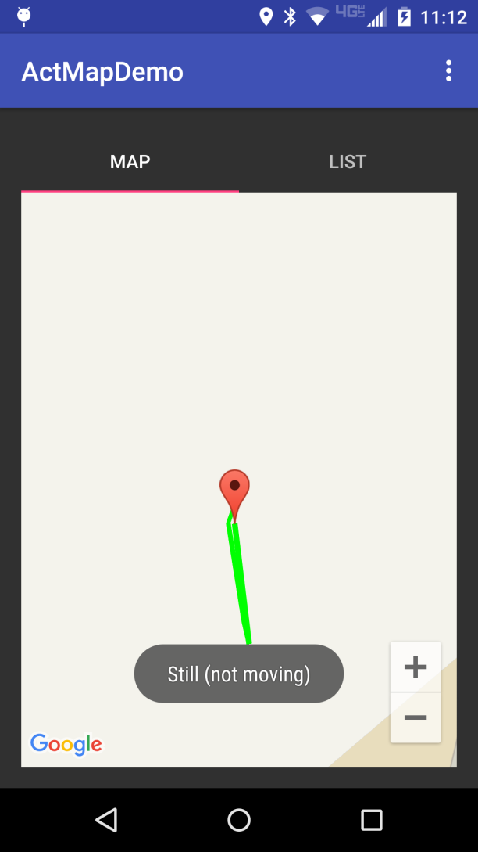
Combining a few things.
This app will use the ActivityRecogntion, plus locationAware to map out the user activities
While the app is running.
The list will show the shows the text information that is mapped on the map view.
It adds Markers to the map for start and end, plus each mile as well.

Slide 13
References
https://developers.google.com/android/reference/com/google/android/gms/location/ActivityRecognition
https://developers.google.com/android/reference/com/google/android/gms/location/ActivityRecognitionResult
https://developers.google.com/android/reference/com/google/android/gms/location/DetectedActivity
https://github.com/googlesamples/android-play-location/tree/master/ActivityRecognition which is google example code.

Slide 14
Sleep API

Slide 15
Sleep API
part of the activity recognition API and requires the android.permission.ACTIVITY_RECOGNITION
starts in API 29.
The sleeping information is reported in two ways:
A "sleep confidence", which is reported at a regular interval (up to 10 minutes)
A daily sleep segment which is reported after a wakeup is detected

Slide 16
How it works.
You app will subscribe to the sleep updates
which (very likely) requires a broadcast receiver
Since these are long term data, starting at system boot, you want to a broadcast receiver, instead of sending the data to the activity
Process the data as needed.
As needed, unsubscribe.
You may also want to boot receiver, so start receiving sleep data when the phone starts.

Slide 17
subscribe
You need a pendingintent and then use the get client to subscribe
PendingIntent pi = PendingIntent.getBroadcast(getApplicationContext(), 0,
new Intent(getApplicationContext(), SleepReceiver.class), PendingIntent.FLAG_CANCEL_CURRENT);
//subscribe to both events.
ActivityRecognition.getClient(getApplicationContext()).requestSleepSegmentUpdates(
pi, SleepSegmentRequest.getDefaultSleepSegmentRequest()
).addOnSuccessListener(new OnSuccessListener<Void>() {
@Override
public void onSuccess(Void aVoid) {
//successfully subscribed, you will receive data.
} }
).addOnFailureListener(new OnFailureListener() {
@Override
public void onFailure(@NonNull Exception e) {
//failed to subscribe.
} });

Slide 18
the Data
SleepSegmentEvent
returns a start and stop time. and status
If the status code is STATUS_SUCCESSFUL or STATUS_MISSING_DATA, then an instance of this class contains a detected sleep start time and a detected sleep end time.
SleepCassifyEvent (returns data at set intervals, like 10 minutes)
getConfidence() between 0 and 100
Higher values indicate that the user is more likely sleeping
getLight ()
range from 1 to 6, higher value is brighter surrounding
getMotion()
range from 1 to 6, higher indicates more movement of the device
also timestamps.

Slide 19
Receiver
via a broadcast receiver:
public void onReceive(Context context, Intent intent) {
if (SleepSegmentEvent.hasEvents(intent)) {
List<SleepSegmentEvent> sleepSegmentEvents = SleepSegmentEvent.extractEvents(intent);
for (SleepSegmentEvent event : sleepSegmentEvents) {
//now deal with the data.
}
} else if (SleepClassifyEvent.hasEvents(intent)) {
List<SleepClassifyEvent> sleepClassifyEvents = SleepClassifyEvent.extractEvents(intent);
for (SleepClassifyEvent event : sleepClassifyEvents) {
//now deal with the data.
}

Slide 20
Now what?
Likely the receiver will store the data in a database (room?) and then the data can be displayed/processed when the user opens the app.

Slide 21
Demo code
The demo is very simple.
it has a subscribe and unsubscribe button and the broadcast receiver prints the data to the logcat.
remember to unsubscribe when you are done (or uninstall). it will continue to sleep data if you leave it subscribed.

Slide 22
References
https://android-developers.googleblog.com/2021/02/low-power-sleep-tracking-on-android.html
https://developers.google.com/location-context/sleep

Slide 23
Q
A
&

