Slide 1
Cosc 5/4735
ARCore

Slide 2
ARCore
ARCore is a platform for building augmented reality apps on Android.
ARCore uses three key technologies to integrate virtual content with the real world as seen through your phone's camera:
  Motion tracking allows the phone to understand and track its position relative to the world.
  Environmental understanding allows the phone to detect the size and location of flat horizontal surfaces like the ground or a coffee table.
  Light estimation allows the phone to estimate the environment's current lighting conditions.
Supported devices with Nougat (Android 7.0) and higher: https://developers.google.com/ar/discover/#supported_devices

Slide 3
How it works
Motion tracking: Using the phone's camera to observe feature points in the room and IMU sensor data, ARCore determines both the position and orientation (pose) of the phone as it moves. Virtual objects remain accurately placed.
Environmental understanding: It's common for AR objects to be placed on a floor or a table. ARCore can detect horizontal surfaces using the same feature points it uses for motion tracking.
Light estimation: ARCore observes the ambient light in the environment and makes it possible for developers to light virtual objects in ways that match their surroundings, making their appearance even more realistic.
Notes:
https://developers.google.com/ar/discover/concepts

Slide 4
How it works (2)
User interaction: it uses hit testing to take an (x,y) coordinate corresponding to the phone's screen (provided by a tap or whatever other interaction you want your app to support) and projects a ray into the camera's view of the world, returning any planes or feature points that the ray intersects, along with the pose of that intersection in world space. This allows users to select or otherwise interact with objects in the environment.
Oriented Points: lets you place virtual objects on non-horizontal surfaces. When you perform a hit test that returns a feature point, ARCore will look at nearby feature points and use those to attempt to estimate the angle of the surface at the given feature point. ARCore will then return a pose that takes that angle into account.
  Because ARCore uses clusters of feature points to detect the surface's angle, surfaces without texture, such as a white wall, may not be detected properly.

Slide 5
How it works (3)
Anchors and Trackables:
  Poses can change as ARCore improves its understanding of its own position and its environment. When you want to place a virtual object, you need to define an anchor to ensure that ARCore tracks the object's position over time. Often times you create an anchor based on the pose returned by a hit test, as described in user interaction.
  The fact that poses can change means that ARCore may update the position of environmental objects like planes and feature points over time. Planes and points are a special type of object called a trackable. Like the name suggests, these are objects that ARCore will track over time.

Slide 6
tools
To help build 3D objects you can use two tools that google built
  https://www.tiltbrush.com/
  Https://vr.google.com/blocks/
  They allow you build 3D objects in a 3D environment.
  Available only on the VIVE and Oculus

Slide 7
Platforms
ARCore can be used on
  Android (Java) API 24+ Covered in this lecture
  Android (c++) NDK
  Unity
  Unreal
  Web
    Requires AR-enchanced browsers, which are currently all alpha level releases.
      WebARonARCore (Android)
      WebARonARKit (iOS)

Slide 8
Basic setup
In the manifest file
<uses-feature android:name="android.hardware.camera.ar" android:required="true" />
<application>
...
<meta-data android:name="com.google.ar.core" android:value="required" />
build.gradle in the dependencies section add
  // ARCore library
  implementation 'com.google.ar:core:1.35.0'
Ask for permissions:
  You need to add the ask permissions for the camera as well.

Slide 9
ARCore installed?
You should make sure ARCore is installed
Uses the snippet of code
  https://developers.google.com/ar/develop/java/enable-arcore#runtime

Slide 10
OpenGL for the most part.
Basically, you need to GlsurfaceView to render everything.
  Even the camera image.
Get a GestureDetector and attach it to the view if you want to allow touch/tap events.
  Via the ontouchlistener
Setup the GLSurfaceView like we did with standard openGL.

Slide 11
com.google.ar.core.Session
Session
  Manages AR system state and handles the session lifecycle. This class is the main entry point to ARCore API.
  This class allows the user to create a session, configure it, start/stop it, and most importantly receive frames that allow access to camera image and device pose.
Frame frame = seesion.update(); //provides with the current
Note we need to configure it and can use the defaults
  Config config = new Config(session);
  Any changes as necessary and then feed it back to the session.
  session.configure(config);

Slide 12
com.google.ar.core.Frame
Captures the state and changes to the AR system from a call to session.update().
Provides:
  acquirepointCloud() which returns the current set of estimated 3d points attached to real-world geometry.
  getLightEstimate() which returns the current ambient light estimate, if light estimation was enabled.
  hitTest(float xPx, float yPx) Performs a ray cast from the user's device in the direction of the given location in the camera view.
  hitTest(MotionEvent motionEvent) Similar to hitTest(float, float), but will take values from Android MotionEvent.
  transformDisplayUvCoords(FloatBuffer uvCoords, FloatBuffer outUvCoords) which Transform the given texture coordinates to correctly show the background image.
    This is what we need to draw the camera image.

Slide 13
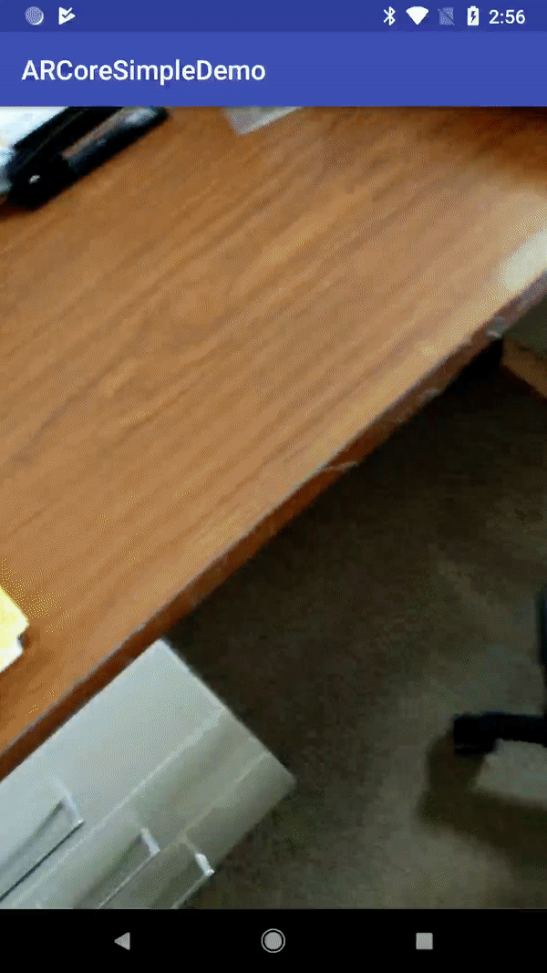
Code example.
We'll look at the code for this example and Google's hello_ar example.
This is also a computervision example that uses textures to change the camera feed.

Slide 14
References
https://developers.google.com/ar/
https://developers.google.com/ar/develop/java/quickstart
https://android-developers.googleblog.com/2017/08/arcore-augmented-reality-at-android.html
https://www.blog.google/products/google-vr/announcing-arcore-10-and-new-updates-google-lens/

Slide 15
Q
A
&

