Slide 1
Cosc 5/4735
Multimedia Part 1:
Audio media

Slide 2
Playing Audio
Android android.media

Slide 3
Playing audio
android.media can be very simple or really complex
Get a MediaPlayer
use the MediaPlayer class, with the create() method to get a "player".
States: prepare() → start()
You can pause(), then start() without calling prepare()
Also seekTo() without needed prepare() again.
with stop() and reset(), then you must prepare() again
See next slide for states and where to go…
supported media formats http://developer.android.com/intl/zh-CN/guide/appendix/media-formats.html

Slide 4
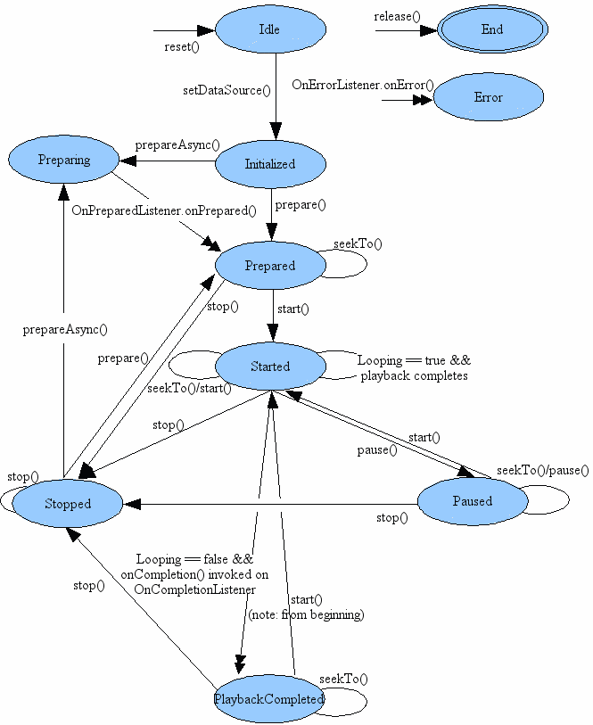
mediaplayer states

Slide 5
Example
When it is stored as a Resource (res/raw directory)
MediaPlayer mp = new MediaPlayer.create(getBaseContext(), R.raw.laser);
mp.start(); //create calls prepare
For media store somewhere else
MediaPlayer mp = new MediaPlayer();
mp.setDataSource("http://www.cs.uwyo.edu/~seker/courses/4730/example/MEEPMEEP.WAV");
OR on filesystem, “/sdcard/file.mp3”
mp.prepare();
mp.start();

Slide 6
As a note.
You can also play the audio from video files with the method as well.
There just won’t be any picture, just the audio.

Slide 7
Audio Capture
May not be able test with the android simulators
Android simulators may through errors, saying device doesn’t exist.
You need to have a microphone attached before the simulator is launched.
You have to test all the code on the phone.
All examples were tested and worked on the phones.

Slide 8
Capturing Audio
Android android.media

Slide 9
Recording Audio
Get a new instance of the MediaRecorder()
Configure it for recording the mic, set the audio type
And configure the output FILE. (there is no outputStream)
Like playing, you prepare() and start().
No thread needed.
Stop() when done recording and then release().
The audio is now located in the file.

Slide 10
Recording Audio (2)
You need to set the following permissions in the AndroidManifest.xml file
android.permission.RECORD_AUDIO
required for all APIs
android.permission.WRITE_EXTERNAL_STORAGE
required for API 23 to 28.
as of API 29, it's depreciated.
But you can write audio/video files to the sdcard without needed permissions through the mediastore ContentResolver, which is what the examples now use.

Slide 11
Example Code
private void startRecording() {
get MediaRecorder
mRecorder = new MediaRecorder();
configure it
mRecorder.setAudioSource(MediaRecorder.AudioSource.MIC);
mRecorder.setOutputFormat(MediaRecorder.OutputFormat.THREE_GPP);
mRecorder.setOutputFile(mFileName);
mRecorder.setAudioEncoder(MediaRecorder.AudioEncoder.AMR_NB);
Prepare to record
try { mRecorder.prepare();
} catch (IOException e) {}
start recording
mRecorder.start();
}
private void stopRecording() {
mRecorder.stop();
mRecorder.release();
mRecorder = null;
}

Slide 12
Audio settings
mRecorder.setAudioSource();
MediaRecorder.AudioSource.MIC
MediaRecorder.AudioSource.CAMCORDER
Audio source with same orientation as camera, otherwise mic.
MediaRecorder.AudioSource.VOICE_CALL
Voice call uplink + downlink audio source
http://developer.android.com/reference/android/media/MediaRecorder.AudioSource.html
mRecorder.setOutputFormat();
MediaRecorder.OutputFormat.THREE_GPP
Recommended setting by Andriod.
Also, AMR_NB, AMR_WB, RAW_AMR
MediaRecorder.OutputFormat.MPEG_4
Using an MPEG-4 container format may confuse some desktop players.
http://developer.android.com/reference/android/media/MediaRecorder.html#setOutputFormat%28int%29
mRecorder.setAudioEncoder();
MediaRecorder.AudioEncoder.AAC
AAC audio codec
MediaRecorder.AudioEncoder.AMR_NB
AMR (Narrowband) audio codec
MediaRecorder.AudioEncoder.AMR_WB
AMR (Wideband) audio codec

Slide 13
Recording incoming phone calls
As of the current time
It doesn't appear to be possible via Android to record the audio "from the other end" of the conversation.
Some phones allow you record the mic during a phone call "headset speaker“
But Android has a setting for recording, so it may work

Slide 14
References
Android
http://developer.android.com/intl/zh-CN/guide/topics/media/index.html
http://developer.android.com/guide/topics/media/index.html

Slide 15
Q
A
&

