Slide 1
Cosc 4735
Firebase Cloud messaging
A primer

Slide 2
Push "notifications"
The basic idea here is this:
We don't want the app to poll a server or other device for new messages.
It's wastes time and resources (think about thousands of apps polling a server!)
Wastes battery on the phones as well.
Push "notifications" are sent to the phone.
No polling necessary.

Slide 3
Basics.
Register the project with firebase cloud messaging.
The app will get a "token", which individual for each phone/device
You then send a specific "message" to that one token or all tokens
Ie one phone or all phones
You can also setup groups (not covered) and send to a set of phones.
You need a backend server.
Can be can be Google Cloud Platform or you own REST services.

Slide 4
Cloud Platform.
A note, we could complete the backend using Google's cloud backend (similar to what was in the google cloud messaging).
https://cloud.google.com/tools/android-studio/quickstart
We'll going to use our own webserver and php instead, so it's clear how the rest services are working.

Slide 5
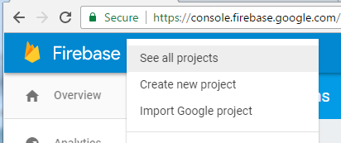
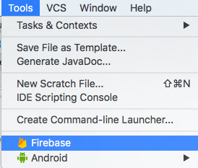
First
Create a project.
Two ways this can be done, but both end up integrating the same thing:
Via the web
OR studio:

Slide 6
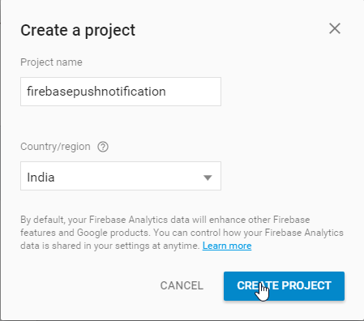
Via the web
Create the project. Put you app name and country (likely already selected)

Slide 7
Via the Web (2)
Click the add android one

Slide 8
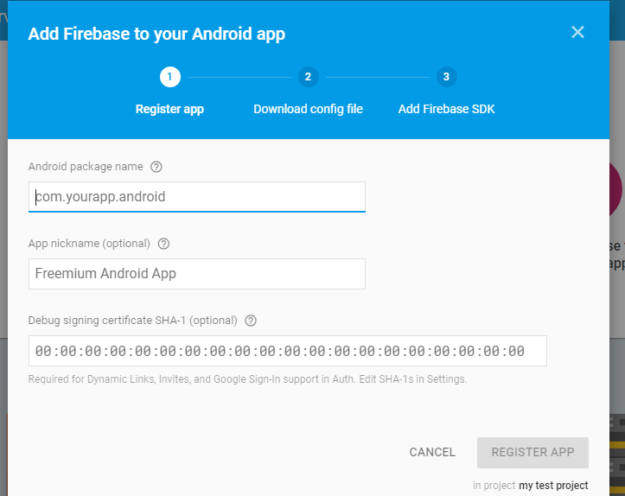
either

Slide 9
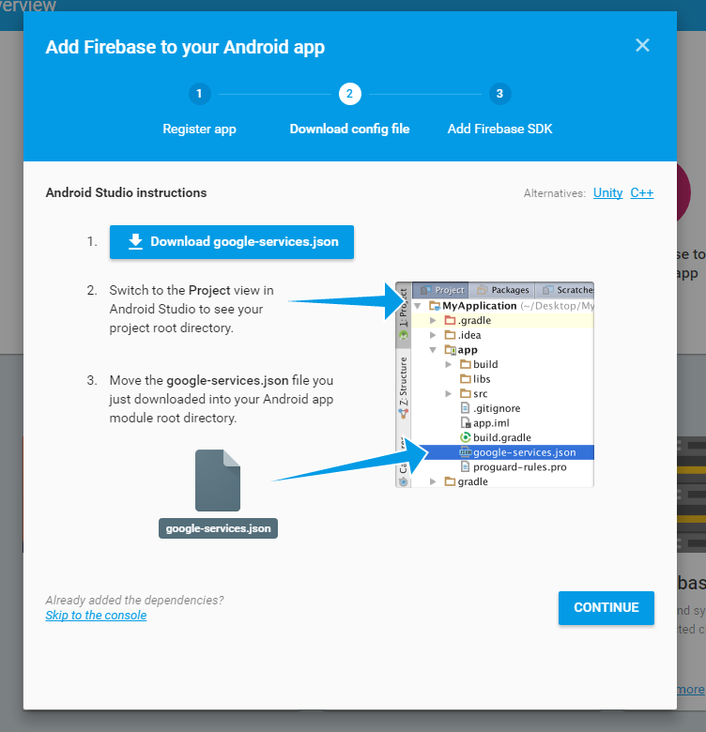

Slide 10
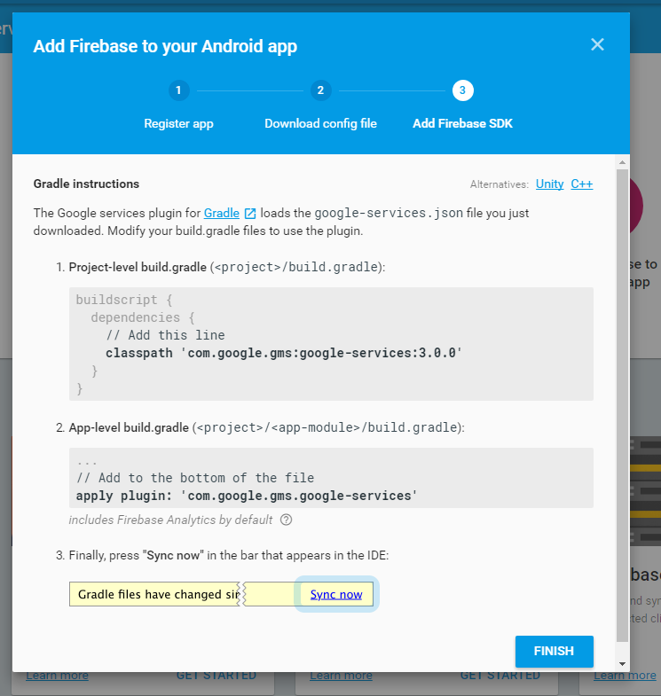

Slide 11
Note
Gradle
Project file
Add classpath 'com.google.gms:google-services:4.3.15' to the dependencies
Module file
Firebase pieces
implementation 'com.google.firebase:firebase-analytics:21.2.0' //may not need.
implementation 'com.google.firebase:firebase-messaging:23.1.1'
implementation "androidx.work:work-runtime:2.7.1" //for long run jobs.
implementation 'com.android.volley:volley:1.2.1'
//https://developer.android.com/training/volley/
Add to the bottom of the file after the }
apply plugin: 'com.google.gms.google-services'

Slide 12
Setup
We need to setup the FirebaseMessageingService.
It provides the token we need
We need to save this token for long term use.
And the it's where messages are received.
public class MyFirebaseMessagingService extends FirebaseMessagingService {
@Override
public void onNewToken(String token) {
super.onNewToken(token);
//we need to store the token for later use.
}
This is called when we get a new push message.
@Override
public void onMessageReceived(RemoteMessage remoteMessage) {
Log.d(TAG, "From: " + remoteMessage.getFrom());
String message = remoteMessage.getData().toString();
}
}

Slide 13
Setup (2)
To receive console messages as well as cloud messages, the onMessageReceived need to handle it.
String message = remoteMessage.getData().toString();
getData should have the data we need, but when sending from the console, it's in getBody, so this is accounting for the possibilities.
if (message.compareTo("{}") != 0) { //none empty message
Log.d(TAG, "Notification Message Data: " + message);
} else {
//console push message.
message = remoteMessage.getNotification().getBody();
Log.d(TAG, "Notification Message Body: " + message);
}

Slide 14
The Rest
The rest involves getting the devices Token, so you can send messages to them.
Or sending to all.
For that we need rest service to hold the "name" and token.
And we can use the rest service to send the messages to the cloud as well.

Slide 15
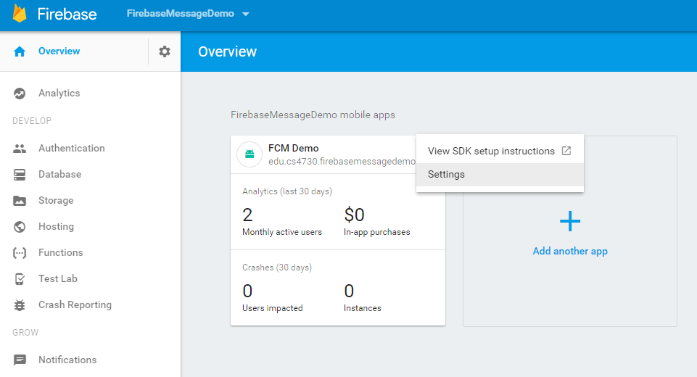
Project ID
To do this, we need the project ID from the cloud messaging:

Slide 16
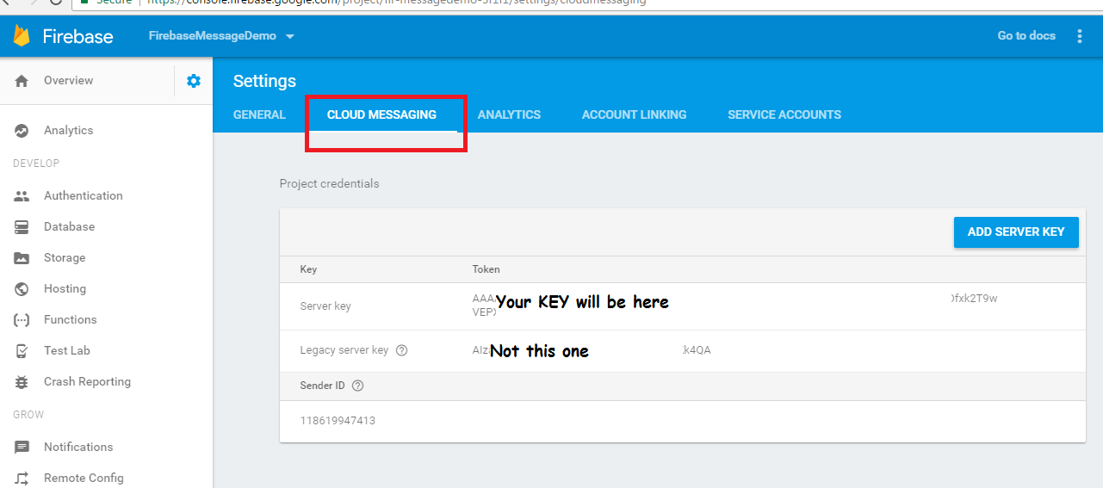
Project ID (2)

Slide 17
The Code
https://github.com/JimSeker/googleplayAPI FirebaseMessageDemo
We take a look at the server side code
Which is all php
And then send message code for android as well.

Slide 18
Reference
https://firebase.google.com/docs/cloud-messaging/
All the documentation and some howtos.
https://www.simplifiedcoding.net/firebase-cloud-messaging-tutorial-android/
Basic howto receive a cloud message.
https://www.simplifiedcoding.net/firebase-cloud-messaging-android/
Send and receive individual messages
https://www.androidtutorialpoint.com/firebase/firebase-cloud-messaging-tutorial/
Sending a message again. This site has a lot more on firebase usage, including database, analysis, and authentication.
https://www.androidtutorialpoint.com/firebase/firebase-android-tutorial-getting-started/ (authentication).
https://cloud.google.com/tools/android-studio/quickstart
Backend google cloud module, which is not covered in this lecture. But maybe useful to you.

Slide 19
Q
A
&

