Slide 1
Cosc 5/4735
Google Fit

Slide 2
Google Fit SDK
Easily view available sensor data sources from connected apps and devices with the Sensors API
Connect your app and devices to Google Fit with the Recording API.
Access and edit the user's fitness history with the History API.

Slide 3
Responsible use of Google Fit
As a developer of fitness and wellness apps, you often collect and manage important user information. Keep these key principles in mind:
Always clearly explain to the user what data you will collect and why.
Honor user requests to delete their data.
If you read fitness data from Google Fit, you must also write the fitness data you collect to Google Fit.
Do not use Google Fit APIs for non-fitness purposes, such as storing medical or biometric data, selling data, or using data for advertising.
Carefully review the Google Fit Terms and Conditions before using Google Fit.
By using the API, you agree to the Google Fit Terms and Conditions.
*Copied directly from Google Fit pages.

Slide 4
Overview
an open ecosystem that allows developers to upload fitness data to a central repository where users can access their data from different devices and apps in one location:
Fitness apps can store data from any wearable or sensor.
Fitness apps can access data created by any app.
User's fitness data is persisted when they upgrade their fitness devices.
Note: The Google Fit app uses the Google Fit platform, which is included in Google Play services. Your fitness or wellness app can use the Google Fit platform without requiring users to install the Google Fit app.

Slide 5
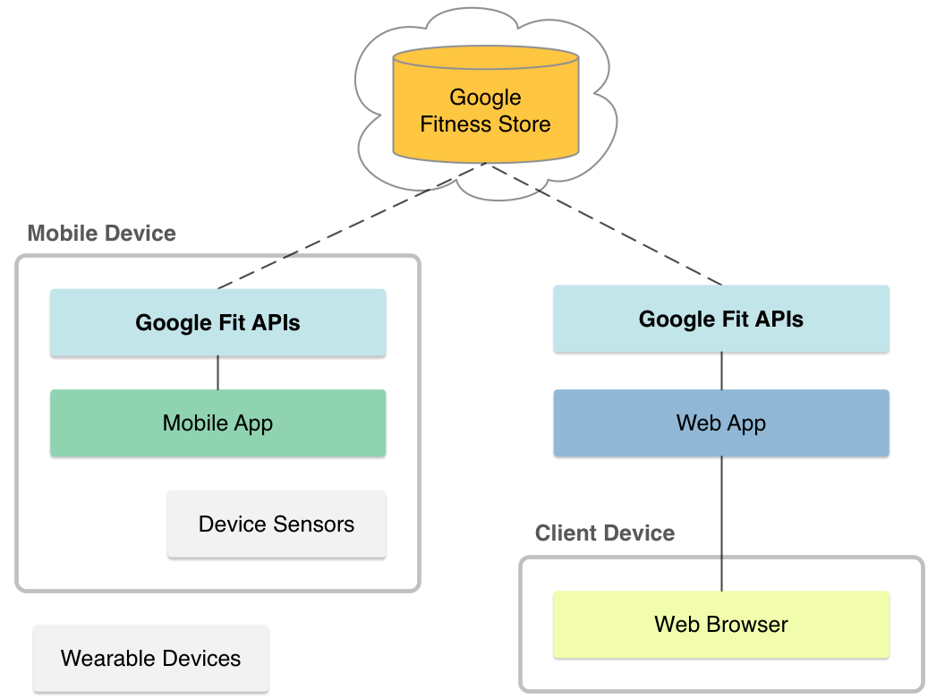
Components
Fitness store
Sensor framework
Permissions and user controls
Google Fit APIs
Both android and REST APIs

Slide 6
Components (2)
The fitness store
The fitness store is a cloud service that persists fitness data using Google's infrastructure.
Apps on different platforms and devices can store data and access data created by other apps.
Google Fit provides a set of APIs that make it easy to insert data and query the fitness store.
Permissions and user controls
Google Fit requires user consent before apps can read or store fitness data.
Google Fit defines OAuth scopes that map to three permission groups with separate read and write privileges: activity, location, and body.
Each permission group grants apps access to a set of data types.
Apps specify one or more of these scopes to work with fitness data, and Google Fit requests the corresponding permissions from the user.

Slide 7
API 29+
Starting in android 10, API 29, you also need the activity_recognition permission manifest file, plus ask for permission as well.
Otherwise, you can't record data or use sensor data.
<uses-permission android:name="android.permission.ACTIVITY_RECOGNITION"/>

Slide 8
The sensor framework
The sensor framework defines high-level representations for sensors, fitness data types, data points, and sessions. These representations make it easy to work with the fitness store on any platform.
Data Sources
represent sensors and consist of a name, the type of data collected, and other sensor details.
A data source may represent a hardware sensor or a software sensor. You can define software sensors in your apps.
Data Types
represent different kinds of fitness data, like step count or heart rate.
Data types establish a schema through which different apps can understand each other's data.
A data type consists of a name and an ordered list of fields, where each field represents a dimension.
For example
a data type for location contains three fields (latitude, longitude, and accuracy)
a data type for weight contains only one field.

Slide 9
The sensor framework (2)
Data Points
consist of a timestamped array of values for a data type, read from a data source.
You use data points to record and insert fitness data in the fitness store, and to read raw data from a data source.
Points that contain a start time represent a time range instead of an instantaneous reading.
Datasets
represent a set of data points of the same type from a particular data source covering some time interval.
You use datasets to insert data into the fitness store.
Queries to read data from the fitness store also return datasets.
Sessions
represent a time interval during which users perform a fitness activity, such as a run, a bike ride, and so on.
Sessions help organize data and perform detailed or aggregate queries on the fitness store for a fitness activity.

Slide 10
Android APIs
Part of the Google Play Services (API 9+) Overview
Google Fit on Android consists of these APIs
The Sensors Client provides access to raw sensor data streams
The Recording Client provides automated storage of fitness data using subscriptions
The History Client provides access to the fitness history and lets apps perform bulk operations
The Sessions Client provides functionality to store fitness data with session metadata
Note covered here
The Bluetooth Sensors provides access to Bluetooth Low Energy sensors in Google Fit
The Config Client provides custom data types and additional settings for Google Fit.
The Goals Client which allows you to work the users fitness goals.
Intro video https://youtu.be/jwaQaWGLlTo the API shown are out of date and don’t work.

Slide 11
OAuth 2.0 Client ID
To use the Google Fit for Android, you need an OAuth 2.0 client ID for Android applications.
Note, the user will still have to log into the google fit account, which is independent of this.
See https://developers.google.com/fit/android/get-api-key#release-cert to setup one.
Note, google will want to review you fit app, but it can do anything. You can add test accounts that allow you test and work on your app via https://console.cloud.google.com/apis/credentials/consent

Slide 12
Sensor Client

Slide 13
Sensor Client setup
In the build.grade (module)
Add
compile 'com.google.android.gms:play-services-fitness:21.1.0'
compile 'com.google.android.gms:play-services-auth:21.4.1'
Androidmanifest.xml add
<uses-permission android:name="android.permission.ACCESS_FINE_LOCATION" />
<uses-permission android:name="android.permission.ACTIVITY_RECOGNITION"/>

Slide 14
Sensor Client setup (2)
Google login and Oauth, not listed here.
First find the datasources (say step counter)
On success there, now setup a listener for it.

Slide 15
Find data sources
Fitness.getSensorsClient(requireActivity(), GoogleSignIn.getLastSignedInAccount(getContext()))
.findDataSources(
new DataSourcesRequest.Builder()
//.setDataTypes(DataType.TYPE_STEP_COUNT_DELTA)
.setDataTypes(DataType.TYPE_STEP_COUNT_CUMULATIVE)
.setDataSourceTypes(DataSource.TYPE_RAW)
.build())
.addOnSuccessListener(
new OnSuccessListener<List<DataSource>>() {
@Override
public void onSuccess(List<DataSource> dataSources) {
for (DataSource dataSource : dataSources) {
Now we have a data sources, and we can setup a listener to receive data from it.
There are lots of datatypes: https://developers.google.com/android/reference/com/google/android/gms/fitness/data/DataType#field-summary

Slide 16
Listeners for data sources
First we need a listener
mlistener = new OnDataPointListener() {
@Override
public void onDataPoint(DataPoint dataPoint) {
//Note, we are not on the UI thread!
for (Field field : dataPoint.getDataType().getFields()) {
Value val = dataPoint.getValue(field);
Log.i(TAG, "Detected DataPoint field: " + field.getName());
Log.i(TAG, "Detected DataPoint value: " + val);}
}
};

Slide 17
Listeners for data sources (2)
Fitness.getSensorsClient(getActivity(), GoogleSignIn.getLastSignedInAccount(getContext()))
.add(new SensorRequest.Builder()
.setDataSource(dataSource) // Optional but recommended for custom data sets.
.setDataType(dataType) // Can't be omitted.
.setSamplingRate(10, TimeUnit.SECONDS)
.build(),
mlistener)
.addOnCompleteListener(
new OnCompleteListener<Void>() {
@Override
public void onComplete(@NonNull Task<Void> task) {
if (task.isSuccessful()) {
}
}
});

Slide 18
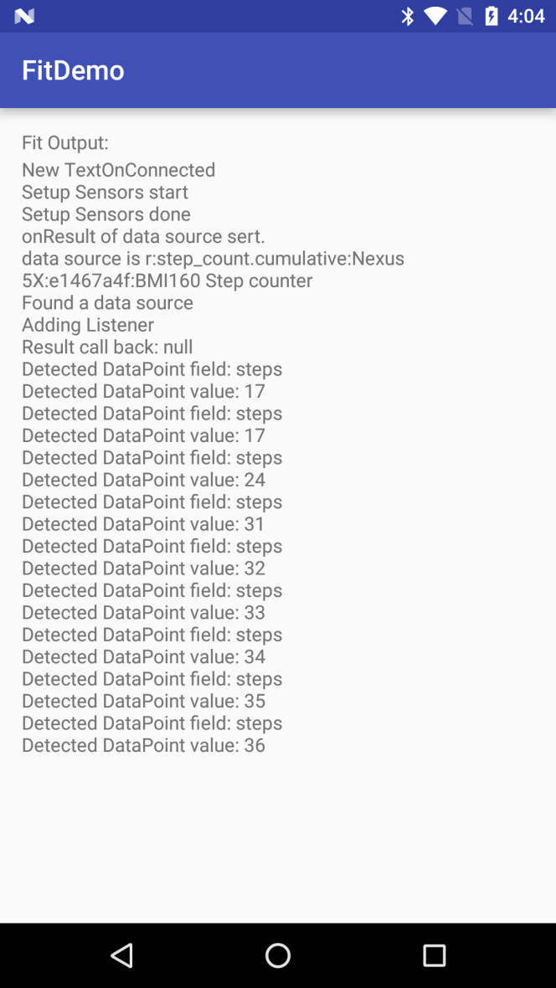
FitDemo
The sensor API are added for a step count
The Delta never reported any data, so using cumulative instead.

Slide 19
A note
Using the ActivityRecognition API and Fit together
May get better results on what the user is doing.

Slide 20
Recording Client

Slide 21
Recording Client
The Recording Client differs from the Sensors Client in that live sensor data is not delivered to the Recording Client, but rather data is saved online in order to save a record of user activity.
If you want to show data in realtime and record it, you would use both the Record and Sensor Clients together.
This lecture shows them separately.

Slide 22
Setup
As before the app needs the Oauth 2.0 client ID
FitnessOptions fitnessOptions =
FitnessOptions.builder().addDataType(DataType.TYPE_STEP_COUNT_DELTA).build();
// Check if the user has permissions to talk to Fitness APIs, otherwise authenticate the
// user and request required permissions.
if (!GoogleSignIn.hasPermissions(GoogleSignIn.getLastSignedInAccount(getContext()), fitnessOptions)) {
GoogleSignIn.requestPermissions(
this,
REQUEST_OAUTH,
GoogleSignIn.getLastSignedInAccount(getContext()),
fitnessOptions);
} else {
//call subscribe code
}

Slide 23
To subscribe
Subscribe to the DataType, in our case Steps and with success and failure.
Fitness.getRecordingClient(getActivity(), GoogleSignIn.getLastSignedInAccount(getContext()))
.subscribe(DataType.TYPE_STEP_COUNT_DELTA)
.addOnSuccessListener(new OnSuccessListener<Void>() {
@Override
public void onSuccess(Void aVoid) {
//Subscribed to the Recording
}
})
.addOnFailureListener(new OnFailureListener() {
@Override
public void onFailure(@NonNull Exception e) {
//failed to subscribe to the Recording
}
});

Slide 24
To disconnect
unubscribe to the DataType, in our case Steps and with success and failure.
Fitness.getRecordingClient(getActivity(), GoogleSignIn.getLastSignedInAccount(getContext()))
.unsubscribe(DataType.TYPE_STEP_COUNT_DELTA)
.addOnSuccessListener(new OnSuccessListener<Void>() {
@Override
public void onSuccess(Void aVoid) {
//success, we are unsubscribed.
}
})
.addOnFailureListener(new OnFailureListener() {
@Override
public void onFailure(@NonNull Exception e) {
// Subscription not removed
}
});

Slide 25
Listing Subscriptions
You can also list all the apps current subscriptions
Fitness.getRecordingClient(getActivity(), GoogleSignIn.getLastSignedInAccount(getContext()))
.listSubscriptions(DataType.TYPE_STEP_COUNT_DELTA)
.addOnSuccessListener(new OnSuccessListener<List<Subscription>>() {
@Override
public void onSuccess(List<Subscription> subscriptions) {
for (Subscription sc : subscriptions) {
DataType dt = sc.getDataType();
log.d(TAG, "Active subscription for data type: " + dt.getName());
}
}
});

Slide 26
History Client

Slide 27
History Client
While the Sensors and Recording Clients are for gathering data, the history Client are about accessing the stored data
The app can access, analyze, and change data.
As Note, since the data is being accessed in the “cloud”, in order to use it. All callbacks will off the main thread.
Bareware of changing the widgets and UI objects.

Slide 28
Working with History
Use the History Client to:
Read fitness data that was inserted or recorded using other apps.
Import batch data into Google Fit.
Update data in Google Fit.
Delete data that your app previously stored in the fitness history.

Slide 29
setup
We'll need Oauth as well as permission
So we will sign in and ask fit/user for WRITE for the data types we are working with.
FitnessOptions.builder()
.addDataType(DataType.TYPE_STEP_COUNT_DELTA, FitnessOptions.ACCESS_WRITE)
.addDataType(DataType.AGGREGATE_STEP_COUNT_DELTA, FitnessOptions.ACCESS_WRITE)
.build();

Slide 30
Reading Data
We can make a request for todays data and/or make a request for a timeframe of data
Daily:
Fitness.getHistoryClient(getActivity(), GoogleSignIn.getLastSignedInAccount(getContext()))
.readDailyTotal(DataType.TYPE_STEP_COUNT_DELTA)
.addOnSuccessListener(new OnSuccessListener<DataSet>() {
@Override
public void onSuccess(DataSet dataSet) {
Log.i(TAG, "Reading History API results for today");
showDataSet(dataSet); //note we no NOT on the UI thread.
}
})
.addOnFailureListener(new OnFailureListener() {
@Override
public void onFailure(@NonNull Exception e) {
Log.i(TAG, "Failed to read DailyTotal for Steps.");
}
});

Slide 31
DataSet
dataSet.getDataType().getName() for the name for the set (if there is one
Normally loop though it to get the datapoints
for (DataPoint dp : dataSet.getDataPoints())
Then DataPoint has the following
dp.getDataType().getName()
dp.getStartTime(TimeUnit.MILLISECONDS))
dp.getEndTime(TimeUnit.MILLISECONDS))
A set of Fields for the datatype, so generally we can look it them like this:
for (Field field : dp.getDataType().getFields()) {
Log.w(TAG, "Field: " + field.getName() +
" Value: " + dp.getValue(field));
}

Slide 32
Reading Data (2)
Timeframe data requests
DataReadRequest readRequest = new DataReadRequest.Builder()
.aggregate( DataType.TYPE_CALORIES_EXPENDED, DataType.AGGREGATE_CALORIES_EXPENDED)
.bucketByActivityType(1, TimeUnit.SECONDS)
.setTimeRange(startTime, endTime, TimeUnit.MILLISECONDS)
.build(); //note, demo code use step count.
Fitness.getHistoryClient(getActivity(), GoogleSignIn.getLastSignedInAccount(getContext()))
.readData(readRequest)

Slide 33
Reading Data (3)
.addOnSuccessListener(new OnSuccessListener<DataReadResponse>() {
@Override
public void onSuccess(DataReadResponse dataReadResponse) {
// Get a list of the sessions that match the criteria to check the result. Used for aggregated data
if (dataReadResponse.getBuckets().size() > 0) {
sendmessage("Number of buckets: " + dataReadResponse.getBuckets().size());
for (Bucket bucket : dataReadResponse.getBuckets()) {
List<DataSet> dataSets = bucket.getDataSets();
for (DataSet dataSet : dataSets) { showDataSet(dataSet); }
}
//Used for non-aggregated data
} else if (dataReadResponse.getDataSets().size() > 0) {
sendmessage("Number of returned DataSets: " + dataReadResponse.getDataSets().size());
for (DataSet dataSet : dataReadResponse.getDataSets()) { showDataSet(dataSet); }
}
}
})
.addOnFailureListener(new OnFailureListener() {
@Override public void onFailure(@NonNull Exception e) { Log.e(TAG, "Failed to read DataResponse."); }
});

Slide 34
Inserting data
First a DataSet needs be created and then it can be “inserted” to Google Fit.
Example here is for step count
DataSource dataSource = new DataSource.Builder()
.setAppPackageName(this)
.setDataType(DataType.TYPE_STEP_COUNT_DELTA)
.setStreamName(" step count")
.setType(DataSource.TYPE_RAW)
.build();
int stepCountDelta = 10000; //we'll add 10,000 steps for yesterday.
For each data point, specify a start time, end time, and the data value -- in this case, the number of new steps.
DataPoint point = DataPoint.builder(dataSource)
.setTimeInterval(startTime, endTime, TimeUnit.MILLISECONDS)
.setField(Field.FIELD_STEPS, stepCountDelta)
.build();
Now add each DataPoint to the a DataSet
DataSet dataSet = DataSet.builder(dataSource)
.add(point)
.build();
Be sure to limit each individual request to 1000 data points. Exceeding this limit could result in an error.

Slide 35
Inserting data (2)
Now insert it into Google Fit
Fitness.getHistoryClient(getActivity(), GoogleSignIn.getLastSignedInAccount(getContext()))
.insertData(dataSet)
.addOnSuccessListener(new OnSuccessListener<Void>() {
@Override
public void onSuccess(Void aVoid) {
// At this point, the session has been inserted and can be read.
}
})
.addOnFailureListener(new OnFailureListener() {
@Override
public void onFailure(@NonNull Exception e) {
//error inserting.
}
});

Slide 36
Inserting data (3)
Each DataPoint must a have unique time interval (startTime and endTime)
There can be no overlap
If your app attempts to insert a new DataPoint that conflicts with an existing DataPoint instance, the new DataPoint is discarded.
To insert a new DataPoint that may overlap existing data points, use the .updateData method instead.

Slide 37
Updating dataSet
Use the same process as before to create the dataSet
Then create an updateRequest
DataUpdateRequest updateRequest = new DataUpdateRequest
.Builder()
.setDataSet(dataSet)
.setTimeInterval(startTime, endTime, TimeUnit.MILLISECONDS)
.build();
And then use updateData with the request.
Fitness.getHistoryClient(getActivity(), GoogleSignIn.getLastSignedInAccount(getContext()))
.updateData(updateRequest)
.addOnSuccessListener …

Slide 38
Deleting Data
Setup a DeleteRequest with the time period and data type, then make the delete Data request.
Create a delete request object, providing a data type and a time interval
DataDeleteRequest DeleteRequest = new DataDeleteRequest.Builder()
.setTimeInterval(startTime, endTime, TimeUnit.MILLISECONDS)
.addDataType(DataType.TYPE_STEP_COUNT_DELTA)
.build();

Slide 39
Deleting Data (2)
Make the request
Fitness.getHistoryClient(getActivity(), GoogleSignIn.getLastSignedInAccount(getContext()))
.deleteData(request)
.addOnCompleteListener(
new OnCompleteListener<Void>() {
@Override
public void onComplete(@NonNull Task<Void> task) {
if (task.isSuccessful()) {
//success
} else {
//failed.
} } });

Slide 40
Session API
The Sessions API enables your app to create sessions in the fitness store using real time data or data you previously collected using the Sensors API
For ongoing fitness activities where the user notifies your app when he or she starts and finishes a fitness activity, you can create sessions in real time.
You can also insert a session into the fitness store after a fitness activity finished, or when you are importing data and sessions from outside Google Fit.
The example code Session does this.

Slide 41
Session Client
For an ongoing fitness in real time
Subscribe to fitness data with the Recording.subscribe method.
Start a session with the Sessions.startSession method when the user initiates the fitness activity.
Stop the session with the Sessions.stopSession method when the user ends the fitness activity.
Unsubscribe from fitness data you are no longer interested in with the RecordingApi.unsubscribe method.

Slide 42
A last note.
It appears that the play-services-fitness is being replaced by the health connect in androidx/jetpack.
it's still in a alpha version, but some fit methods are showing deprecated saying to use health connect instead.
https://developer.android.com/guide/health-and-fitness/health-connect
https://github.com/android/health-samples/tree/main/health-connect

Slide 43
References
https://developers.google.com/fit/
Note, many of the videos are out of date and the API has changed.
https://github.com/googlesamples/android-fit do work however.
http://code.tutsplus.com/tutorials/google-fit-for-android-an-overview--cms-25466
http://code.tutsplus.com/tutorials/google-fit-for-android-reading-sensor-data--cms-25723

Slide 44
Q
A
&

