Slide 1
Cosc 5/4735
Google VR (gvr)
CardBoard
With OpenGL

Slide 2
CardBoard and DayDream
Most of the setup is covered the by "GVR"
Google VR (which is both Cardbard and DayDream)
So I cover most of the setup as the same thing and at the end of lecture talk about differences
One note:
Cardboard is API 19+
Daydream is API 24+ and only available on a small number of phones. to the pixel 3. daydream is dead at this point. the hardware was discontinued and not supported in pixel4 onward.

Slide 3
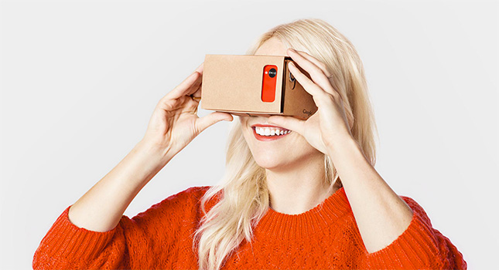
GVR
GVR allows most phones be to used with a Cardboard or Daydream VR devices.
Some phones will not work (like moto G), because they are missing accelerometer/gyroscope.

Slide 4
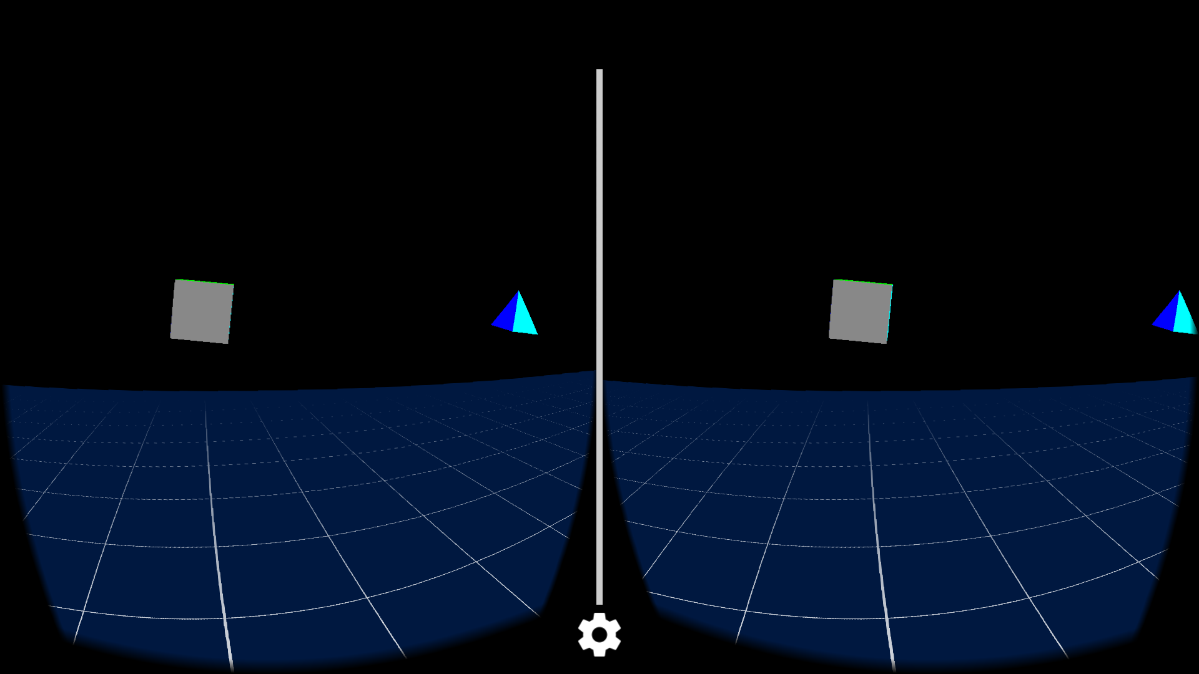
Basics
Using a layout and overlay, you split the screen in two and project objects on both but slightly off from each other to get a 3D effect with the lens.

Slide 5
Setup Guide
For this lecture, we are looking at with Android and OpenGL 2.0/3.X
You can do most of by importing their sample at
https://github.com/googlevr/gvr-android-sdk
To setup you own.
Create an empty project with a blank activity.
Add the follow to dependencies of module
compile 'com.google.vr:sdk-base:1.190.0' //only one needed as of 190, but before need more.
compile 'com.google.vr:sdk-audio:1.180.0' //if you want sound.
compile 'com.google.vr:sdk-common:1.180.0' * note, version 1.200.0 (the last version) is actually broken, likely intentional.
Edit the manfiest.xml file (next slide)
Edit the layout (3 slides down)
Change activity to GvrActivity

Slide 6
AndroidManifest.xml
Cardboard needs the following permissions:
<uses-permission android:name="android.permission.NFC" />
<uses-permission android:name="android.permission.VIBRATE" />
<uses-permission android:name="android.permission.READ_EXTERNAL_STORAGE" />
<uses-permission android:name="android.permission.WRITE_EXTERNAL_STORAGE" android:maxSdkVersion="28" />
Files are for Cardboard SDK to pair the user’s phone with the VR viewer
Vibrate is the allow feed back by the app.
OpenGL Change to 2000 if you want to use v2.0
<uses-feature
android:glEsVersion="0x00030000"
android:required="true" />

Slide 7
AndroidManifest.xml
Add an intent filter, so the Cardboard app can launch it as well.
And kept the phone in landscape mode.
<activity android:name=".MainActivity“
android:screenOrientation="landscape"
android:configChanges="orientation|keyboardHidden|screenSize">
<intent-filter>
<action android:name="android.intent.action.MAIN" />
<category android:name="com.google.intent.category.CARDBOARD" />
<category android:name="android.intent.category.LAUNCHER" />
</intent-filter>
</activity>

Slide 8
Layout File
Basic version:
The cardboard view and fill the screen.
< com.google.vr.sdk.base.GvrView
android:id="@+id/cardboard_view"
android:layout_width="fill_parent"
android:layout_height="fill_parent"
android:layout_alignParentTop="true"
android:layout_alignParentLeft="true" />
We can also add Google’s cardbardOverlayoutview to display text.
Note this comes from their sample code and is not part of the gvr package.

Slide 9
MainActivity
Change to Activity and setup the view
import com.google.vr.sdk.base.GvrActivity; import com.google.vr.sdk.base.GvrView;
public class MainActivity extends GvrActivity { //note fragments and everything is possible here.
protected void onCreate(Bundle savedInstanceState) {
super.onCreate(savedInstanceState);
setContentView(R.layout.Main_layout);
setup the gvrview and set the renderer for it.
GvrView gvrView = (GvrView) findViewById(R.id.cardboard_view);
gvrView.setRenderer(new myStereoRenderer());
setGvrView(cardboardView);
…
}
Like OpenGL examples before, we need a renderer, this one is for Stereo.

Slide 10
Stereo Renderer
Implement a GvrView.StereoRenderer
Similar to a Renderer
Override OnsurfaceCreated, and onSurfaceChanged
Adds
public void onNewFrame(HeadTransform headTransform)
Prepares variables before we draw a frame.
headTransform is The head transformation in the new frame. We can get the headview matrix to determine which way user is facing.
public void onDrawEye(Eye eye)
We the frame is drawn and Eye.getEyeView() gives us eye transformation to the camera
public void onFinishFrame(Viewport viewport)
A last frame finish, so move the camera (I think). It’s not documented.

Slide 11
Stereo Renderer (2)
Any objects like cubes and pyramids from previous openGL examples would be declared in the SurfaceCreated
Then drawn in the OnDrawnEye
We just drawn the objects like normal, the API handles the two views.

Slide 12
CardBoard
GVR

Slide 13
Button
The CardBoardVR unit provides a single button
Either a touch or NFC (depends are the headset)
It’s all handled by an listener in the GvrActivity
@Override
public void onCardboardTrigger() {
Log.i(TAG, "onCardboardTrigger");
}
}

Slide 14
Text and Overlay.
A CardboardOverlayView.java is provided in the sample code.
It can be used to display text to the user.
Copy the java code into your project
The default layout is relative, add CardboardOverlayView to fill the screen as well.
See sample code for example.
In MainActivity:
overlayView = (CardboardOverlayView) findViewById(R.id.overlay);
To use it:
overlayView.show3DToast(“Hi there!.");

Slide 15
Example code
FloatingCube is the OpenGL cube example, setup in the cardboard
FloatingCubes is has 4 cubes and 4 pyramids floating around the user.
FlyAroundAcube allows the user to “fly” by clicking the button to start moving.
It works in the X and Z plane, but not well with X Y plane.

Slide 16
Daydream
GVR

Slide 17
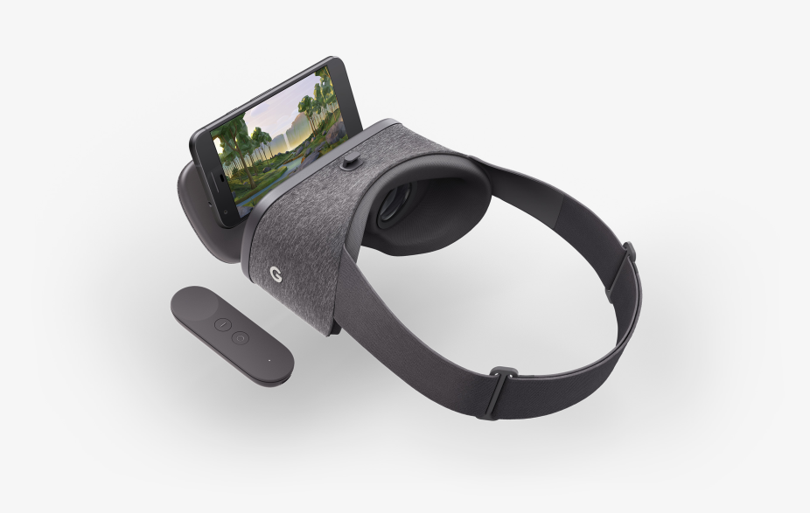
Daydream VR
Daydream works on a very small set of phones
hardware has been discontinued in 2019.
Includes a controller.
Note there is no "button" on the device like cardboard.

Slide 18
Note Daydream
Since daydream headset doesn't use the button/trigger
You will get an error if you include onCardboardTrigger() and use app in daydream device.
You can't mix and match headset devices within the same activity.
You would need 1 activity for daydream and another to handle cardboard.
But you can use the daydream controller without the headset.

Slide 19
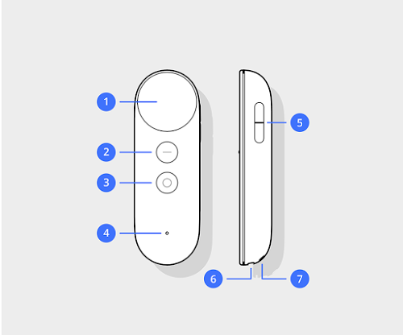
Daydream Controller
touchpad swipe and press click
App button (app defined)
Home button
Status light
Volume up/down buttons

Slide 20
Add to the dependencies
In the module gradle add the following:
180 and before use this
compile 'com.google.vr:sdk-controller:1.180.0'
Otherwise 190+
implementation 'com.google.vr:sdk-base:1.190.0'

Slide 21
Redirecting controller events.
If you are not using the VR, but using the controller
Need to "fake" the VR with the following statement
AndroidCompat.setVrModeEnabled(this, true);

Slide 22
Connecting controller
Start the ControllerManager and acquire a Controller object which represents a single physical controller.
We receive all events from the Controller through this listener. (user defined)
EventListener listener = new EventListener();
controllerManager = new ControllerManager(this, listener);
Bind our listener to the ControllerManager and Controller.
controller = controllerManager.getController();
controller.setEventListener(listener);

Slide 23
EventListener
class EventListener extends Controller.EventListener implements ControllerManager.EventListener {
Then override the following as needed.
public void onApiStatusChanged(int state)
public void onConnectionStateChanged(int state)
public void onRecentered()
public void onUpdate()

Slide 24
onUpdate()
Likely the most important. The controller has registered a "change"
As Note, we use the controller variable as declared before.
As first thing in onUpdate is call this:
controller.update();
Otherwise you never see the update information.
The following boolean variables for buttons:
controller.appButtonState, controller.homeButtonState,
controller.clickButtonState, controller.volumeUpButtonState,
controller.volumeDownButtonState

Slide 25
onUpdate() (2)
For touch
Boolean controller.isTouching
Then these give the location:
controller.touch.x and controller.touch.y
controller.clickButtonState is for the click, but when you click, you are also touching.

Slide 26
Example code
The CardBoard Vr repo
cardboardSample has the google example setup and running.
The DayDreamControllerDemo
Shows how to use the controller (without VR)
it's in the legacy directory of the repo.

Slide 27
References
https://developers.google.com/vr/
https://developers.google.com/vr/cardboard/overview
https://developers.google.com/vr/daydream/overview
As note, the pages, may not completely match the sample code.
The code is updated more often then the webpages.
and all of this is deprecated as of 2021. for a new C++ ndk version, which only sort of works.

Slide 28
cardboard NDK.
there is no java/kotlin version for the NDK. you write c++ library code, which is then loaded by the activity and runs.
but there is a unity version, which looks to be pretty well supported.
https://github.com/googlevr/cardboard
you need to have the whole sdk in your project, then build it
replace their example with your code? in the project?
also appears to use vulkan instead of opengl.
also uses the old vision API to find qr codes.
It is likely that the cardboard NDK is dead ish.
the only updates seem to be vulkan shader fixes.
no other active development in 2 years.

Slide 29
Q
A
&

