Slide 1
Cosc 5/4735
Android Nearby API
Message and Connection

Slide 2
Nearby Connections

Slide 3
Nearby Connections.
Nearby Connections is a peer-to-peer networking API that allows apps to easily discover, connect to, and exchange data with nearby devices in real-time, regardless of network connectivity
Some example use cases:
Collaborative whiteboard: Jot ideas down with nearby participants on a shared virtual whiteboard.
Local multiplayer gaming: Set up a multiplayer game and invite other users nearby to join.
Multi-screen gaming: Use a phone or tablet as a game controller to play games displayed on a nearby large-screen Android device, such as Android TV.
Offline file transfers: Share photos, videos, or any other type of data quickly and without requiring a network connection.
Under the hood, the API uses a combination of Bluetooth, BLE, and Wifi hotspots.
Neither the user nor programmer needs to think about what is used. Nearby does work for you.

Slide 4
Basics
One (or more) device will "advertise". It will wait for a connection
Effectively you can think of it as server in a client server model. But it's more complex then that.
One or more devices will use "discovery" mode to find and connect to the advertised device(s).
Effectively a client.
both will now initiate a connection and accept a connection (the more complex part)
Now they can both send and receive data.

Slide 5
Basics (2)
Exchanging Data
They can each 1 of three types of data
BYTES a Byte array limited to 32K.
For simple messages
FILE which his a file of any size.
STREAM
Which very general, could be a stream you create or could something like a audio/video stream.
One they are done, both disconnect
Which will end any wifi hotspots created by nearby and return the device to original wifi.

Slide 6
Permissions
Nearby Connections requires the following permission
<uses-permission android:name="android.permission.BLUETOOTH" />
<uses-permission android:name="android.permission.BLUETOOTH_ADMIN" />
<uses-permission android:name="android.permission.ACCESS_WIFI_STATE" />
<uses-permission android:name="android.permission.CHANGE_WIFI_STATE" />
<uses-permission android:name="android.permission.ACCESS_COARSE_LOCATION" />
<uses-permission android:name="android.permission.ACCESS_FINE_LOCATION" />
Android Q onward needs coarse is replaced by fine
Only required for apps targeting Android 12 and higher
<uses-permission android:name="android.permission.BLUETOOTH_SCAN" />
<uses-permission android:name="android.permission.BLUETOOTH_ADVERTISE" />
<uses-permission android:name="android.permission.BLUETOOTH_CONNECT" />
13 and above also needs.
<uses-permission android:name="android.permission.NEARBY_WIFI_DEVICES"/>
Note, you will also need to ask for coarse or fine location, since it is a "dangerous system permission".

Slide 7
Choose a Strategy.
There are two STRATEGY provided. Both work to about ~100m.
P2P_STAR
1 to many or star shaped. It uses wifi hotspots, Bluetooth and BLE for the communication.
Higher bandwidth then cluster.
P2P_CLUSTER
A Peer to peer, Supports a M to N, or cluster-shaped. For more flexible then STAR
uses only Bluetooth and BLE for communication so lower communications speed.

Slide 8
setup
Add nearby to gradle
implementation 'com.google.android.gms:play-services-nearby:18.3.0'
Or higher.
Choose a "User Nick name"
A simple name that identifies you app and is shown as a short name.
Choose a ServiceID
This needs to a unique identifier for you service.
Normally your package name will works, so my example is "edu.cs4730.nearbyconnectiondemo"

Slide 9
Advertising
The code itself is pretty simple:
Nearby.getConnectionsClient(getContext())
.startAdvertising(
UserNickName, //human readable name for the endpoint.
ServiceId, //unique identifier for advertise endpoints
mConnectionLifecycleCallback, //callback notified when remote endpoints request a connection to this endpoint.
new AdvertisingOptions(STRATEGY))

Slide 10
Callback: ConnectionLifecycleCallback
Both advertise and discovery use the same callback method.
Public void onConnectionInitiated( …)
A device has initiated a connection to us.
Do we accept or reject
If accept setup the payloadcallback to receive data.
public void onConnectionResult ( …)
Successfully connected, rejected, or an error
public void onDisconnected( …)
If connected, then called when it has been disconnected.
If on success connection, we may choose to stop advertising as well or we can accept multiple connections.

Slide 11
Accept and PayloadCallback
We accept the connection and create callback to handle data sent to use.
Nearby.getConnectionsClient(getContext()).acceptConnection(endpointId,
new PayloadCallback() {
@Override public void onPayloadReceived(String endpointId, Payload payload) {
if (payload.getType() == Payload.Type.BYTES) { String stuff = new String(payload.asBytes());
} else if (payload.getType() == Payload.Type.FILE)
else if (payload.getType() == Payload.Type.STREAM) //payload.asStream().asInputStream()
}
@Override public void onPayloadTransferUpdate(String endpointId, PayloadTransferUpdate payloadTransferUpdate) {
//if stream or file, we need to know when the transfer has finished. ignoring this right now.
}
});

Slide 12
Sending data.
To send data, we need to know the endpointID, which is passed at the accept.
And use the sendpayload method
Payload payload = Payload.fromBytes(data.getBytes());
Nearby.getConnectionsClient(getContext()).
sendPayload(ConnectedEndPointId, //end point to send to
payload) //the actual payload of data to send.
If sending to multiple
sendPayload (List<String> endpointIds, Payload payload)

Slide 13
Discovery
Like advertise, we start a discovery mode for the serviceID, which returns an endpoint that we initiate a connection to.
Nearby.getConnectionsClient(requireContext()). startDiscovery(
ServiceId, //id for the service to be discovered. ie, what are we looking for.
new EndpointDiscoveryCallback() { //callback when we discovery that endpoint.
@Override public void onEndpointFound(String endpointId, DiscoveredEndpointInfo info) {
//we found an end point now make a initiate a connection to it.
}
@Override
public void onEndpointLost(String endpointId) {
//lost an end point.
}
},
new DiscoveryOptions(STRATEGY)) //options for discovery.

Slide 14
Discovery initiate connection.
Request a connection with the endpoint name
Nearby.getConnectionsClient(getContext())
.requestConnection(
UserNickName, //if null, uses the devices name
endpointId,
mConnectionLifecycleCallback)
Where the callback is the same as before.

Slide 15
Transfer data
Transfer data as necessary.
For file and stream data, you will need to use the onPayloadTransferUpdate to track if the transfer is IN_PROGRESS or finished.
BYTES doesn't require it, since it is small enough.

Slide 16
Disconnect and stop X
When done you need to disconnect
Nearby.getConnectionsClient(getContext()).disconnectFromEndpoint(ConnectedEndPointId);
Stop advertising or discovery
Nearby.getConnectionsClient(getContext()).stopAdvertising() ;
Nearby.getConnectionsClient(getContext()).stopDiscovery();
Note this use about twice as much battery, so in onStop() you should stop and disconnect as well, since the app is in the background.

Slide 17
Nearby Messages

Slide 18
Nearby Messages
A device "publishes" a message. Which is a payload and a token.
The publishing device will use a combination of Bluetooth, Bluetooth Low Energy, Wi-Fi and an ultrasonic modem to make the token detectable by nearby devices.
Another device "subscribes" with the same technology with a token
If in range it will receive the message/payload.
We maybe able to find an approximate distance to a message beacon.

Slide 19
Get started.
We will need to get an API key for this.
Follow directions here
https://developers.google.com/nearby/messages/android/get-started
When the app first starts it will ask for permissions.
Note, we won't have any in the manifest file.

Slide 20
Publish a message.
First we need a message, this is a simple one
mActiveMessage = new Message("Hello World".getBytes());
They can be more complex, basically location info, websites, etc.
Nearby.getMessagesClient(getActivity()).publish(mActiveMessage);
To unpublish a message
Nearby.getMessagesClient(getActivity()).unpublish(mActiveMessage);

Slide 21
Subscribe for messages.
Just as easy.
To save power
SubscribeOptions options = new SubscribeOptions.Builder()
.setStrategy(Strategy.BLE_ONLY)
.build();
To subscribe:
Nearby.getMessagesClient(getActivity()).subscribe(mMessageListener, options);

Slide 22
MessageListener
Basic messag listener is this:
MessageListener mMessageListener = new MessageListener() {
@Override
public void onFound(Message message) {
logthis("Found message: " + new String(message.getContent()));
}
@Override
public void onLost(Message message) {
logthis("Lost sight of message: " + new String(message.getContent()));
}

Slide 23
MessageListener (2)
For distance information we can add to more methods and only for ble messages
@Override
public void onBleSignalChanged(final Message message, final BleSignal bleSignal) {
logthis( "Message: " + message + " has new BLE signal information: " + bleSignal);
}
@Override
public void onDistanceChanged(final Message message, final Distance distance) {
logthis( "Distance changed, message: " + message + ", new distance: " + distance);
}

Slide 24
unsubscribe
unsubscribe:
Nearby.getMessagesClient(getActivity()).unsubscribe(mMessageListener);

Slide 25
Background subscription
You can setup a background subscription with a broadcast receiver.
Which you register and unregister in the app.
You can statically register them in the manifest.xml file.
See the code.

Slide 26
Beacons
fully depreciated and shutdown (google console even) by April 2021. Left only as intro demo for fall 2020.

Slide 27
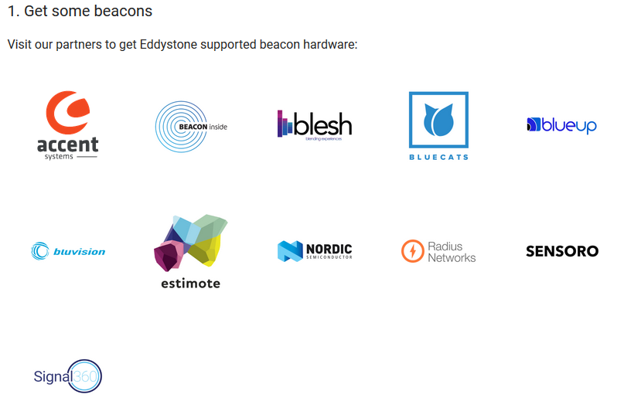
Beacons
https://developers.google.com/nearby/notifications/get-started
About $12 to $50 per beacon.
You can use beacons instead of a device to broadcast a message.
And register them with google so nearby will know the "locations" as well.
This allow for more marketing or directions.

Slide 28
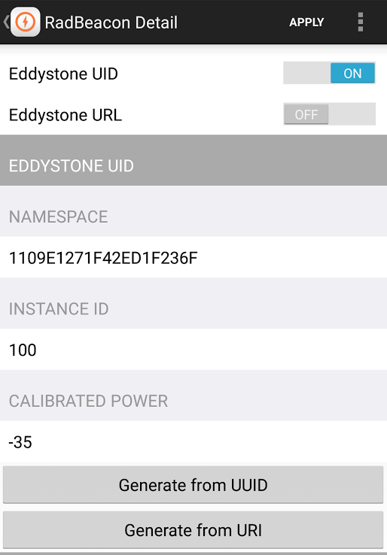
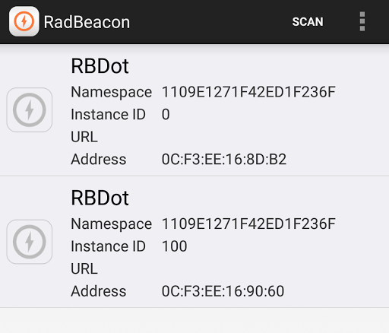
Beacons
After up get a couple of them.
Configure the beacons.
Must have a UID (or EID if available)

Slide 29
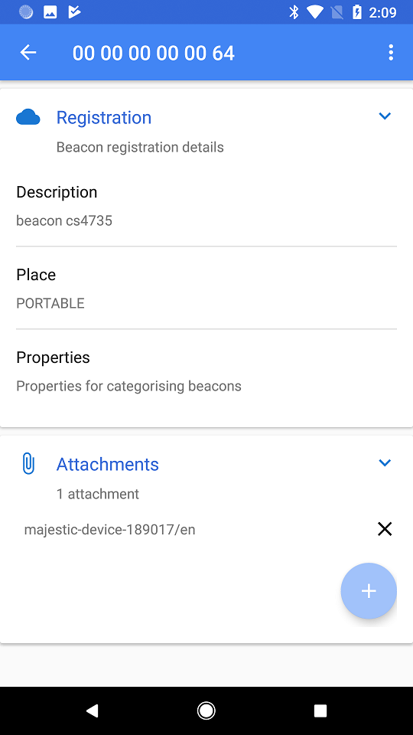
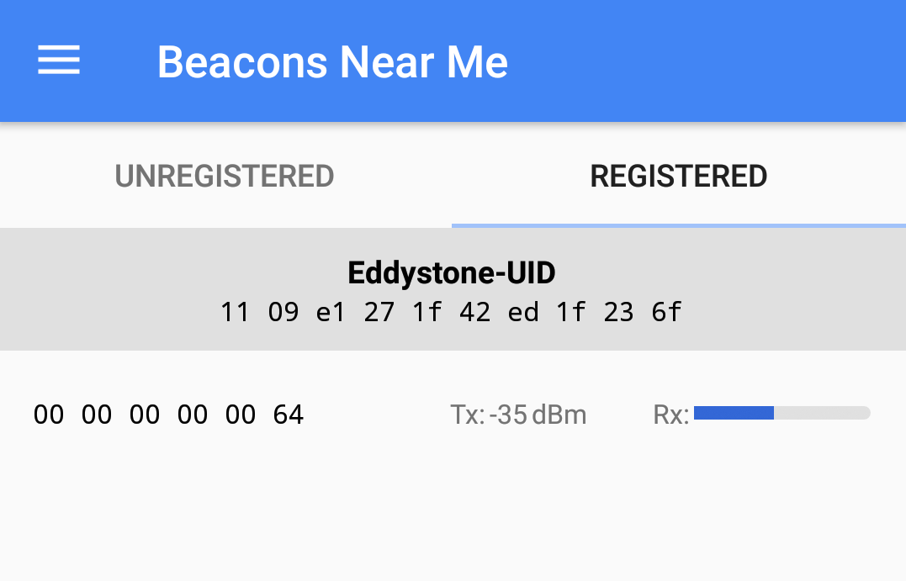
Beacons (2)
Use the Beacon Tools app (by Google) to register it.
Note must be registered to a google project (in the dashboard)
Give the beacon a name, etc.

Slide 30
Beacons (3)
Go to the google beacon dashboard
Configure it and it's ready.
For message for your app to read, set an attachment

Slide 31
Beacons (4)
For a Nearby Notification that most phones can see (Android 4.4+ and iphone)

Slide 32
Q
A
&

