Slide 1
Cosc 4735
OpenGL ES 2.0 and 3.0
A basic guide.

Slide 2
OpenGL 3.0
OpenGL 3.0 is derived from v2.0
V2.0 is fully usable in 3.0
For this lecture, I’m going to use 3.0 examples though.

Slide 3
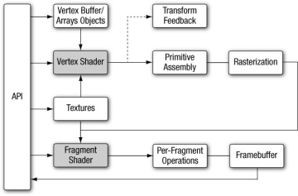
Basics
We provide the Vertex Buffers, a Vertex Shader, and a Fragment Shader
Using the API we can then “draw”

Slide 4
Vertex Shader
The vertex shader implements a general-purpose programmable method for operating on vertices.
The inputs to the vertex shader consist of the following:
Shader program—Vertex shader program source code or executable that describes the operations that will be performed on the vertex.
Vertex shader inputs (or attributes)—Per-vertex data supplied using vertex arrays.
Uniforms—Constant data used by the vertex (or fragment) shader.
Samplers—Specific types of uniforms that represent textures used by the vertex shader

Slide 5
Vertex Shader (2)
1. #version 300 es
2. uniform mat4 u_mvpMatrix; // matrix to convert a_position
3. // from model space to normalized
4. // device space
5.
6. // attributes input to the vertex shader
7. in vec4 a_position; // position value
8. in vec4 a_color; // input vertex color
9.
10. // output of the vertex shader - input to fragment
11. // shader
12. out vec4 v_color; // output vertex color
13. void main()
14. {
15. v_color = a_color;
16. gl_Position = u_mvpMatrix * a_position;
17. }
Line 1 provides the version of the Shading Language—information that must appear on the first line of the shader (#version 300 es indicates the OpenGL ES Shading Language v3.00).
Line 2 describes a uniform variable u_mvpMatrix that stores the combined model view and projection matrix.
Lines 7 and 8 describe the inputs to the vertex shader and are referred to as vertex attributes. a_position is the input vertex position attribute and a_color is the input vertex color attribute.
On line 12, we declare the output v_color to store the output of the vertex shader that describes the per-vertex color. The built-in variable called gl_Position is declared automatically, and the shader must write the transformed position to this variable. A vertex or fragment shader has a single entry point called the main function.
Lines 13–17 describe the vertex shader main function.
In line 15, we read the vertex attribute input a_color and write it as the vertex output color v_color.
In line 16, the transformed vertex position is output by writing it to gl_Position.

Slide 6
Fragment Shader
The fragment shader implements a general-purpose programmable method for operating on fragments
the shader is executed for each generated fragment by the rasterization stage and takes the following inputs:
Shader program—Fragment shader program source code or executable that describes the operations that will be performed on the fragment.
Input variables—Outputs of the vertex shader that are generated by the rasterization unit for each fragment using interpolation.
Uniforms—Constant data used by the fragment (or vertex) shader.
Samplers—Specific types of uniforms that represent textures used by the fragment shader.

Slide 7
Fragment Shader
1. #version 300 es
2. precision mediump float;
3.
4. in vec4 v_color; // input vertex color from vertex shader
5.
6. out vec4 fragColor; // output fragment color
7. void main()
8. {
9. fragColor = v_color;
10. }
This is a very simple version. That sets the color as we specified it. For color changing or light effects, we would need a more complex version.
line 1 provides the version of the Shading Language; this information must appear on the first line of the fragment shader (#version 300 es indicates the OpenGL ES Shading Language v3.00).
Line 2 sets the default precision qualifier
Line 4 describes the input to the fragment shader. The vertex shader must write out the same set of variables that are read in by the fragment shader.
Line 6 provides the declaration for the output variable of the fragment shader, which will be the color passed on to the next stage.
Lines 7–10 describe the fragment shader main function. The output color is set to the input color v_color.
The inputs to the fragment shader are linearly interpolated across the primitive before being passed into the fragment shader.

Slide 8
Writing OpenGL code.
MainActivity and Oncreate()
setContentView(new myGlSurfaceView(this));
MyGLSurfaceView
Setups and calls the renderer. Also deals with any touch events.
Renderer
Actually implements the surfaceview parts and Draws the frame

Slide 9
GLSurfaceView
Pretty simple code, mostly setup
public class myGlSurfaceView extends GLSurfaceView {
myRenderer myRender;
public myGlSurfaceView(Context context) {
super(context);
setEGLContextClientVersion(3); //using OpenGL ES 3.0
super.setEGLConfigChooser(8 , 8, 8, 8, 16, 0); //note 16 is the depth,
// Set the Renderer for drawing on the GLSurfaceView
myRender = new myRenderer(context);
setRenderer(myRender);
// Render the view only when there is a change in the drawing data
setRenderMode(GLSurfaceView.RENDERMODE_CONTINUOUSLY);
}
public boolean onTouchEvent(MotionEvent e) { … } //as needed

Slide 10
Renderer
Where the drawing actually happens.
public class myRenderer implements GLSurfaceView.Renderer {
// Initialize the shader and program object
@Override
public void onSurfaceCreated(GL10 glUnused, EGLConfig config) {
//setup clear buffer, set the clear buffer color to light gray.
GLES30.glClearColor(0.9f, .9f, 0.9f, 0.9f);
//initialize any objects for drawing
}
@Override
public void onSurfaceChanged(GL10 glUnused, int width, int height) {
// Set the viewport
GLES30.glViewport(0, 0, width, height);
float aspect = (float) width / height;
// this projection matrix is applied to object coordinate no idea why 53.13f, it was used in another example and it worked.
Matrix.perspectiveM(mProjectionMatrix, 0, 53.13f, aspect, Z_NEAR, Z_FAR);
}
@Override
public void onDrawFrame(GL10 glUnused) {
// Clear the color buffer set above by glClearColor.
GLES30.glClear(GLES30.GL_COLOR_BUFFER_BIT | GLES30.GL_DEPTH_BUFFER_BIT);
…
}

Slide 11
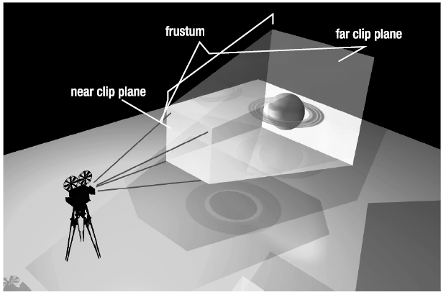
Viewing Frustum and Projection Matrix

Slide 12
Renderer and drawing
We are going to create Model-view-projection matrix in the in the drawing and pass that information to the shaders.
Always remember:
If you need to rotate an object around it’s axis and move it.
Translate first
Then rotate it. Otherwise you some strange results.
Rotate, then translate causes the object to move in another direction that is based on the rotate.
Which may actually be what you want.
You should be able to scale at any point.

Slide 13
OnDrawFrame
Most of the time, you have a series of “objects” to draw. Such as cubes, pyramids, etc.
First create the Model-view-projection matrix for the object. Then call the class object for it.
all the code to draw the object is located in one place, the object’s class.
That way you can easily have 8 cubes (for example) in different places.
Or the code for each object class can create it’s own MVP matrix, based on “setters” called to the object.

Slide 14
Object code
Object classes
Contain the vertices of the object
Based on the origin (ie 0,0,0)
Vertex and Fragment Shader used for that object
Draw method
That actually draws the object.
It’s called from OnDrawFrame
With the MVP matrix, unless the object handles it.
See the cube or pyramid example to see how it is all put together.

Slide 15
Object code (2)
OpenGL doesn’t use standard float, instead it uses a FloatBuffer
so most of the time, you create the array of floats and then translate it to a FloatBuffer
Example:
FloatBuffer mVertices;
Float[] mVerticesData = new float[] { …};
mVertices = ByteBuffer
.allocateDirect(mVerticesData.length * 4)
.order(ByteOrder.nativeOrder())
.asFloatBuffer()
.put(mVerticesData);
mVertices.position(0);

Slide 16
References
Large amount of information was taken from the OpenGL 3.0 Programming Guide 2rd.
This online guide maybe very helpful. It’s for openGL 2.0, but 3.0 is backward comp.
http://www.learnopengles.com/android-lesson-one-getting-started/

Slide 17
Q
A
&

