Slide 1
Cosc 5/4735
OpenGL ES

Slide 2
Introduction with android
OpenGL

Slide 3
OpenGL ES
GL was first developed by SGI as a priority graphics language
OpenGL was developed initially by SGI and working group of other people in 1992.
Open GL is used from games to supercomputers
OpenGL and OpenGL ES are managed by a consortium, called the Khronos group.
OpenGL ES (Embedded Systems) is a subset of OpenGL intended for devices like mobile phones.

Slide 4
Open GL ES (2)
OpenGL ES 1.0 had much functionality stripped from the original OpenGL API and a little bit added. Two of the more significant differences between OpenGL ES and OpenGL are the removal of the glBegin ... glEnd calling semantics for primitive rendering (in favor of vertex arrays) and the introduction of fixed-point data types for vertex coordinates and attributes to better support the computational abilities of embedded processors, which often lack an FPU.
OpenGL ES 1.1 adds to the OpenGL ES 1.0 functionality by introducing additional features such as mandatory support for multitexture, better multitexture support (with combiners and dot product texture operations), automatic mipmap generation, vertex buffer objects, state queries, user clip planes, and greater control over point rendering.
OpenGL ES 2.0, publicly released in March 2007^{[1]}, eliminates most of the fixed-function rendering pipeline in favor of a programmable one. Almost all rendering features of the transform and lighting pipelines, such as the specification of materials and light parameters formerly specified by the fixed-function API, are replaced by shaders written by the graphics programmer. As a result, OpenGL ES 2.0 is not backwards compatible with OpenGL ES 1.1.

Slide 5
Android Device support.
OpenGL ES 1.0 and 1.1
This API specification is supported by Android 1.0 and higher.
OpenGL ES 2.0
This API specification is supported by Android 2.2 (API level 8) and higher.
2.0 is NOT backward compatible with 1.1
OpenGL ES 3.0 - This API specification is supported by Android 4.3 (API level 18) and higher.
Backward compatible to 2.0 (and not to 1.1).
ES 3.0 API requires a device implementation provided by manufacturer, Not all support 3.0+
To check the version see
http://developer.android.com/guide/topics/graphics/opengl.html#version-check
OpenGL ES 3.1 - This API specification is supported by Android 5.0 (API level 21) and higher.

Slide 6
This lecture
Since openGL ES usages is the same across platforms, so even though we are covering android, this will basically work on IOS as well.
This is also not a graphics course. To cover OpenGL requires a great deal of time, which is provided in the Graphics course, which spends the most of course covering OpenGL.
I cover the basics later in the lecture.

Slide 7
Android
Provides two ways to render OpenGL
Based on API 1, extend a SurfaceView
Start a OpenGL thread, where all OpenGL calls must be called
initialize the EGL
Initialize GL
now start drawing
This is actually how it was still done with many devices, like a blackberry
Based on API 5+ We’ll focus on this for android
extend/instantiate a GLSurfaceView and extend /implement a GLSurfaceView.Rendener
start drawing.

Slide 8
Example
public class OpenGlDemo extends Activity {
public void onCreate(Bundle savedInstanceState) {
super.onCreate(savedInstanceState);
GLSurfaceView view = new GLSurfaceView(this);
view.setRenderer(new OpenGLRenderer());
OpenGLRenderer is a class that implements Renderer
setContentView(view);
}
}

Slide 9
GLSurfaceView
The API class in Android that helps you write OpenGL ES applications.
Providing the glue code to connect OpenGL ES to the View system.
Providing the glue code to make OpenGL ES work with the Activity life-cycle.
Making it easy to choose an appropriate frame buffer pixel format.
Creating and managing a separate rendering thread to enable smooth animation.
Providing easy-to-use debugging tools for tracing OpenGL ES API calls and checking for errors.

Slide 10
Renderer
GLSurfaceView.Renderer is a generic render interface. In your implementation of this renderer you should put all your calls to render a frame. There are three functions to implement:
Called when the surface is created or recreated.
public void onSurfaceCreated(GL10 gl, EGLConfig config)
A place to setup things that don't change over rendering cycles
Called to draw the current frame.
public void onDrawFrame(GL10 gl)
this is where the drawing actually takes place
Called when the surface changed size.
public void onSurfaceChanged(GL10 gl, int width, int height)
called if the devices changes from landscape to portrait or back again.

Slide 11
OpenGL 2.0
Works similar (except not compatible with 1.1)
Get the GLSurfaceView (or extend it)
setEGLContextClientVersion(2);
Create a render
import android.opengl.GLES20;
The variable/parameters GL10 are unused and switch to GLES20. It just exists, instead of being passed to the methods.
Now use the 2.0 methods and the GLES20 variable.

Slide 12
OpenGL 3.0
Is backward compatible with 2.0
Get the GLSurfaceView (or extend it)
setEGLContextClientVersion(3);
Create a render
import android.opengl.GLES30;
The variable/parameters GL10 are unused and switch to GLES30. It just exists, instead of being passed to the methods.

Slide 13
Events
Touch/key events. Make sure these are all handled in the GLSurfaceView
Instead of the activity.

Slide 14
TextureView
API 14+ works with any of the OpenGL versions
Start a OpenGL thread, where all OpenGL calls must be called
initialize the EGL
Initialize GL
now start drawing
No render, but my example code shows how to use one.

Slide 15
See the Demos
OpenGl 1.1, Note these are all legacy code at this point.
OpenGLDemo is Very basic framework. Draws a Square.
OpenGL showing Triangle, cube, lighting.
Vortex has Triangles, with touch events.
Extends the GLSurfaceView instead of implements.
OpenGl 2.0
HelloOpenGLES20 is the basic framework with touch events.
Opengl2ex1 is has render class it sends to default GLSurfaceView
OpenGL 3.0
helloOpenGLES30, Opengl3ex1, and Opengl3ex2 are updated from 2.0 to 3.0, since it is backward compatible.
Opengl3ex3 is native GL ES 3.0 code.
OpenGL30Cube and Pyramid are examples how a how to work with 3D objects.
OpenGL30CubeTextView is OpenGL30Cube using a TextureView.

Slide 16
References
Tutorials:
General OpenGL ES tutorials (25 parts)
A great OpenGL ES Tutorial for Android (5 parts)
http://blog.jayway.com/2009/12/03/opengl-es-tutorial-for-android-part-i/
http://www.droidnova.com/android-3d-game-tutorial-part-i,312.html (7 parts)
http://docs.blackberry.com/en/developers/deliverables/11942/Creating_2-D_and_3-D_graphics_using_OpenGL_ES_944406_11.jsp
JavaDocs
http://java.sun.com/javame/reference/apis/jsr239/
http://developer.android.com/intl/zh-CN/reference/javax/microedition/khronos/opengles/package-summary.html
http://www.blackberry.com/developers/docs/5.0.0api/index.html click on the javax.microedition.khronos.opengls. This has much better descriptions of the methods, then android.
http://en.wikipedia.org/wiki/OpenGL_ES
http://www.khronos.org/opengles/
OpenGL ES Game Development book.
OpenGL ES 3.0 Programming Guide 2rd edition.

Slide 17
References (2)
http://developer.android.com/guide/topics/graphics/opengl.html is pretty good at the basics (combined with the same code)
OpenGl 2.0
http://www.learnopengles.com/android-lesson-one-getting-started/ is a pretty good site and lessons. All examples are in github, so easy to look at and use.
https://github.com/learnopengles/Learn-OpenGLES-Tutorials.git
http://androidblog.reindustries.com/a-real-open-gl-es-2-0-2d-tutorial-part-1/ useful site for examples.
http://developer.android.com/training/graphics/opengl/index.html googles developer training site. Helpful in some cases.

Slide 18
Last Note
OpenGl 1.1 examples will run the emulators
OpenGl 2.0/3.0 examples are supposed to run in the emulators, but even following googles directions, they may sometimes crash.
Several fixes have been added and they mostly work, but may still crash now and again.
You will likely need to test on a device.

Slide 19
the basics
Opengles

Slide 20
Basics
First our program describes some geometry and information on handling lighting, colors, materials, and textures.
This data goes into the pipeline

Slide 21
Basics (2)
Next the data is moved, scaled, and rotated.
Then for each object lighting is calculated and stored.
Example: A solar system
we may move, rotate and scale the model (not the planets, that’s the animation)
Based on our viewpoint, which is based on “rectangular cone” that is limits the scene to a manageable level.

Slide 22
Basics (3)
Next the scene is clipped, so that only the objects that are likely to be visible are processed.
Culling out objects as soon as possible saves processing time.
Continuing the example, if the moon is behind the earth, then we don’t process the moon.
Other planets and moons would also be culled as needed. This also includes “backsides” and “insides” of objects that can be seen as well.

Slide 23
Basics (4)
Next the remaining objects are now “projected” against the “viewport”
The viewport again is cone
Now rasterization takes place, which creates fragments that could be single pixels.
Fragments can have textures and fog effects
More culling may take place for fog that obscures objects.

Slide 24
Basics (5)
And finally any surviving fragments are written to the frame buffer.
Some last minute operations take place as well
Fragment’s values are applied for translucency
Depth tests to ensure closer fragments are written “in front” of further ones
And now you “see” the data.

Slide 25
2D
Well start with 2D drawing
Later on we get to 3D objects.

Slide 26
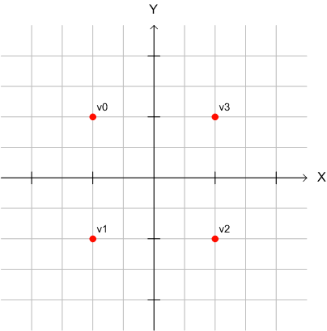
Geometry and describing objects
Let’s start simple and describe a square.
First we describe the object around center point of 0,0
float vertices[] = {
-1.0f, 1.0f, //v0
-1.0f, -1.0f, //v1
1.0f, -1.0f, //v2
1.0f, 1.0f, //v3
};

Slide 27
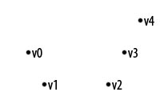
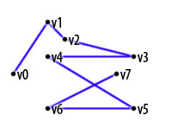
Primitives to render
OpenGL has a lot more primitives, but ES only has the following.
GL_POINTS
Draw individual points to the screen.
GL_LINE_STRIP
Series of connected line segments
Same, with a segment added
first and last vertices

Slide 28
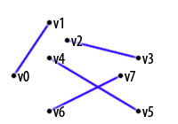
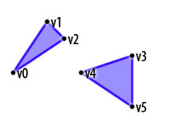
Primitives to render (2)
GL_LINES
Pears of vertices are interpreted as
Individual line segments
GL_TRIANGLES
Triples of vertices interpreted as triangles.

Slide 29
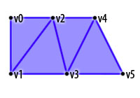
Primitives to render (3)
GL_TRIANGLE_STRIP
Draws a series of triangles (three-sided polygons) using vertices v0, v1, v2, then v2, v1, v3 (note the order), then v2, v3, v4, and so on. The ordering is to ensure that the triangles are all drawn with the same orientation so that the strip can correctly form part of a surface.

Slide 30
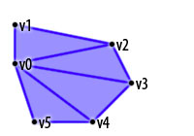
Primitives to render (4)
GL_TRIANGLE_FAN
Same as GL_TRIANGLE_STRIP, except that the vertices are drawn v0, v1, v2, then v0, v2, v3, then v0, v3, v4, and so on.

Slide 31
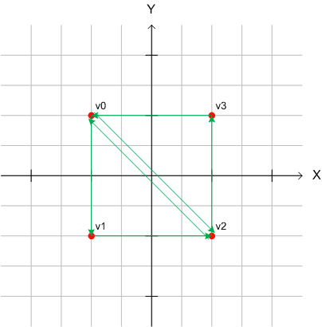
Geometry and describing objects (2)
I want a colored square, so I’m going to use GL_TRIANGLES
could use strip or Fan as well.
We arrays with the vertices in the correct order
Always work in the same order
Counter Clockwise for performance reasons and facing
Or clockwise, but always the same way.

Slide 32
Geometry and describing objects (3)
float[] mVerticesData = new float[]{
-1.0f, 1.0f //v0 tri 1
-1.0f, -1.0f //v1
1.0f, -1.0f //v2
-1.0f, 1.0f //v0 tri 2
1.0f, -1.0f //v2
1.0f, 1.0f //v3
};

Slide 33
Fan and strip
Using the fan and v0 as the initial
List v0, v1, v2, v3
It will generate out the triangles as
v0, v1, v2
V0, v2, v3
Using the strip using v1 as initial
List v1, v2, v0, v3

Slide 34
Circles?
Say we wanted to draw a circle.
How?
A circle outline
Likely use a GL_LINE_STRIP
Shaded circle
Use a GL_TRIANGLE_FAN
Include the first vertex again as the last vertex

Slide 35
Some more complex
Let try a simple stick figure.

Slide 36
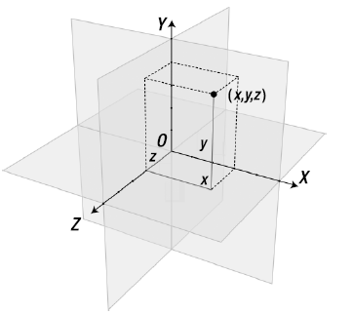
3D
Adding another dimension.
Note:
OpenGL coordinates
0,0,0 is in the “middle”
+y goes up, +x goes right
+z is pointing toward you

Slide 37
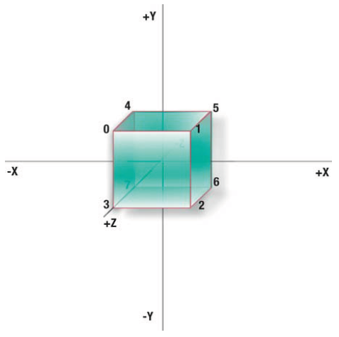
Cube
Using the square from before, now we need to add a z space to it, creating a cube. Plus add the another plane.
float vertices[] = {
-1.0f, 1.0f, 1.0f, //v0
1.0f, 1.0f, 1.0f, //v1
1.0f, -1.0f, 1.0f, //v2
-1.0f, -1.0f, 1.0f, //v3
-1.0f, 1.0f,-1.0f, //v4
1.0f, 1.0f,-1.0f, //v5
1.0f, -1.0f,-1.0f, //v6
1.0f, -1.0f,-1.0f //v7
};

Slide 38
Cube(2)
We can then generate out the vertices in order to create a series of 12 triangles
6 faces, 2 triangles per face
We could generate a triangle fan to cover 5 faces and finish up with a 2 more triangles as the 6 face.
Or we generate 2 triangle_fan.

Slide 39
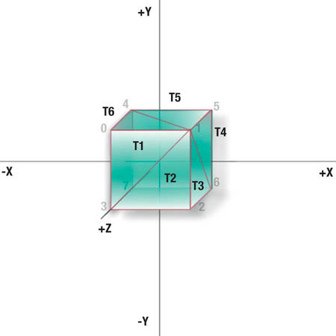
Cube: Triangle_fan
Using two fans, we can generate out the cube
Fan1 Vertices: Fan2 Vertices:
1,0,3 7,4,5
1,3,2 7,5,6
1,2,6 7,6,2
1,6,5 7,2,3
1,5,4 7,3,0
1,4,0 7,0,4

Slide 40
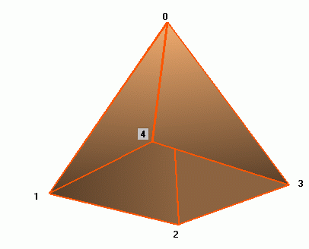
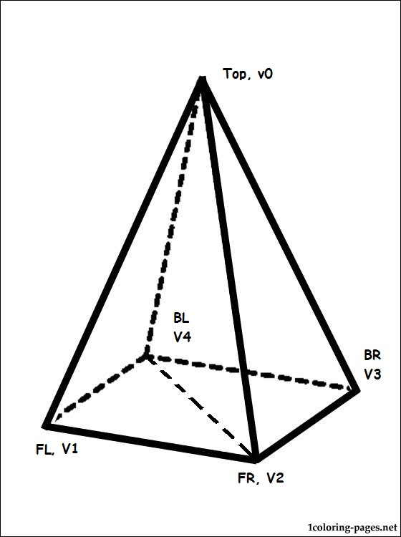
Pyramid
We can draw this in a couple of ways
6 triangles
1 fan and 2 triangles for the base
1 Strip
Order: Front face, Right face, bottom tr1, bottom tr2, Left face, then back.

Slide 41
References
Much of this lecture and examples are taken from
Apress, Pro OpenGL ES for Android, 2012
Addison Wesley OpenGL ES 3.0 Programming guide, 2014

Slide 42
Transformations
A good look at transformations with lots of pictures and diagrams can be found here.
how to understand the coordinate system
moving, scaling, and rotating.
http://blog.jayway.com/2010/01/01/opengl-es-tutorial-for-android-%E2%80%93-part-iii-%E2%80%93-transformations/
Part IV is about colors, which is also a very good read.

Slide 43
Q
A
&

