Slide 1
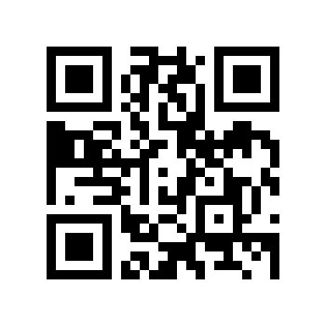
Cosc 5/4730
QR codes

Slide 2
What is QR code?
A QR code (abbreviated from Quick Response code) is a type of matrix barcode (or two-dimensional code) first designed for the automotive industry.
More recently, the system has become popular outside of the industry due to its fast readability and large storage capacity compared to traditional UPC barcodes.
The code consists of black modules arranged in a square pattern on a white background.
The information encoded can be made up of four standardized kinds ("modes") of data (numeric, alphanumeric, byte/binary, Kanji), or by supported extensions virtually any kind of data
From Wikipedia, http://en.wikipedia.org/wiki/QR_code

Slide 3
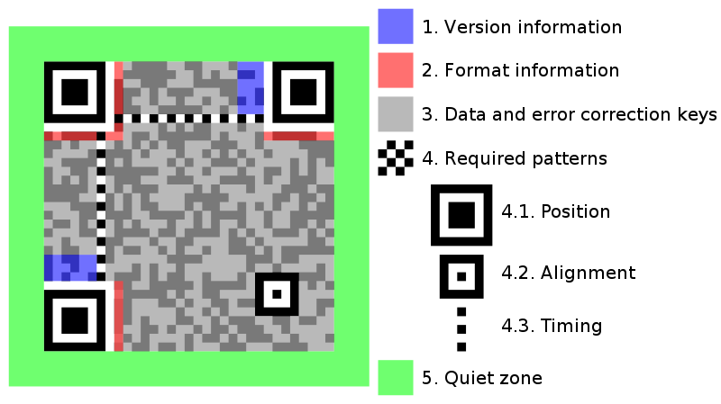
Anatomy of a QR code

Slide 4
QR app’s
The Main api for QR codes comes from the ZXing (“Zebra Crossing”).
https://github.com/zxing/zxing
Android does not have any built-in API (for it’s own code…). Instead you need to install the barcode Scanner+ apk (in the Goolge Play Store and on the zxing website)
Version 4.7.7 (as of Oct 28, 2017)
Note, it used be barcode Scanner, but zxing is maintenance mode only, so there is another group that updated the app, hence the +.
https://github.com/srowen/zxing-bsplus but archived as well.
Note: Vision API can now do QR (and most barcodes) codes also.

Slide 5
Creating QR codes
You can use XYing website to create QR code
http://zxing.appspot.com/generator/

Slide 6
Before anything else!
https://play.google.com/store/apps/details?id=com.srowen.bs.android&hl=en_US
You will need to install the BarcodeScannerX.apk into the simulator
And download it first of course.
Adb.exe install BarcodeScanner4.7.7.apk
this doesn't exist anymore. there is a support scanner replacement. but it is also only in maintenance, not active development.
We’ll use intents to call it.
It should noted, you can also import and use their code
We are not covering this. We’ll use the intents instead.
Their code is pretty easy to follow if you want to use it.

Slide 7
Encoding.
Create the intent and call the activity.
So for a simple one, text encoding.
Intent intent = new Intent( "com.google.zxing.client.android.ENCODE");
intent.putExtra("ENCODE_TYPE", “TEXT_TYPE”);
intent.putExtra("ENCODE_DATA", “http://www.cs.uwyo.edu);
startActivity(intent);
The encoded QR will show on the screen.

Slide 8
Scanning
create an intent, but we’ll need a result.
Intent intent = new Intent( "com.google.zxing.client.android.SCAN");
intent.putExtra("com.google.zxing.client.android.SCAN.SCAN_MODE", "QR_CODE_MODE");
startActivityForResult(intent, 0);

Slide 9
Scanning (2)
Add the onActivityResult method
if (requestCode == 0) { //code used to call Scanner.
if (resultCode == RESULT_OK) {
String contents = intent.getStringExtra("SCAN_RESULT");
String format = intent.getStringExtra( "SCAN_RESULT_FORMAT");
// Handle successful scan
} else if (resultCode == RESULT_CANCELED) {
// Handle cancel
}
}

Slide 10
All well and good, EXCEPT
What happens if the BarcodeScanner app is not installed?
FORCE CLOSE!
But there is code to handle it.
xying has two java class you can add to your project.
IntentIntegrator.java and IntentResult.java

Slide 11
IntentIntegrator
It checks to make sure the app is installed.
If not, then it asks the user to get it from the Market.
Now your code doesn’t force close.
https://github.com/zxing/zxing/wiki/Scanning-Via-Intent

Slide 12
Create with the Integrator
We call the integrator code, which we included in the project
IntentIntegrator integrator = new IntentIntegrator( qrDemoActivity.this);
Where qrDemoActivity is the name of your activity.
integrator.shareText(“http://www.cs.uwyo.edu” );
Again shows the qrCode or an error message if there is a problem with the text.

Slide 13
Scan with the Integrator
Same idea as creating, but again we need a result
IntentIntegrator integrator = new IntentIntegrator(qrDemoActivity.this);
Where qrDemoActivity is the name of your activity.
integrator.initiateScan( IntentIntegrator.QR_CODE_TYPES);
And wait for the result in onActivityResult

Slide 14
Scan with the Integrator (2)
In the onActivityResult method
//code to handle the intentintegrator, then
IntentResult scanResult = IntentIntegrator.parseActivityResult(requestCode, resultCode, intent);
if (scanResult != null) {
// handle scan result
String contents = scanResult.getContents();
if (contents != null) {
logthis("[II] Scan result is "+ scanResult.toString());
} else {
logthis("[II] Scan failed or canceled");
}
} //handle the other result codes as needed.

Slide 15
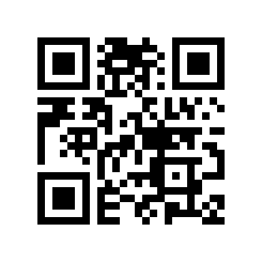
You can use Android qrDemo code
Which is located here:

Slide 16
References
http://zxing.appspot.com/generator
https://github.com/zxing/zxing
https://github.com/zxing/zxing/wiki/Getting-Started-Developing
http://devblog.blackberry.com/2010/10/barcode-api/
http://stackoverflow.com/questions/9795501/how-do-i-use-zxings-qr-barcode-scanner-with-intentintegrator-and-intentresult

Slide 17
Q
A
&

