Slide 1
Cosc 5/4735
Android
SMS and MMS

Slide 2
Introduction
Wireless messaging protocols predate
JavaME, Android, Blackberry
IP over cellular networks (most cell phone networks)
Developed for Pagers and now used for call control.
Wireless Messaging services
Major: SMS, Cell Broadcast (SMS-CB), MMS

Slide 3
SMS
Short message service (ie texting)
Developed in 1985 by Global System for mobile (GSM)
All major terrestrial cellular network support it in some form.
160 characters compressed into 140 bytes
There is a binary format as well (not MMS)
routed by SMS center (SMSC)
No guarantee of delivery.
Can be address to a port (on a device), so different applications can receive the sms message.
CDMA (most north American carriers) may not use port numbers

Slide 4
MMS
Multimedia Messaging Service
Works on top of a number of wireless protocols
SMS or TCP/IP
Uses same ideas as email
message subject, body, multiple messages parts
multiple receipts as well.
Uses MMS Center to route messages.
Problems, not everyone device supports it
Carriers can't agree on MMS, so may not route between Cell Carriers either.

Slide 5
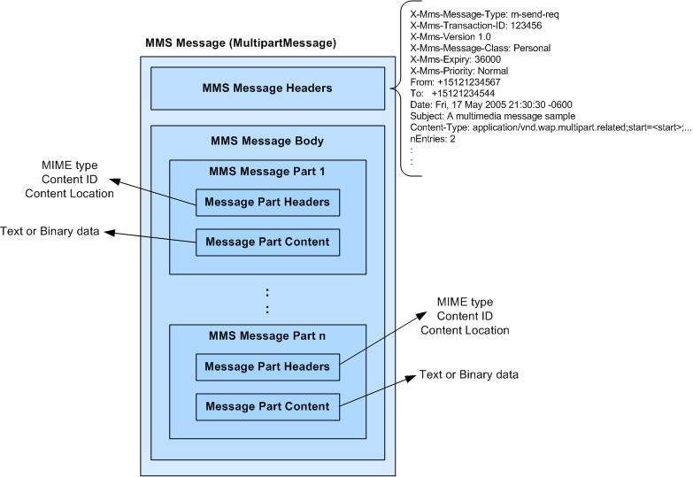
mms message

Slide 6
SMB-CB
Short Message Service Cell Broadcast
Very new, not generally available.
May never be available to general public.
it's a point to area (1 to many) protocol
Allows you send a message to an area (such a geographic region or city)
Weather service, alerts, that sort of thing. (advertizing?)
message is 82 bytes, text or binary
can be concatenated a mechanism to deliver longer messages.

Slide 7
As a side note.
Standard SMS message accept a port number as well as a phone number.
The default is port Zero.
But on other devices you can use your own port number as well, so it would stay off the main sms applications.
Ie a private sms message between applications. The user would never see the messages!
Android does not appear to support port numbers in their sms API.
But port numbers are supported in the binary method.

Slide 8
SMS and KitKat
Android 4.4+
There is a default SMS app now, which can be a third party app.
And only the default SMS app can write directory to the SMS ContentProvider
The other apps will fail silently.
The other apps can send a sms via an intent, which is shown in this lecture.
Any app can still read sms
But can not delete or “alter the flow” of the sms message.

Slide 9
Well cover sending a sms message first
Then broadcast receiver, so we can receive sms messages.
We’ll come back to binary sms methods as well.

Slide 10
A note first
Depending on the API level, an import changes because of a deprecated
API 3 uses
import android.telephony.gsm.SmsManager;
While above, use
import android.telephony.SmsManager;
The change doesn't effect the code, just if the phone supports both GSM and CDMA.
The source code provided, has the gsm line commented out.

Slide 11
emulators
To send/receive sms message between 2 emulators, the "phone number" is the port number of the emulator. (normally 5554 for the first one, 5556 for the second)
remember you need to get the application on both emulators too.
You can also send to the emulator you on by using it’s number, so you don’t need two.
Test with the messaging app, before you test your code to make sure everything is working.
Or use ddms to send sms messages.

Slide 12
Sending a Text message
We get the static method of an SmsManager with getDefault()
We then send the SMS message with PendingIntent
PendingIntenet object is used to identify a target to invoke at a later time.
Can be used to display another activity after we send the message, but in our case, we just point to the same activity.

Slide 13
Sending a Text message (2)
private void sendSMS(String phoneNumber, String message) {
PendingIntent pi = PendingIntent.getActivity(this, 0, new Intent(this, smsDemo.class), 0);
SmsManager sms = SmsManager.getDefault();
sms.sendTextMessage(phoneNumber, null, message, pi, null);
}
Where phoneNumber has the phone number to send to and message is the sms message.

Slide 14
Sending a Text message (3)
If we need to monitor the status of the SMS message sending process
Was there a failure or did the message actually go out.
you can actually use two PendingIntent objects together with two BroadcastReceiver objects
See the Android smsDemo code example.

Slide 15
Receiving sms texts
We extend a broadcast receiver
public class SmsReceiver extends BroadcastReceiver {
@Override
public void onReceive(Context context, Intent intent) {
}
}
Intent Tells you what it is, via the get getAction() method.
The SMS message is contained and attached to the Intent object via a Bundle object.
The messages are stored in an Object array in the PDU format.
To extract each message, you use the static createFromPdu() method from the SmsMessage class.

Slide 16
Receiving an sms message
To receiving incoming SMS messages use a BroadcastReceiver object.
For the code example, I use the receiver tag in the AndroidManifest.xml file.
private static final String ACTION = "android.provider.Telephony.SMS_RECEIVED";
public void onReceive(Context context, Intent intent) {
if(intent.getAction().equals(ACTION)){
//---get the SMS message passed in--
}

Slide 17
SmsMessage
First get the SMS message from the bundle
Bundle bundle = intent.getExtras();
Object[] pdus = (Object[]) bundle.get("pdus");
SmsMessage[] msgs = new SmsMessage[pdus.length];
now pull the message(s) out.
for (int i=0; i<msgs.length; i++){
msgs[i] = SmsMessage.createFromPdu((byte[])pdus[i]);
}
msgs[i].getMessageBody().toString() returns the message
msgs[i].getOriginatingAddress() has the from address

Slide 18
AndroidManifest.xml
We need permissions to send and receive sms message with our app's.
<uses-permission android:name="android.permission.SEND_SMS"/>
<uses-permission android:name="android.permission.RECEIVE_SMS"/>
To setup a receiver for the sms, will also need a tell the OS to send sms messages to the app.
<receiver android:name=".SMSRecv">
<intent-filter>
<action android:name="android.provider.Telephony.SMS_RECEIVED"/>
</intent-filter>
</receiver>
Where SMSRecv is our class this is to receive the sms and this is a static method so once installed, it will receive all sms messages.

Slide 19
AndroidManifest.xml (2)
<manifest package=“edu.cosc4730.smsdemo" … >
<uses-permission android:name="android.permission.SEND_SMS"/>
<uses-permission android:name="android.permission.RECEIVE_SMS"/>
<application … >
<activity android:name=".smsDemo" … >
<intent-filter>
<action android:name="android.intent.action.MAIN" />
<category android:name="android.intent.category.LAUNCHER" />
</intent-filter>
</activity>
<receiver android:name=".SMSRecv">
<intent-filter>
<action android:name="android.provider.Telephony.SMS_RECEIVED"/>
</intent-filter>
</receiver>
</application>
</manifest>

Slide 20
Max length
Text message can be 160 characters. If it’s longer then…
There is a function named divideMessage(string), which will break a message longer then 160 into parts, then you can send it with sendMultipartTextMessage like this:
ArrayList<String> messagelist = sms.divideMessage(message);
sms.sendMultipartTextMessage(phonenumber, null, messagelist, null, null);

Slide 21
SMS folders
The sms folders are dealt with via contentproviders provided.
First you need use-permissions:
android.permission.READ_SMS
Short listing
All: content://sms/all
Inbox: content://sms/inbox
Sent: content://sms/sent
Draft: content://sms/draft
Outbox: content://sms/outbox
Failed: content://sms/failed
Queued: content://sms/queued
Undelivered: content://sms/undelivered
Conversations: content://sms/conversations
Since MMS and SMS are combined in android
content://mms-sms/conversations
See Chapter 9 of Android Pro book for more info.

Slide 22
Binary and port numbers
We can use sendDataMessage,
sendDataMessage (String destinationAddress, String scAddress, short destinationPort, byte[] data, PendingIntent sentIntent, PendingIntent deliveryIntent)
scAddress is the service center address or null to use the current default SMSC.
So we can sendDataMessage(phonenumber, null, (short) PortNumber, data, null, null)
Where data is a byte[] array.

Slide 23
Binary and port numbers (2)
Example:
int MAX_SMS_MESSAGE_LENGTH = 160;
int SMS_PORT = 8091;
SmsManager manager = SmsManager.getDefault();
byte[] data = new byte[message.length()];
for(int index=0; index<message.length() && index < MAX_SMS_MESSAGE_LENGTH; ++index){
data[index] = (byte)message.charAt(index);
}
manager.sendDataMessage(phonenumber, null, (short) SMS_PORT, data,null, null);

Slide 24
Receiving binary
The receiver is just the same, except that you need to convert binary to data.
SmsMessage[] msgs = new SmsMessage[ pdus.length];
msgs[i] = SmsMessage.createFromPdu((byte[]) pdus[i]);
byte[] data = msgs[i].getUserData();
for(int index=0; index<data.length; ++index) {
info += Character.toString((char)data[index]);
}

Slide 25
Receiving binary (2)
The difference is in the manifest
<receiver android:name=".BinarySMSReceiver">
<intent-filter>
<action android:name="android.intent.action.DATA_SMS_RECEIVED"/>
<data android:port="8091"/>
<data android:scheme="sms"/>
</intent-filter>
</receiver>

Slide 26
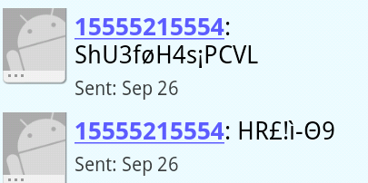
Lastly: Binary, port number
In testing, there were problems.
Some it just didn’t work. Don’t know why.
The binary receiver didn’t always get the message, only the messeger app got it, which displayed the “binary data”.
The emulators sort of worked, but you really need to phones to test with.

Slide 27
Android MMS 4.3 and below
It’s possible with hidden APIs
But there is ZERO documentation on android's development site (at least using their search), code on the web, nor in any android book I have either.
We can do this using an intent though, which is the next slide.
The user will have to hit the send button in the messager app.
These maybe help, but no complete answer:
http://stackoverflow.com/questions/6798730/android-mms-example http://stackoverflow.com/questions/1914456/android-sdk-mms http://stackoverflow.com/questions/6659957/mms-listener-for-android http://stackoverflow.com/questions/6659957/mms-listener-for-android

Slide 28
Intent and MMS android 4.3 and below.
We create an intent that launches the messaging app with the information and the attached “picture”.
Intent sendIntent = new Intent(Intent.ACTION_SEND);
sendIntent.putExtra("address", PhoneNumber);
sendIntent.putExtra("sms_body", "some text");
Note, find your own picture on the system and replace this one.
String url = "file:///sdcard/Download/nasapic.jpg";
sendIntent.putExtra(Intent.EXTRA_STREAM, Uri.parse(url));
sendIntent.setType("image/jpg");
startActivity(sendIntent);

Slide 29
MMS 4.4+
DevBytes: Android 4.4 SMS APIs
http://www.youtube.com/watch?v=mdq0R2WQssQ
http://www.shinobicontrols.com/blog/posts/2014/03/11/bitesize-android-kitkat-week-4-replacing-the-default-sms-app
http://stackoverflow.com/questions/21748209/receive-mms-messages-in-android-kitkat
http://android-developers.blogspot.com/2013/10/getting-your-sms-apps-ready-for-kitkat.html

Slide 30
Reading mms messages.
Ones that already on the device.
Use content://mms-sms/conversations
http://stackoverflow.com/questions/3012287/how-to-read-mms-data-in-android
For the varying “boxes” of mms
https://developer.android.com/reference/android/provider/Telephony.Mms.html

Slide 31
Example code
SmsDemo is a simple sms send/receive
Remember you need two phones or one phone and the ddms to test with
smsDemo2 uses binary data and port numbers
mmsDemo shows how to use an intent to “send” a picture.
It’s a hack and should not be used.

Slide 32
References
http://mobiforge.mobi/developing/story/sms-messaging-android
http://blog.bruary.net/2009/06/android-sms-handling.html
http://stackoverflow.com/questions/990558/android-broadcast-receiver-for-sent-sms-messages
http://developer.android.com/intl/zh-CN/reference/android/telephony/SmsManager.html
http://stackoverflow.com/questions/2726976/how-to-receive-text-sms-to-specific-port

Slide 33
Q
A
&

