Slide 1
Cosc 5/4735
Android Things

Slide 2
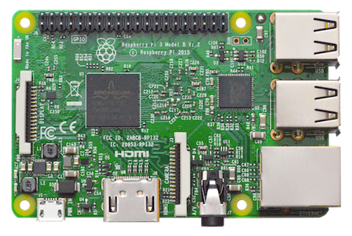
Android Things
It's Android OS designed for the Internet of Things (IoT) devices
  Currently
    Raspberry Pi 3 Model B (~ $35)
    NXP Pico I.MX7D (~$64) , Pico I.MX6UL (~$42)
    Argon i.Mx6UL (Dev or SOM boards are ~$50)
For the purpose of this course
  Raspberry Pi 3 will be used.
  It's more flexible and better supported.

Slide 3
Android things console
Once you have hardware, you need the OS.
https://partner.android.com/things/console/ and login with an account.
  Add a product
  And create the product

Slide 4
Android things console (2)
Select Factory Images
  To start off, select an empty bundle, so you can get the OS for testing. [next]
  Select the current OS version [next]
  Finally name it, and create the build.
    It will take a minute or two for it to build and then you will be able to download the OS.
  Now you can flash the sdcard with the image.
    You can use a sdcard writer like win32 disk imager, insert into Pi and boot.
    You can also use the Androidthings setup utility and follow the Raspberry Pi 3 directions to flash it, reboot.

Slide 5
Bundle
A bundle is a zip file that contains the following:
  bootanimation.zip—Boot animation located in the root directory
  <user-space driver>.apk—User-space driver as a service (action=BOOT_COMPLETED)
  <main>.apk— (Required) The apk for the main entry point (action=MAIN, category=IOT_LAUNCHER)
  <sub>.apk—One of any number of apks that is launched by the main apk
Upload the bundle instead of using an empty bundle
  The "main" app will launch on start up of the device.
To roll OTA updates, it appears you must have bundle.

Slide 6
If a monitor is connect, you will see
With a mouse you can click on the varying devices.
As Note, android Things is API 25+ (0.6.1 is API 27)

Slide 7
Android Studio
The simple way to connect, is to plug the device into the network
You can lookup it ip address on the main screen
At any dos prompt
  adb connect <IP number>
  You will now see the device in Android Studio and the logs will show as well.

Slide 8
Overview
Remember, the UI is optional and things platform is streamlined for a single application use. Not everything is available.
  No status bar or navigation buttons, the app takes the full real estate of the display.
  Don’t use CaldardContract, Contacts, documents, DownloadManager, mediaStore, telephony, userdictionary, etc.
Google services supported
  Awareness, Cost, Firebase (analytics, authentication [no UI auth], cloud message, database, remote config, store), fire, location, maps, nearby (connection and message [no use dialog]), places, mobile vision, and safetynet.
  Reference: https://developer.android.com/things/sdk/index.html

Slide 9
Overview (2)
API additions
  Bluetooth API
    enable access to he pairing and connections process for remote devices and configuration settings.
  Device Updates API
    allows an application to control and monitor applying over the air (OTA) software updates to the device.
  LoWPAN API
    The Low-Power Wireless Personal Area Networks (LoWPAN) APIs enable apps to interact with local devices connected over a wireless personal area network
  User Driver API
    User drivers extend existing Android framework services and allow apps to inject hardware events into the framework that other apps can access using the standard Android APIs.
  Settings API
    Android Things uses three different settings APIs to control settings for the screen (display), system time, and available locales

Slide 10
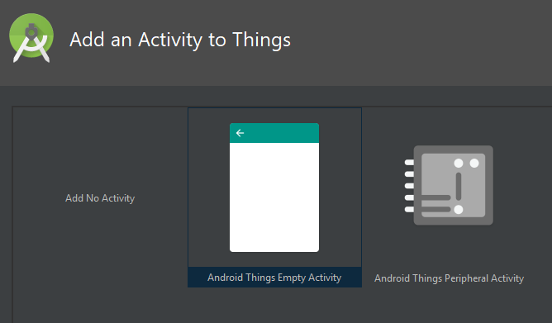
Project
Start a new project
UI no UI, peripheral input only

Slide 11
Side point HATs and peripherals.
Android Things has support for
  Motorhat (complete)
  Rainbowhat (complete)
  Voicehat (complete)
    This comes in the Voice Kit
  Sensehat (partial)
  The camera Module v2 is also supported.
You can also use a breadboard and wire up buttons, lights, etc.
Pinouts
  MotorHat
  voicehat
  Rainbowhat
  sensehat

Slide 12
Gradle implementations
implementation 'com.google.android.things.contrib:driver-button:0.6'
implementation 'com.google.android.things.contrib:driver-rainbowhat:0.10'
implementation 'com.google.android.things.contrib:driver-bmx280:0.5'
  Tempature, pressure and humidity driver
implementation 'com.google.android.things.contrib:driver-ht16k33:0.5'
  7-digit alphanumeric segment display
implementation 'com.google.android.things.contrib:driver-apa102:0.6'
  Rgb LED strip
implementation 'com.google.android.things.contrib:driver-pwmspeaker:0.4'
  PWM speaker/buzzer
See https://github.com/androidthings/contrib-drivers for more.

Slide 13
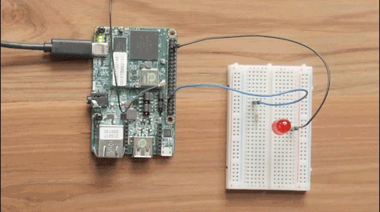
Start simple. LED light.
  private Gpio mLedGpio;
In onCreate
  mLedGpio = PeripheralManager.getInstance().openGpio("BCM6");
    Assumes Raspberry PI here.
  LedGpio.setDirection( Gpio.DIRECTION_OUT_INITIALLY_LOW);
Somewhere else
  mLedGpio.setValue(true); //on
  mLedGpio.setValue(false); //off

Slide 14
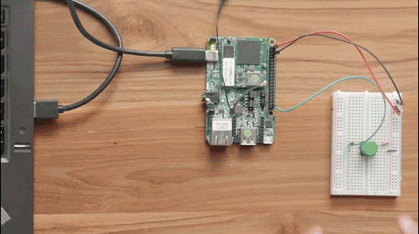
A button
  private Gpio mButtonGpio;
In onCreate
try {
mButtonGpio = PeripheralManager.getInstance().openGpio("BCM21"); //assumes Pi
mButtonGpio.setDirection(Gpio.DIRECTION_IN);
mButtonGpio.setEdgeTriggerType(Gpio.EDGE_FALLING);
mButtonGpio.registerGpioCallback(new GpioCallback() {
@Override
public boolean onGpioEdge(Gpio gpio) {
Log.i(TAG, "GPIO changed, button pressed");
return true;
}
});
} catch (IOException e) { Log.e(TAG, "Error on PeripheralIO API", e);
}

Slide 15
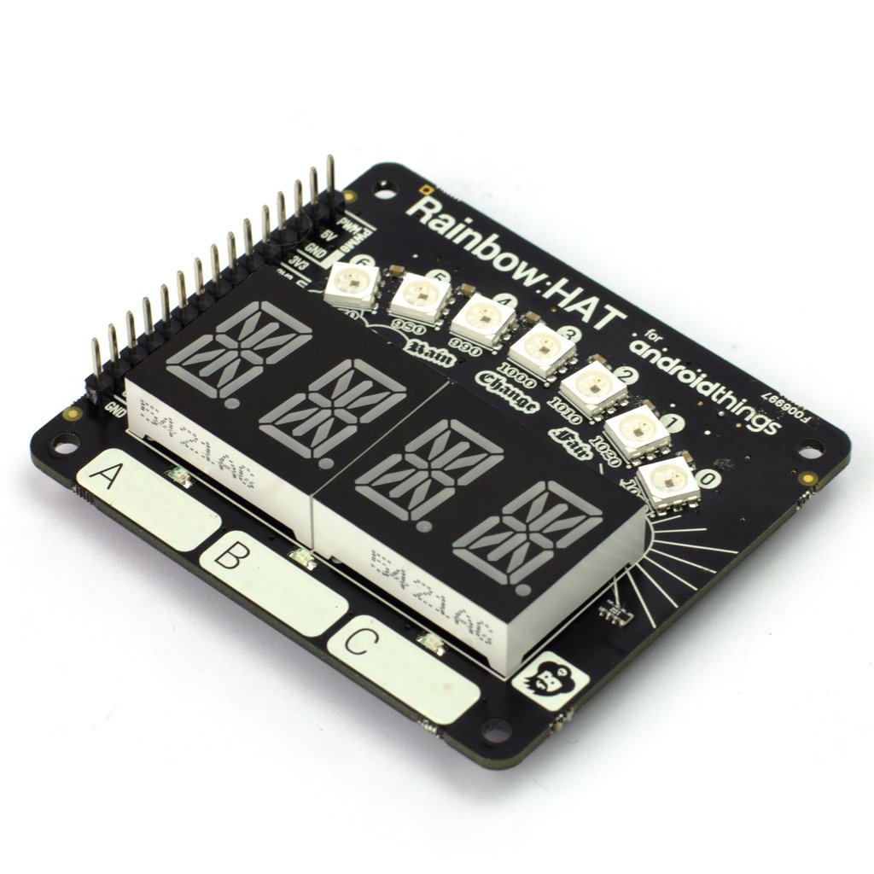
Rainbow Hat
The a button and led are same
  plus 2 more buttons and leds
Plus
  Alpha numeric display
  Sensors for pressure, temperature
  Led Strip as well.

Slide 16
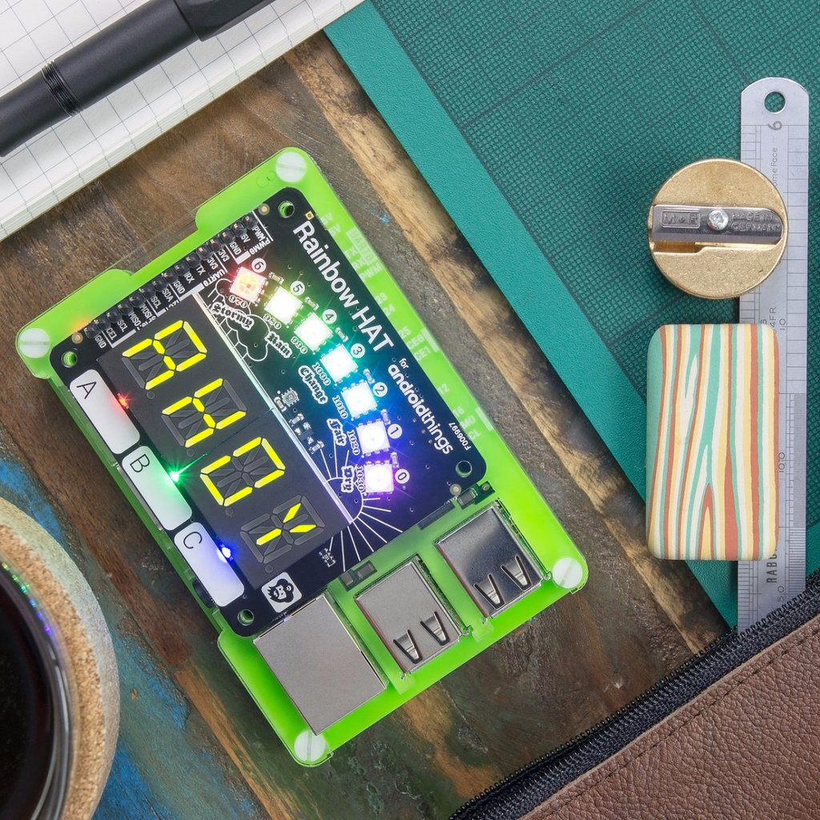
Rainbow Hat (2)
Alpha numeric display
private AlphanumericDisplay mDisplay;
try {
mDisplay = new AlphanumericDisplay("I2C1");
mDisplay.setEnabled(true);
mDisplay.clear();
mDisplay.display("AHOY")
} catch (IOException e) { … }

Slide 17
Rainbow Hat (3)
There are two examples in the AndroidThings repo
  ThingsWeatherStationsample could be used for breadboard wired devices
  WeatherStationRainbowHatonly requires the rainbow Hat to work.
  Both have a UI if video is plugged in.

Slide 18
Sense Hat
not implemented:
  The orientation (yaw, pitch, and roll)
    Accelerometer and magnetometer
  Pressure, humidity, and temperature is also missing a driver currently.
  And joystick
but the 8x8 matrix is working.
  In the sense Demo
  Requires a UI, click on the picture (chose different colors too) and it will change the matrix on the device.

Slide 19
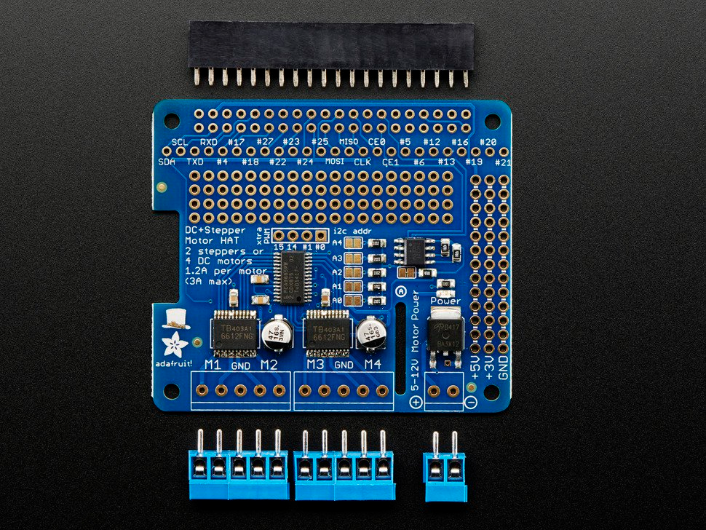
DC & Stepper Motor Hat
Allows for motors. (note requires soldering)
  Up to 4 bi-directional DC motors and UP to 2 stepper motors
    Requires a battery pack and motors are sold separately.
  This is based on the following project:
    https://www.hackster.io/46886/android-robocar-553991

Slide 20
Motor hat
implementation 'com.google.android.things.contrib:driver-motorhat:0.2'
Then we control the motors (4 on my project).
  Note the wheels do turn for left and right, so turning is skid turns.
private MotorHat mMotorHat;
mMotorHat = new MotorHat("I2C1"); //Pi only.
Go forward
for (int motor : ALL_MOTORS) {
mMotorHat.setMotorSpeed(motor, SPEED_NORMAL);
mMotorHat.setMotorState(motor, MotorHat.MOTOR_STATE_CW); }
Stop
for (int motor : ALL_MOTORS) {
mMotorHat.setMotorState(motor, MotorHat.MOTOR_STATE_RELEASE);
}
To turn left for example:
for (int motor : LEFT_MOTORS) {
mMotorHat.setMotorSpeed(motor, SPEED_TURNING_INSIDE);
mMotorHat.setMotorState(motor, MotorHat.MOTOR_STATE_CW);
}
for (int motor : RIGHT_MOTORS) {
mMotorHat.setMotorSpeed(motor, SPEED_TURNING_OUTSIDE);
mMotorHat.setMotorState(motor, MotorHat.MOTOR_STATE_CW);
}

Slide 21
Controlling robby (robocar)
Bluetooth controller
  RobocarBtcontroller in android things repo
    Note this project needs to updated to new Bluetooth API manager code.
Use the camera and some AI
  Use the TensorFlow that is included with AndroidThings (API 27)
    https://codelabs.developers.google.com/codelabs/androidthings-classifier/#0 codelab for image classifier using tensorflow model.
NearBy API
  A phone app that connects up and gives direction
    Camera feed is TBW
  Robocar in the androidthings repo.

Slide 22
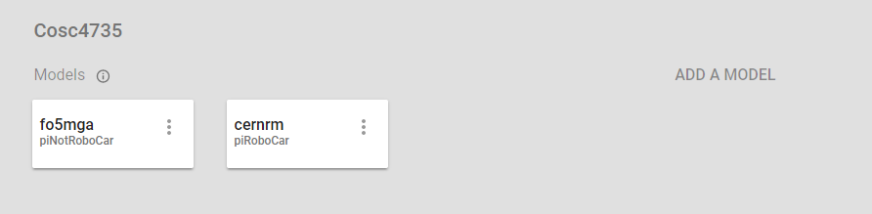
Back to the AndroidThings console
You can have multiple builds inside one project
So there a build for the Car and one for "not" a car. Since I have two PI devices.

Slide 23
References
https://partner.android.com/things/console/
https://developer.android.com/things/index.html
https://developer.android.com/things/reference/index.html
https://www.raspberrypi.org/
https://www.raspberrypi.org/documentation/installation/installing-images/windows.md
Hardware purchases
  https://www.adafruit.com/ https://amazon.com/
  Junior Runt Rover for the car https://www.servocity.com/junior
    Note servocity.com is pretty good for many parts like battery case, etc.

Slide 24
Q
A
&

