Slide 1
Cosc 5/4735
Unity 3D
Getting Started Guide for Android.

Slide 2
Unity
What is Unity?
  It’s a 2D and 3D graphics development environment.
  Designed to create games, but is used for more
  Multiplatform support
    Includes VR support as well.
    Write once, deploy to many.

Slide 3
Get Unity
On the unity site, use the “Get Unity” link
  Select Personal
    Or Professional if you want to pay for it
  Download the installer.
    Install it, When asked in the install, install Android (ios, tizen, etc are options too)
  You will need to create an account with unity. When you start up it will require you to login.
For the purposes of this lecture, The version installed was 5.3.4f1

Slide 4
Use
File-> new Project 3D (or 2D depends on need)
    Or sample project if you installed it.
    Add some assets Characters, crossPlatformInput, cameras, environment, etc.
You can now use the Create-> 3D object, light source, etc to add objects to your scene.
  Hold the right mouse down to move the view of the scene.
Click on an object to “transform” it.
Create -> 3D object -> terrain
  To adds a large terrain object.
I’m to demo this in class from a New project to install on a android device.

Slide 5
Make a spinning cube
Create-> 3DObject ->cube
  Move the cube as needed in the space.
In Assets
  Create -> C# script
    Name it something like spin
  Double click the script
    Add to Update() method
      transform.Rotate (new Vector3 (15, 30, 45) * Time.deltaTime);
  We are going to attach the script to the cube
    Click on the Cube in Hierarchy
      On the right, Add Component -> Scripts -> spin

Slide 6
Add controls and moving.
https://cgcookie.com/questions/11010-where-to-find-assets-for-those-watching-in-2019-2020
Add a “character” to walk around our environment.
  Project -> Assets->Characters-> FirstPersonCharacter->Prefabs->FPSController
Now we need to add mobile controls
  Project -> Assets -> CrossPlatformInput -> Prefabs -> DualTouchControls -> Jump
    Gives move, jump, and look around control.
    Or add MobileSingleStrikControl: JumpButton and MobileJoyStick

Slide 7
Testing
You can use the “play” button to test the environment in idle.
    Mouse and keyboard controls
Once you are ready, Build and Run
  Select Android
  It will ask where the android sdk is the first time
  Then it should install on a physical device.
    The first time around, it will likely take 2 to 3 minutes.

Slide 8
Tip of the Iceberg
This is only the tip of what you can do.
We’ll see more with CardBoard and Unity
Unity may have been what some of you wanted cosc 1010 to be.
  IE, but I just want to write games. ☺

Slide 9
Importing Assets
You can create a lot of assets in something like blender and then import them into unity.
  Other 3D editors are much better
  Example with a Maze from blender.
    Import the asset. In this case, we want the walls to stop us from moving through them so click Generate Colliders and apply.

Slide 10
References
Unity web site: https://unity3d.com/
Unity Game Development in 24 hours, Tristem & Geig, SAMS, Jan 2016

Slide 11
An Example
Previous years presentation by By Caleb Carlson, Brandon Neff, and Nathan Spaulding

Slide 12
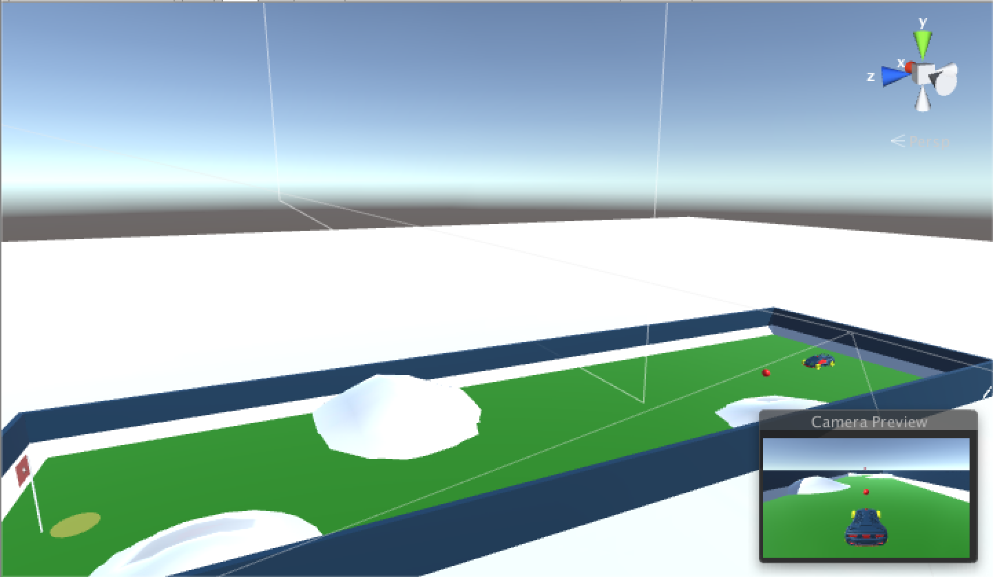
Rocket Golf!!!

Slide 13
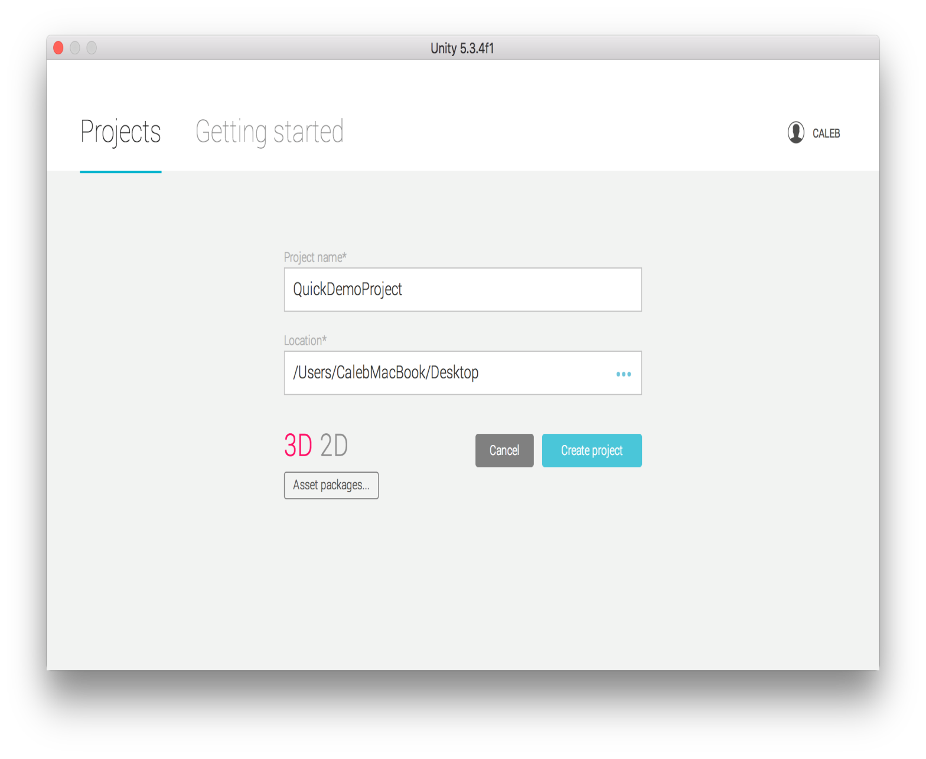
Creating A Project

Slide 14
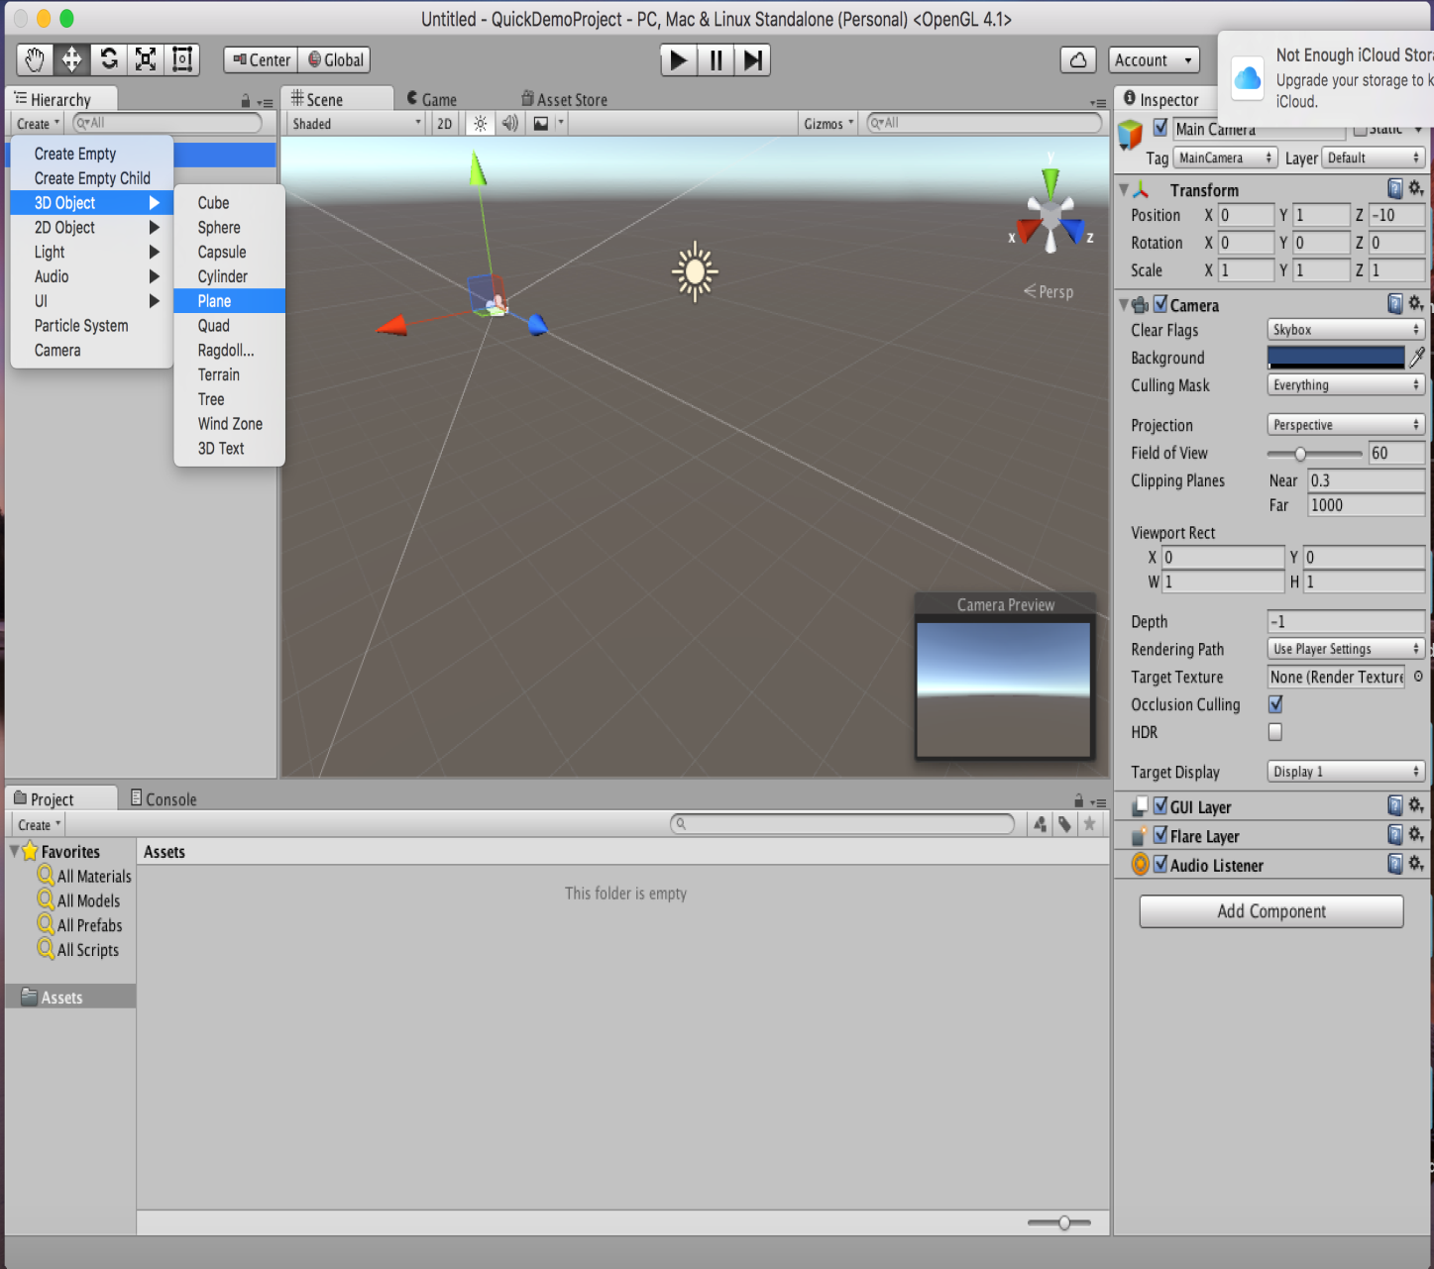
Creating Shapes

Slide 15
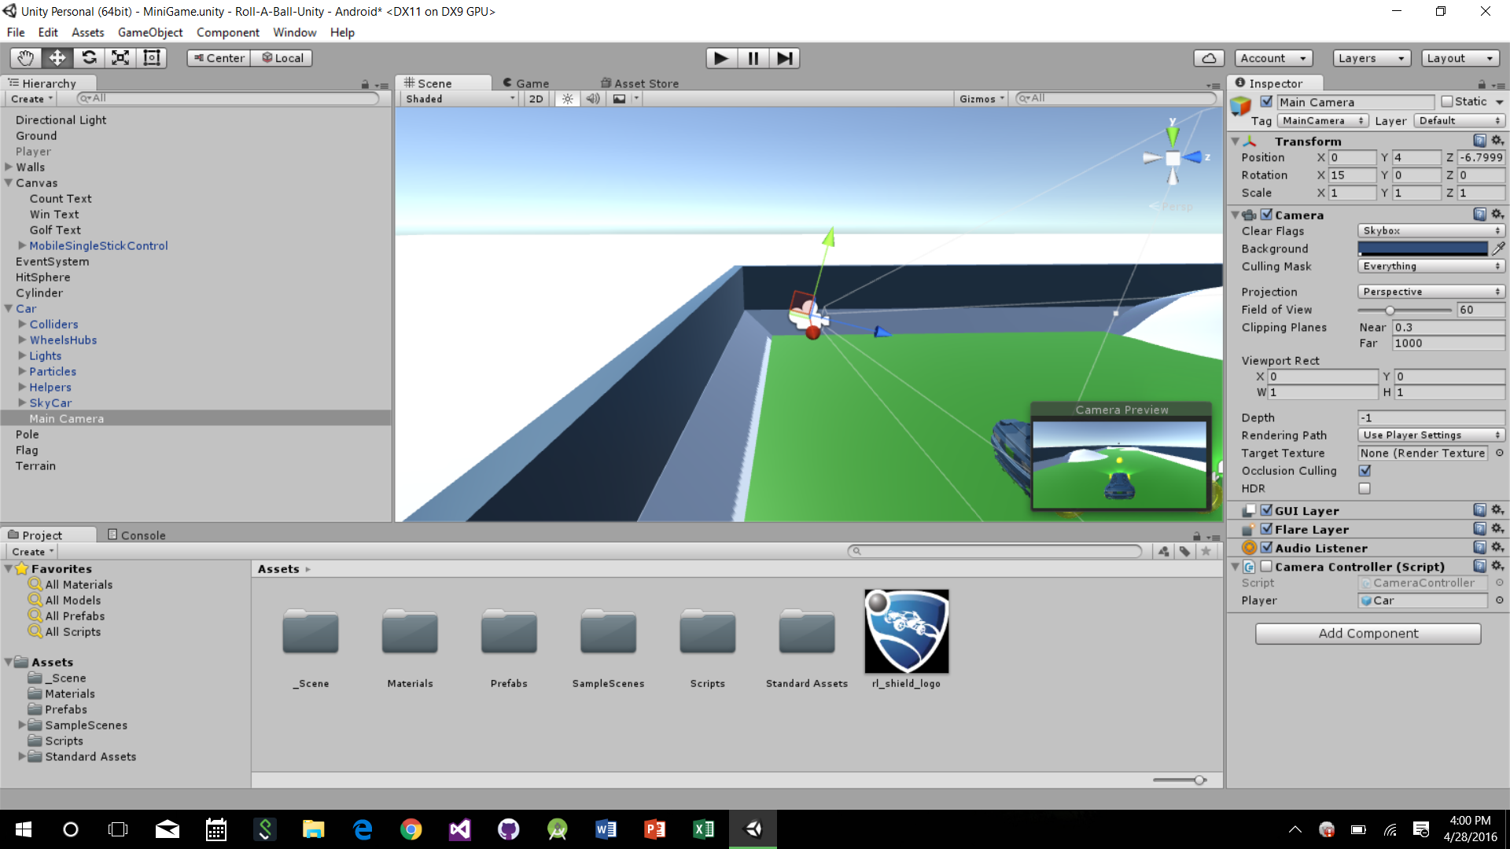
The Camera
Display the content of the entire project to
the user.
When a new scene is created, a GameObject
is created and the camera is then paired
with that object.

Slide 16
Camera Script to track the ball
public GameObject player;
private Vector3 offset;
// Use this for initialization
void Start () {
offset = transform.position - player.transform.position;
}
// Update is called once per frame
void LateUpdate () {
transform.position = player.transform.position + offset;
}

Slide 17
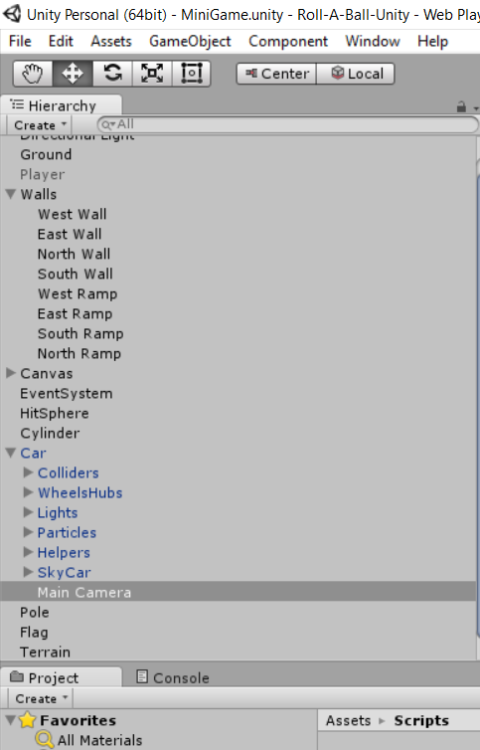
Fixing Camera Location

Slide 18
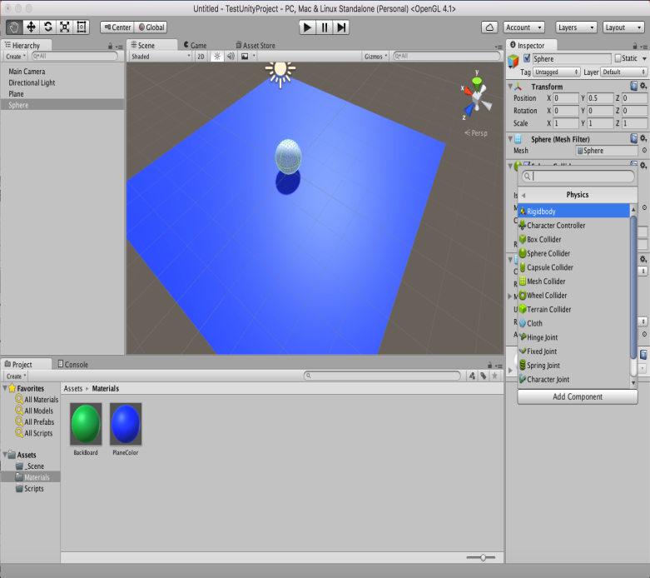
Physics
To get an object to animate you need to add a Rigidbody to you object. This is the basic 3D Physics component to get your object to act to collisions and gravity.

Slide 19
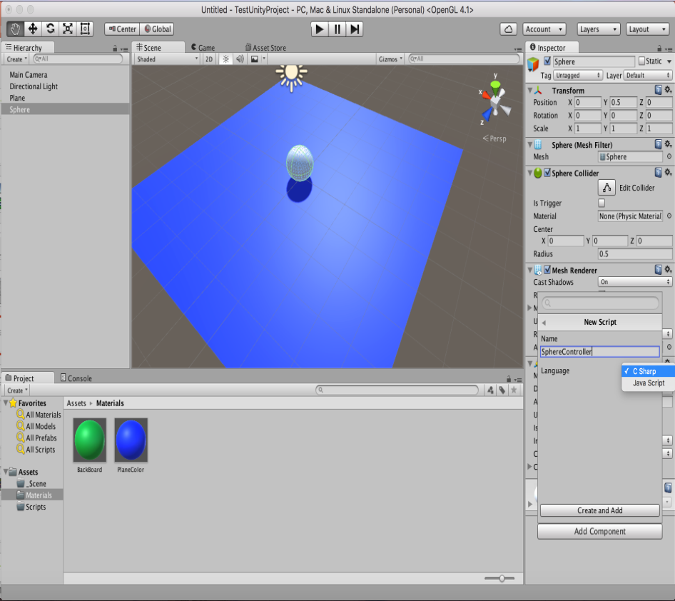
Scripts
Scripts allow you to modify how objects interact with each other beyond the basic collision.

Slide 20
Two Types Of Contact:
Collision vs Trigger
Triggers are used when you want to objects to overlap and “collect” each other
Collisions are meant for when objects are going to collide and have physics forces act on each shape

Slide 21
To the project!

Slide 22
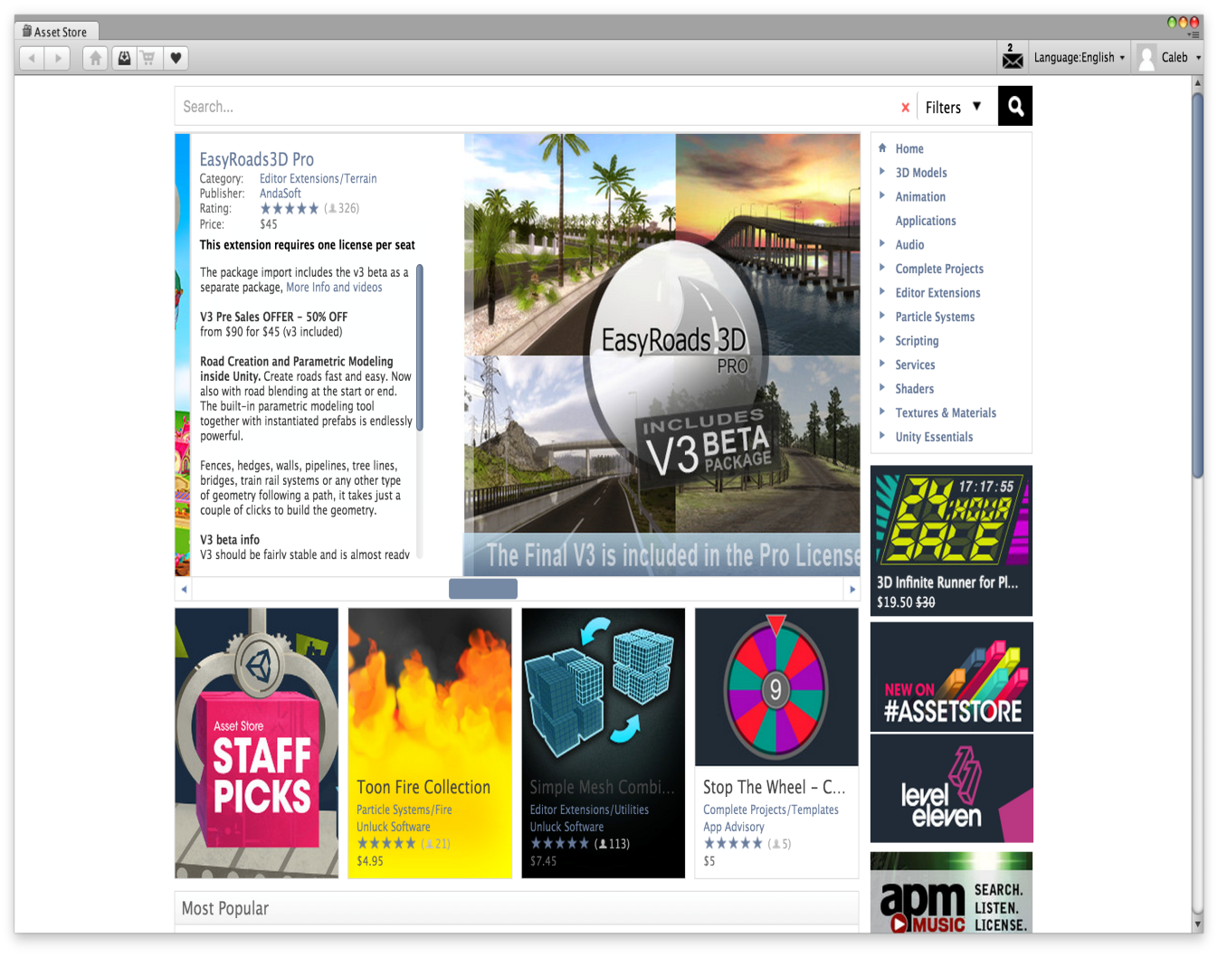
How did we make that awesome car???
We didn’t…
Assets Store

Slide 23
Adding textures, trees, and more has never been easier!

Slide 24
Exporting the project!

Slide 25
Building in Android
Back to the project!

Slide 26
It even works on IOS devices
Back to the project!

Slide 27
References
http://unity3d.com/learn/tutorials/projects/roll-ball-tutorial (Great tutorial for game basics)
http://docs.unity3d.com/Manual/index.html (Unity Manual)
https://www.assetstore.unity3d.com/en/ (Asset Store)
https://github.com/cosc4735/final-rocketgolf

Slide 28
Play the game that inspired it all….

Slide 29
Q
A
&

