Slide 1
Cosc 4735
Google Play API: Vision
FaceTracking, Barcodes, and OCR

Slide 2
Mobile Vision
This lets you find objects in photos and video, using real-time on-device vision technology
It uses a framework called detectors to locate objects.
Currently OCR, barcodes, and face.
Face is a generic face, not an individual person’s face.
We’ll start with the barcode, because it simpler to explain.
Also note, it doesn't need a "client" or "googleapi".
Nor does it use "tasks", like the rest of the Google play services.

Slide 3
barcodes

Slide 4
Barcode detectors
The API will currently recognize most (if not all) of the barcode types, include QR codes
https://developers.google.com/vision/barcodes-overview
First extend the Tracker<Barcode> and override the methods you need
onNewItem(int id, T item)
for barcode ontNewItem(int id, Barcode barcode)
A new barcode has been found given id.
There is also OnDone(), onUpdate(), onMissing()
We are ignoring these right now.

Slide 5
Barcode detectors
In onNewItem the parameter barcode contains the information about the barcode
barcode.displayValue has the barcode number (as a string)
barcode.format says which type,
Say Barcode.QR_CODE
This is where the app decides what to do with the barcode.

Slide 6
MultiProcessor
We extend a MultiProcessor with theTracker class
Which is needed by the detector.
public class BarcodeTrackFactory implements MultiProcessor.Factory<Barcode> {
@Override
public Tracker<Barcode> create(Barcode barcode) {
return new BarCodeTracker();
}
}

Slide 7
Detector
Now create the detector
BarcodeDetector detector = new BarcodeDetector.Builder(context)
.build();
And set Multiprocessor in the detector
detector.setProcessor(new MultiProcessor.Builder<>(new BarcodeTrackFactory()).build());
Lastly, setup a camera and give it the detector.

Slide 8
Camera
Lastly we setup a camera preview
The vision API have a CameraSource object, which simplifes a few things.
Creates and starts the camera. Note that this uses a higher resolution in comparison to other detection examples to enable the barcode detector to detect small barcodes at long distances.
CameraSource.Builder builder = new CameraSource.Builder(getApplicationContext(), detector)
.setFacing(CameraSource.CAMERA_FACING_BACK)
.setRequestedPreviewSize(1600, 1024)
.setRequestedFps(15.0f);
builder = builder.setAutoFocusEnabled(true);
mCameraSource = builder.build();
Note: API 23+ You need to use ask for permissions. And don’t forget the manifest permissions too

Slide 9
Camera (2)
Finally start up the preview on a SurfaceView/TextureView and everything starts.
Note the tracker are on a separate thread.
mCameraSource.start(mPreview.getHolder());
Where mPreview is surfaceview
This lecture is skipping over the surfaceview parts.
See the examples for complete code.

Slide 10
Google’s Examples
The Google’s barcode example uses a graphic overlay to draw a box on the barcode and show the number.
https://github.com/googlesamples/android-vision/tree/master/visionSamples
To keep things simple, my code doesn’t use the overlay.

Slide 11
FACE Tracking

Slide 12
FaceTracking
The API simply detects areas in the image or video that are human faces
It’s smart enough to detect faces even at different orientations -- so if your subject’s head is turned sideways, it can detect it.
Specific landmarks can also be detected on faces, such as the eyes, the nose, and the edges of the lips.
It can also detect if each eye is open or closed
And if the face is smiling or not.

Slide 13
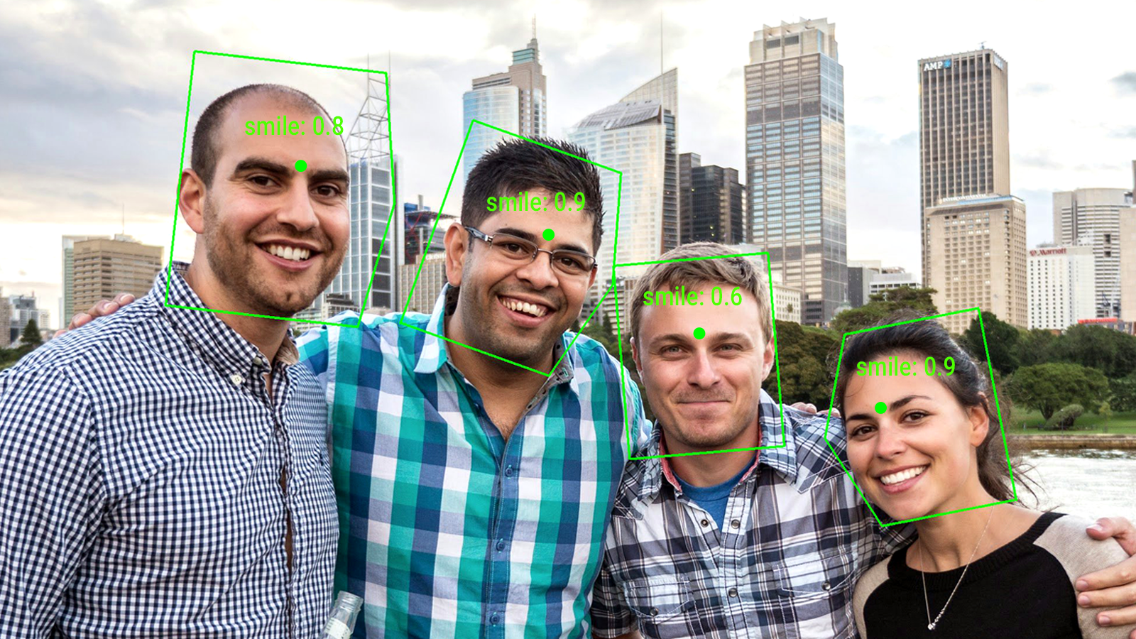
FaceTracking (2)
Example:

Slide 14
Tracker<Face>
Unlike the barcode previous, the code may need to update information about the face.
OnUpdate becomes the primary method in the Tracker code.
public void onUpdate(Detector.Detections<Face> detections, Face face) {
Where face contains information we need.

Slide 15
face class
getPosition()
Returns the top left coordinates of the area where a face was detected
getWidth()
Returns the width of the area where a face was detected
getHeight()
Returns the height of the area where a face was detected
getId()
Returns an ID that the system associated with a detected face
getIsLeftEyeOpenProbability() and getIsRighteyeOpenProbability()
Returns a value between 0 and 1, giving probability that the eye is open
getIsSmilingProbability()
Returns a value between 0 and 1 giving a probability that the face is smiling
getLandmarks()
Returns a list of coordinates for Bottom of mouth, left cheek, left ear, left ear tip, left eye, left mouth, base of nose, right cheek, right ear, right ear tip, right eye, right mouth.
Note, not all maybe returned in the list, only what is detected.
Landmarks appears to be broken as of Jan 2020.

Slide 16
Detector setup
The face detector can be setup to deal with only one face, which makes the system faster or as a multi detector
Single face
FaceDetector detector = new FaceDetector.Builder(context)
.setProminentFaceOnly(true)
allows for eye and smile detection!
.setClassificationType(FaceDetector.ALL_CLASSIFICATIONS) .build();
detector.setProcessor(new LargestFaceFocusingProcessor( detector, new FaceTracker()));

Slide 17
Detector setup (2)
Multiple face detector with a MutiProcessor
FaceDetector detector = new FaceDetector.Builder(context)
.setClassificationType(FaceDetector.ALL_CLASSIFICATIONS)
.build();
detector.setProcessor(new MultiProcessor.Builder<>(new GraphicFaceTrackerFactory()).build());
Where GraphicFaceTrackerFactory() is
private class GraphicFaceTrackerFactory implements MultiProcessor.Factory<Face> {
@Override
public Tracker<Face> create(Face face) {
return new GraphicFaceTracker(mGraphicOverlay);
}
}

Slide 18
Camera Preview
Like Barcodes, setup the camera preview
Which kick starts the face trackers.
mCameraSource = new CameraSource.Builder(context, detector)
.setRequestedPreviewSize(640, 480)
.setFacing(CameraSource.CAMERA_FACING_FRONT)
.setRequestedFps(30.0f)
.build();
mCameraSource.start(mPreview.getHolder());

Slide 19
face class (2)
Eye and smile probability
The documentation states 0.75 is sure.
Another states over .50
My testing shows that 0.75 may not very natural
The eyes must be VERY open.
Also doesn’t work well with glasses. Any glare will screw up the detection.

Slide 20
Example code
FaceTrackerDemo is shows how to use the code and uses the tts to tell the user to open their eyes and smile.
FaceTrackerDemo2 uses the graphic overlay instead
FaceTrackerMultiDemo works with more then one face.

Slide 21
OCR

Slide 22
Very similar
The text detectors are very similar.
Except they don't use the "Tracker" classes. Trackers don't work with text recognizer.
We use Detector.Processor<TextBlock>
A Textblock is a block of text (think of it as a paragraph) as deemed by the OCR engine.
Note, it may not be the entire "paragraph" of text. It's what the engine decides.

Slide 23
Text recognizer
Like Bar Code, it's much simpler there face detectors.
TextRecognizer detector = new TextRecognizer.Builder(context).build();
detector.setProcessor(new OcrDetectorProcessor(mGraphicOverlay));
The OcrDetectorProcessor is a class we made, like before.
We similar code,
OcrDetectorProcessor(GraphicOverlay<OcrGraphic> ocrGraphicOverlay) {
mGraphicOverlay = ocrGraphicOverlay;
}
Except, it's not a tracker, so we have to track all the instances via the public void receiveDetections(Detector.Detections<TextBlock> detections) method. (see the code in OCRDemo).

Slide 24
TextBlock class.
A Textblock is a block of text (think of it as a paragraph) as deemed by the OCR engine.
getValue() returns a String with the detected text
note, they maybe end of line markers
getLanguage()
We can also get the language it detected
getBoundBox()
returns a Rect of bounding box of the text on the "screen".

Slide 25
Note
These examples show a face tracker and barcode tracker in isolation.
You can build a MultiDectector that adds both (more as others are added to the API)
MultiDetector multiDetector = new MultiDetector.Builder()
.add(faceDetector)
.add(barcodeDetector)
.build();
mCameraSource = new CameraSource.Builder( getApplicationContext(), multiDetector)
…
It's not tested with text. But face and barcode do work.

Slide 26
final note
the vision api are actually being phased out.
google removed the face landmarks so that some things have stopped working
Replacement is the ML Kit. (Jan 2021)
Which there is an example of the face. but the libraries themselves are producing internal errors. (won't compile with zero code even).
They are using the experimental camera libraries which are also breaking the ML vision pieces.
Basically it's a pretty standard google mess.

Slide 27
References
Google’s example code:
https://github.com/googlesamples/android-vision
Documentation pages
https://developers.google.com/vision/introduction
https://developers.google.com/android/reference/com/google/android/gms/vision/text/package-summary
http://android-developers.blogspot.com/2015/08/face-detection-in-google-play-services.html
https://github.com/googlesamples/android-vision/tree/master/visionSamples

Slide 28
Q
A
&

