Slide 1
Cosc 5/4735
Voice Actions
Voice Interactions (API 23+)

Slide 2
Voice Actions
Using the google App and search.
You can talk to it with either “Ok Google” or touching the microphone.
Most of the time, it’s a search
But there are a set of commands as well and we can setup our app to receive the command.
https://developers.google.com/voice-actions/

Slide 3
First the intent filter
For this example, we are using create_note.
In the manifest file. Add the following intent filter, to the activity you want to receive it.
<intent-filter>
<action android:name= "com.google.android.gms.actions.CREATE_NOTE" />
<category android:name="android.intent.category.DEFAULT" />
<category android:name="android.intent.category.VOICE" />
<data android:mimeType="text/plain"/>
</intent-filter>
The two in red are required for all Voice Actions

Slide 4
Activity Receiving the action
In OnCreate get the Intent and put out the information.
Intent intent = getIntent();
if (intent == null) { finish(); //launched wrong or other problem.
} else if (intent.getAction().equals( "com.google.android.gms.actions.CREATE_NOTE")) {
title = intent.getExtras().getString( "android.intent.extra.SUBJECT", "");
text = intent.getExtras().getString( "android.intent.extra.TEXT", "nothing?");
There is more in the bundle.

Slide 5
Activity Receiving the action (2)
Lastly tell google api you are done and the action is complete.
This is not required for most actions.
Uri APP_URI = Uri.parse("android-app://edu.cs4730.voiceactionsdemo/VoiceActionActivity");
GoogleApiClient mClient = new GoogleApiClient.Builder(this).addApi(AppIndex.API).build(); Thing note = new Thing.Builder() .setName(title) .setDescription(text) .setUrl(APP_URI) .build(); Action createNoteAction = new Action.Builder(Action.TYPE_ADD) .setObject(note) .setActionStatus(Action.STATUS_TYPE_COMPLETED) .build(); AppIndex.AppIndexApi.end(mClient, createNoteAction);
finish(); //but you do need this.

Slide 6
GoogleApiClient
Dependences to use GoogleApi and AppIndex
Build.gradle (app) add
compile 'com.google.android.gms:play-services-appindexing:8.4.0‘
Imports
import com.google.android.gms.appindexing.Action;
import com.google.android.gms.appindexing.AppIndex;
import com.google.android.gms.appindexing.Thing;
import com.google.android.gms.common.api.GoogleApiClient;

Slide 7
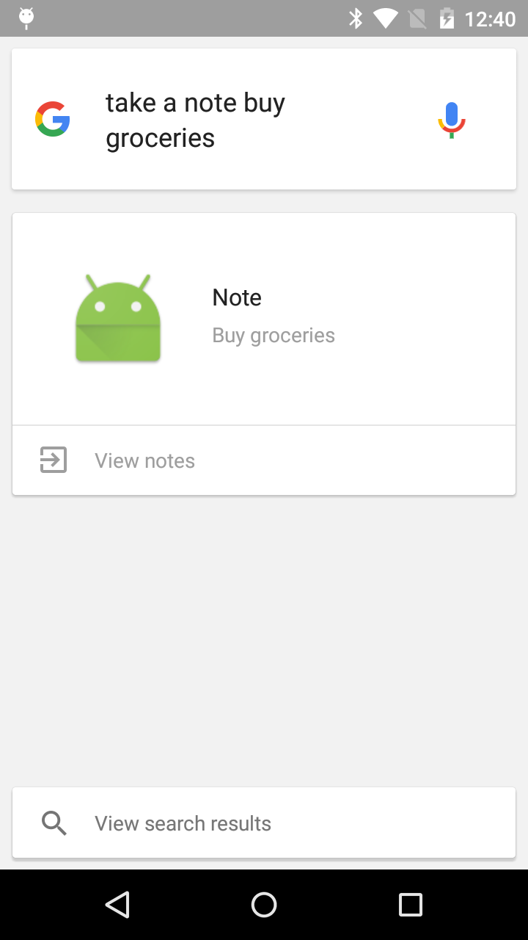
Finally getting

Slide 8
VoiceActionsDemo
The Demo is very simple and stores only one note at a time.
It also has some extra code to find all the keys in the bundle, since google’s doc told me to use the WRONG keys to get the data out of the intent/bundle.

Slide 9
Voice Interactions
https://www.youtube.com/watch?v=OW1A4XFRuyc
This allows for more interaction.
But Starts at API 23 (marshmallow).
This seems to be very experimental as well. A lot of the documentation doesn’t really work.

Slide 10
Start with a Voice Action.
So interactions start with a Voice Action first.
So like before, create_note, image_capture, music_search, etc…
Setup the intent, etc.
Your app, then checks to see if there isVoiceInteraction()
If true then we can continue
Else normal touch interaction or finish()

Slide 11
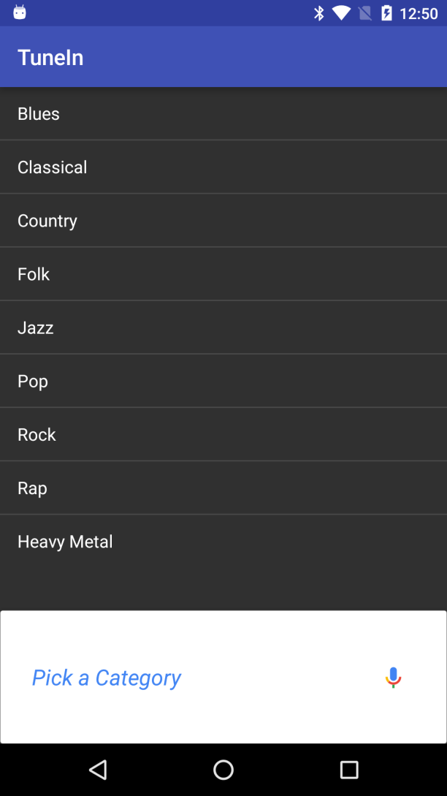
VoiceInteractions
Setup you screen as normal. The interactions will be over the screen.
In this example I want them to pick a category, so the screen is showing a listview.
A note, the app name was change to TuneIn for testing.

Slide 12
VoiceInteractor
A request can now be submit.
Via submitRequest(VoiceInteractor.Request)
A Request can be one of the following:
VoiceInteractor.AbortVoiceRequest
Reports that the current interaction can not be complete with voice, so the application will need to switch to a traditional input UI.
VoiceInteractor.CommandRequest (which doesn’t seem to work.)
Execute a vendor-specific command using the trusted system VoiceInteractionService.
VoiceInteractor.CompleteVoiceRequest
Reports that the current interaction was successfully completed with voice, so the application can report the final status to the user.
VoiceInteractor.ConfirmationRequest
Confirms an operation with the user via the trusted system VoiceInteractionService.
VoiceInteractor.PickOptionRequest
Select a single option from multiple potential options with the user via the trusted system VoiceInteractionService.

Slide 13
Requests
ConfirmationRequest allow you confirm with an affirmative that user wants to do this
Ie Yes, Ok, etc.
PickOptionRequest(String prompt, Option[] options, bundle extras)
Takes prompt
example: “Pick a category of music”
Options would then be the array of categories allowed.
While you should display the list on your screen, you don’t have to.
Example
Option1 = new VoiceInteractor.PickOptionRequest.Option(“Heavy metal”, 8)
Option1.addSynonym("Angry White boy Music")
So the user can say Heavy Metal or Angry White boy Music for this one.

Slide 14
Requests (2)
PickOptionRequest also has a listener (all requests have listeners)
public void onPickOptionResult(boolean finished, Option[] selections, Bundle result) {
if (finished && selections.length >= 1) {
//so doc's say it could be more then one selection, so just choose first one.
Log.v(TAG, "Option is " + selections[0].getLabel());
// call completed request now.
} else {
Log.v(TAG, "No Selection?");
finish();
}
}
@Override
public void onCancel() {
Log.v(TAG, "User Canceled.");
finish();
}

Slide 15
Lastly CompleteVoiceRequest
Once the voiceinteraction is done, the app is to call CompleteVoiceRequest
My prompt is playing, but “Success”, etc is also recommented. Depends on the interaction.
VoiceInteractor.Prompt prompt = new VoiceInteractor.Prompt("Playing "+ genre);
Bundle status = new Bundle();
The bundle may contain extra info to be display like a picture if it was an image capture
getVoiceInteractor().submitRequest(
new VoiceInteractor.CompleteVoiceRequest(prompt, status) {
@Override
public void onCompleteResult(Bundle result) {
super.onCompleteResult(result);
}
});
finish(); //optional, but likely you app is done now.

Slide 16
References
https://developers.google.com/voice-actions/system/
https://developer.android.com/guide/components/intents-common.html#NewNote
https://developers.google.com/app-indexing/android/publish#use-the-app-indexing-api
https://developers.google.com/voice-actions/interaction/
http://developer.android.com/reference/android/app/VoiceInteractor.html
http://developer.android.com/reference/android/app/VoiceInteractor.PickOptionRequest.html
http://io2015codelabs.appspot.com/codelabs/voice-interaction#1

Slide 17
Final note.
Much of the Intents don’t allow voiceinteractions
Even the ones android says will
Have tested most of them, only the image_capture intent worked
The test code has other intents and this one as well just to test with.
As of Janaury 20th 2015

Slide 18
Q
A
&

